Slide 1
My Favourite English Writer
Agatha Christie

Slide 2
Agatha Christie was born at Torquay , Devonshire. She was educated at home and took singing lessons in Paris. She began writing at the end of the First World War. Agatha Christie became generally recognised in 1926, after the publishing of her novel The Murder of Roger Ackroyd.

Slide 3
Her way to present the stories was quite different from that of her colleagues. You can’t find much blood and violence in her stories. The reader has to solve the mystery and decide who the murderer is together with the author.

Slide 4
Agatha Christie is known around the world as the Queen of Crime. She wrote 78 crime novels, 19 plays and 6 romantic novels under the name of Mary Westmacott. Her books have been translated into 103 languages.

Slide 5
She is the third best-selling author in the world. Many of her novels and short stories have been filmed. The Mousetrap, her the most famous play, is now the longest-running play in history.

Slide 6
From 1971 to 1974, Christie's health began to fail, but she continued to write.
Agatha Christie died on 12 January on 1976 from natural causes.

Slide 7
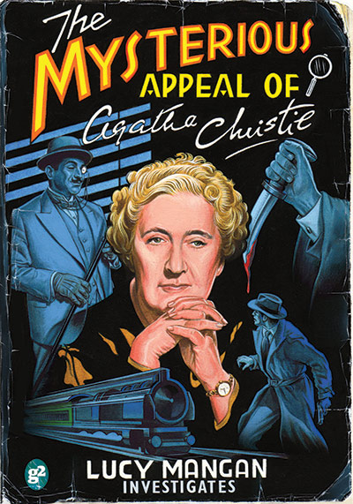
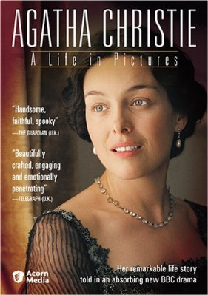
Agatha Christie’s favourite way of murdering was poisoning.
Her novels are very popular now. Over 3 billion books by Agatha Christie were sold around the world.

Slide 8
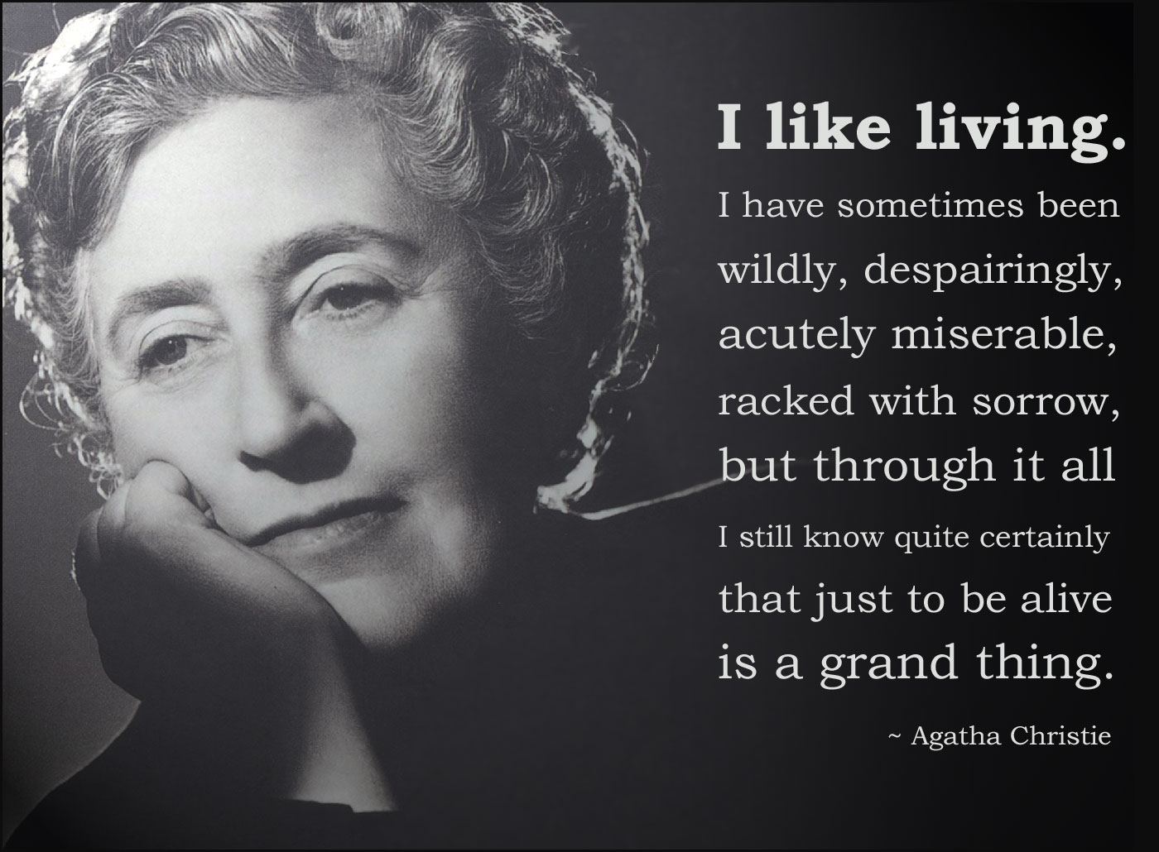

Slide 10
Thank you for your attention

