Slide 1
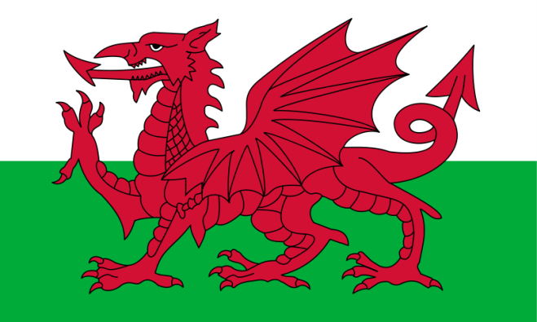
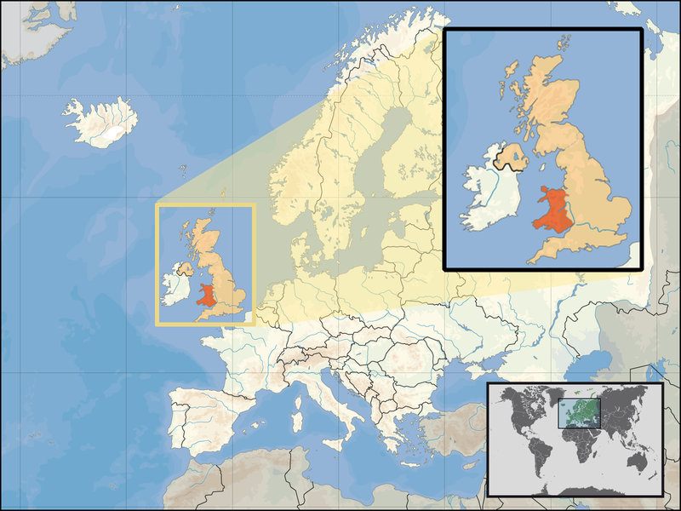
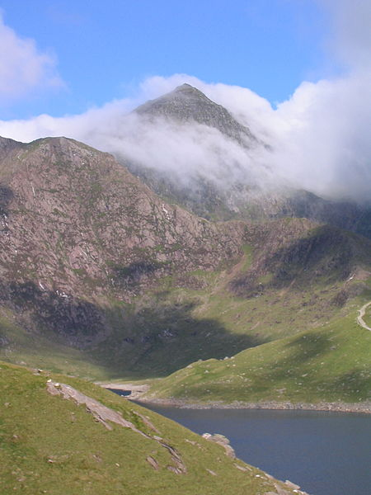
City Wales

Slide 2
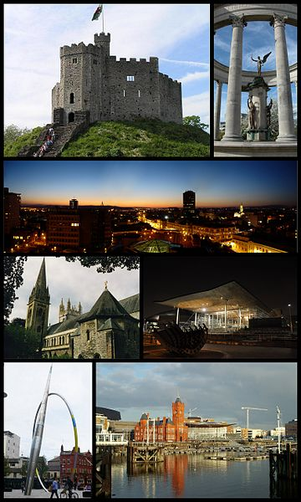
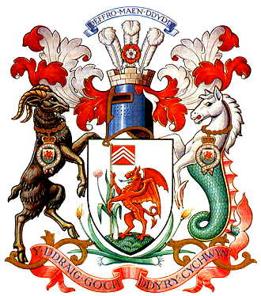
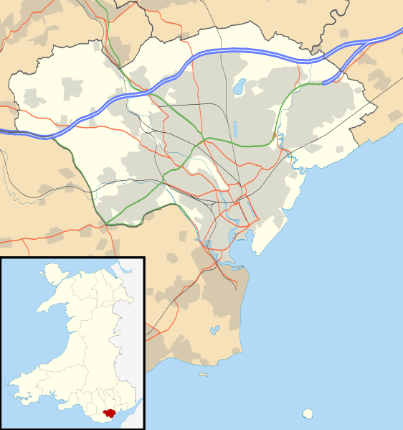
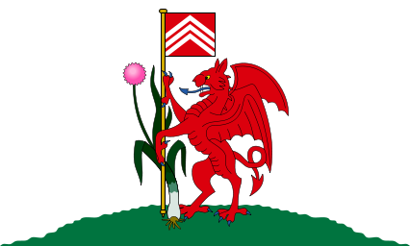
Cardiff
Cardiff is the capital and largest city in Wales and the tenth largest city in the United Kingdom. The city is the country's chief commercial centre, the base for most national cultural and sporting institutions, the Welsh national media, and the seat of the National Assembly for Wales. The unitary authority area's mid 2011 population was estimated to be 346,100, while the population of the Larger Urban Zone was estimated at 861,400 in 2009. Cardiff is a significant tourist centre and the most popular visitor destination in Wales with 18.3 million visitors in 2010.[1] In 2011, Cardiff was ranked sixth in the world in National Geographic's alternative tourist destinations.[2]

Slide 3
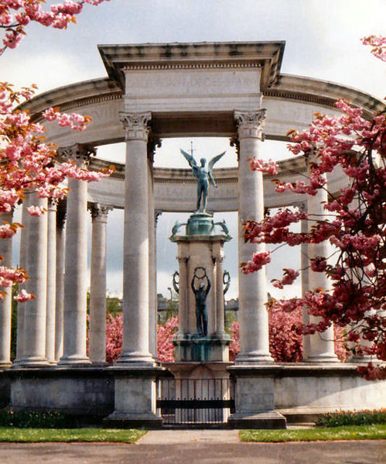
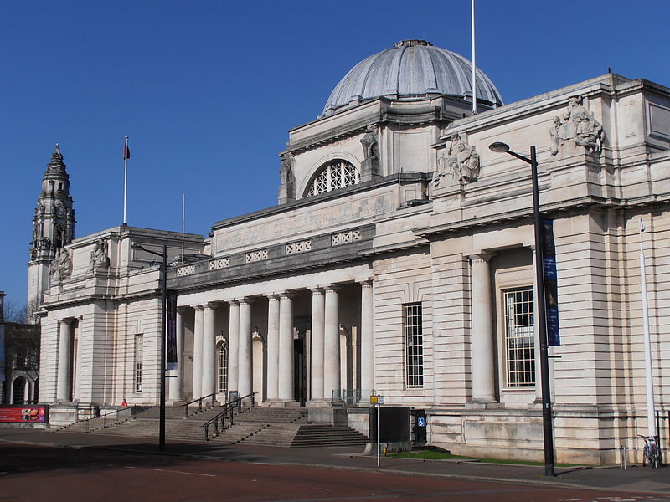
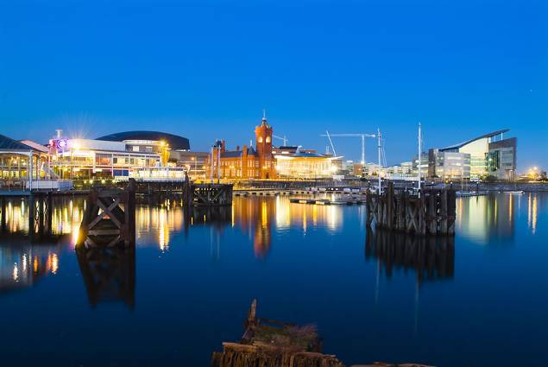
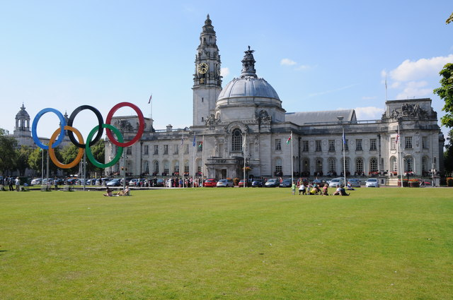
Welsh National War Memorial
National Museum of Wales, Cardiff
Redevelopment in the city's historic Cardiff Bay area.
Cardiff City Hall borders Cathays Park

Slide 4
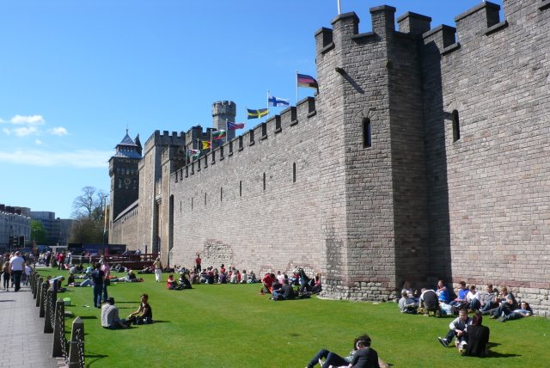
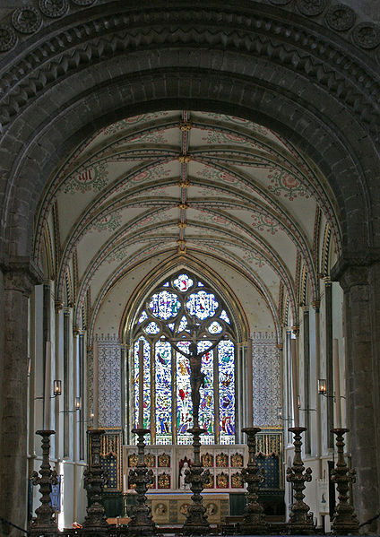
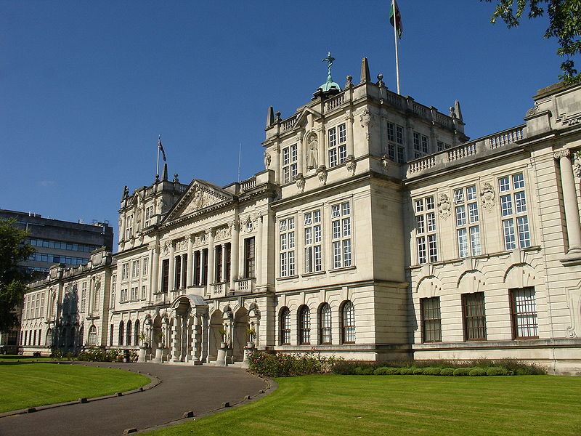
Cardiffians and visitors alike relax beneath the walls of Cardiff Castle.
The nave and east window ofLlandaff Cathedral
Cardiff University's main building

Slide 5
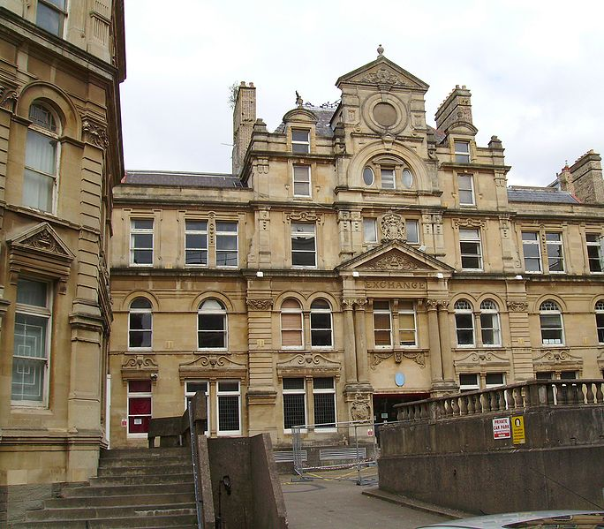

The Coal Exchange

Slide 6
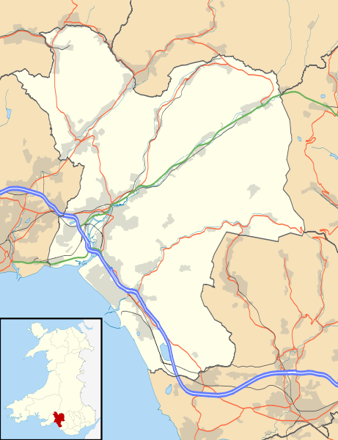
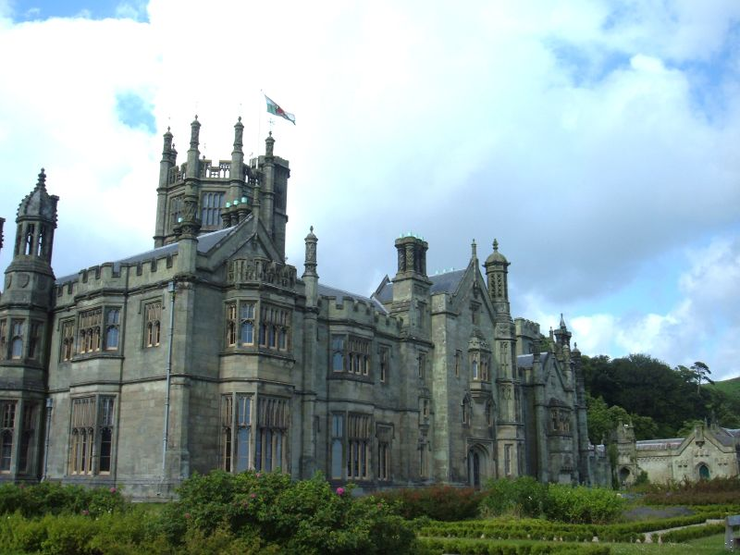
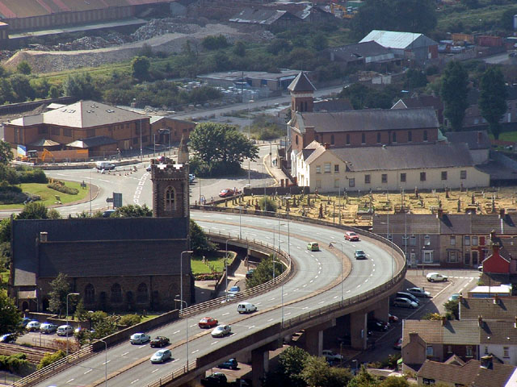
Port Talbot
The town is built along the eastern rim of Swansea Bay in a narrow strip of coastal plain surrounding the River Afan estuary.Swansea is visible on the opposite side of Swansea Bay. The local beach is known as Aberavon Sands and is situated along the edge of the bay between the River Afan and the River Neath. The other beach in Port Talbot is Margam Sands, popularly known as Morfa Beach. The north-eastern edge of the town is marked by the River Neath. A significant landmark in the town is the Port Talbot Steelworks.
The town is still said to be the most polluted place in Wales and the most polluted in the United Kingdom outside of London.However, air quality in the Port Talbot area has improved.
Margam Castle, not far from Margam Abbey

Slide 7
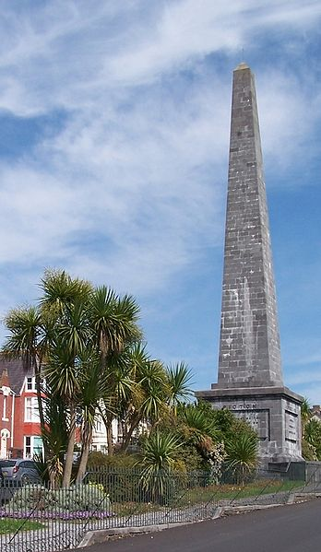
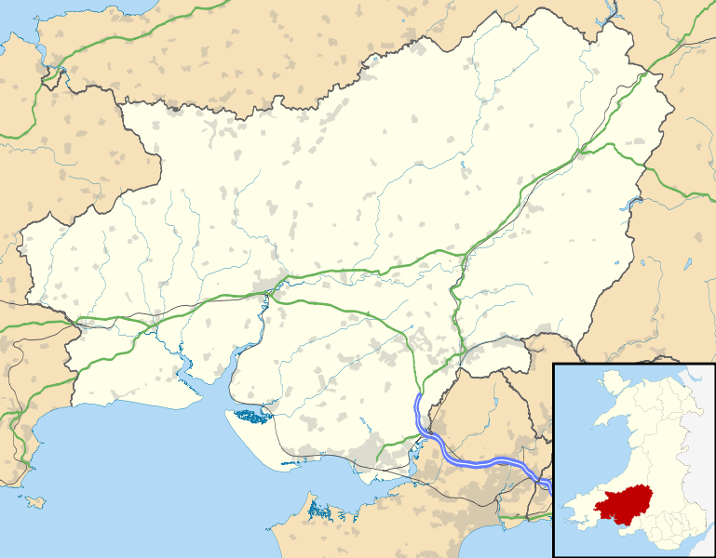
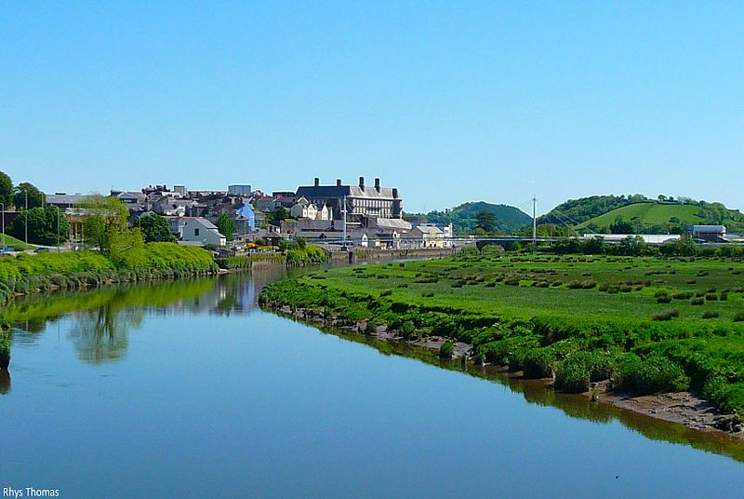
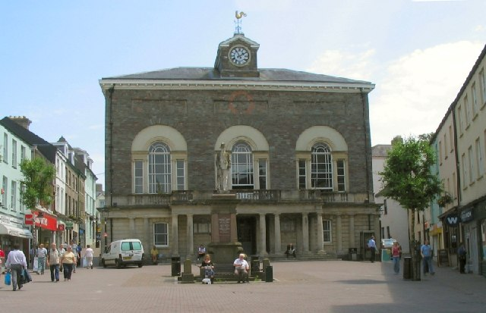
Carmarthen
Picton Monument in Carmarthen
Carmarthen is the county town of, Carmarthenshire, Wales. It is sited on the River Towy 8 miles (13 km) north of its mouth at Carmarthen Bay.
Carmarthen lays claim to being the oldest town in Wales but the two settlements of Old and New Carmarthen were only united into a single borough in 1546. Currently, Carmarthen is the location of the headquarters of Dyfed-Powys Police, the Carmarthen campus of the University of Wales, Trinity Saint David and the West Wales General Hospital.
Guildhall Square, Carmarthen

Slide 8
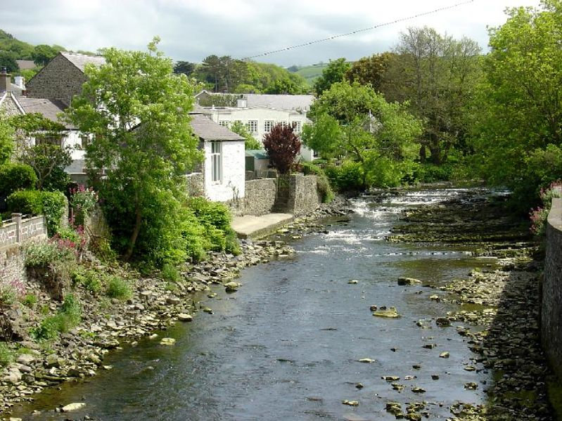
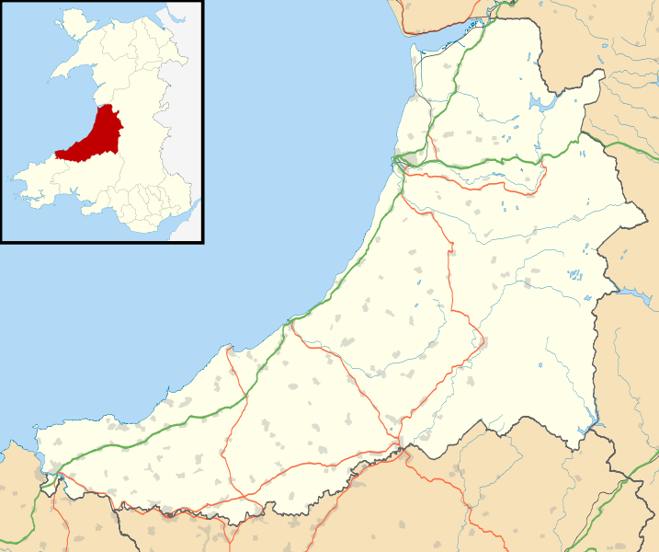
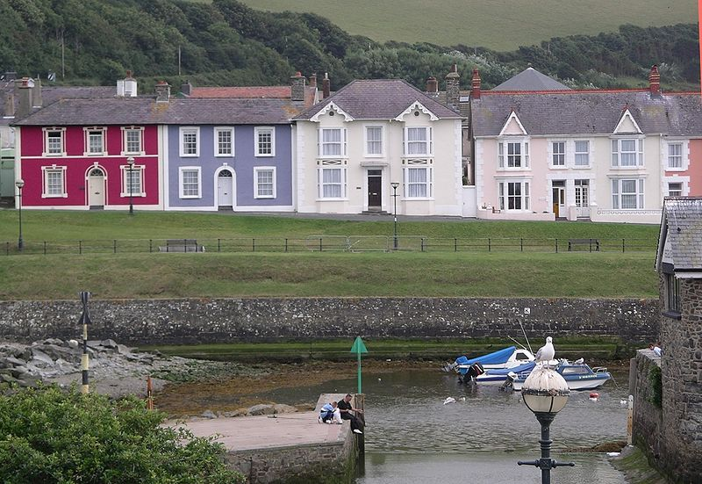
Aberaeron
The River Aeron
Aberaeron is located between Cardigan and Aberystwyth on the A487, at a junction with the A482 leading south-east to the university town of Lampeter.
The shoreline consists of generally steep storm beaches of pebbles, although fine sand is visible at low tide levels. Aberaeron south beach was awarded the Blue Flag rural beach award in 2005.[8] It contains the Harbourmaster Hotel.
The town is notable for the sale of honey, honey ice-cream and, more recently, honey mustard.

Slide 9
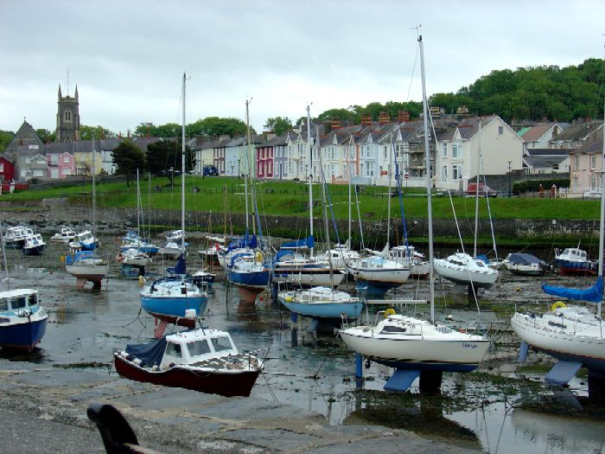
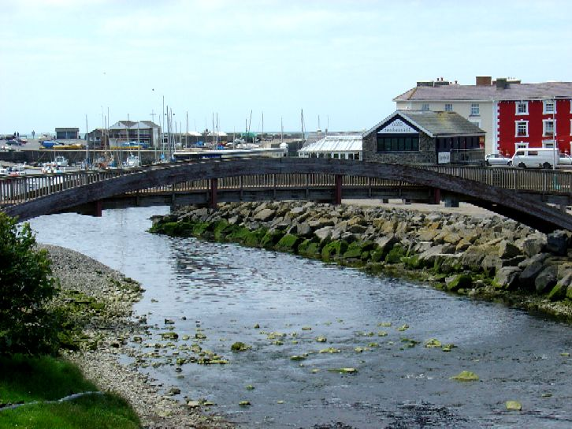
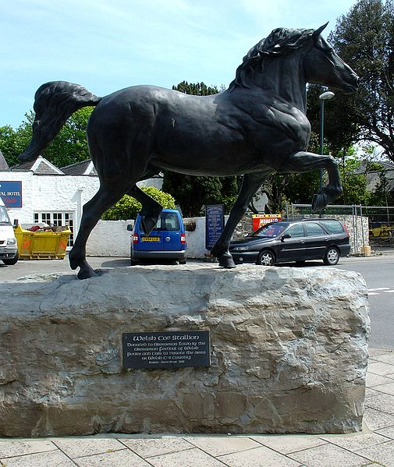
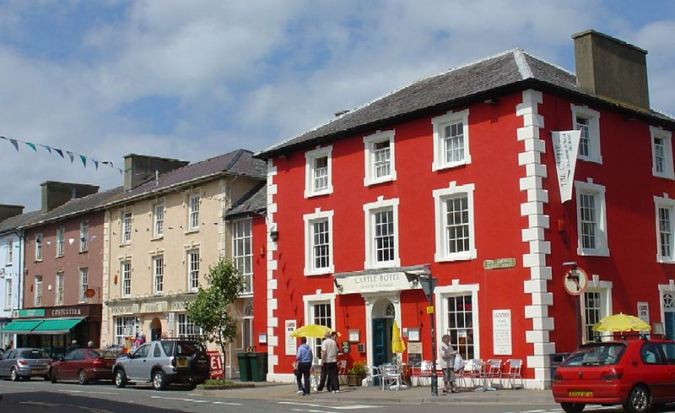
Harbour at low tide
Footbridge over the Aeron
Welsh cob statue
Market Street

Slide 10
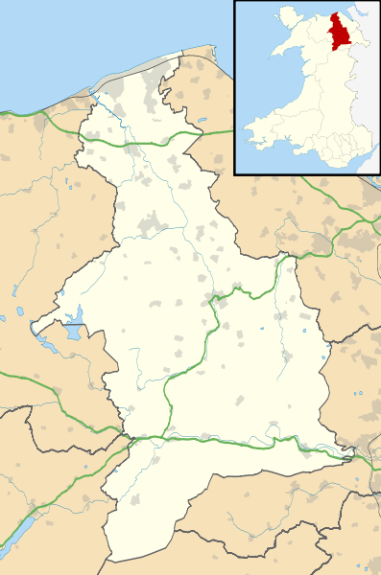
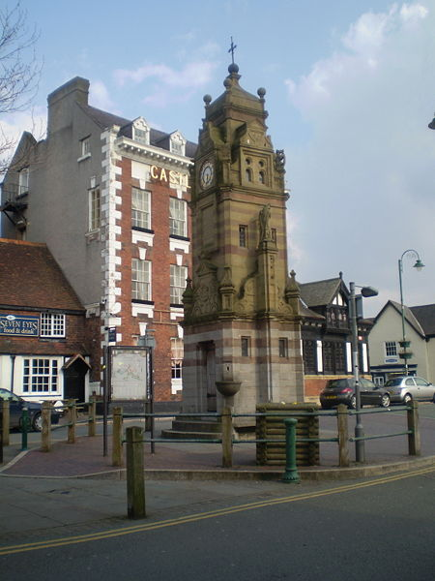
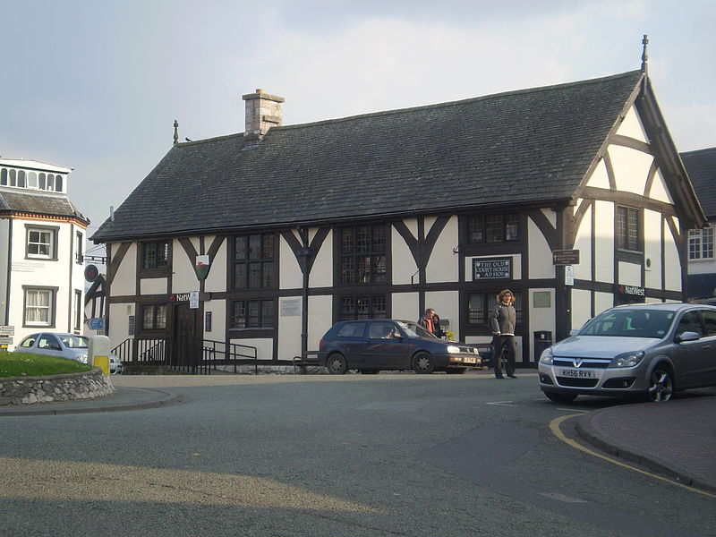
Ruthin
Ruthin is a community and the county town of Denbighshire in north Wales. Located around a hill in the southern part of the Vale of Clwyd - the older part of the town, the castle and Saint Peter's Square are located on top of the hill, while many newer parts of the town are on the floodplain of the River Clwyd.
The name 'Ruthin' comes from the Welsh words rhudd (red) and din (fort), and refers to the colour of the new red sandstone which forms the geologic basis of the area,[2] and from which the castle was constructed in 1277-1284. The original name of Rhuthin was 'Castell Coch yng Ngwern-fôr' (red castle in the sea-swamps).
Clock tower on St Peter's Square.
The Old Court House built in 1401

Slide 11
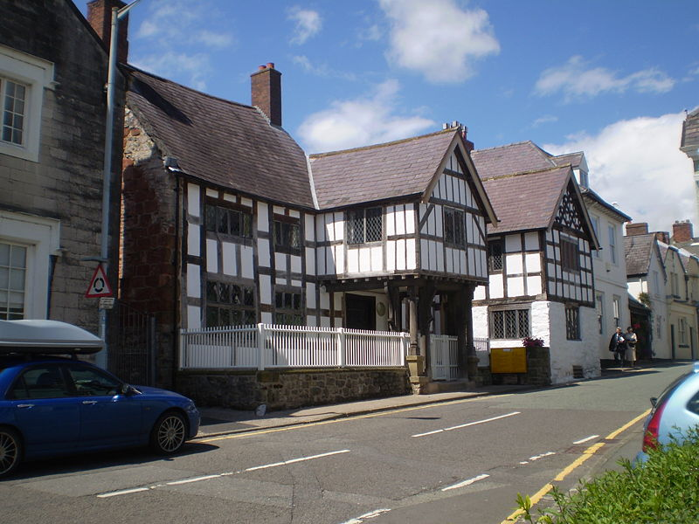
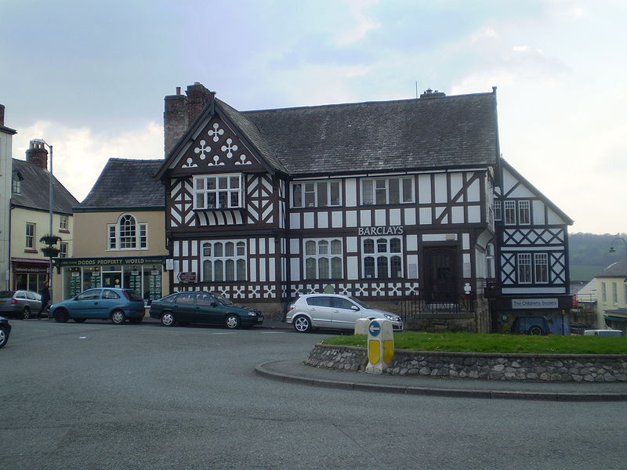
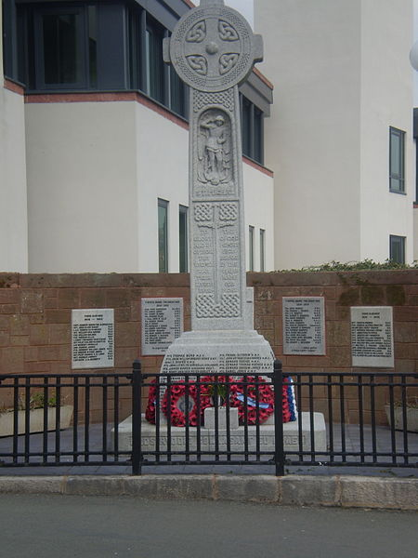
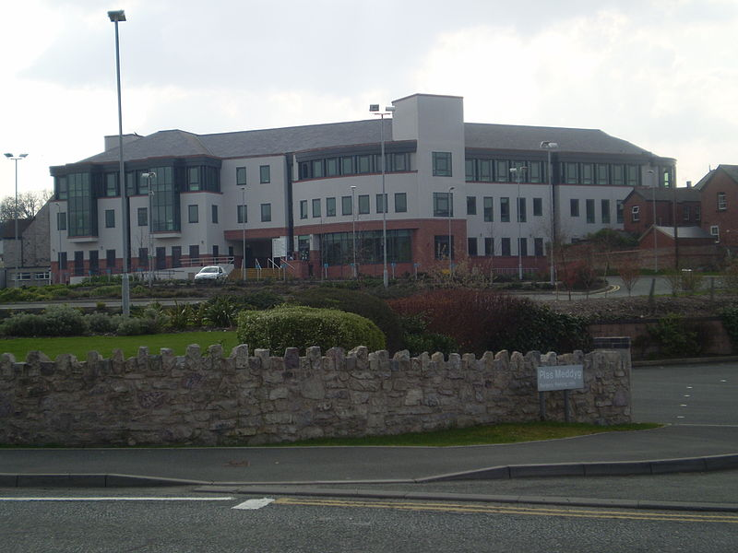
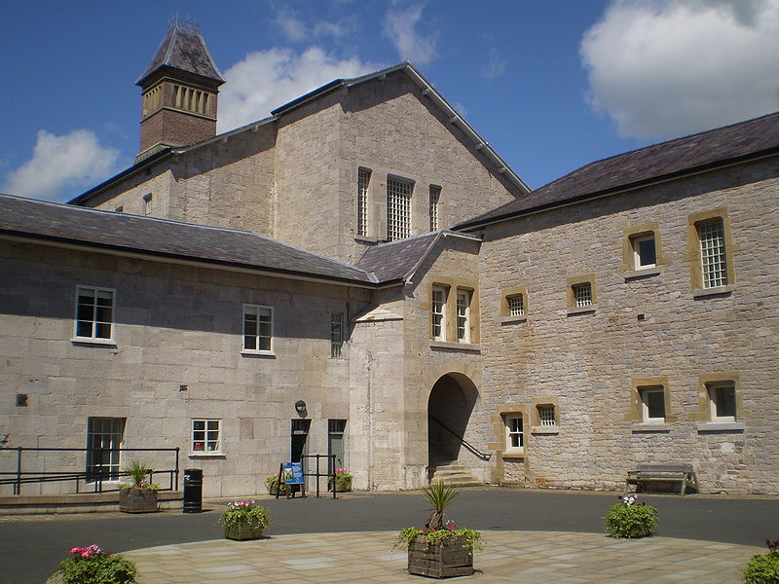
Nantclwyd House is the oldest known house, with timbers dated to 1435.
The town War Memorial

