Slide 1
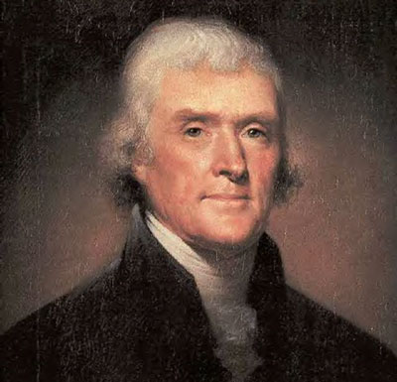
Thomas Jefferson

Slide 2
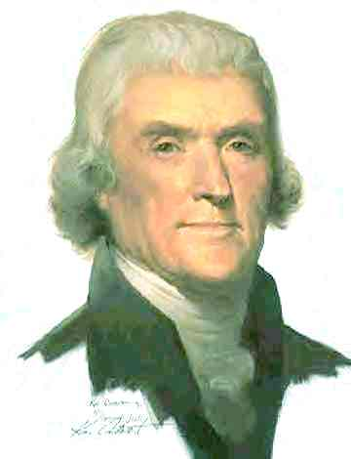
The Beginning
March 4, 1801
Thomas Jefferson is the first President inaugurated in the new capital city of Washington D.C.
He delivers his first inaugural address. This address outlines what he feels are the essential principles of government.

Slide 3
Background and Education
Father: Peter Jefferson
Like most sons of land owners, he studied land surveying
Graduated from William and Mary University in Williamsburg, VA
Tall, red-headed, quiet

Slide 4
Political Beliefs
The government which governs least, governs best
Strongly favored States Rights as opposed to a strong national government
Believed in a strict construction, or strict interpretation, of the U.S.Constitution
Wanted to end all taxes of any kind paid by U.S. citizens

Slide 5
Accomplishments Prior to becoming President
Wrote the first draft of the Declaration of Independence
Wrote the Statute of Virginia for Religious Freedom
Created the University of Virginia
Served as an ambassador to Europe from the United States

Slide 6
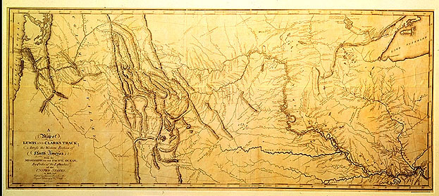
Lewis and Clark Expedition
January 18, 1803
Jefferson asks Congress for funds to explore the land west of the Mississippi
His goal is to find a water route to the Pacific
May 1804
Meriwether Lewis and William Clark depart on the expedition

Slide 7
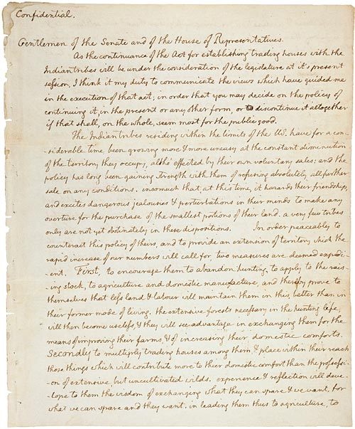
Lewis and Clark Expedition
January 18, 1803
Jefferson sends a secret message to congress regarding the Lewis and Clark Expedition
In this message Jefferson asks for permission to establish trading with the Indians

Slide 8
Embargo Act of 1807
1803 - Renewal of the Napoleonic Wars between France and Great Britain
America was once again trapped between the two nations
Jefferson wanting to stay neutral proposed an embargo on all foreign trade
This was highly unsuccessful and devastated the American Economy
The Non-Intercourse Act of 1809 was put in place to repeal the unsuccessful Embargo Act

Slide 9
First Inaugural Address
Essential Principles of Government
“equal and exact justice to all men”
“peace, commerce, and honest friendship with all nations”
“the support of state governments”
“the preservation of general government”
punishment for those who choose to revolt
compliance with the decisions of the majority
a well disciplined militia
honest payment of debts
maintaining a sound economy
proper distribution of information
freedom of religion
freedom of the press

Slide 10
Second Inaugural Address
Delivered on March 4, 1805
Stresses the importance of American neutrality in matters of foreign affairs
Outlines the Louisiana Purchase and the processes by which the original inhabitants of the land will become citizens of the United States
Stresses the importance of harmony amongst all inhabitants of America

Slide 11
Thanks for your attention!

