Slide 1
Food

Slide 2
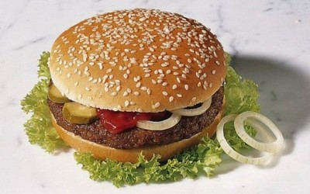
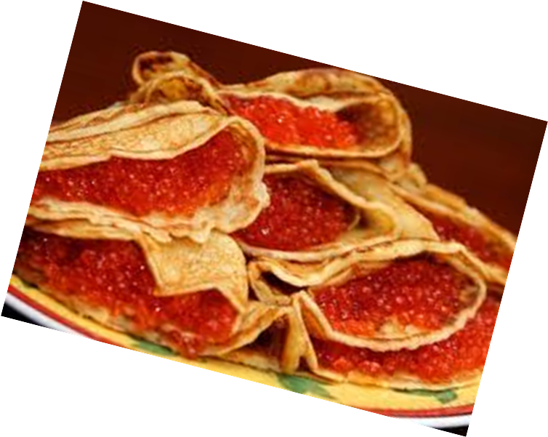
There is a good proverb that I like very much: “We eat to live, but do not live to eat.” I think this is true because food is something that we need to stay alive. Food is a source of energy. Nevertheless I like eating tasty food even though I am not much into it. So, for some people food is a source of pleasure, too. But the food that we eat should also be healthy.

Slide 3
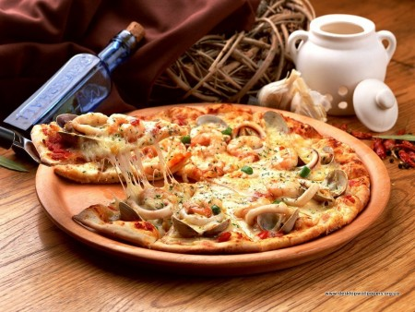

Slide 4
I eat similar food every day. It is usually very simple. My daily meal consists of light breakfast, lunch (at school), dinner and supper.
In the morning I usually have some tea with cheeseburgers or hamburgers, some porridge or cottage cheese with sugar or jam.

Slide 5
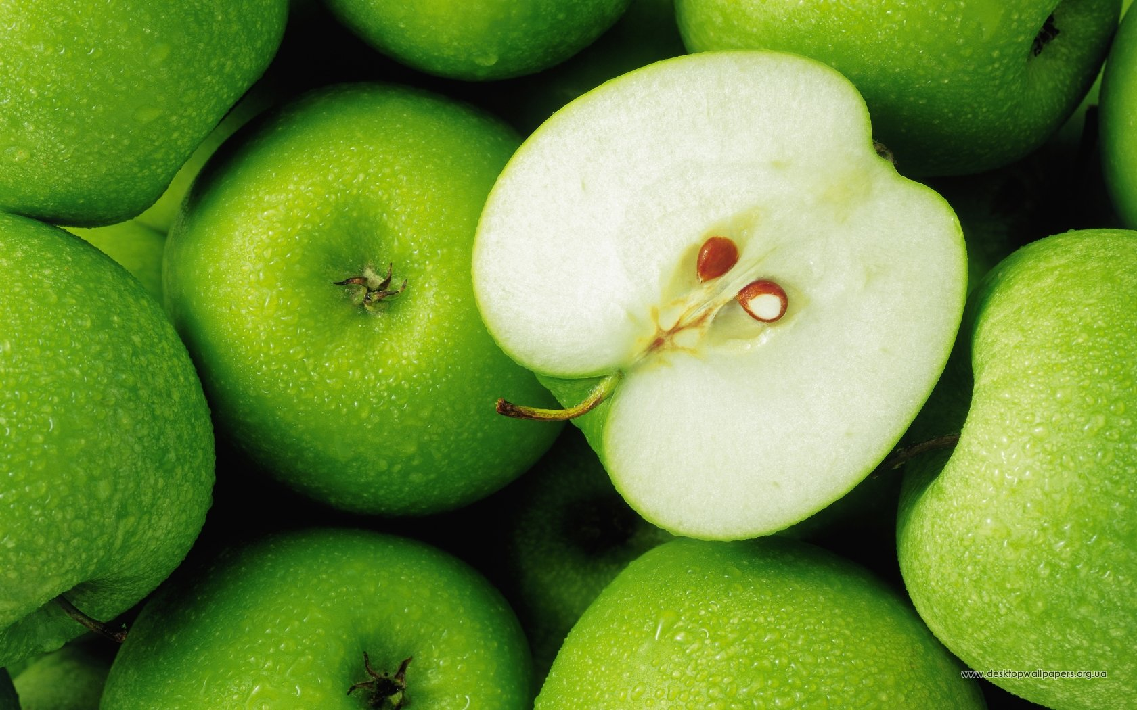
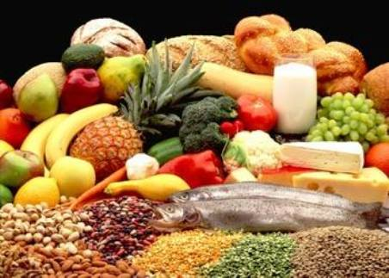
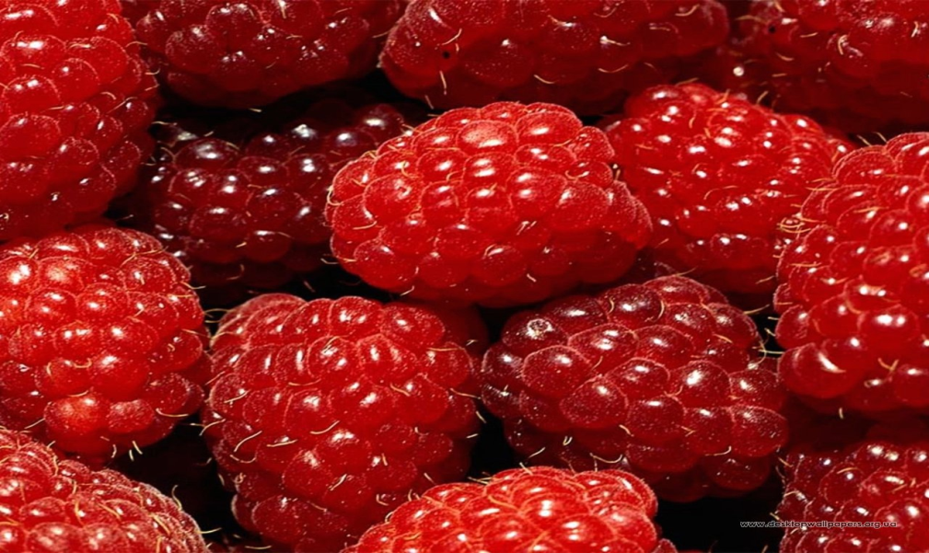

Slide 6
I like tea with toast and home-made jam. I have a sweet tooth, so I like chocolate and different cakes, sweets very much.
I usually have lunch at school – it’s juice or tea and sandwiches that I take from home. I can also go to a canteen.

Slide 7
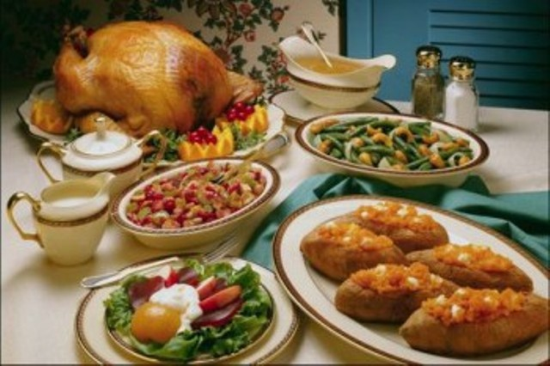
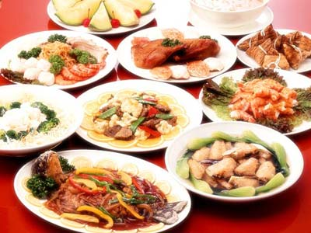
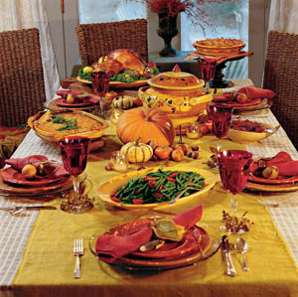
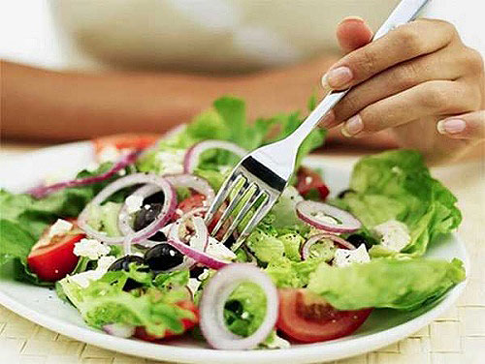

Slide 8
For dinner when I come home I have vegetable soup. Actually I don’t like soup. But I have to eat it because it’s healthy. But when I come to my granny I can’t stop trying her specialty - borsch or shi. Soup with meat balls that my mom cooks is my favourite. I can also have a salad or fried fish. I usually do not have desserts. Maybe some green or black tea with lemon.
For supper we usually have different kinds of potato dishes or pasta. I like meat very much. But I also like fish and other sea products – shrimps, squids, salmon and mackerel.
Vegetables are also what I love! Different vegetables are always on our dinner table. My mom makes tasty salads. I love different salads with dressings. I don’t eat much mayonnaise. Our salads usually have olive oil or sour cream as a dressing. We buy different fruits as well. My favourite fruits are bananas and tangerines.

Slide 10
I also love all kinds of dairy products like milk, yoghurt, kefir, cottage cheese and cheese.
While eating I usually drink juice or tea.
I think fast food (like McDonalds) is very bad for our health. Ready-made food like pelmeni, hamburgers and so on is also not very good. So, we try to cook at home. It is better to spend some time cooking, than to have health problems.

Slide 12
The end

Slide 13
Prepared student 11-A class Vladislav Didenko

