Slide 1
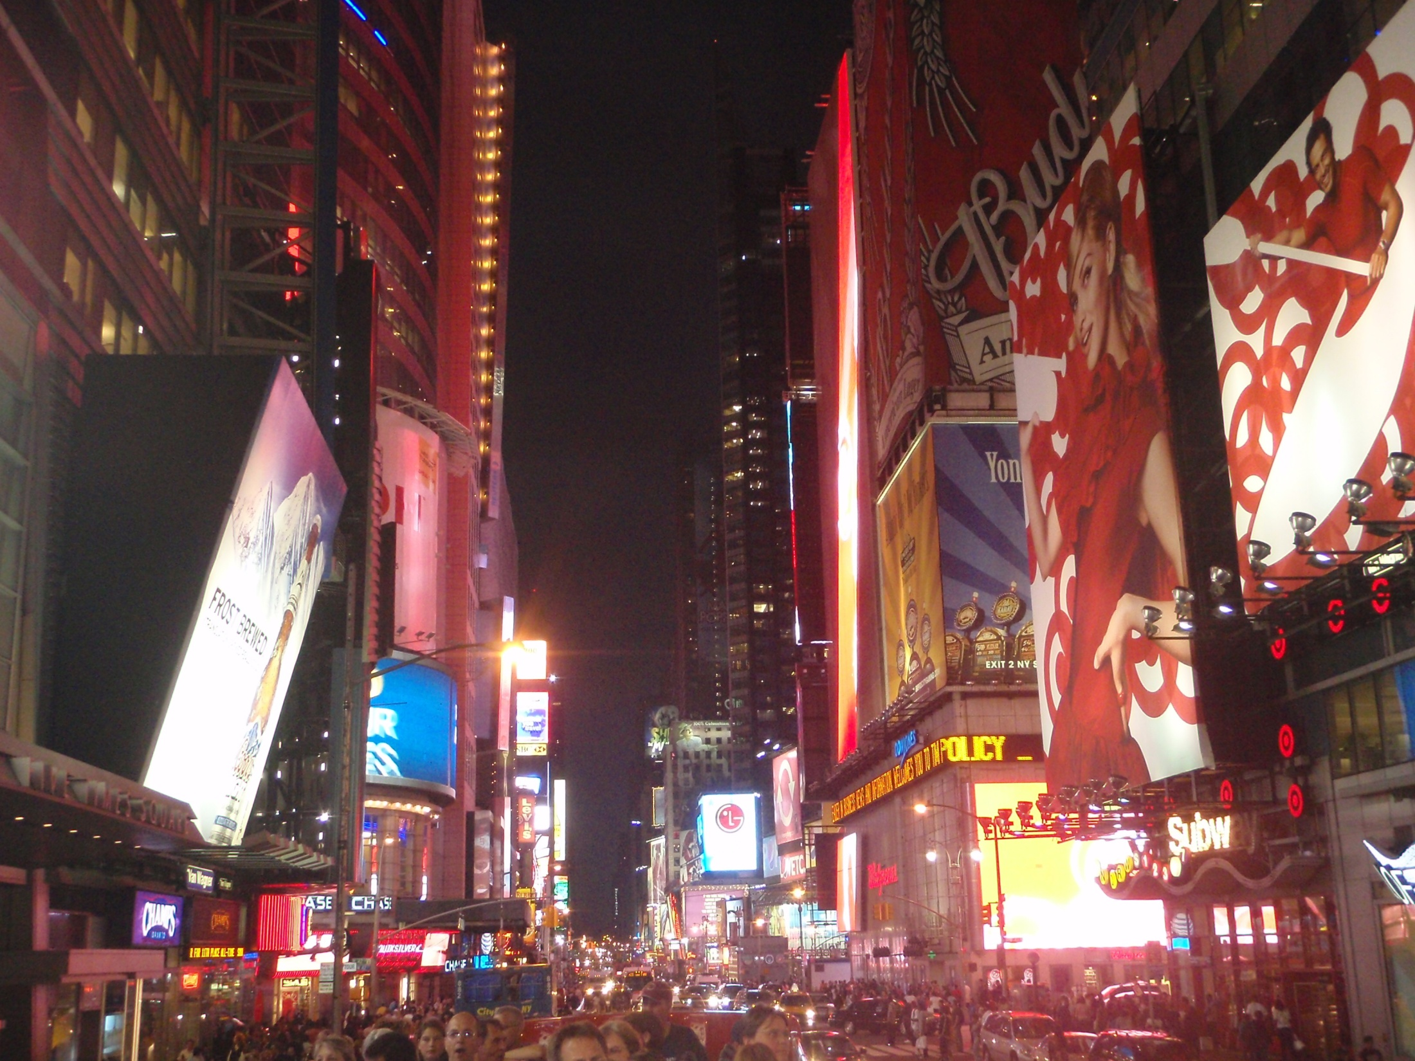
New York City
By: Skorokhvatova Liza 11-A

Slide 2
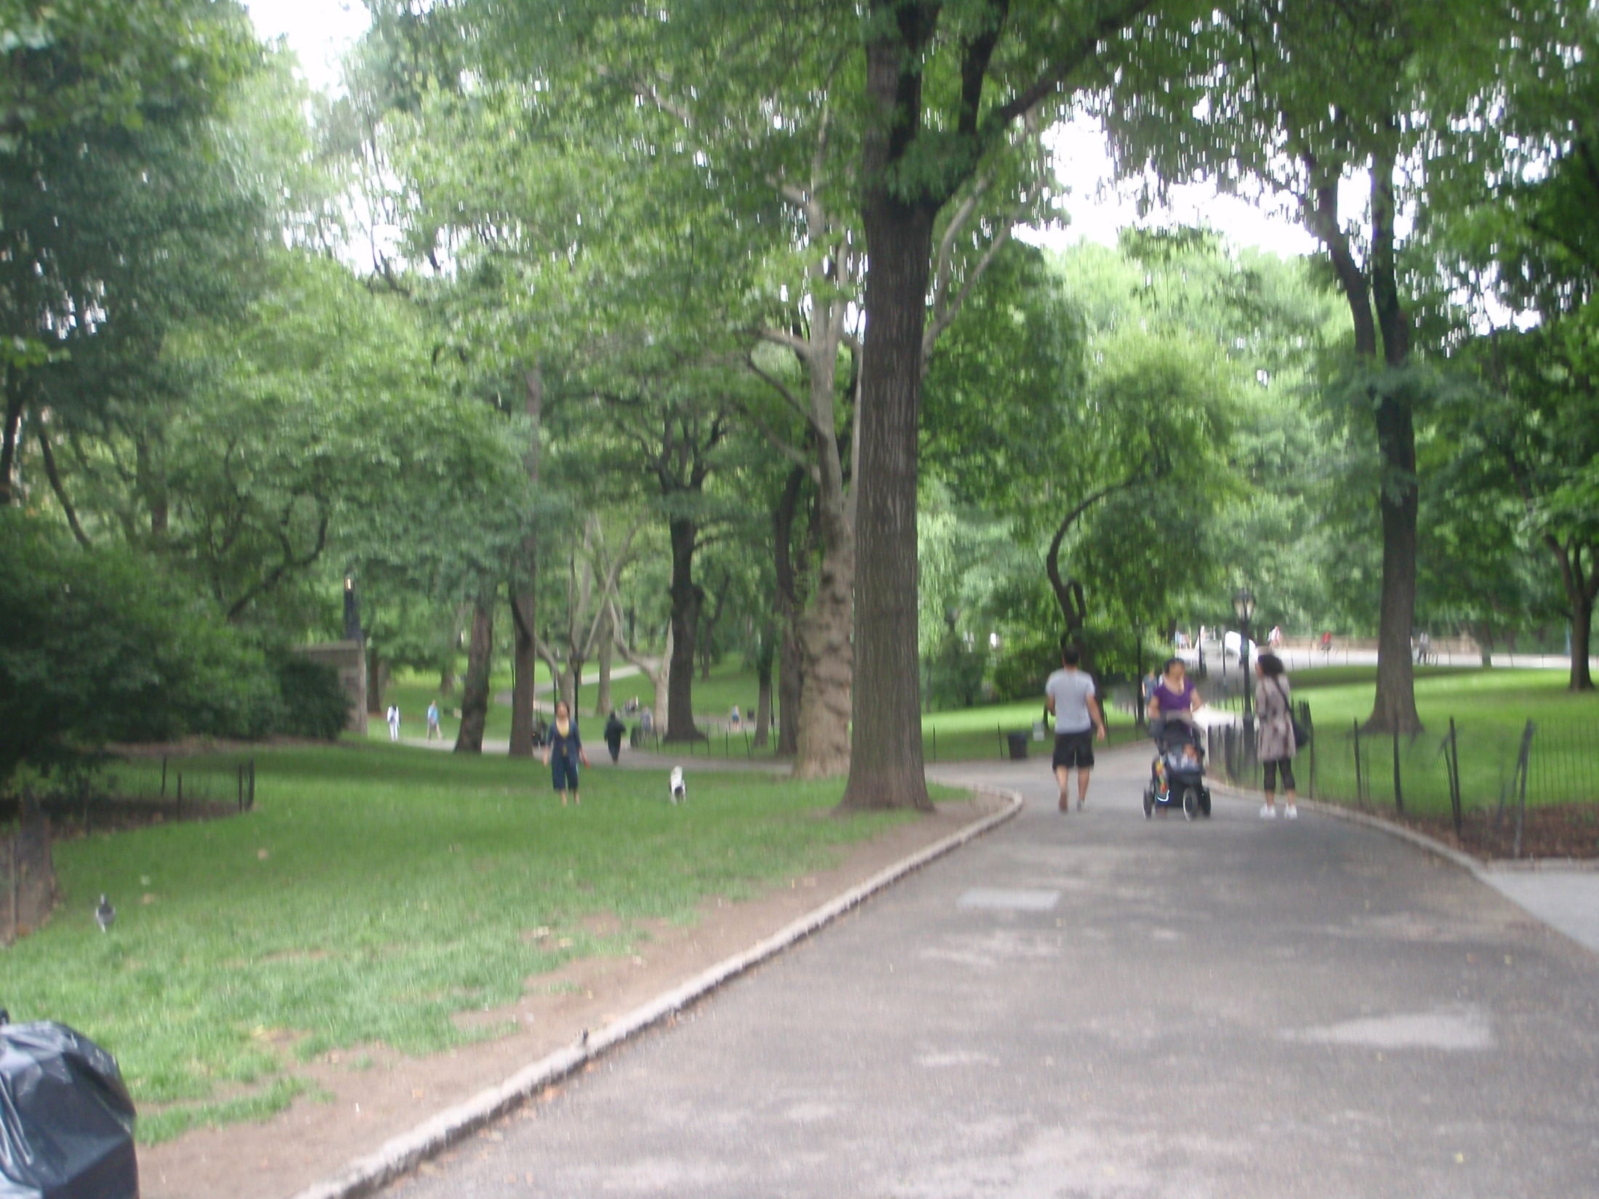
History of New York City
New York City was discovered in 1524 by Giovanni da Verrazzano, an Italian explorer. Europeans started to settle there once a Dutch fur trading settlement was founded, and they gave it the name "New Amsterdam“. Some time after, the island of Manhattan was purchased by Peter Minuit for what would be $1000 today. After it was purchased by him, the English conquered it in 1664 and finally gave it it’s name as of today, “New York. It became the largest U.S. city by 1790.

Slide 3
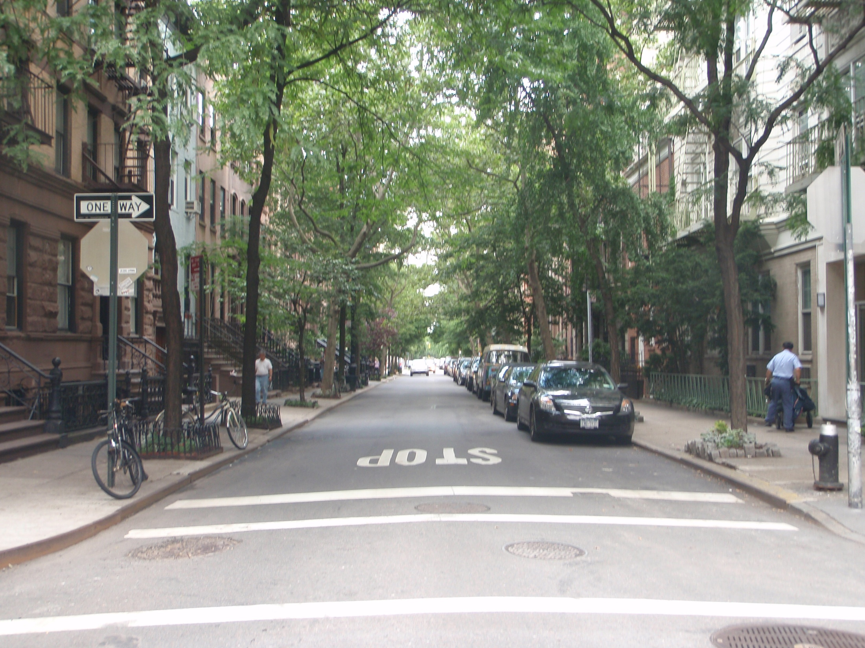
History of New York City
From the mid to late 1780’s to 1790, NYC spent a brief time as the capital of the U.S., and it was also the state capital of New York until 1790. In 1898, a charter was adopted that said the New York City would not only be Manhattan, but the four surrounding counties as well, which were the counties of Richmond, New York, Queens, and Brooklyn. This is where the five districts, Manhattan, Brooklyn, Staten Island, Queens, and the Bronx, come from. In the years to come after that, the city saw some tough times as the Great Depression hit, crimes rates rose, and the September 11th attacks happened. Eventually though, the economy went back up, the crime rates went back down, and everyone came together to re-build after accident in September.

Slide 4
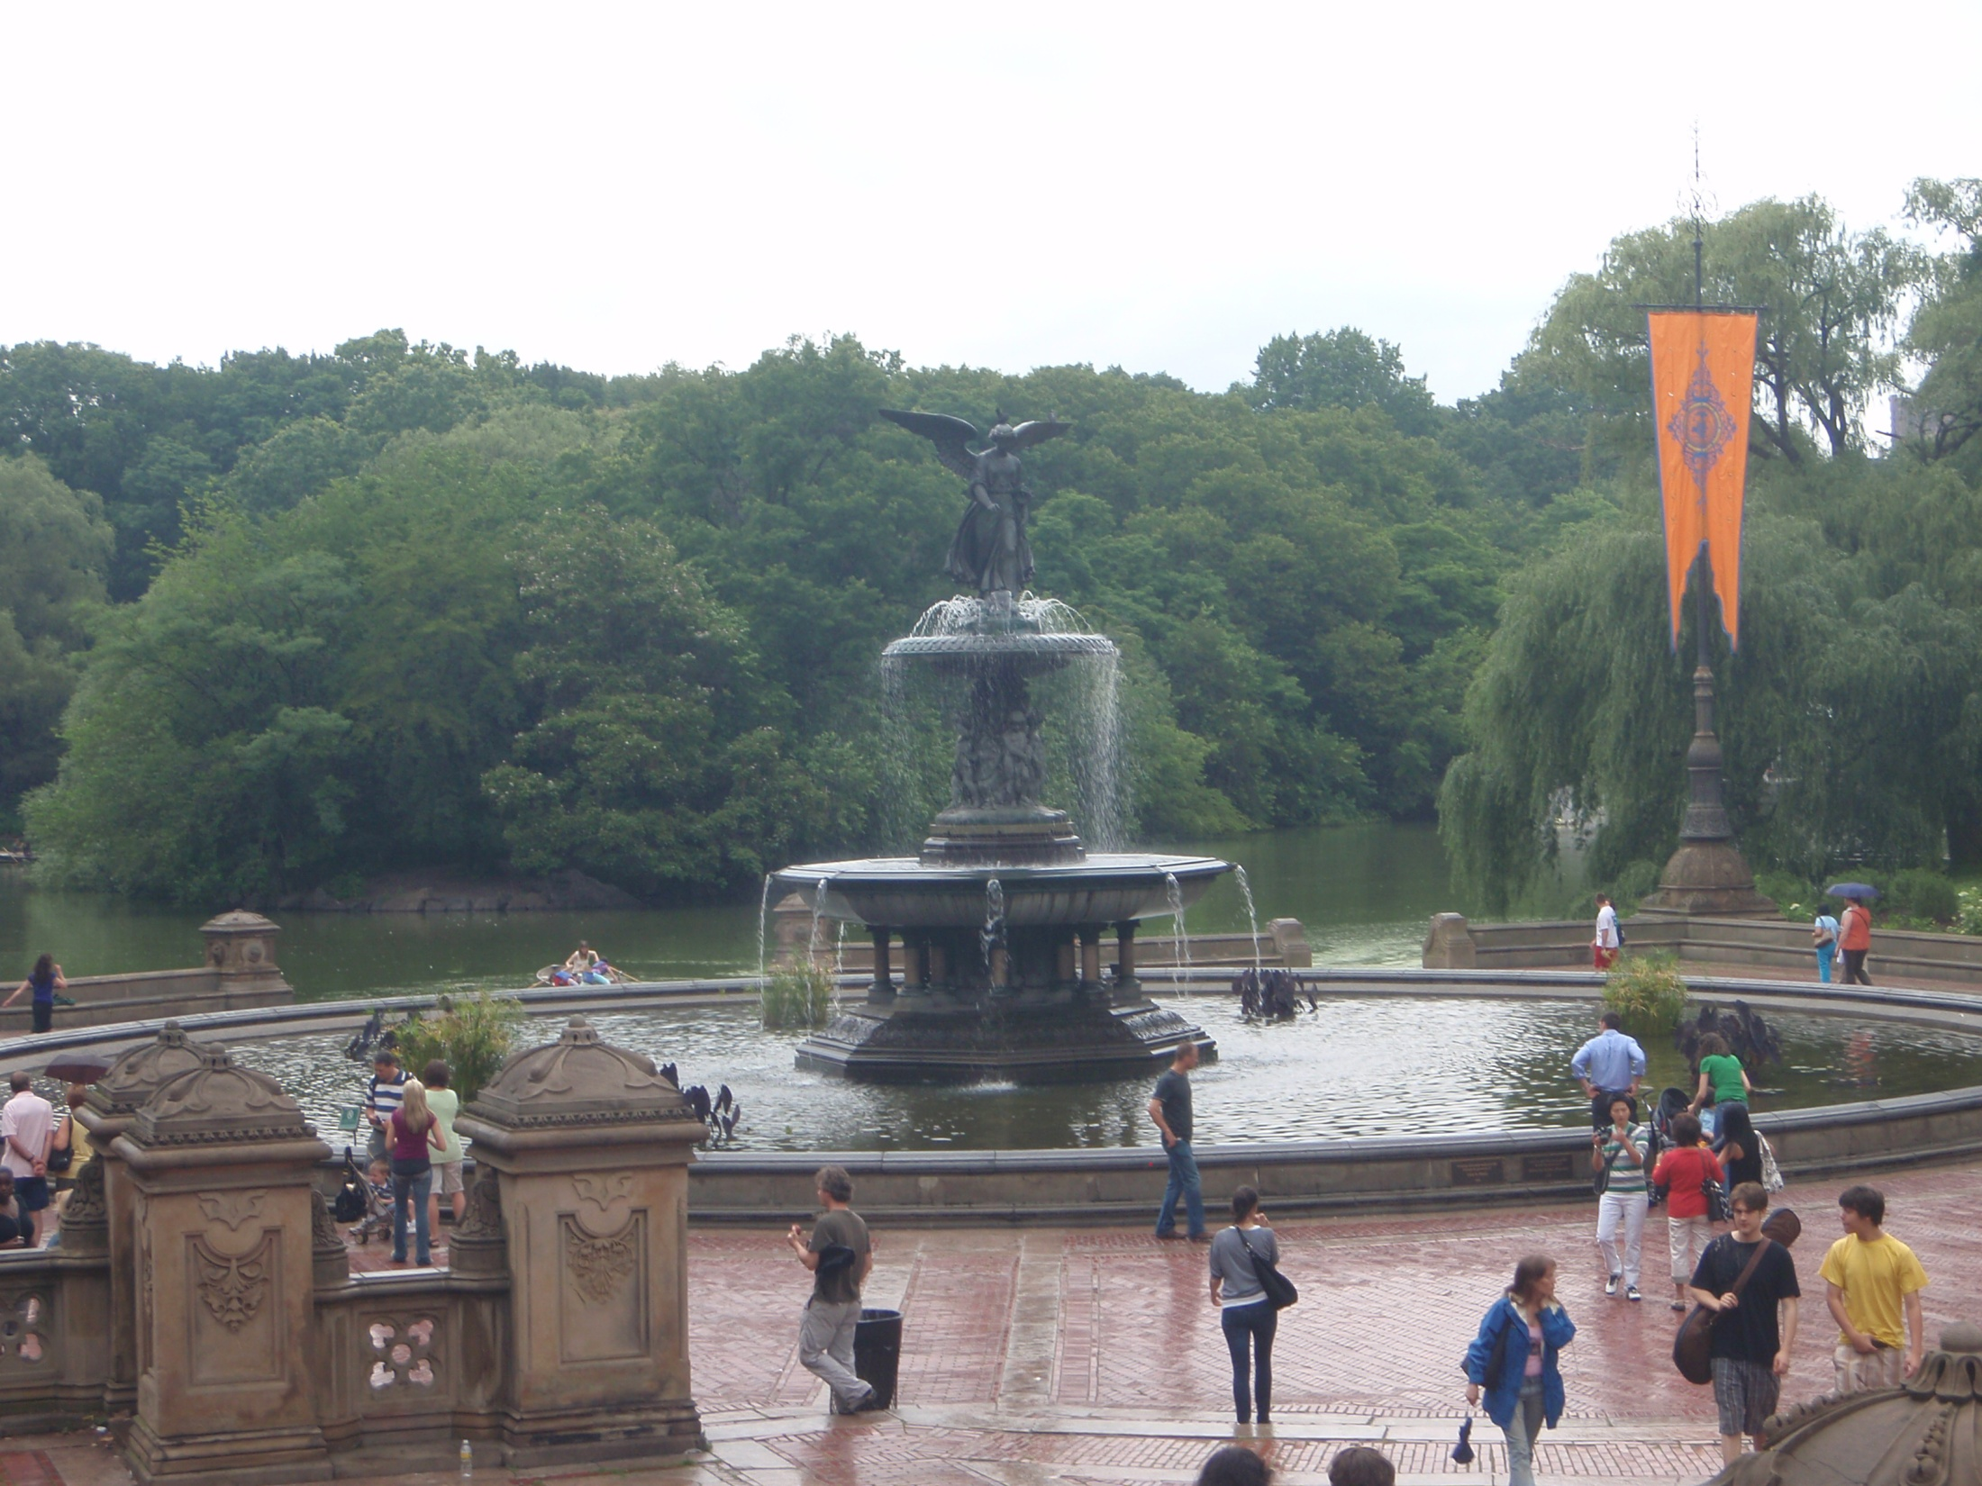
Facts about New York City
It is the largest city in the United States, with a population of over 8 million people
Contrary to popular belief, Brooklyn is actually the most populated district of New York City, and Queens is the second, Manhattan is third
As of 2005, over 170 languages were spoken in the city, and 36% of it’s population was born outside of the U.S.

Slide 5
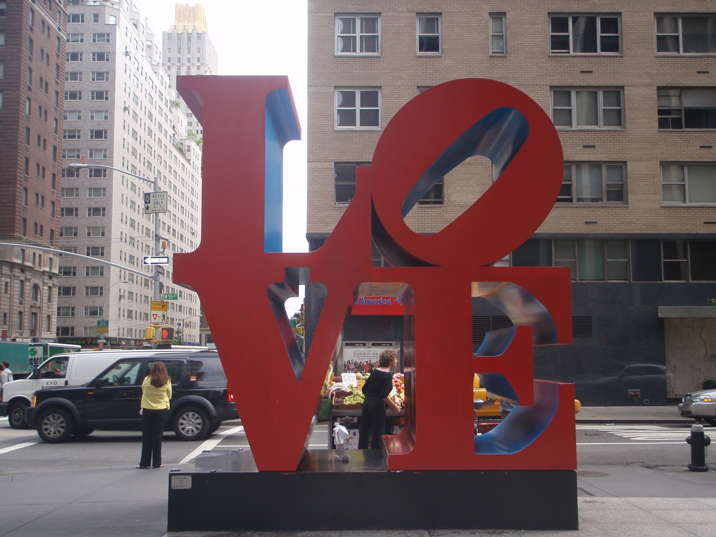
Facts about New York City
New York City is home to over 1700 parks, and the biggest is actually Pelham Bay Park located in the Bronx, not Central Park in Manhattan
NYC has had the lowest crime rate of the 25 largest U.S. cities since 2005

Slide 6
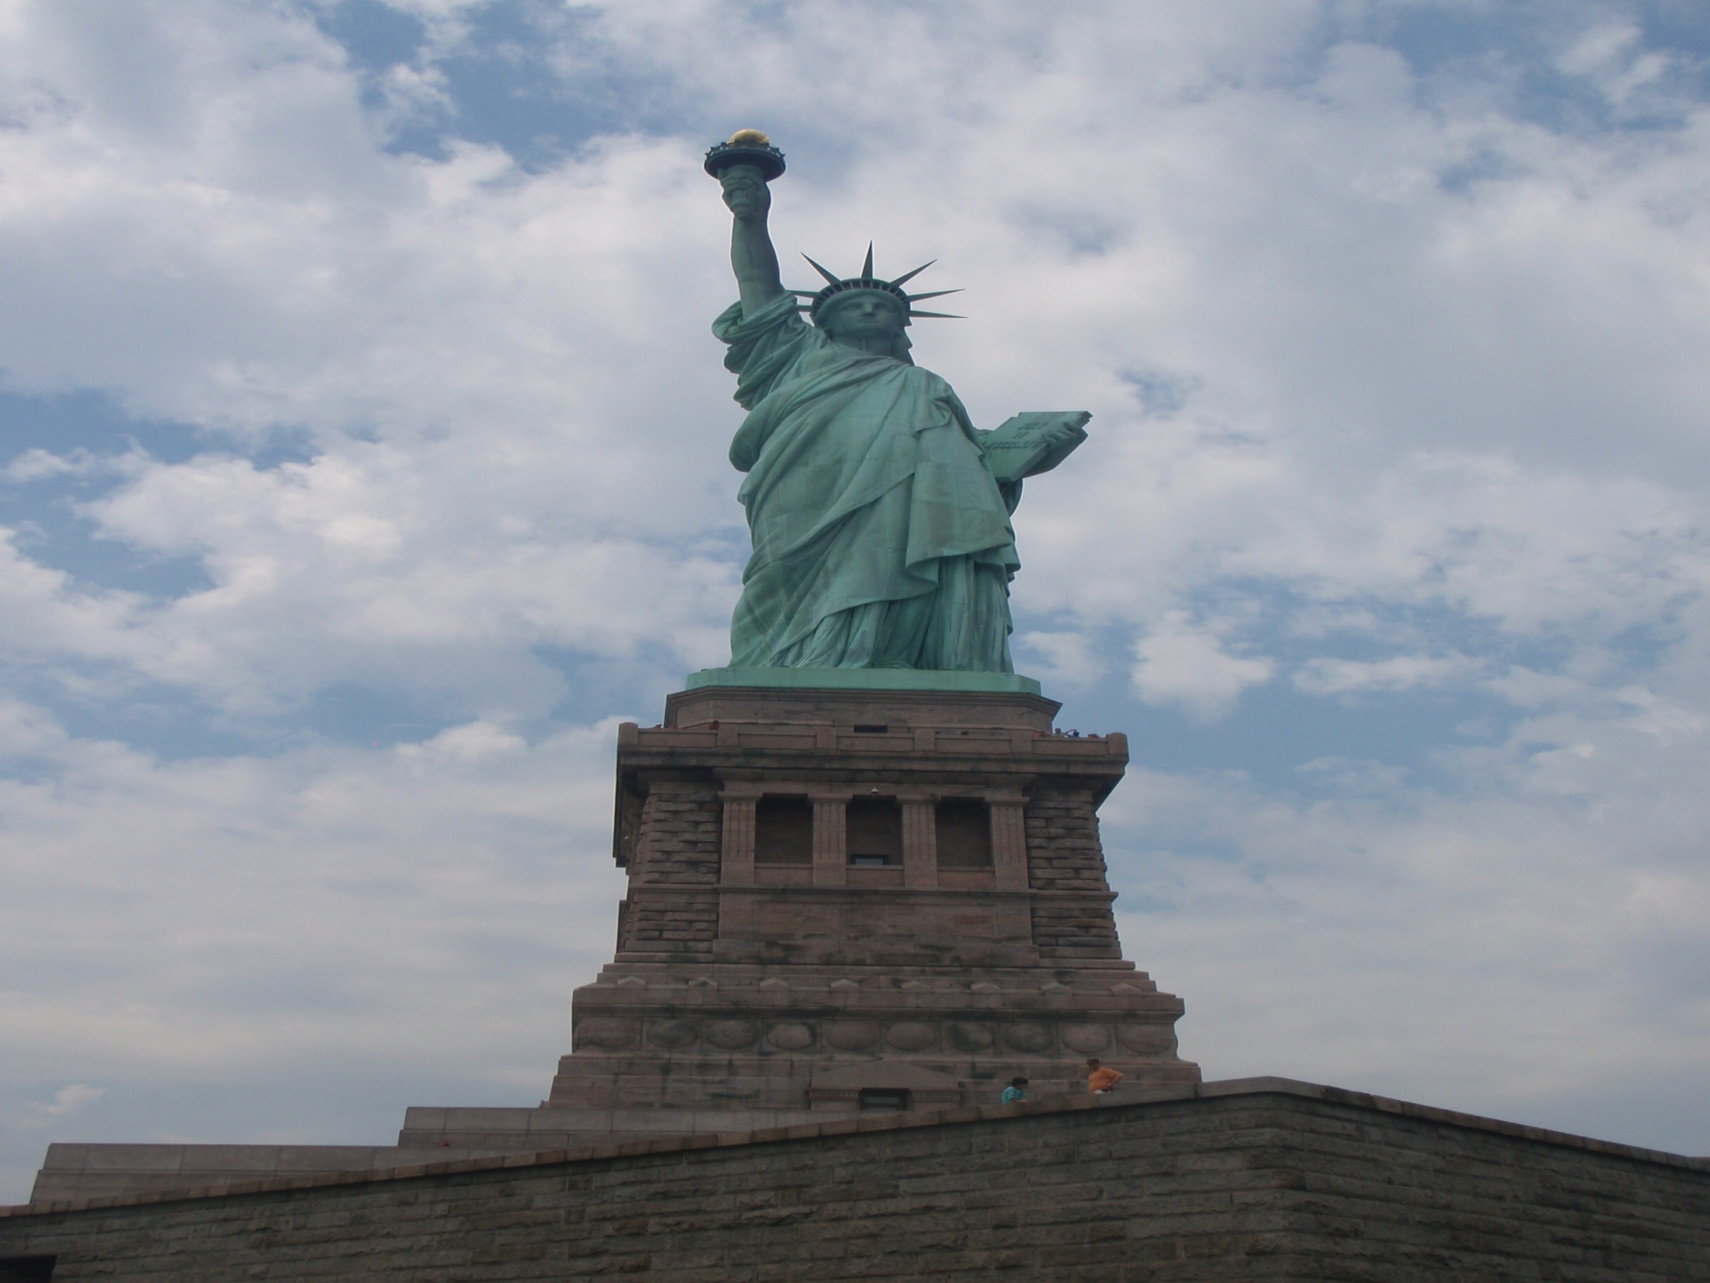
Things to do in New York City
Take a ferry to the Statue of Liberty/Ellis Island
Visit the Empire State Building
Go see the World Trade Center Memorial
Buy buss passes and see all the different Manhattan neighborhoods by double decker bus
See a Broadway play

Slide 7
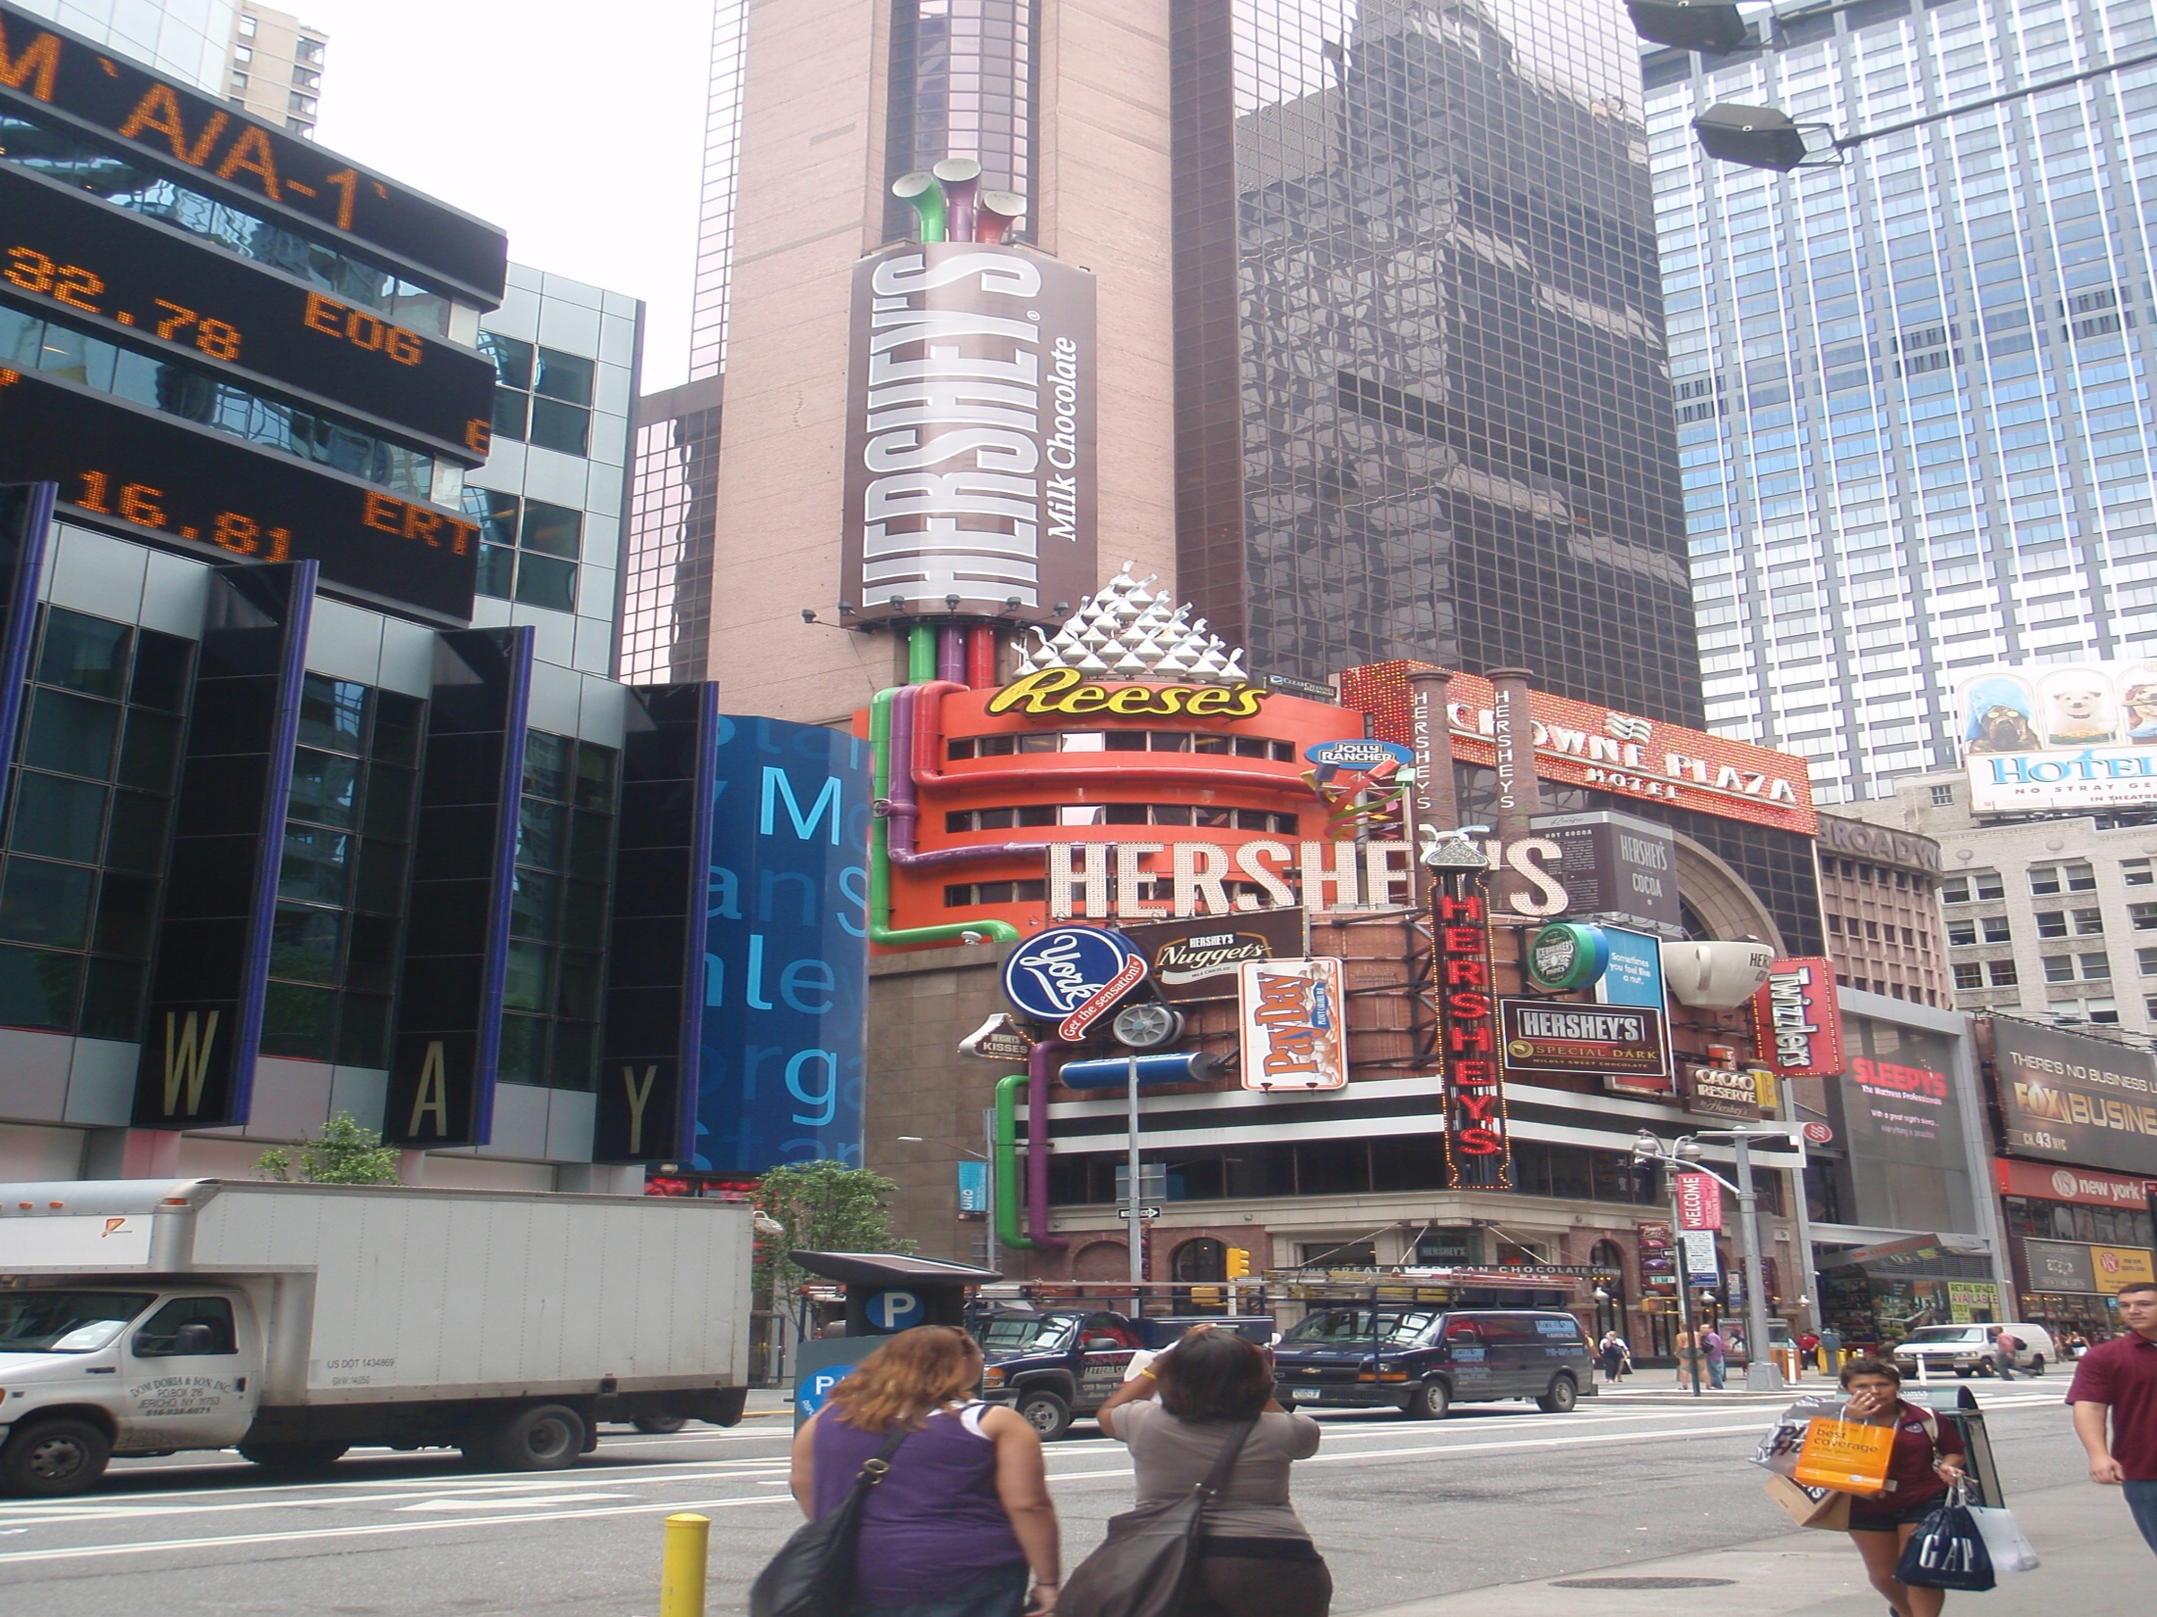
Things to do in New York City
Walk through Times Square
Take a night time cruise on the Hudson River to see a great view of the skyline
Shop on 5th Avenue
Visit Central park

