Slide 1
Hobbies in our life

Slide 2
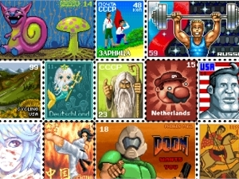
collecting
A postage stamp is a small piece of paper that is purchased and displayed on an item of mail as evidence of payment of postage. They are sometimes a source of net profit to the issuing agency, especially when sold to collectors who will not actually use them for postage.

Slide 3
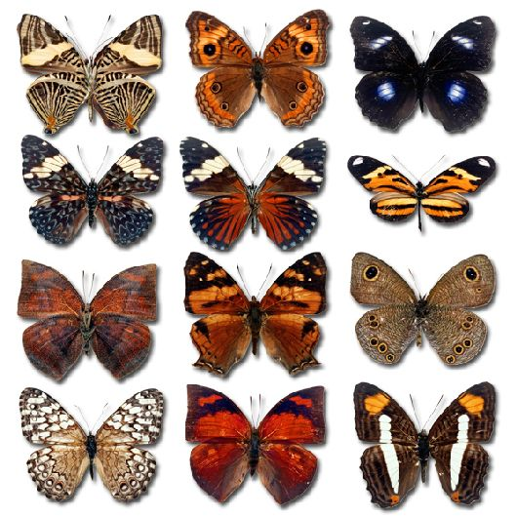
A butterfly is a mainly day-flying insect of the order Lepidoptera, which includes the butterflies and moths. Most species are diurnal. Butterflies have large, often brightly coloured wings, and conspicuous, fluttering flight.

Slide 4
Creative hobby
A player piano is a self-playing piano. The rise of the player piano grew with the rise of the mass-produced piano for the home in the late 19th and early 20th century.

Slide 5
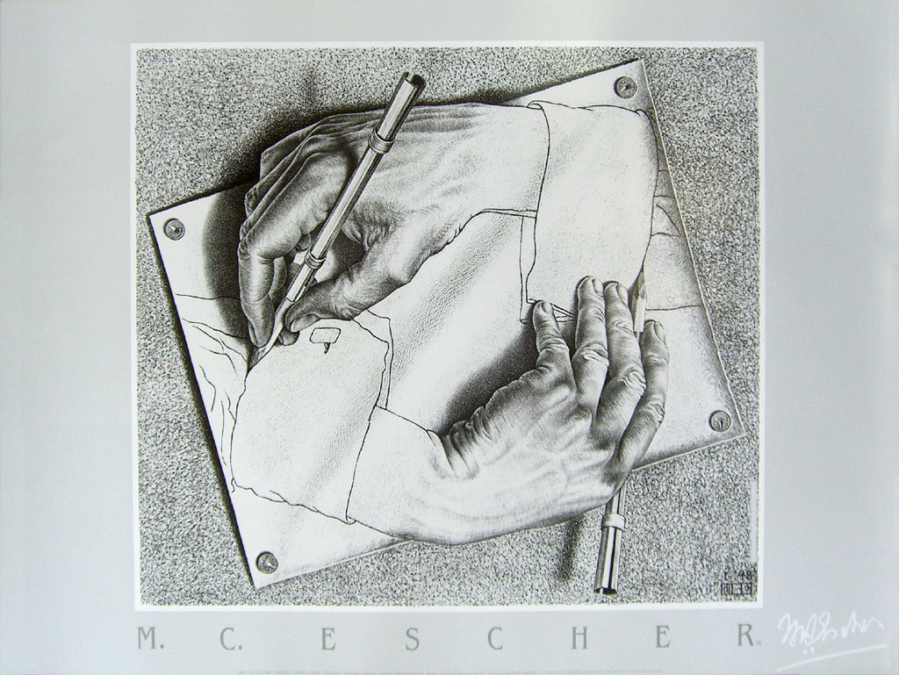
Drawing is one of the major forms of expression within the visual arts, and is generally concerned with the marking of lines and areas of tone onto paper. There are several categories of drawing, including figure drawing, cartooning, doodling and shading.

Slide 6
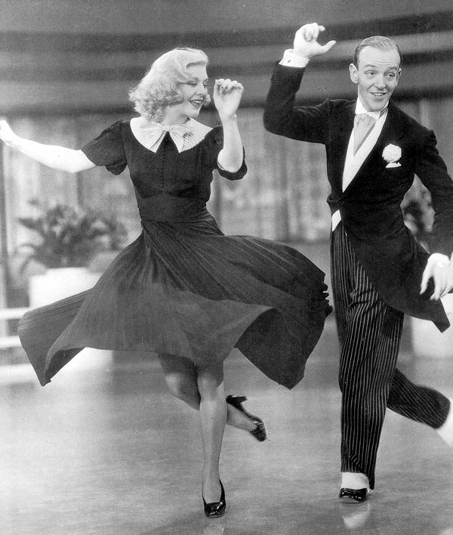
Dance is a type of art that generally involves movement of the body, often rhythmic and to music. It is performed in many cultures as a form of emotional expression, social interaction, or exercise, in a spiritual or performance setting, and is sometimes used to express ideas or tell a story.

Slide 7
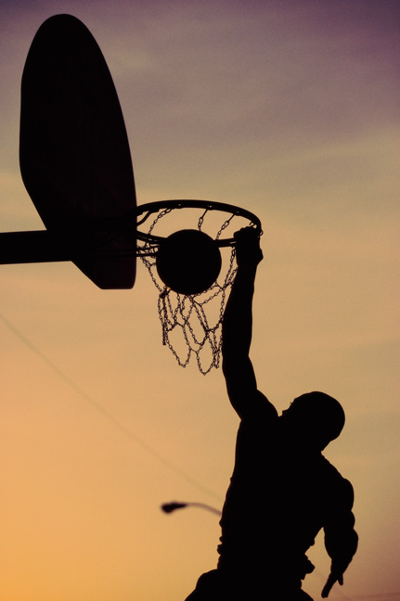
Sport hooby
Basketball is a sport played by two teams of five players on a rectangular court. The objective is to shoot a ball through a hoop 18 inches (46 cm) in diameter and 10 feet (3.0 m) high mounted to a backboard at each end.

Slide 8
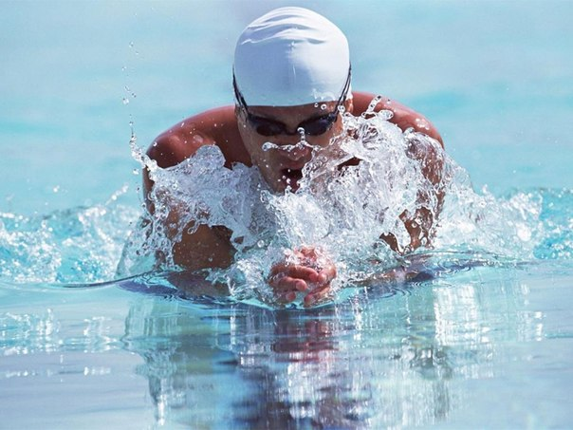
The sport of swimming has been recorded since prehistoric times; the earliest recording of swimming dates back to Stone Age paintings from around 7,000 years ago. Written references date from 2000 BC.

Slide 9
Football refers to a number of sports that involve, to varying degrees, kicking a ball with the foot to score a goal. The most popular of these sports worldwide is association football, more commonly known as just "football" or "soccer".

Slide 10
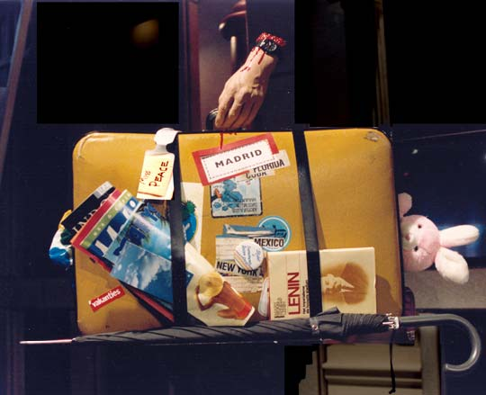
Traveling
Travel is the movement of people between relatively distant geographical locations, and can involve travel by foot, bicycle, automobile, train, boat, airplane, or other means, with or without luggage, and can be one way or round trip.

Slide 11
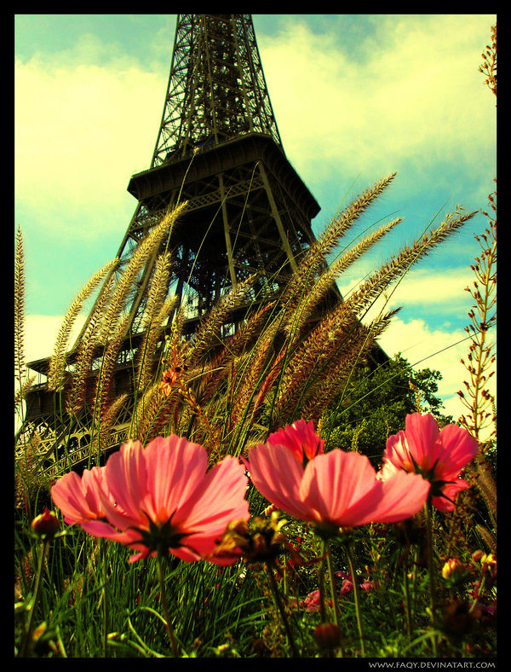
Paris
Paris is the capital and most populous city of France. Centuries of cultural and political development have brought Paris a variety of museums, theatres, monuments and architectural styles. Many of its masterpieces such as the Louvre and the Arc de Triomphe are iconic buildings, especially its internationally recognized symbol, the Eiffel Tower.

Slide 12
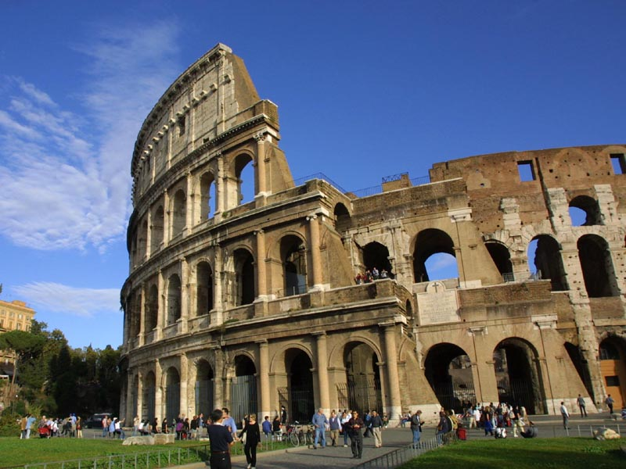
Rome
Rome is a city and special comune in Italy. Rome is the only city in the world to contain in its interior a whole state; the enclave of Vatican City. Monuments and museums such as the Vatican Museums and the Colosseum are among the world's most visited tourist destinations with both locations receiving millions of tourists a year. Rome hosted the 1960 Summer Olympics.

