Slide 1
Hotel “Golden Crown”

Slide 2
The hotel “Golden Crown” is the most famous hotel in Spain. It located in Barcelona on the coast of Mediterranean Sea. The hotel is very beautiful and comfortable. There is a large range of services.

Slide 3
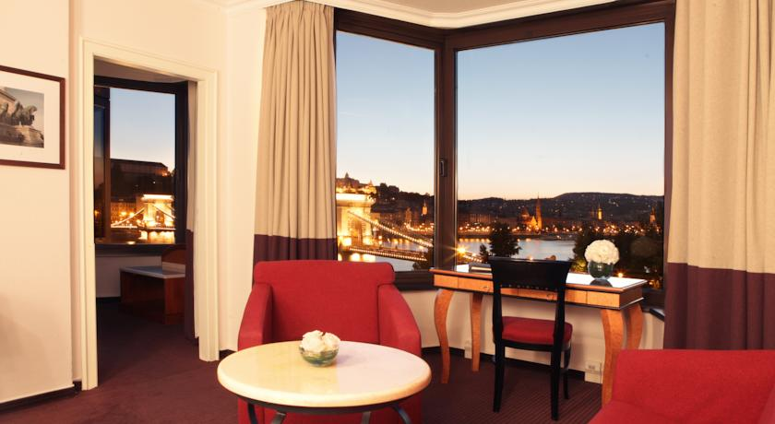
All the stylish rooms at the hotel are equipped with cable TV and free Wi-Fi. It overlooks the sea.

Slide 4
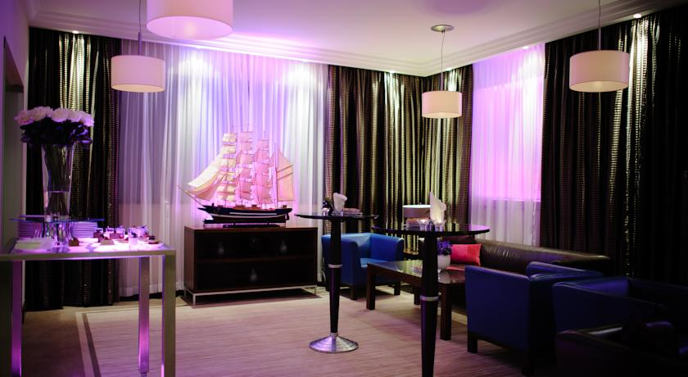

Slide 5
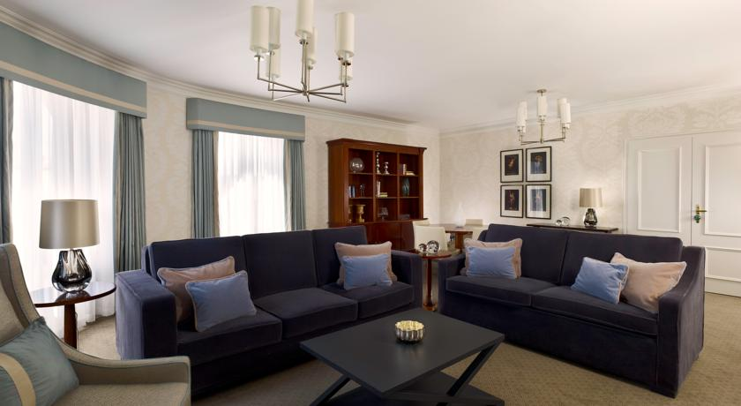

Slide 6
The restaurant serves delicious Spanish cuisine. In addition, the hotel has a bar. The café offers fresh coffee, delicious cakes and desserts. In the morning a rich breakfast "buffet".

Slide 7
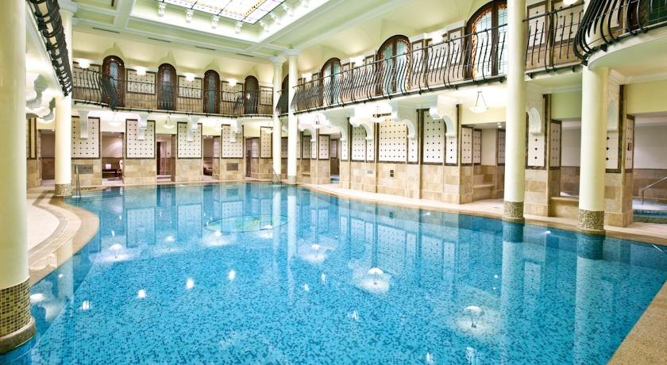
The hotel “Golden Crown” has a large swimming pool.

Slide 8
In the newly opened Royal Spa you can relax in the relaxation areas, saunas, steam baths.

Slide 9
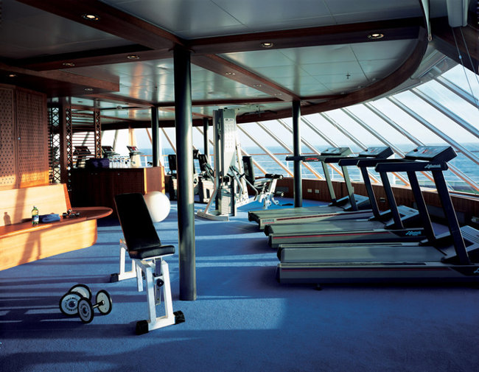
Don’t forget to visit the fitness center.

Slide 10
Type of the rooms. Price
Executive Double Room with sea view – 320$
Classic Double Room with 2 single beds – 150$
Classic Room – 125$
Superior Double Room with 2 single beds and views of the city – 280$
Superior King Room "queen-size“ – 250$
Luxury Double Room with sea view – 350$

Slide 11
WELCOME! We will be glad to see you!

