Slide 1

I and society
The presentation was made
by the pupils of form 10-В
School №5
Kate Zhilavskaya,
Dasha Neteplyk,
Lera Goncharenko

Slide 2

Plan
Aim
I in society
Friends
Classmates
Student-teacher
Parents and children
Brothers and sisters
Society in human life
Conclusion
Source

Slide 3
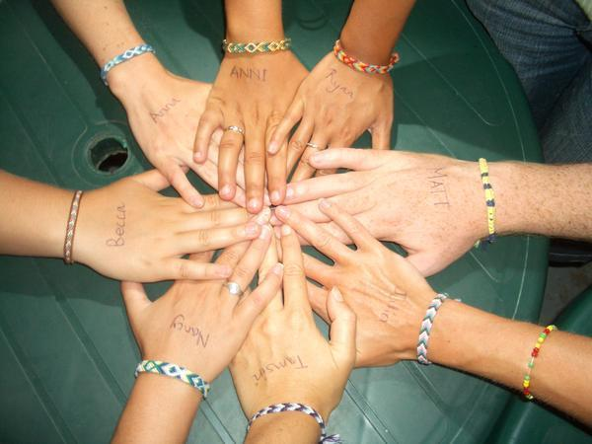
Aim
The aim of our work is to show that friendship is very important in human life.

Slide 4
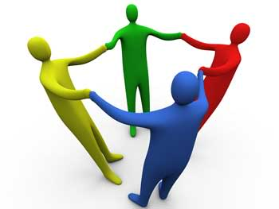
I in society
Everyone likes to communicate. Everyone has friends and acquaintances. And there are the best friends whom you can tell everything. There are classmates, teachers or teachers with pupils and students, parents, brothers and sisters.

Slide 5
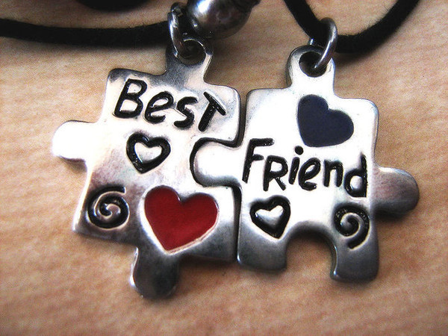
Friends
Friendship - is one soul living in two bodies. With friends you can relax as you like. Friendship is based on reciprocity, friends should support each other. As soon as we realize the importance of friendship, the word 'friend' takes a different meaning, significance and depth. If life is the lottery, then a true friend is a huge prize.

Slide 6
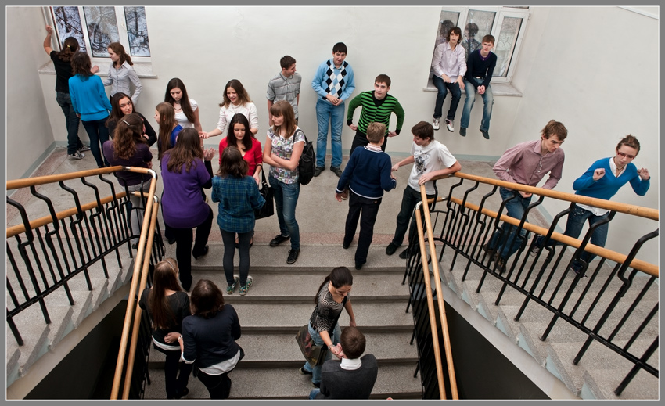
Classmates
Classmates - are the people with whom the teenager spends most of the day, it's his "flock." Therefore particularly important for a teenager is his relationships with classmates. Classmates help each other to do their homework, complete answers to each other in class. Classmates often became good friends.

Slide 7
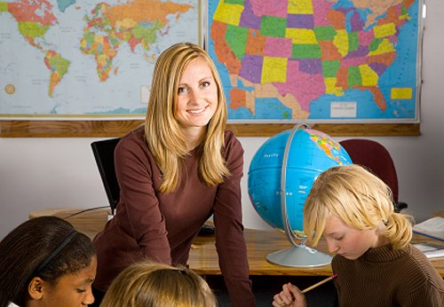
Student-teacher
Student-teacher relationship can be both good and bad. Teachers give us knowledge from the first form. They teach us so that in the future we will become that someone we want to become, not for those who can. Students who relate well to the teachers get more knowledge because they know how to listen and get them the necessary knowledge. After that they become well-educated.

Slide 8

Parents and children
Relationship between parents and children is good in must cases. Girls often tells their secrets to mothers, but boys – he their fathers. You can ask your parents for help and they do everything for you.

Slide 9
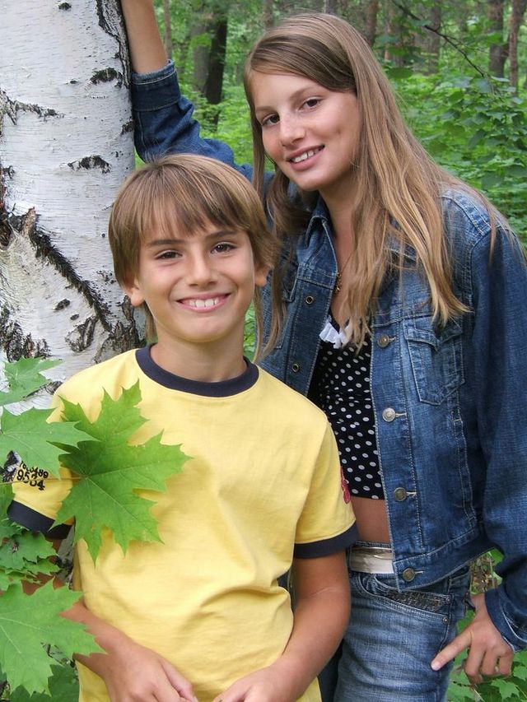
Brothers and sisters
If you have an older brother he always stick up for you, and a sister teaches you how to come out of different situations on your own. Brothers and sisters will always help you. Always someone is competing with someone. Sometimes one child is shy, and another is a sociable, so they complete each other. But at the same time when they are different they can be honest, hard-working, creative.

Slide 10
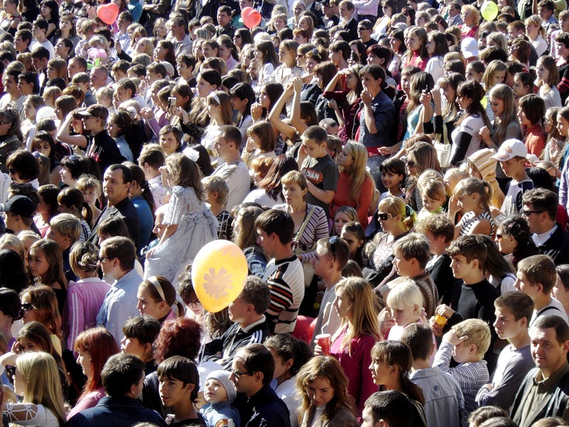
Society in human life
Society is important for a man. Due to society he/she develops his/her ability. He/she can feel different emotions.

Slide 11
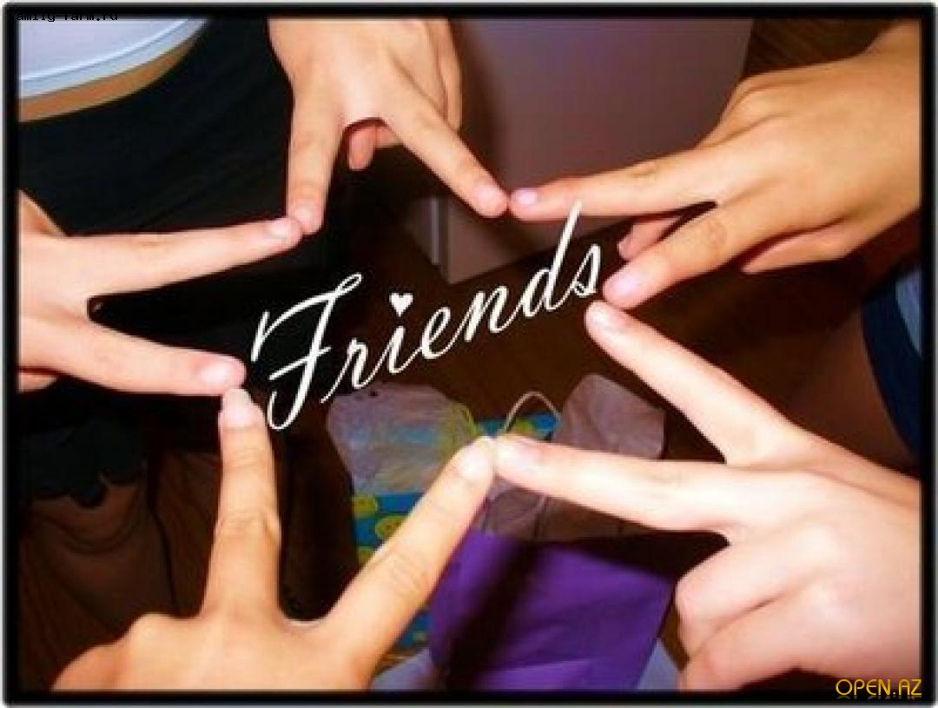
Conclusion:
We can’t live without other people.
Friendship an essential quality of every man.

Slide 12
Source
http://images.yandex.ua/yandsearch?text=%20society
http://images.yandex.ua/yandsearch?text=%20Friends
http://images.yandex.ua/yandsearch?text=%20Classmates
http://images.yandex.ua/yandsearch?text=%20Student-teacher
http://images.yandex.ua/yandsearch?text=%20Parents%20and%20children
http://images.yandex.ua/yandsearch?text=%20Brothers%20end%20sisters

