Slide 1
Mark Twain
(November 30, 1835 – April 21, 1910)

Slide 2
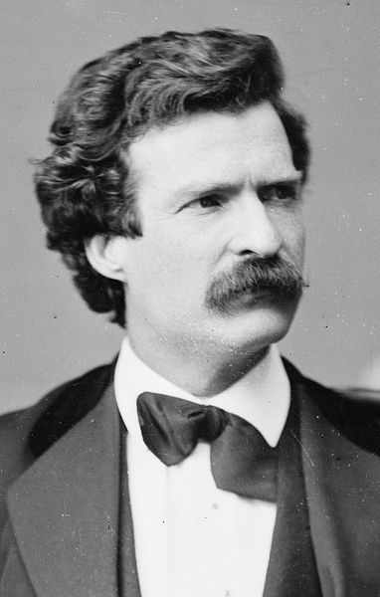
Samuel Langhorne Clemens was born in Florida, Missouri, on November 30, 1835. He was the son of Jane and John Marshall Clemens (1798–1847). His parents met when his father moved to Missouri and were married several years later, in 1823.He was the sixth of seven children, but only three of his siblings survived childhood: his brother Orion (1825–1897), Henry, who died in a riverboat explosion (1838–1858), and Pamela (1827–1904). His sister Margaret (1833–1839) died when he was three, and his brother Benjamin (1832–1842) died three years later. Another brother, Pleasant (1828–1829), died at six months.Twain was born two weeks after the closest approach to Earth of Halley's Comet.

Slide 3
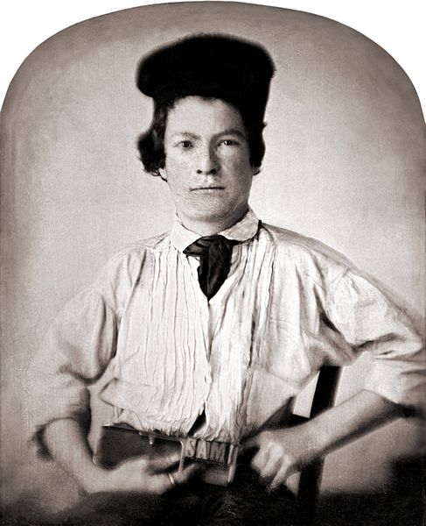
In 1847, when Twain was 11, his father died of pneumonia.The next year, he became a printer's apprentice. In 1851, he began working as a typesetter and contributor of articles and humorous sketches for the Hannibal Journal, a newspaper owned by his brother Orion. When he was 18, he left Hannibal and worked as a printer in New York City, Philadelphia, St. Louis, and Cincinnati.

Slide 4
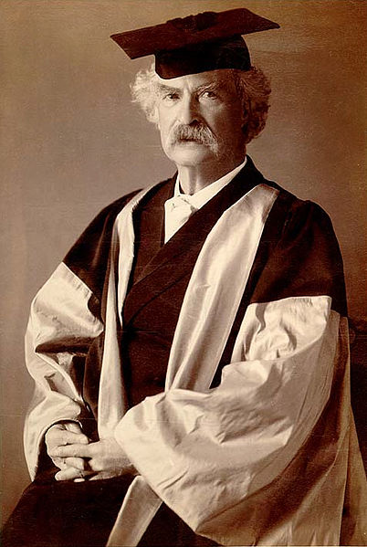
Throughout 1868, Twain and Olivia Langdon corresponded but she rejected his first marriage proposal. Two months later, they were engaged. In February 1870, Twain and Langdon were married in Elmira, New York, where he had courted her and overcome her father's initial reluctance. She came from a "wealthy but liberal family," and through her he met abolitionists, "socialists, principled atheists and activists for women's rights and social equality,"

Slide 5
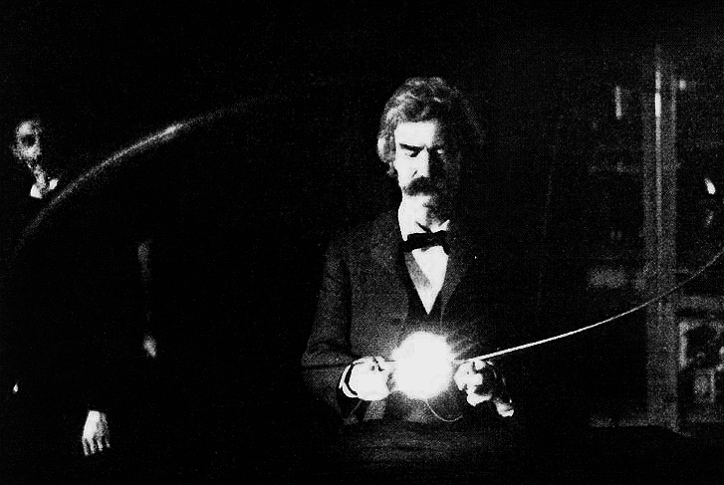
Twain was fascinated with science and scientific inquiry. He developed a close and lasting friendship with Nikola Tesla, and the two spent much time together in Tesla's laboratory.

Slide 6
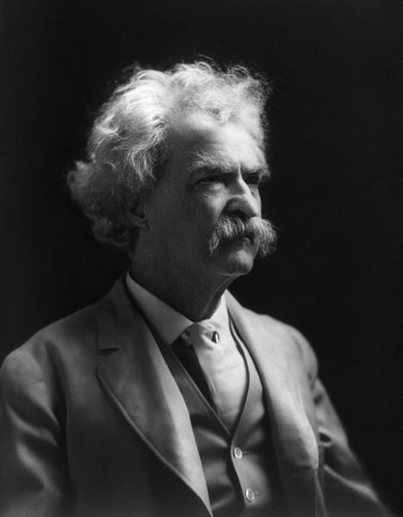
His prediction was accurate—Twain died of a heart attack on April 21, 1910, in Redding, Connecticut, one day after the comet's closest approach to Earth.
Twain's funeral was at the "Old Brick" Presbyterian Church in New York. He is buried in his wife's family plot at Woodlawn Cemetery in Elmira, New York. The Langdon family plot where he is buried is marked by a 12-foot (two fathoms, or "mark twain") monument, placed there by his surviving daughter, Clara. There is also a smaller headstone. Although he expressed a preference for cremation, he acknowledged that his surviving family would have the last word.

