Slide 1
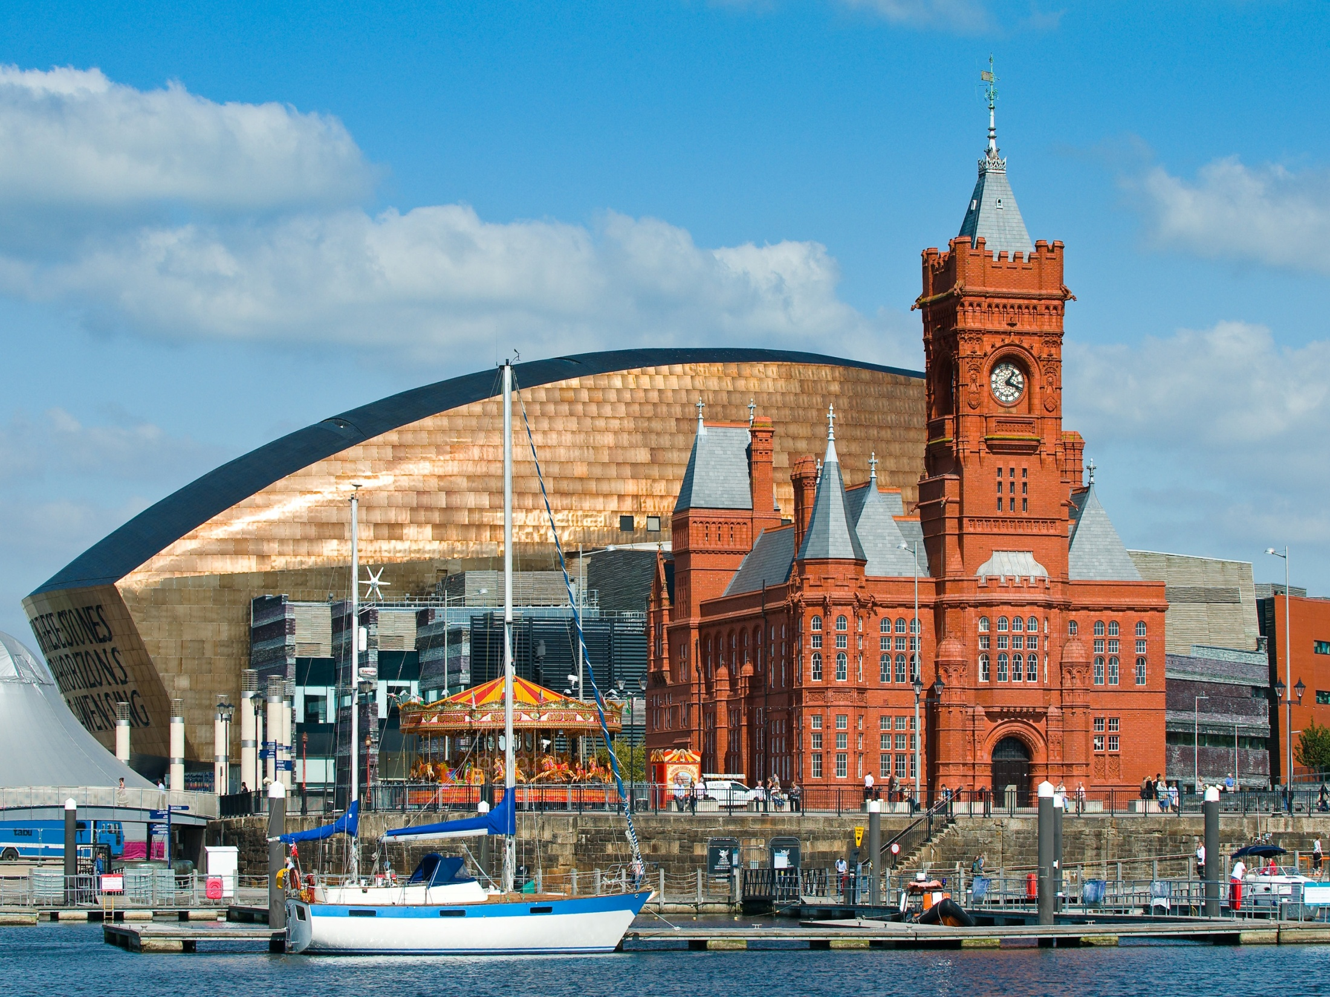
Cardiff

Slide 2
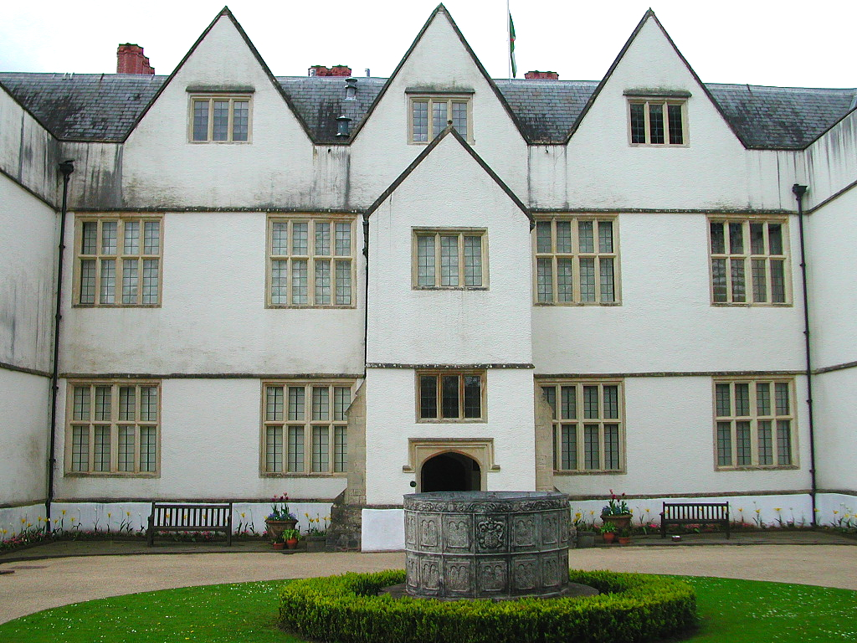
The National History Museum, St Fagans

Slide 3
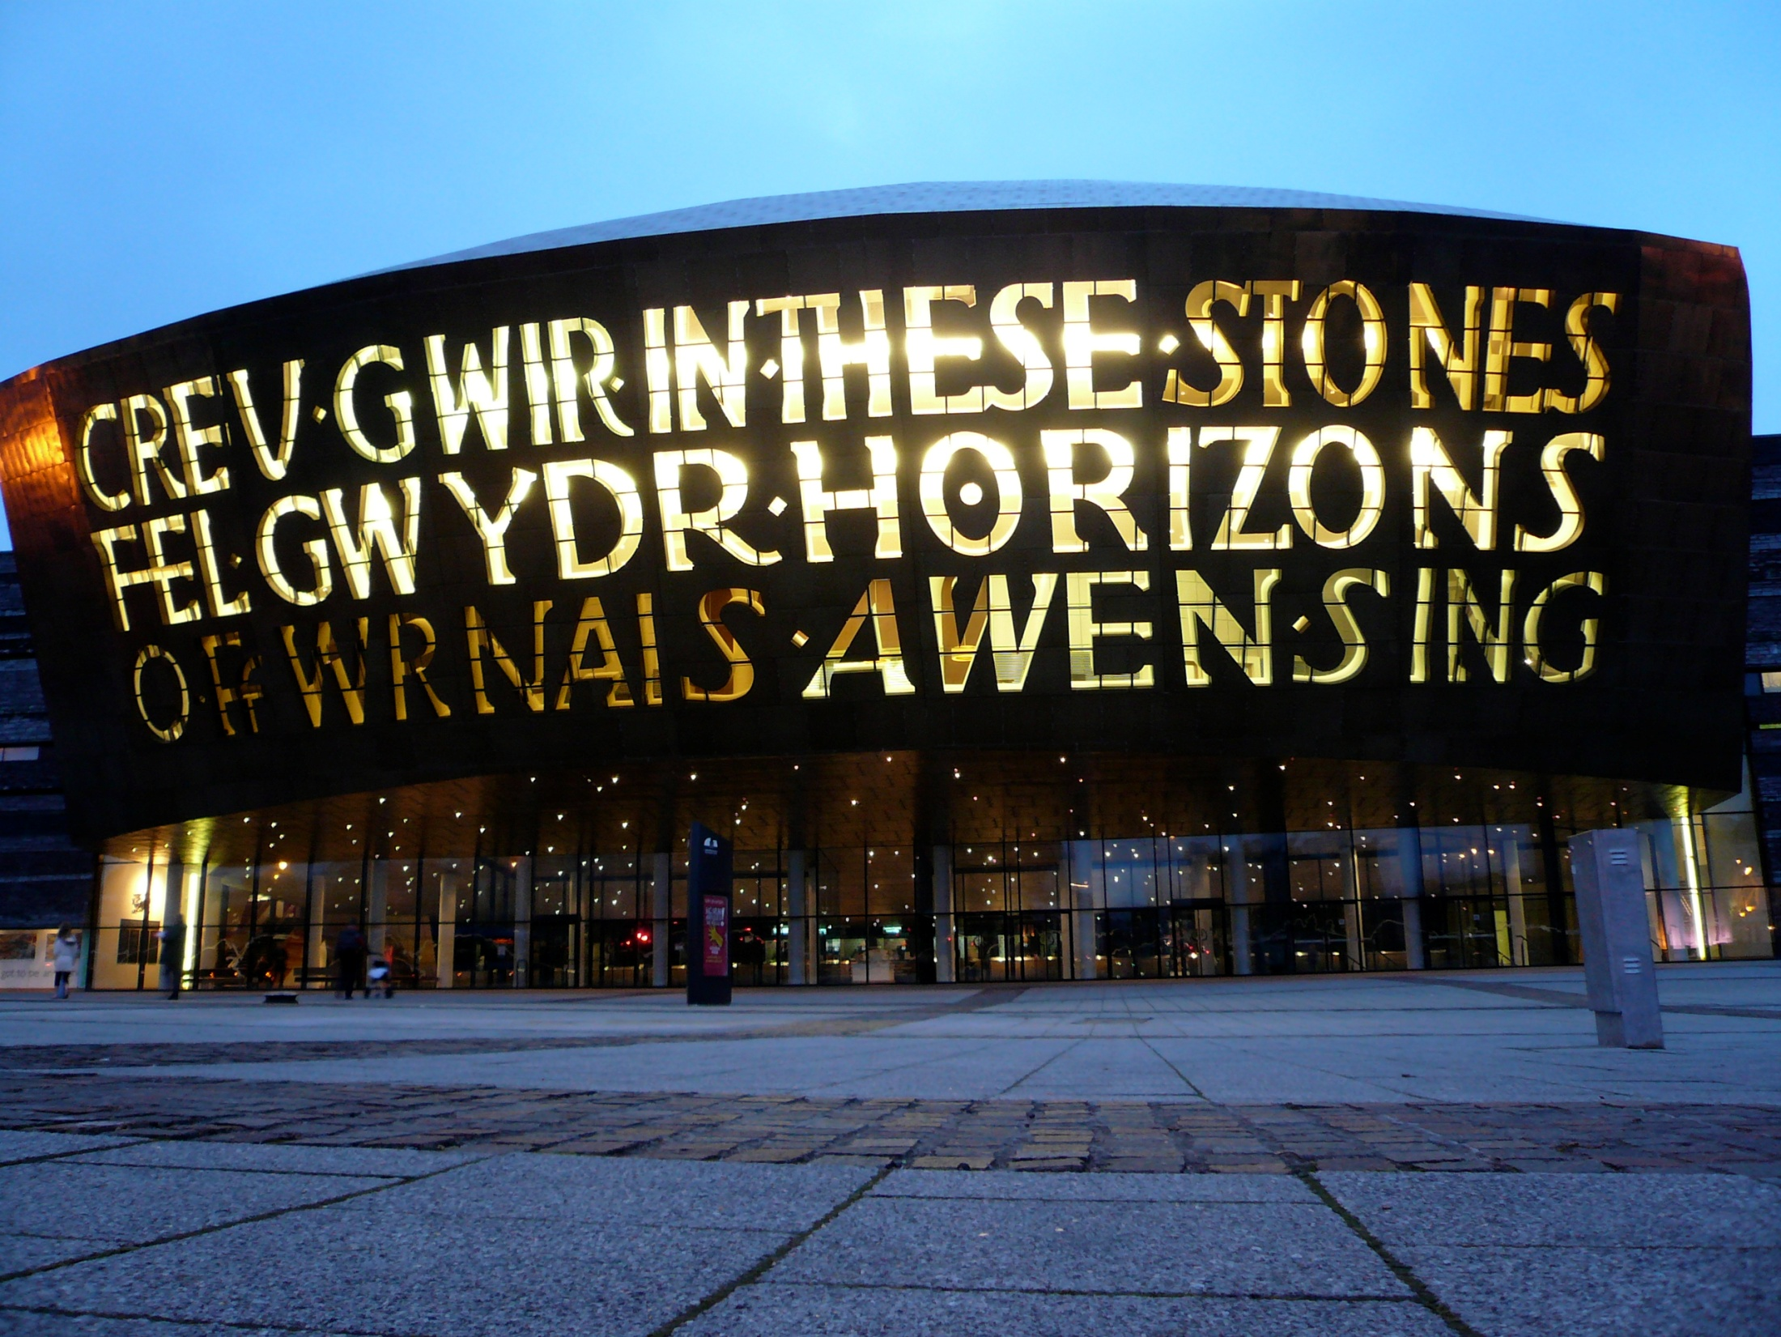
Wales Millennium Centre

Slide 4
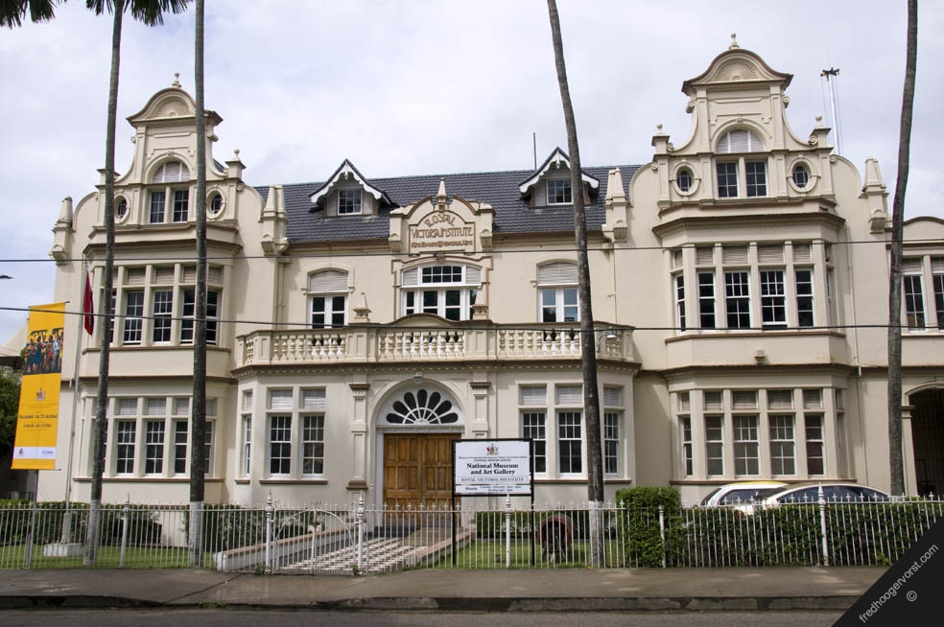
National Museum and Art Gallery

Slide 5
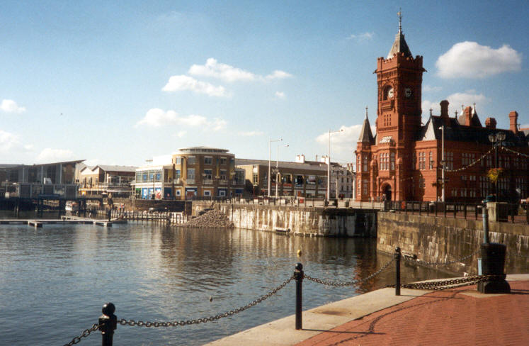
Cardiff Bay

Slide 6
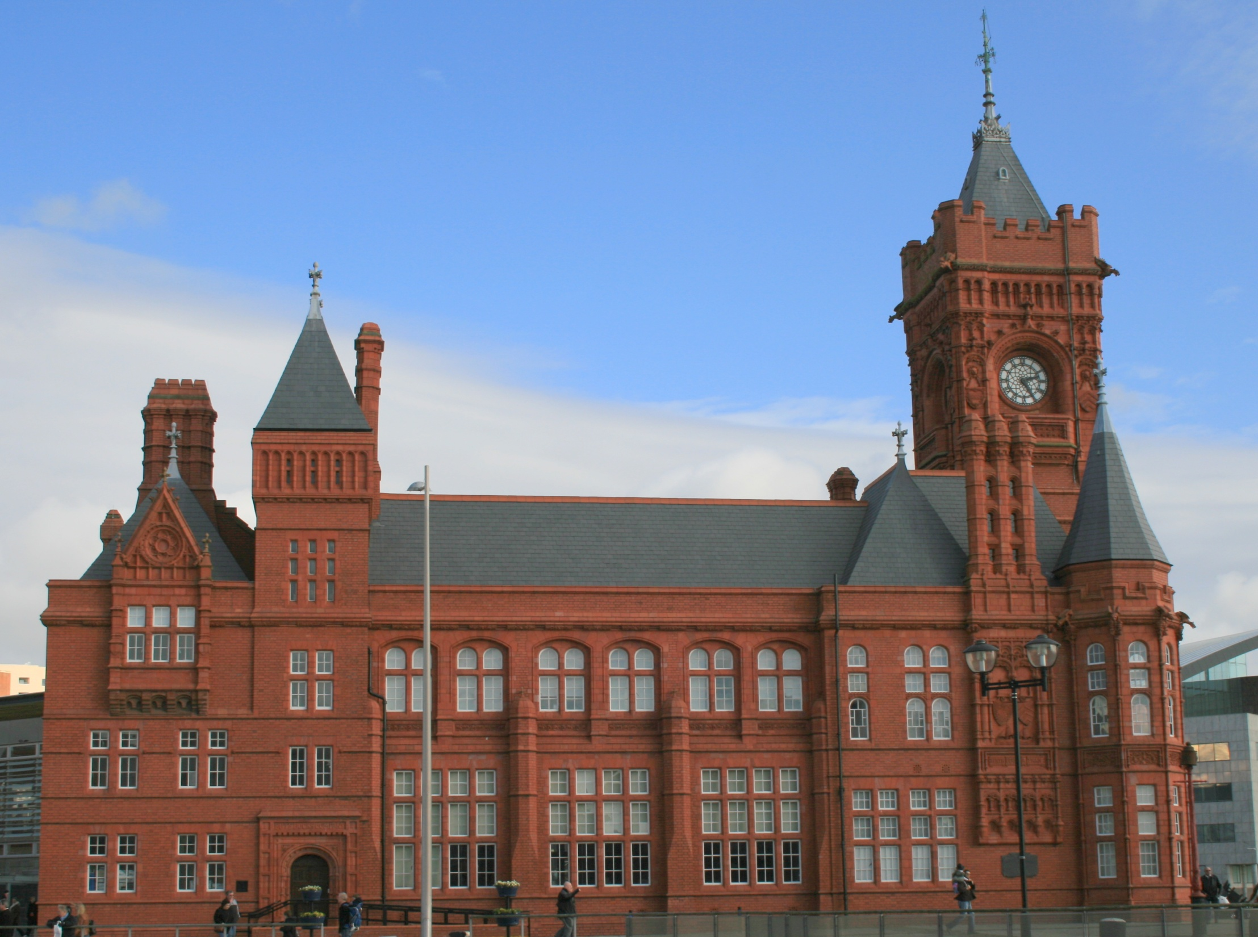
The Pierhead Building

Slide 7
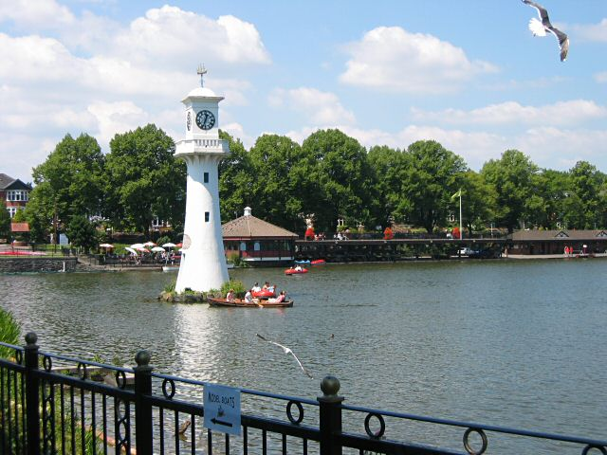
Roath Park

Slide 8
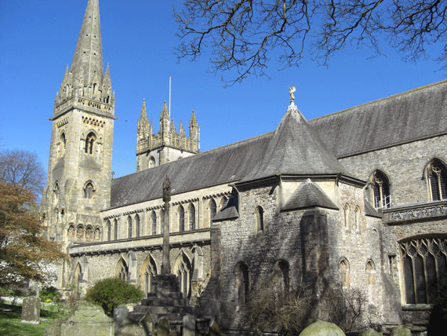
Llandaff Cathedral

Slide 9
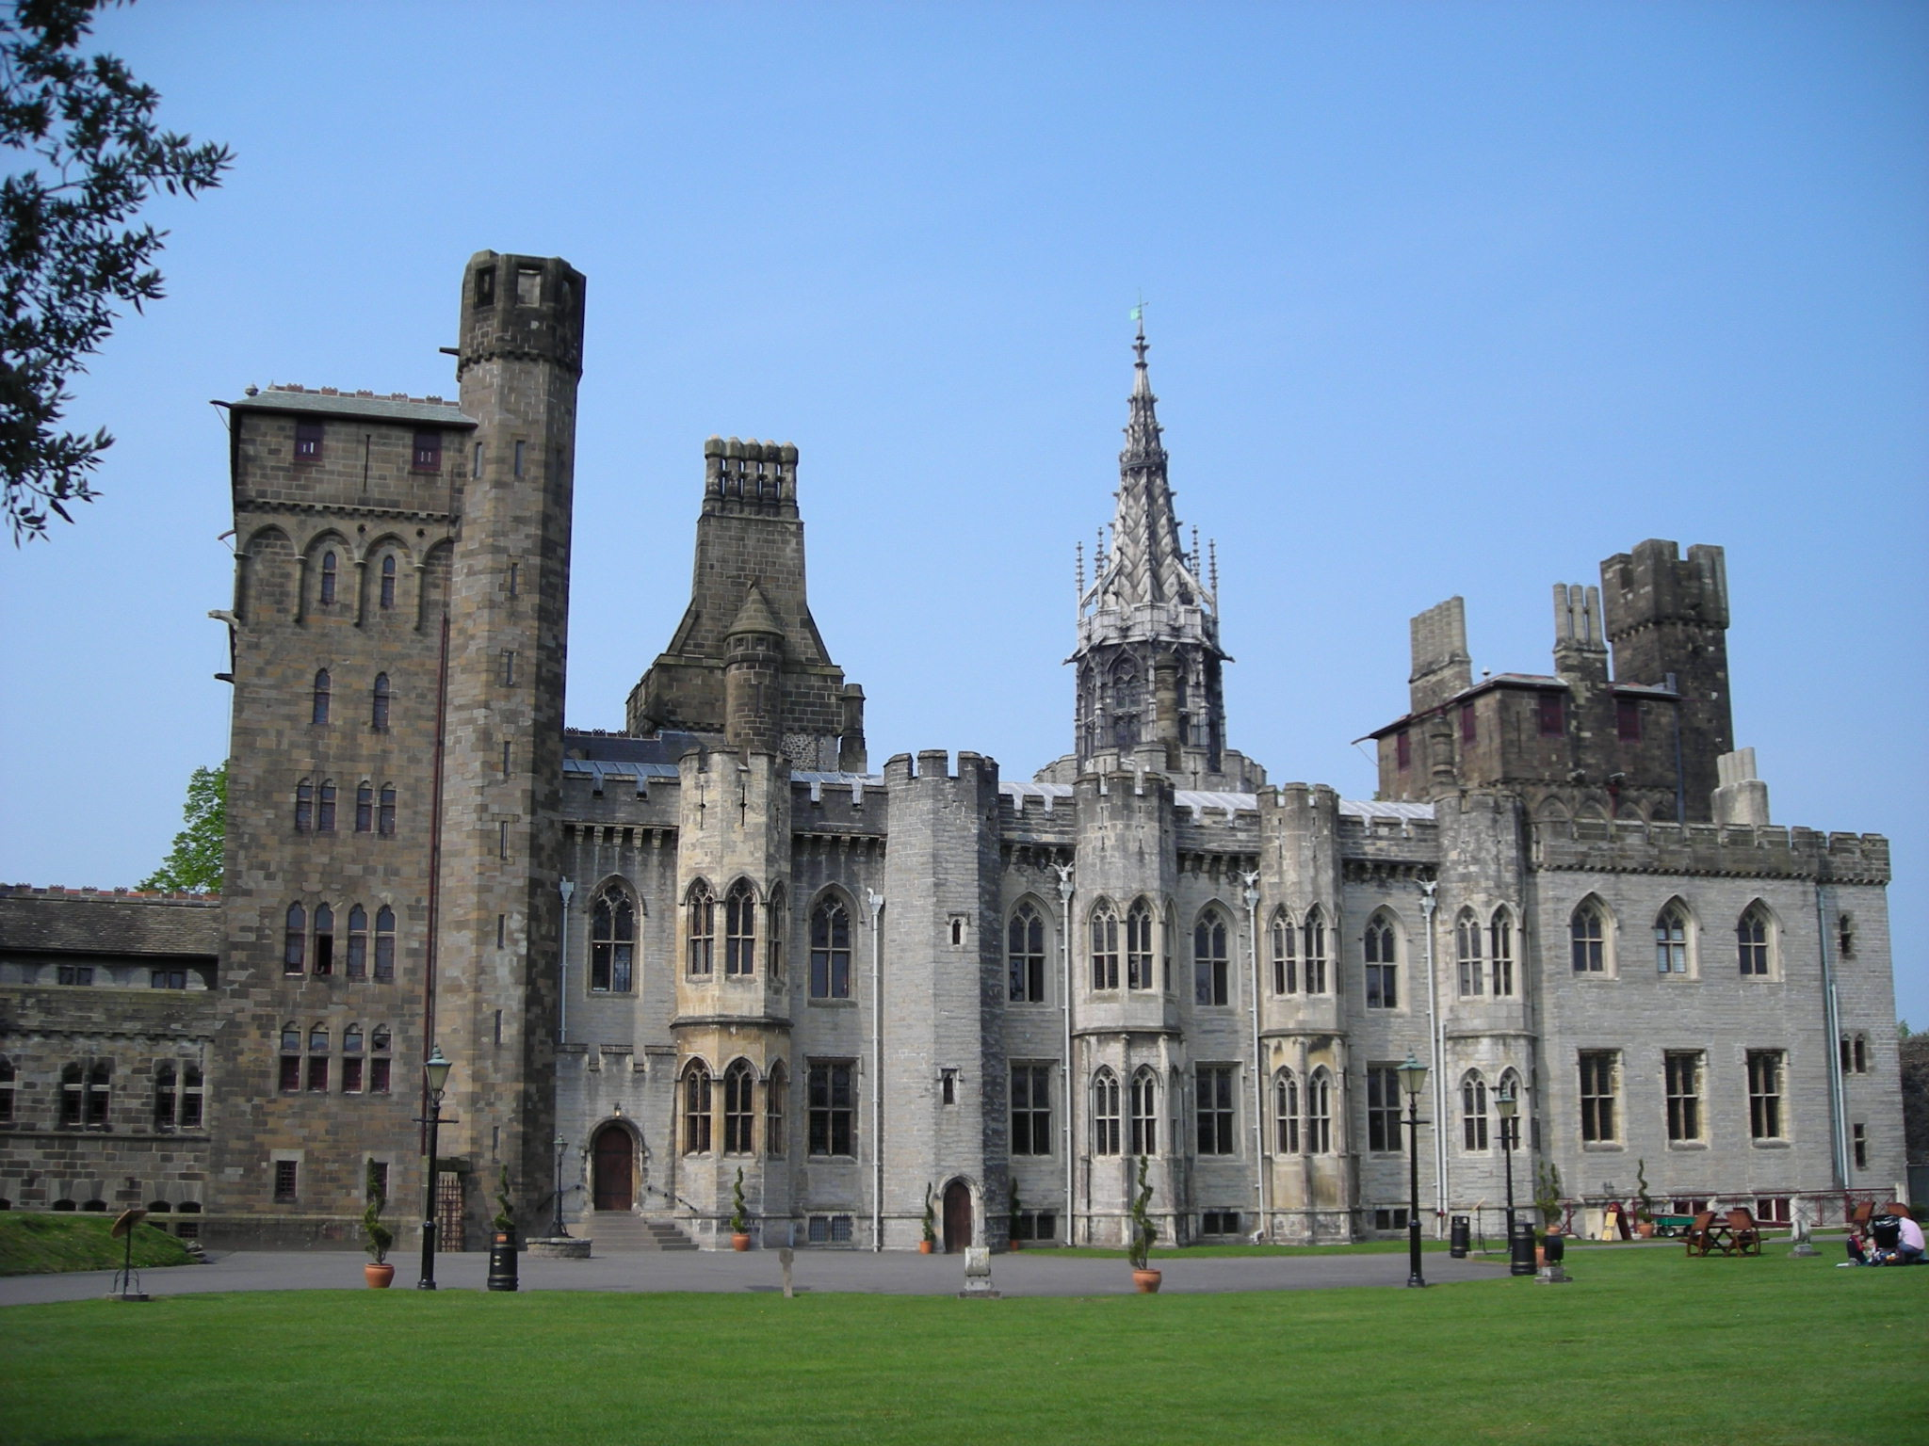
Cardiff Castle

Slide 10
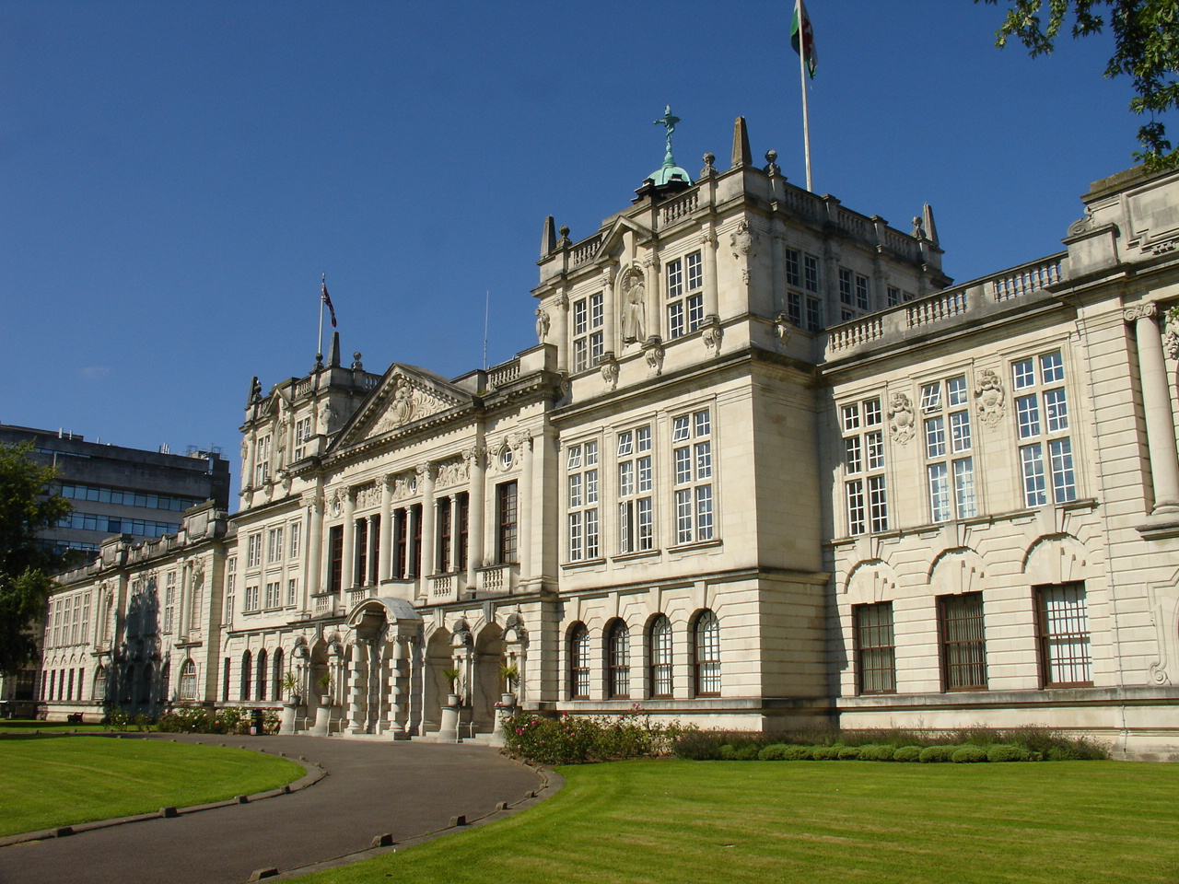
Cardiff University

