Slide 1
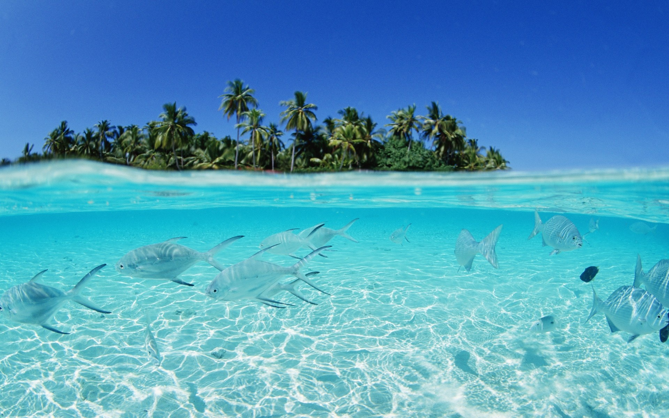
Paradise on the Earth.
The Maldives.
By Sheveleva Mariya 11-A form

Slide 2
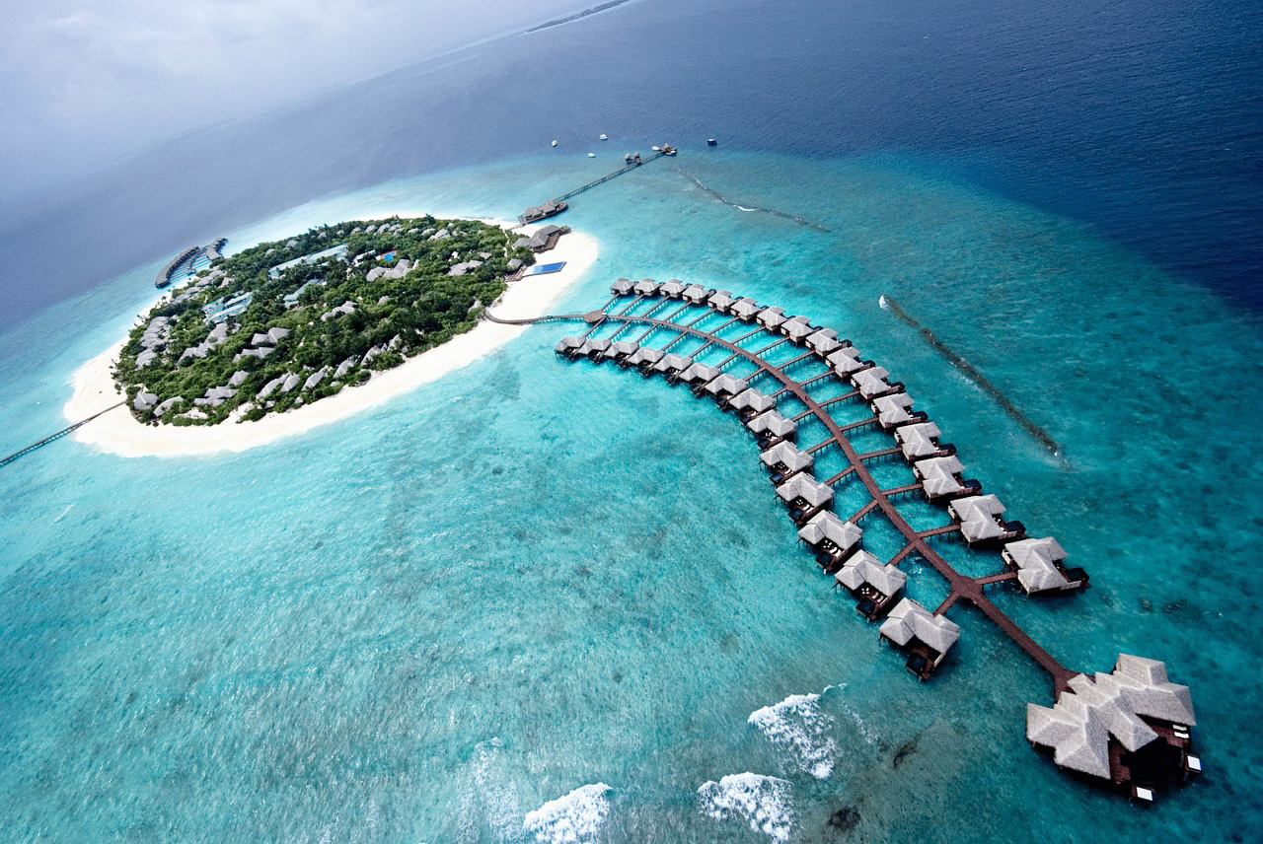
The average upland of the Maldives above the sea level is 1.5 m. The Maldives is the most low-lying country in the world. Interestingly, the highest point in the country is only 2.3 meters!

Slide 3
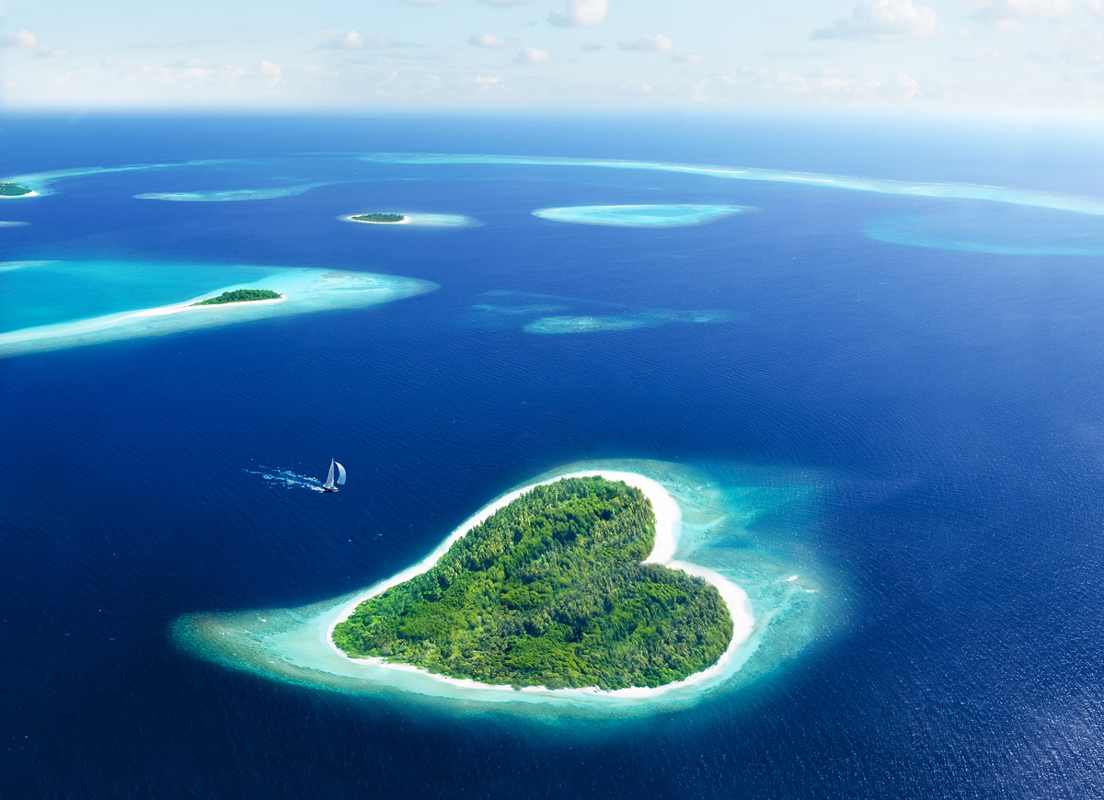
Only 200 of the 1,192 islands are inhabited by people. Population of the country is about 320 thousand people. More than 30% of the population lives in the Maldives’ capital – Male.

Slide 4
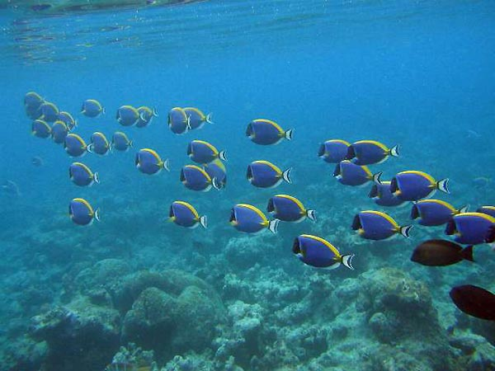
About 2,000 kinds of fishes were found in coastal waters of the Maldives. There are 300 kinds of reef fish, including 7 kinds that were not found in other places of the world ocean.

Slide 5
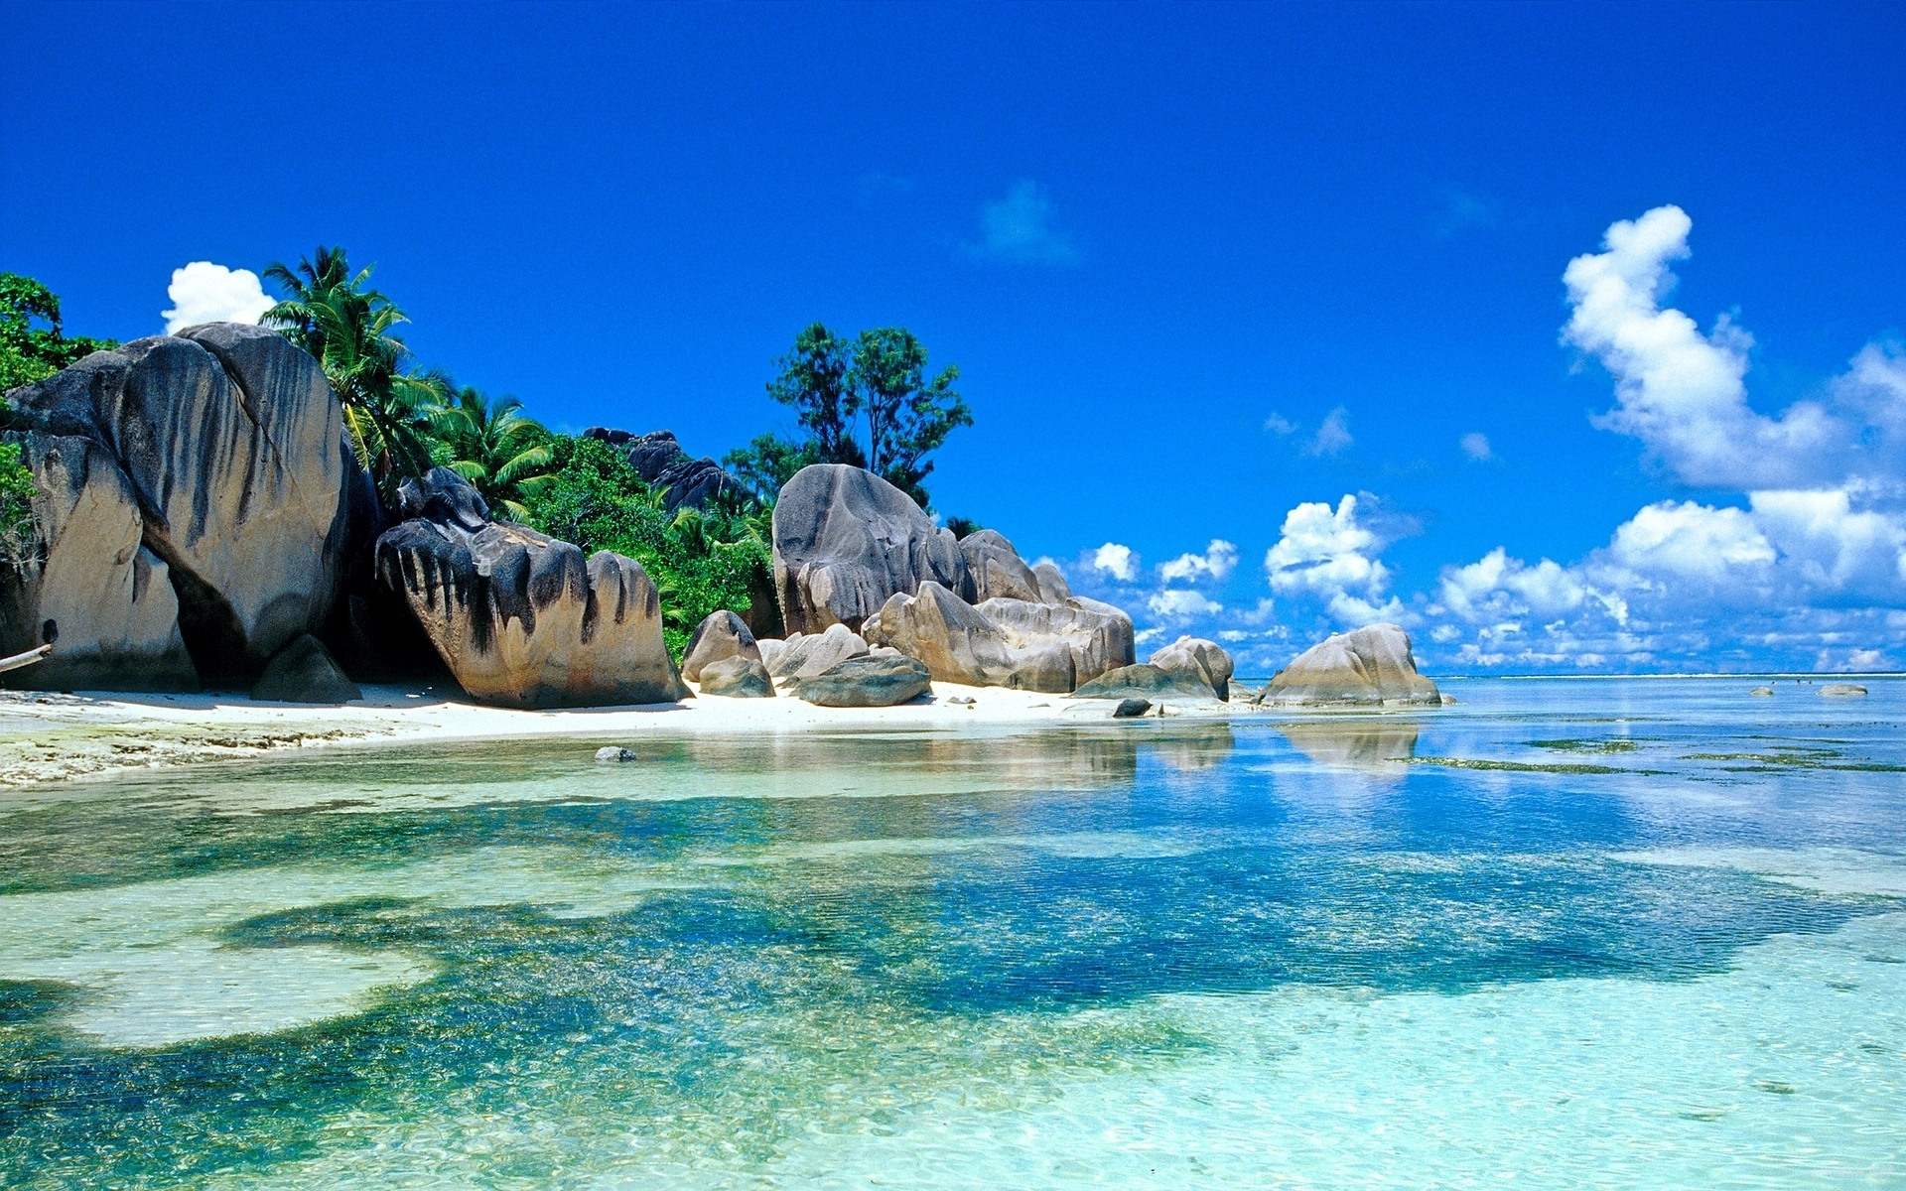
Adult’s level of literacy on the Maldives is about 99%, which is one of the highest rates in the world.

Slide 6
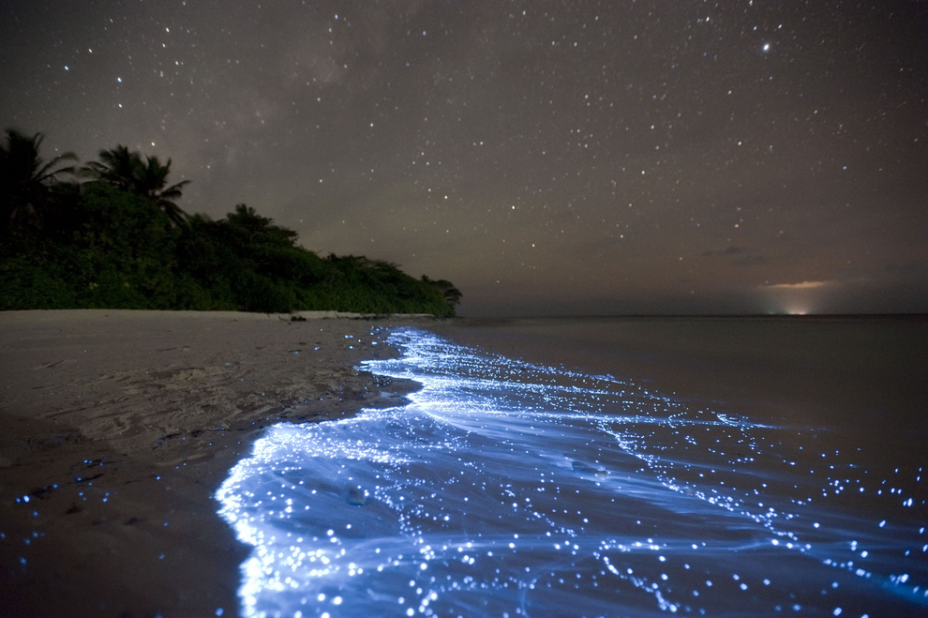
On the Maldives you can see this fantastic phenomenon. Unique luminous waves on the Maldives are explained by bioluminescence - chemical processes in animals' organisms when liberated energy is released in the form of light. It seems that stars are reflecting from the sky in the sea.

Slide 7
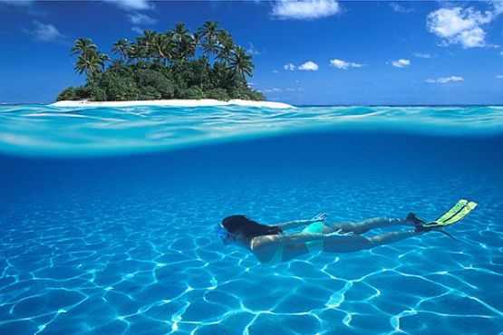
Maldives is the first country in the world, which held an official meeting of the President and the Government under water. This meeting was held to attract the attention to global changes of climate, which can raise the water level in the oceans.

Slide 8
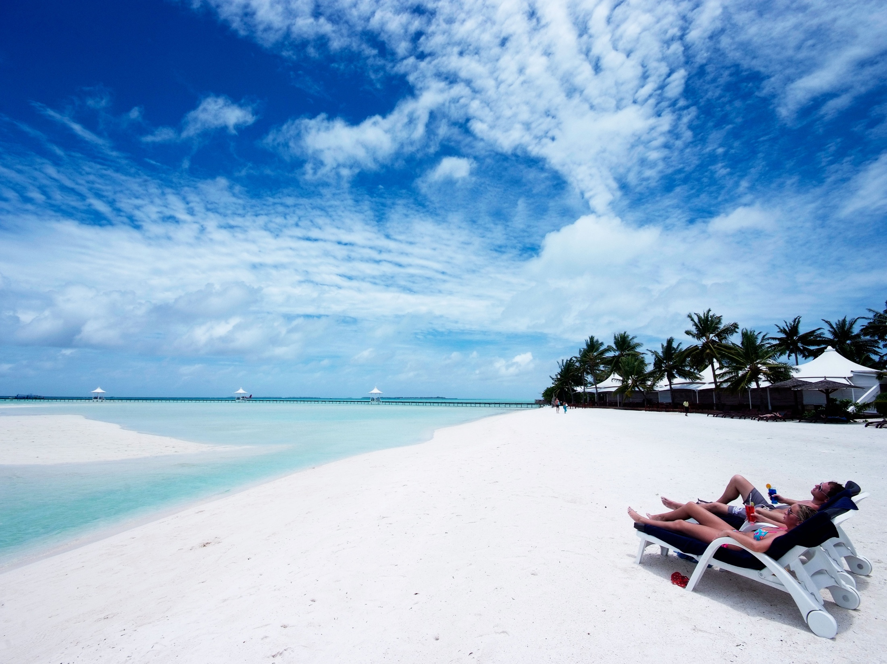
The weather on the Maldives is very favorable for tourism. The temperature varies between 24-33 ° C throughout the year. From June to August on the islands there is the rainy season.

Slide 9
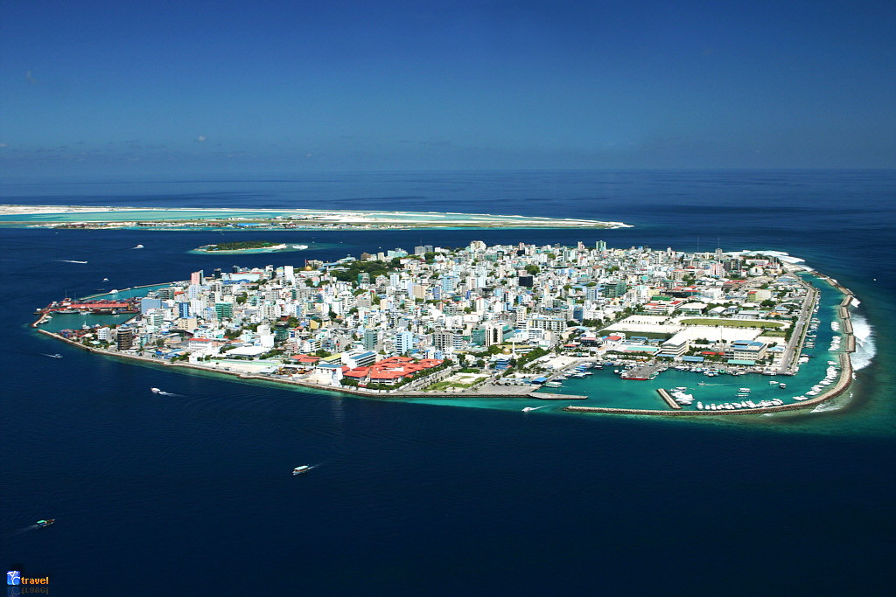
The capital of the Maldives Male is one of the most densely populated capitals in the world. On the island size of 2 to 1 km live more than 110 thousand of people.

Slide 10
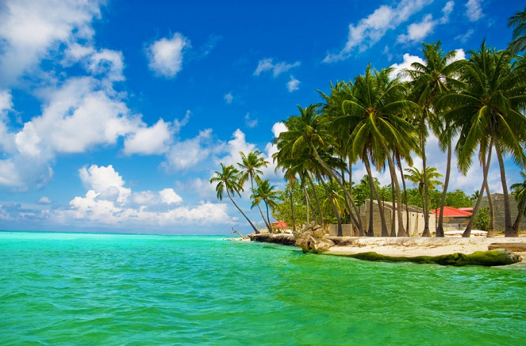
There are no rivers and other freshwater sources on any island of the Maldives.

Slide 11
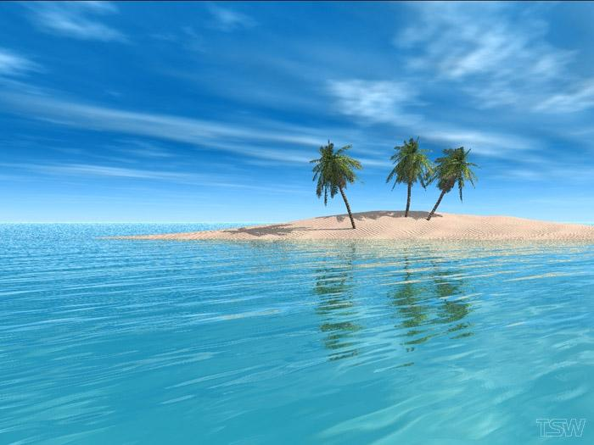
Thank you for your attention

