Slide 1
Art museums of London

Slide 2
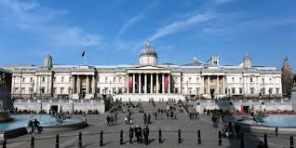
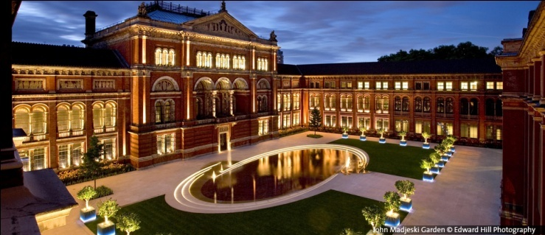
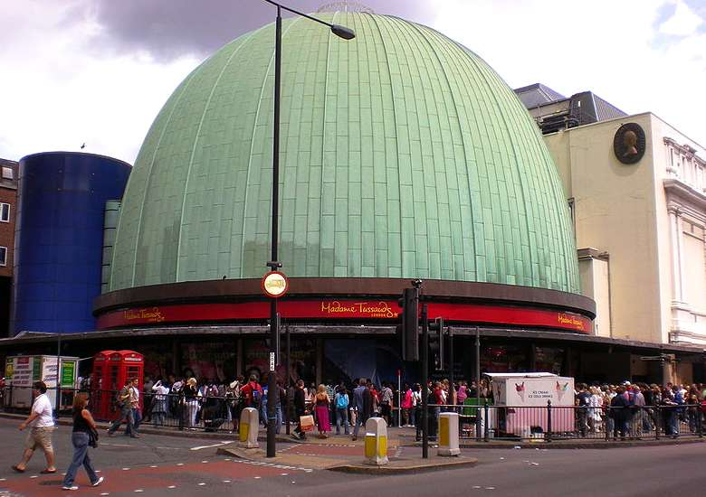
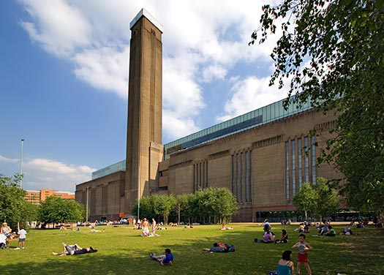
You will see:
Museum Tate Modern;
London's National Gallery;
Victoria and Albert Museum;
Madame Tussauds.

Slide 3
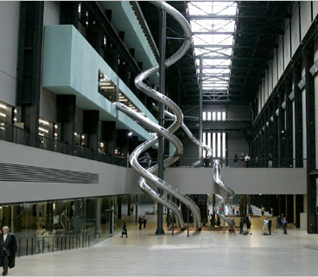
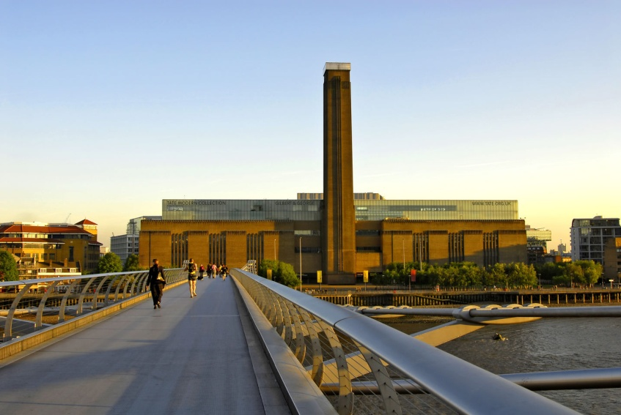
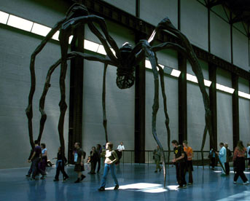
Museum Tate Modern
Tate Modern gallery is located in a former building of the impressive power, the Tate Modern is a one of the best museums of modern art in the world. It is a picture of such influential artists as Henri Matisse and Andy Warhol. The works are grouped into four thematic exhibitions - landscape, still life, nude, story. .

Slide 4
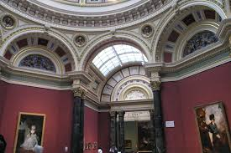
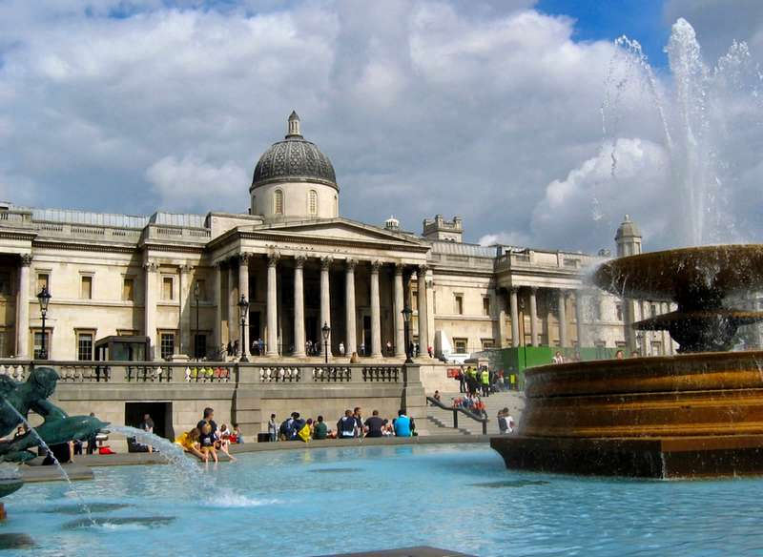
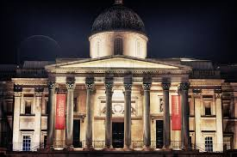
London's National Gallery
In the Gallery of paintings
by Western artists of the period 1260-1900 years.
All pictures are presented in chronological order.

Slide 5
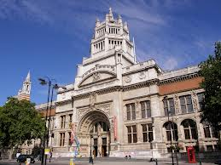
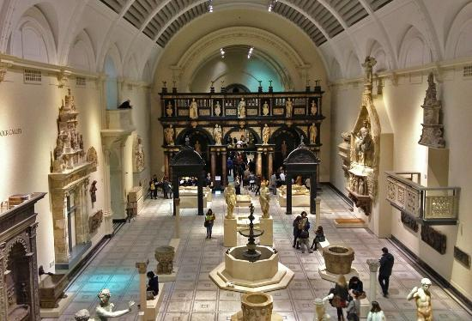
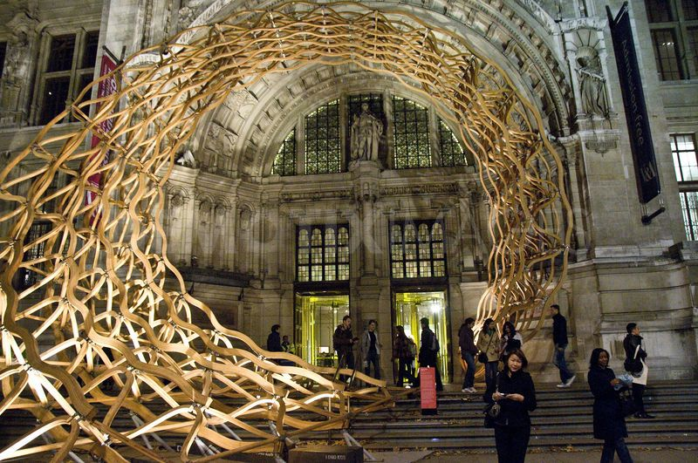
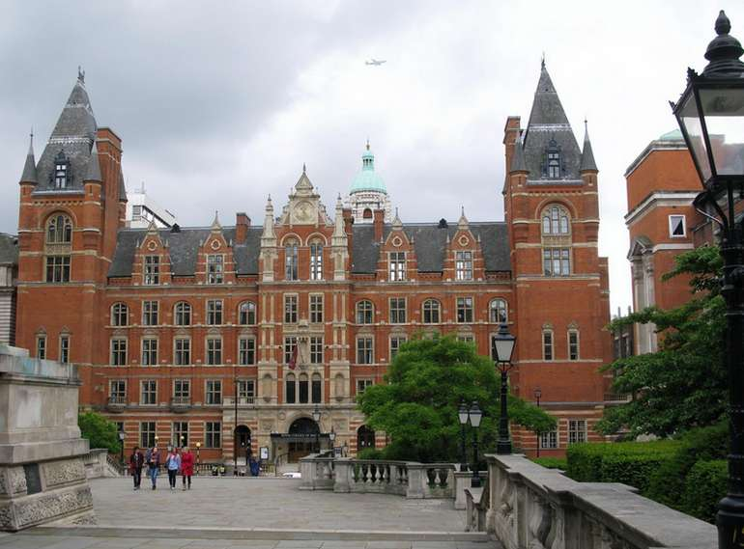
Victoria and Albert Museum
Victoria and Albert Museum - One of the leading exhibition houses arts and crafts. The highlight of the collection was the "glass" gallery with its amazing staircase made ​​of glass. As well it will be able to learn the art of India, China, Japan, Korea and many others.

Slide 6
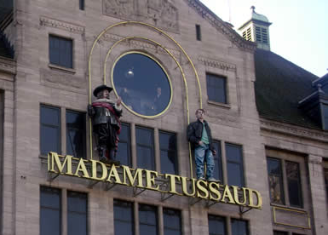
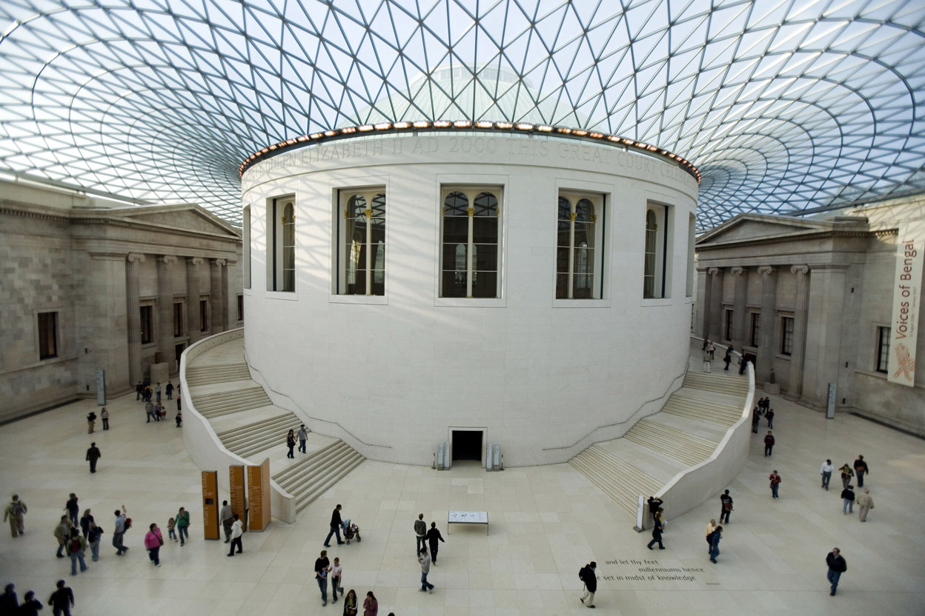
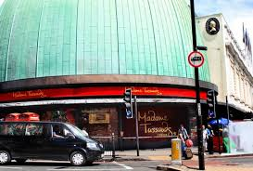
Museum Madame Tussauds
This is a legendary place that attracts the attention of absolutely everyone. Wax Museum Madame Tussaud figure - it is an opportunity to get closer to their idols and to assess how the wax copies are similar to their favorite actors and musicians.

Slide 7
Work
Larissa Sidorenko
student 9 - G -2 class
Lyceum of Informational Technologies
The end!

