Slide 1
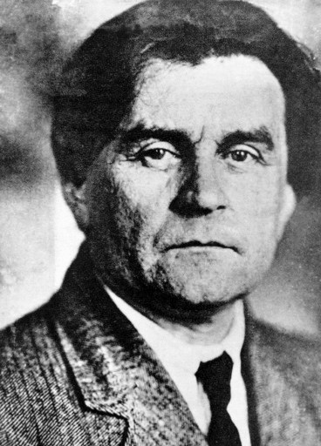
Kazimir Malevich
23.02.1879-15.05.1935

Slide 2
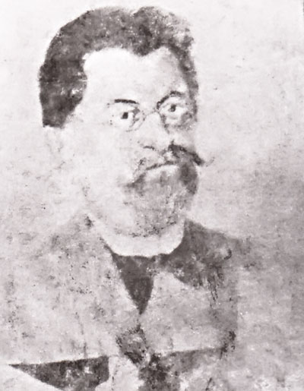
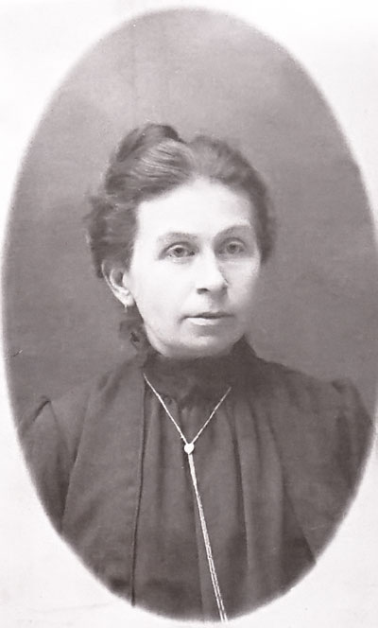
Family and childhood
Kazimir Malevich was born near Kiev,Ukraine.
His parents, Seweryn and Ludwika Malewicz, were ethnic Poles.
Kazimir was the first of 14 children, only nine of whom survived into adulthood.
His family moved often and he spent most of his childhood in the villages.

Slide 3
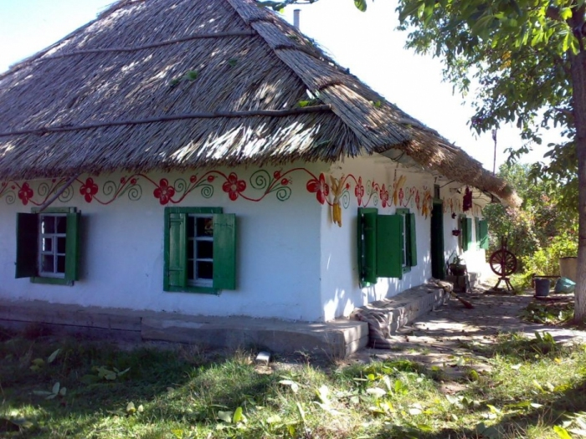
Art in his life
Until age 12 he knew nothing of professional artists, though art had surrounded him in childhood.
He enjoyed embroidery, and in decorated walls and stoves.
He was able to paint in the style.
He studied drawing in Kiev from 1895 to 1896.

Slide 4
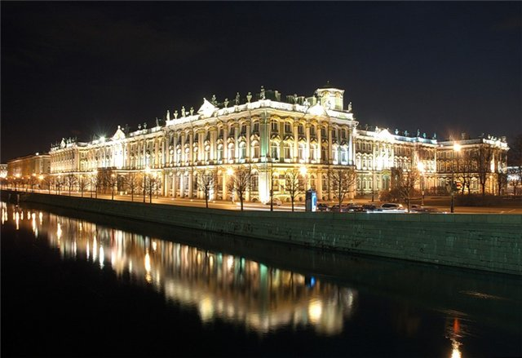
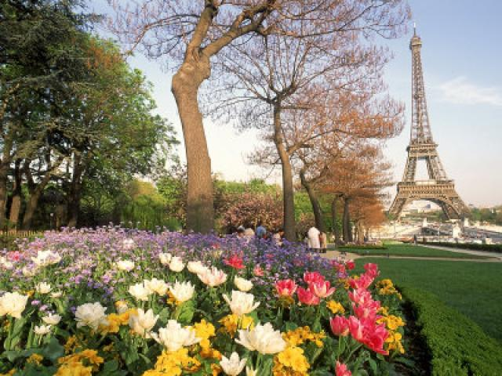
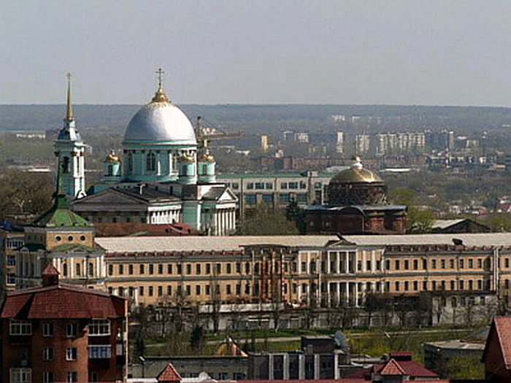
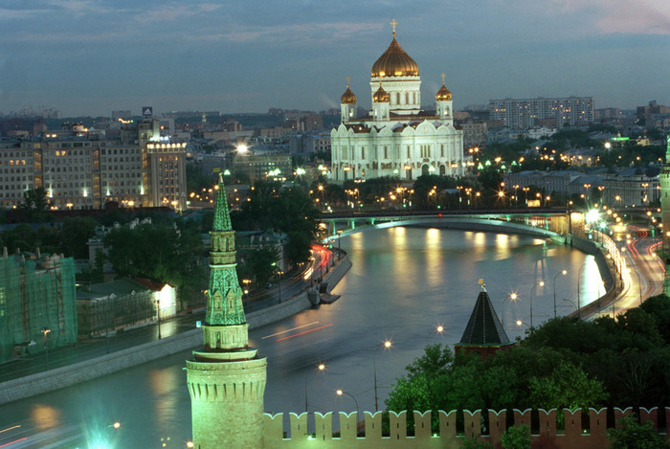
Profession life
In his life, Kazimir Malevich lived in Kursk, in Moscow, where he studied at the School of Painting.
Malevich exhibited his works in Paris, in St. Petersburg, in Moscow.

Slide 5
Suprematism
Malevich is a founder of Suprematism.
Famous examples of his Suprematist works include Black Square and White On White.
He wrote the book The World as Non-Objectivity.
Many of his works were confiscated and he was banned from creating and exhibiting similar art.

Slide 6
achievements
Malevich supported love of life and love of nature.
Malevich said that "art does not need us, and it never did".
He was awarded the highest category "1A - a world famous artist" in "United Art Rating".

Slide 7
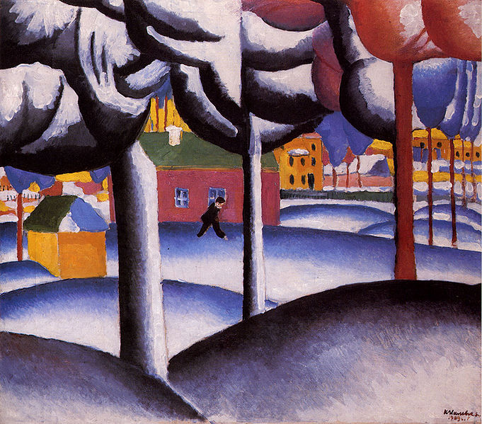
Winter 1909

Slide 8
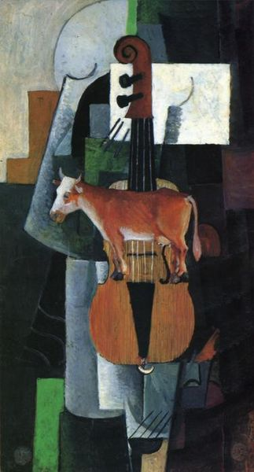
Cow and Fiddle 1913

Slide 9
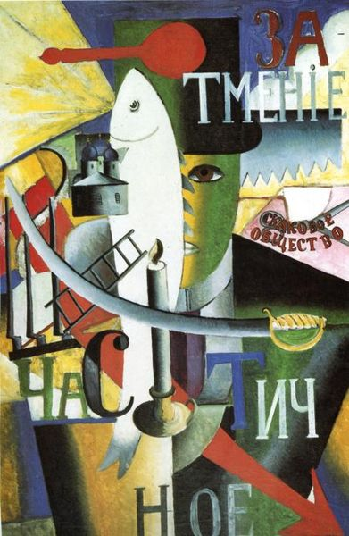
Englishman in Moscow 1914

Slide 10
Black circle signed 1913, painted 1915

Slide 11
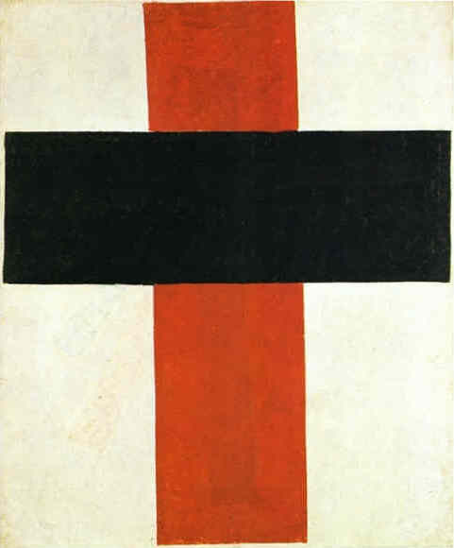
Suprematism 1921-1927

Slide 12
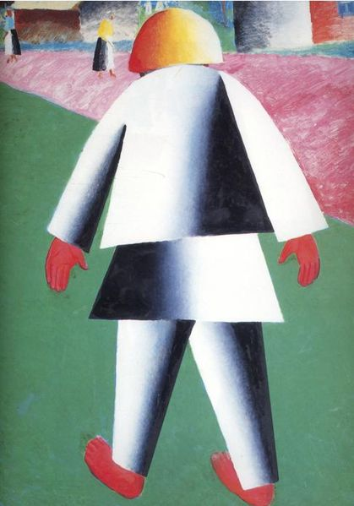
Boy 1928-1932

Slide 13
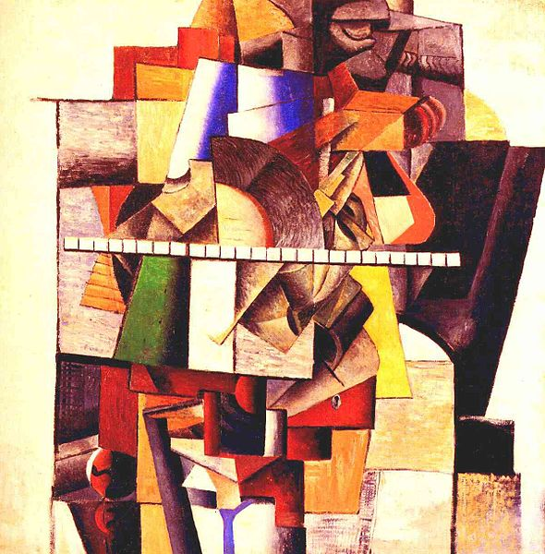
Portrait of Matiushin 1913

Slide 14
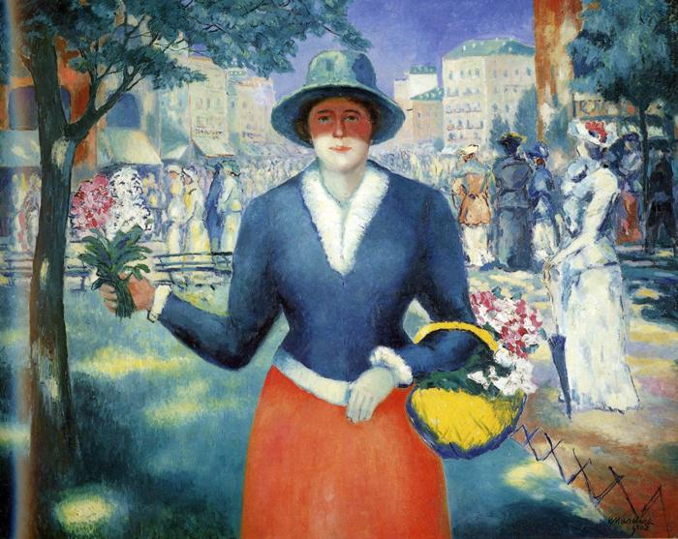
Flower Girl 1903

Slide 15
Thank you for your attention !!!

