Slide 1
Presentation National Culture of Ukraine
XTL-11a
By Denis Danilenko

Slide 2
Ukrainian culture has a long history, it has evolved into complex historical conditions for centuries. Creating their own cultural values, the Ukrainian people absorbed the customs and traditions of many nations, whose fate was linked to the history of Ukraine.

Slide 3
Great influence on the culture of the Ukrainian people had Greek, Roman and Byzantine culture, through which culture of Ukraine has gained much knowledge and skills.

Slide 4
Despite the variety of different sources of world culture, Ukrainians have established their identity, not similar to any other, distinct culture. Culture of Ukraine reflects the uniqueness of the spiritual world of the people, surrounding nature and specifics of traditions and customs.

Slide 5
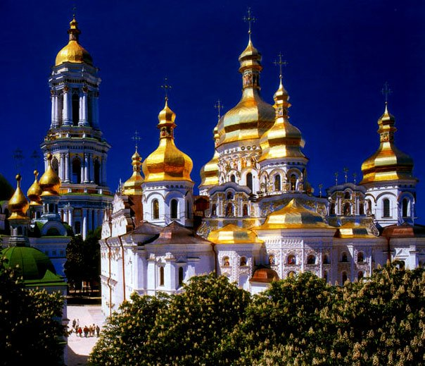
An important event that determined for centuries artistic and spiritual development of Ukrainian culture in the adoption of Christianity in 988.

Slide 6
The beginnings of Ukrainian writing date back to 13-14 centuries. - Galicia-Volyn and Lithuanian Chronicle. The first printed book in Ukraine began in the early 16th century, in the 17th century opened the Kiev-Mohyla Academy - the first Orthodox University. And in the 18th century Ukrainian national culture began its rapid development.

Slide 7
The most important contribution to world culture through Ukraine has made its literature, art, music, cinema. Ukraine is a home of the world-famous poet and artist Taras Shevchenko; philosopher, poet and educator Gregory Pans; writer Michael Kotsyubinskiy; Ilya Repin; composer and musical public figure Mykola Lysenko. In addition, the great Russian writers such as Nikolai Gogol, Anna Akhmatova, Vladimir Korolenko, who were natives of Ukraine.

Slide 8
For many centuries the culture of Ukraine has developed as folk. Farmers, artisans, Cossacks have become real creators and bearers of culture. Great place it held oral folklore (songs, stories, tales, legends, proverbs and sayings), folk dancing, arts and crafts.

Slide 9
Thank You For Attention!

