Slide 1
Petrykivka style of painting

Slide 2
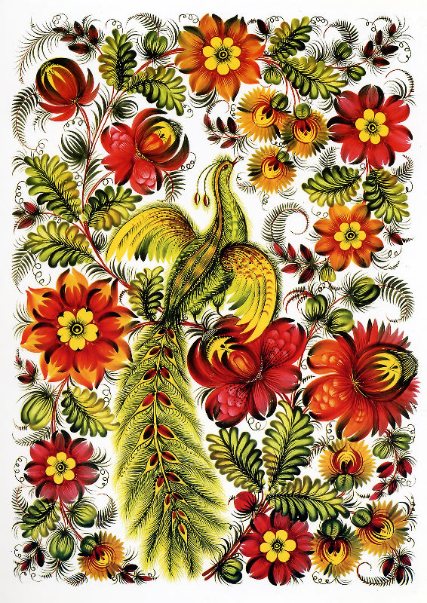
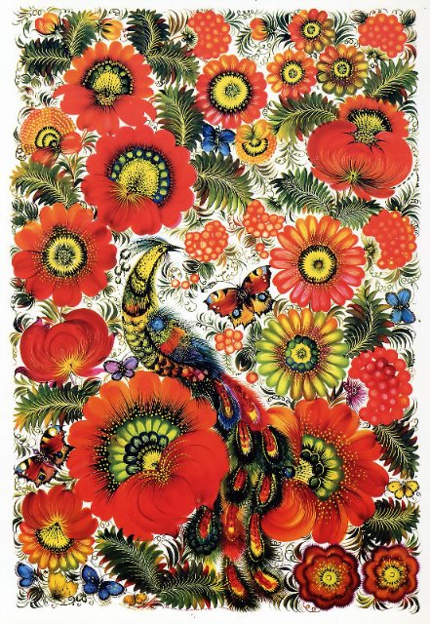
Petrykivka is a historically old village in the Tsarichanka district, Dnepropetrovsk region. It gave its name to a unique school of decorative painting which was founded there in every early times.

Slide 3
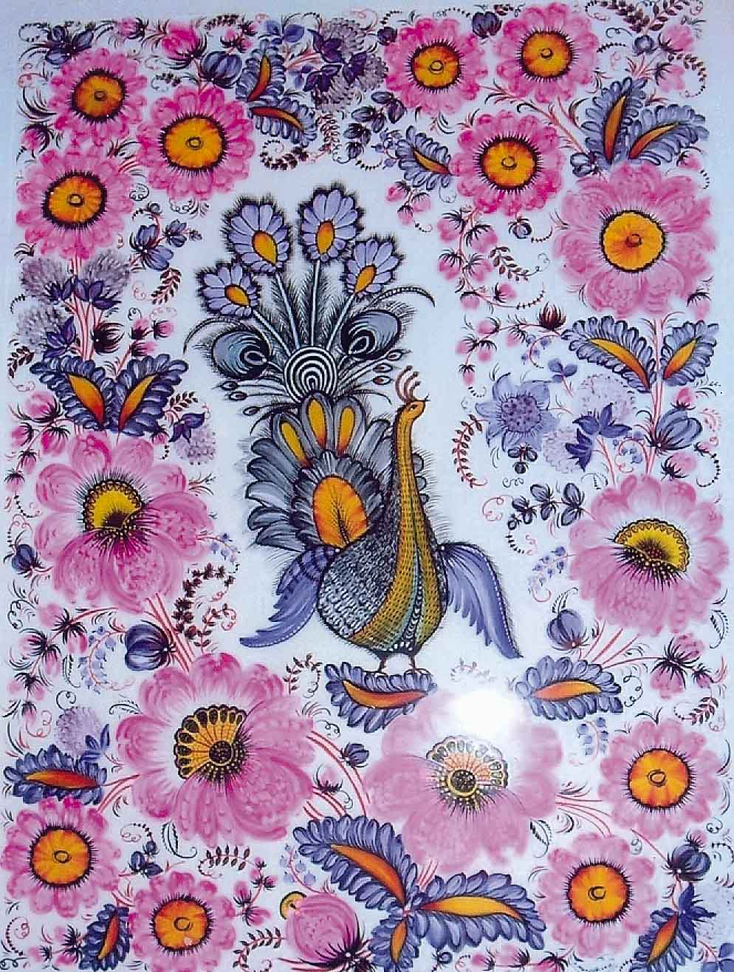
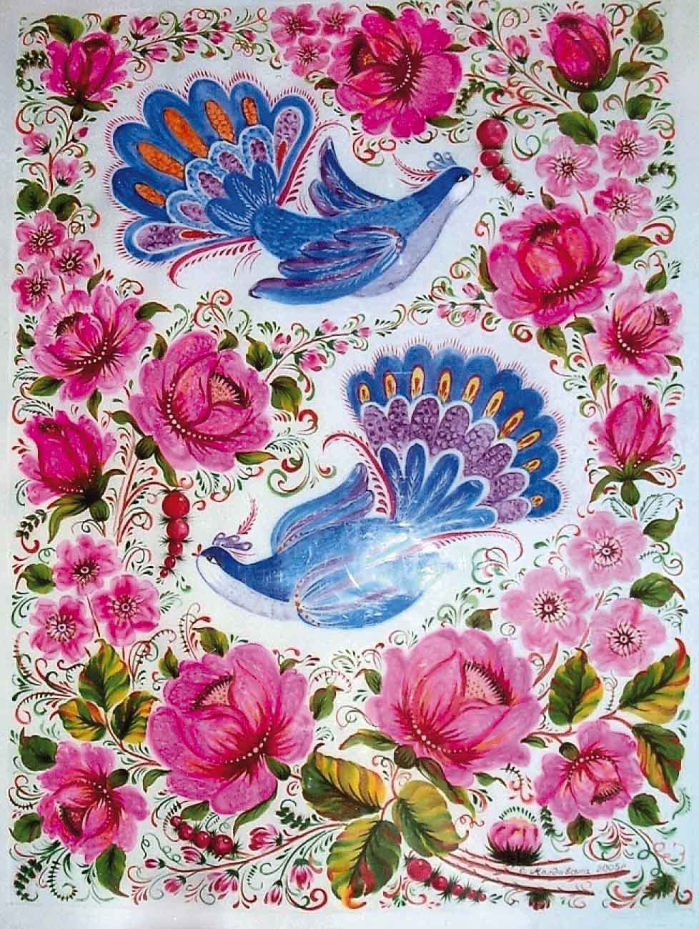

Slide 4
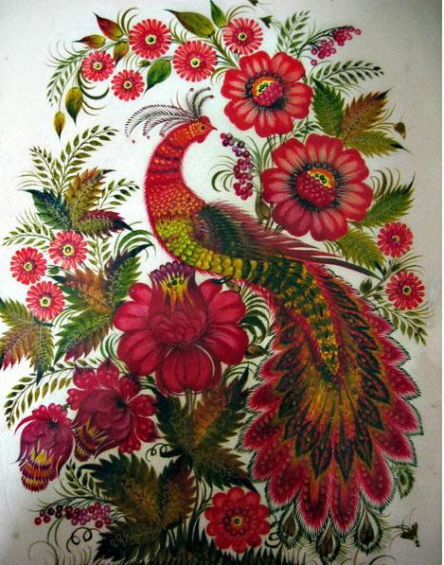
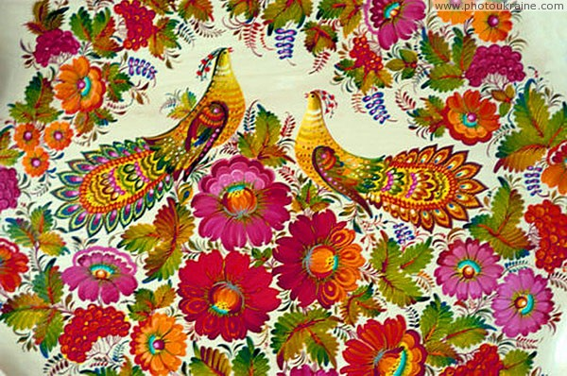
Priority is given to floral painting, but the fantasy of Petrykivka artists is often expressed by including in a single pattern a medley of garden and wild flowers, clusters of berries, or fruits, birds and butterflies – those eternal symbols of beauty.

Slide 5
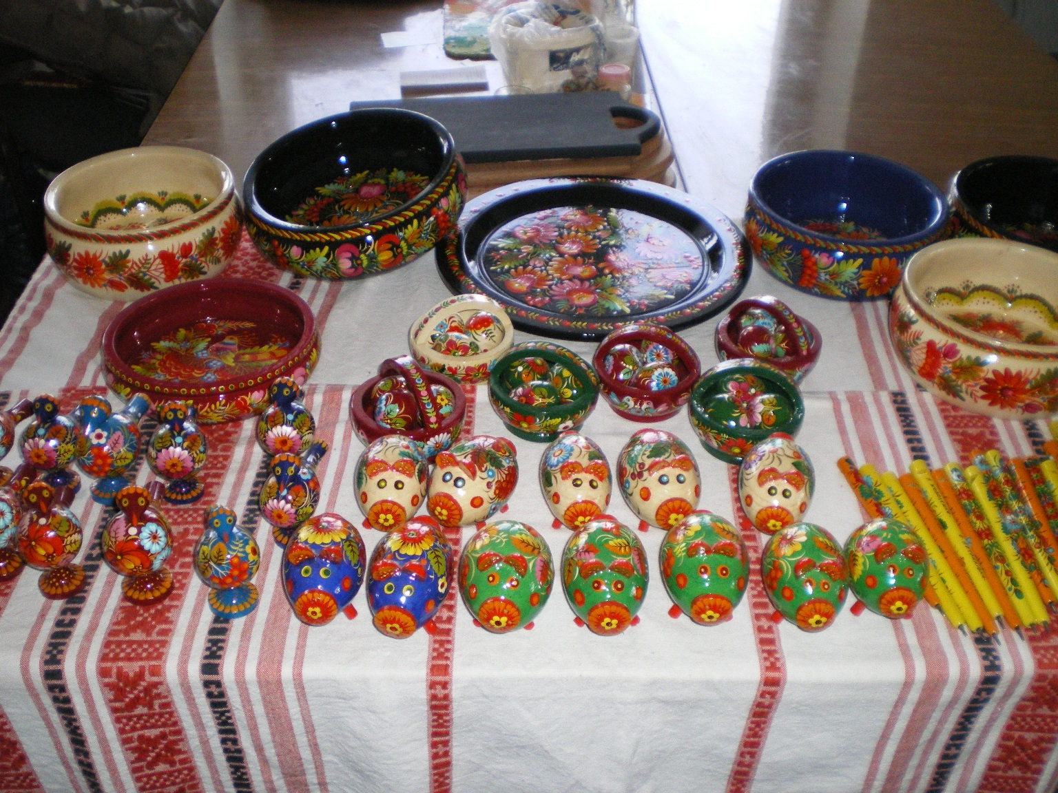
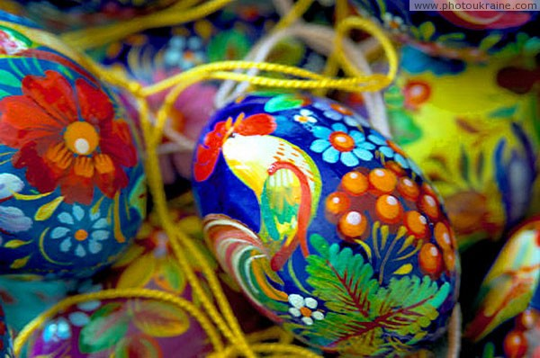

Slide 6
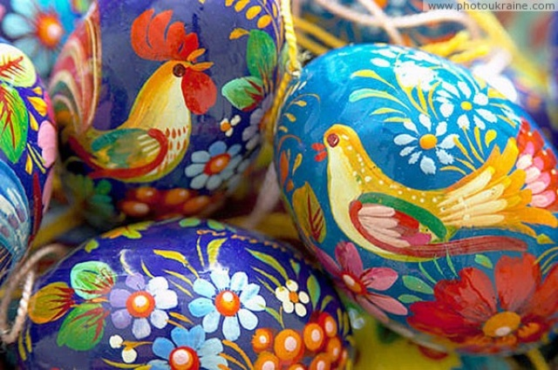
The Petrykivka style of painting is a very poetis view of the world around us. It’s a world which is free to interpret the usual things in a very unusual manner.

