Slide 1
Dwelling

Slide 2
Furniture and Equipment

Slide 3
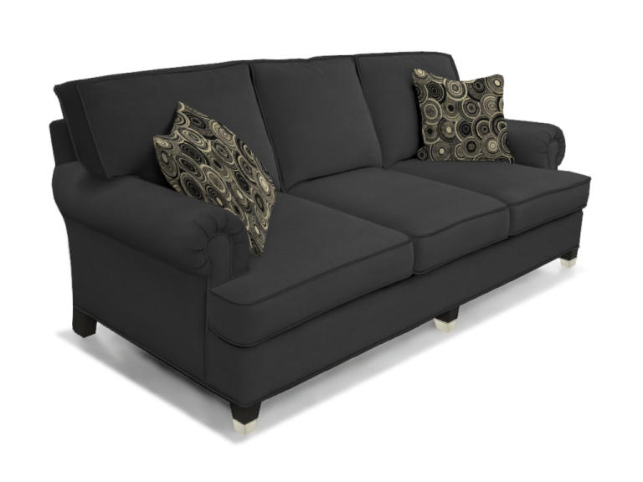
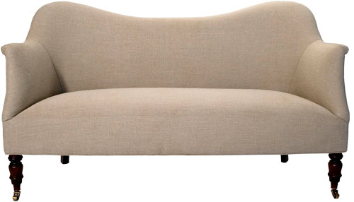
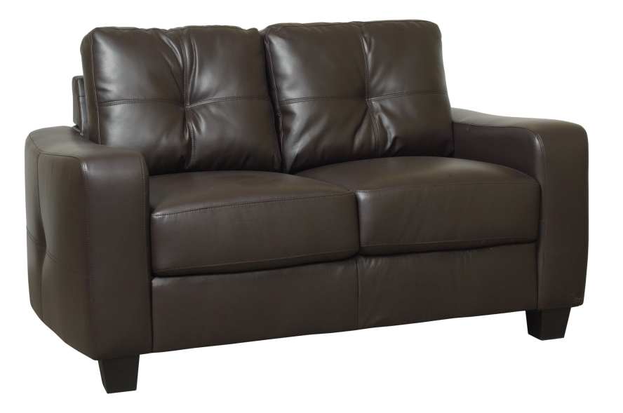
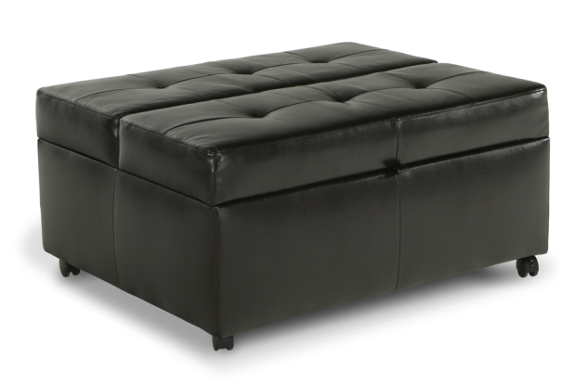
Sofas: a couch, a settee, a loveseat, an ottoman

Slide 4
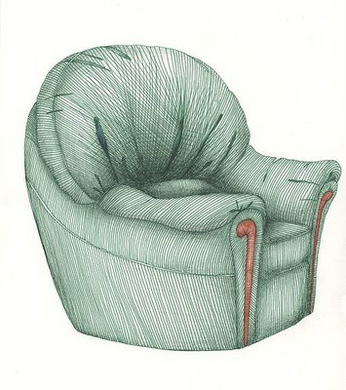
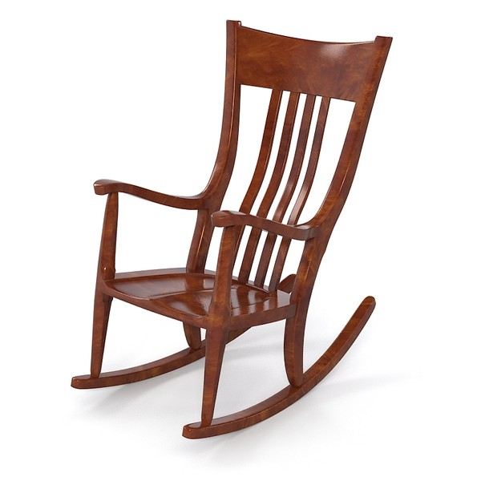
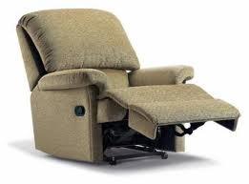
Chairs: an armchair, a rocking chair, a recliner

Slide 5
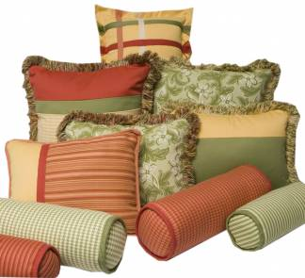
A throw pillow, a cushion

Slide 6
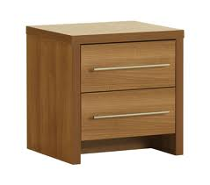
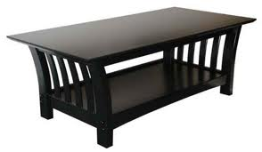
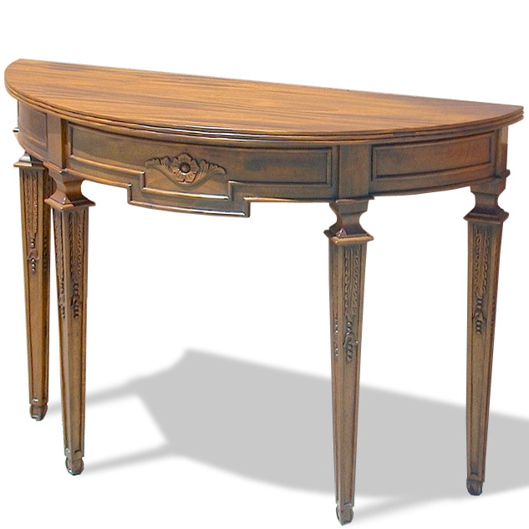
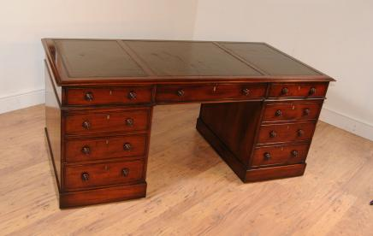
A coffee table, a side table, a bedside table, a writing table

Slide 7
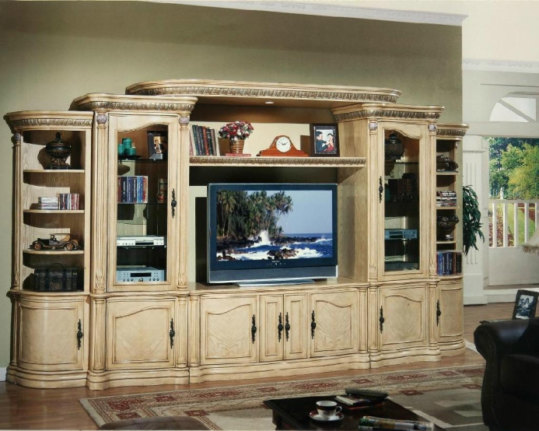
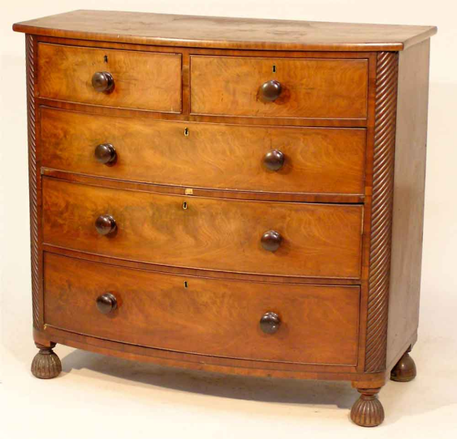
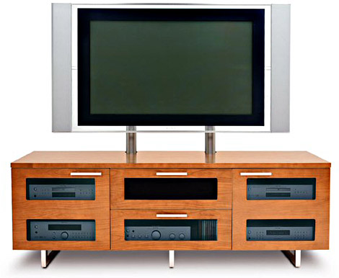
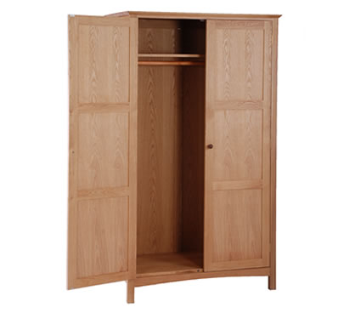
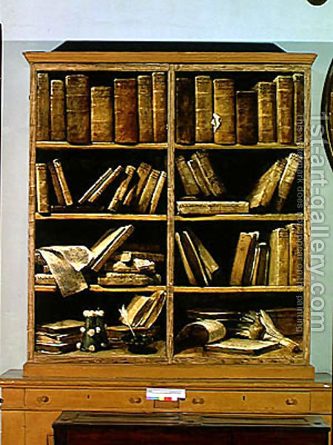
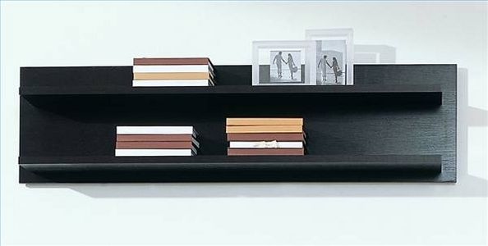
A wall unit, a TV stand, a chest of drawers, a wardrobe, a shelf, a bookcase

Slide 8
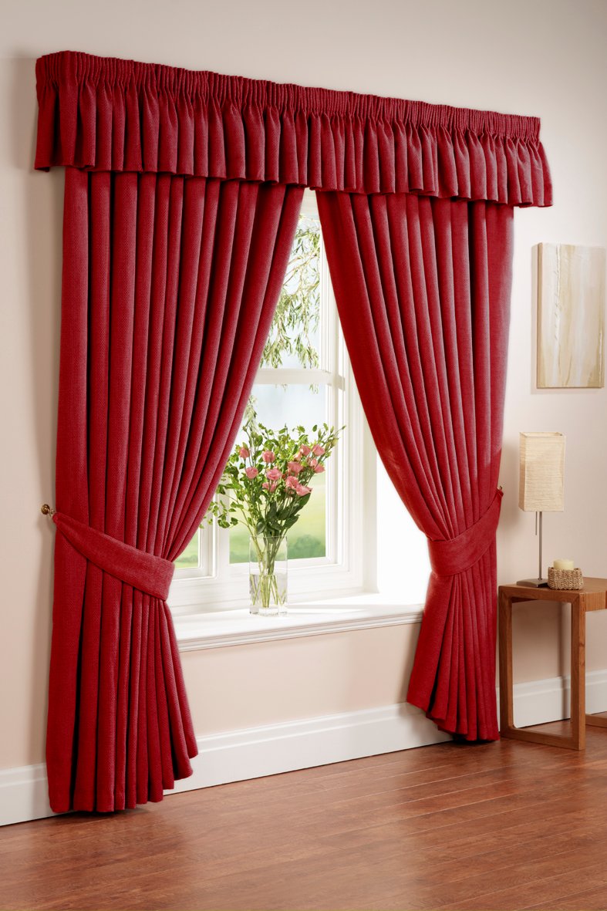
Curtains = drapers, shades = blinds

Slide 9
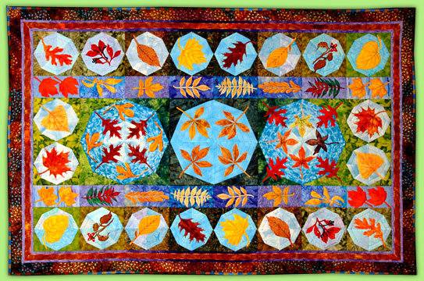
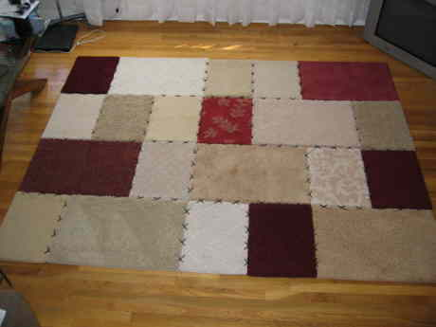
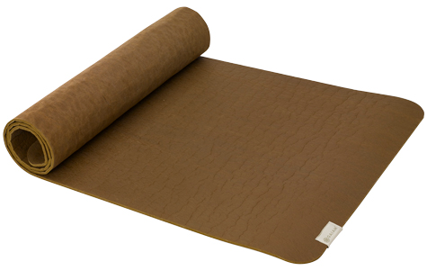
A carpet, a rug, a mat

Slide 10
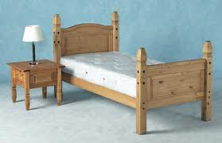
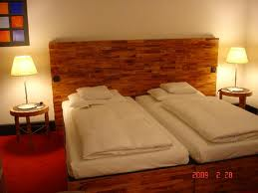
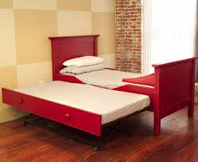
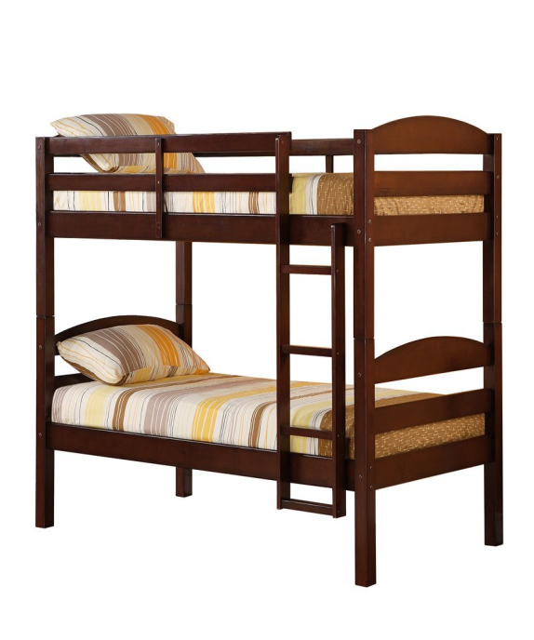
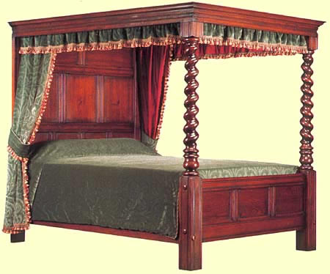
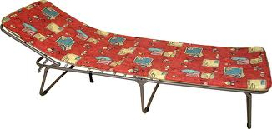
A single bed, a double bed, a twin bed, a futon, a four-poster, a bunk bed

Slide 11
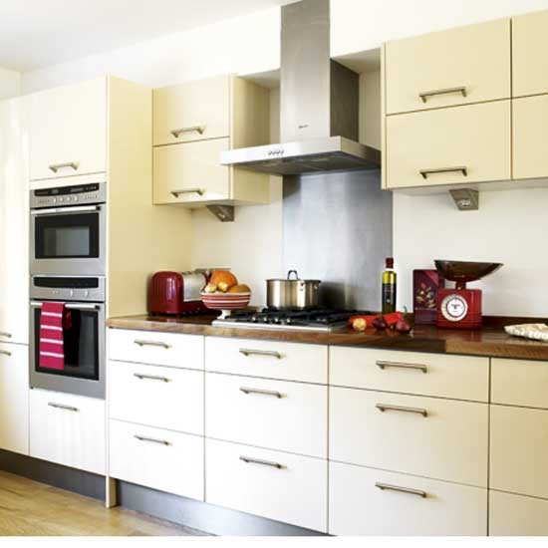
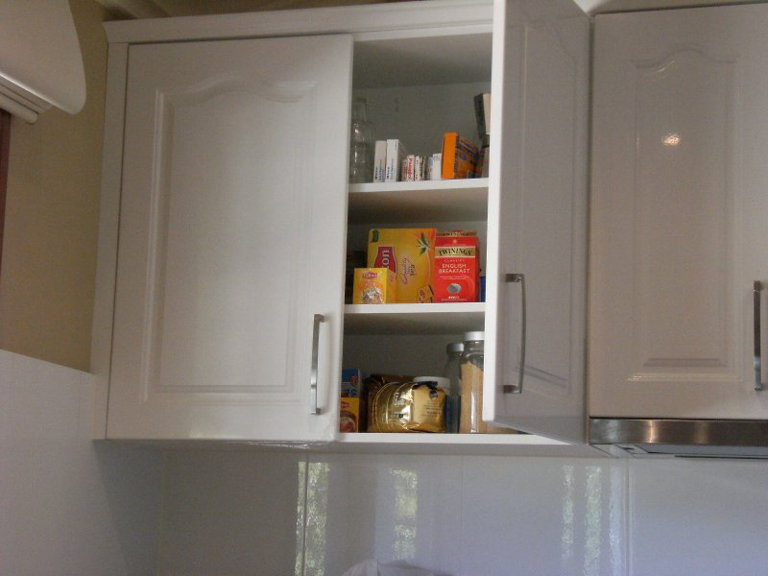
A kitchen unit, a cupboard = a cabinet

Slide 12
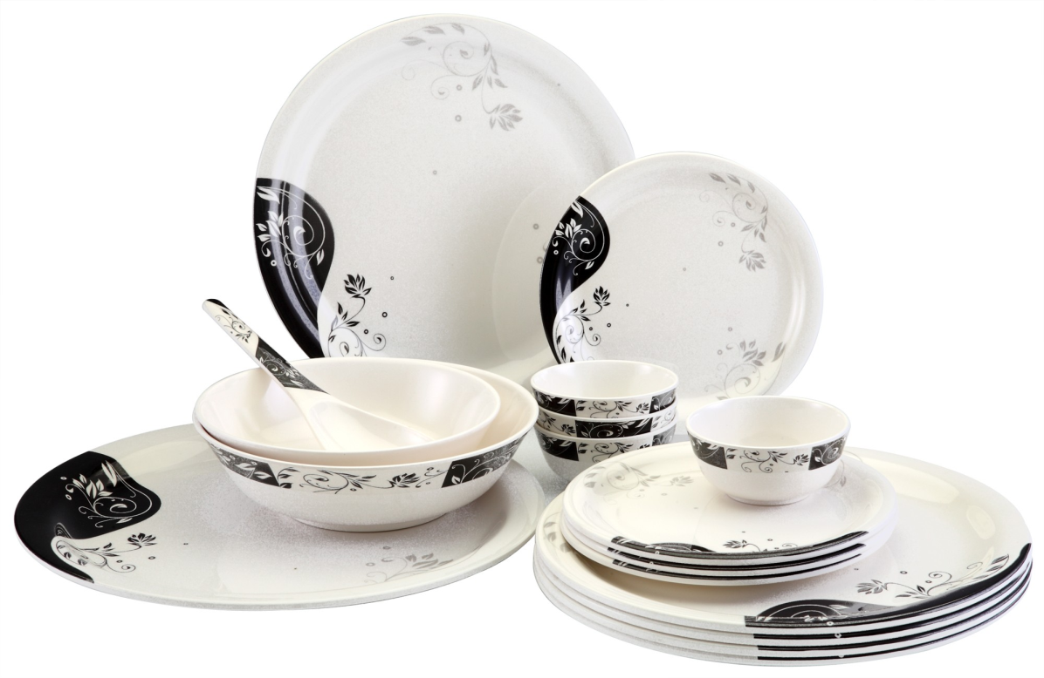
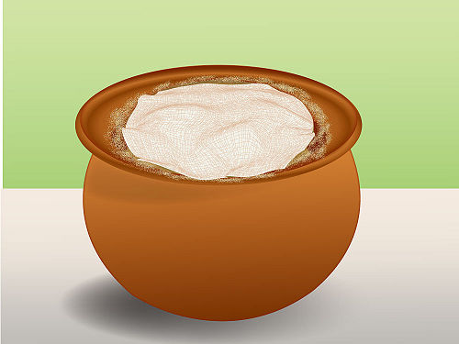
Crockery (plates, bowls), a pot

Slide 13
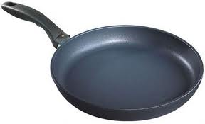
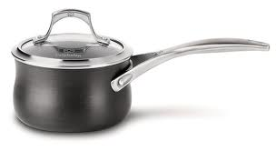
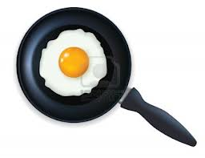
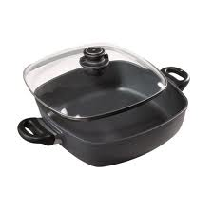
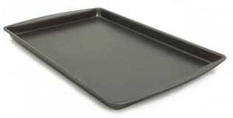
A pan, a saucepan, a frying pan, a casserole, a baking (roasting) tin

Slide 14
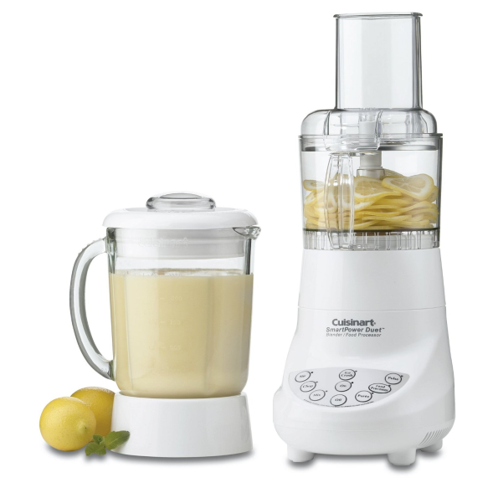
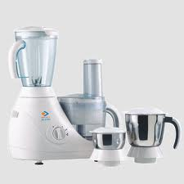
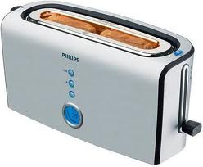
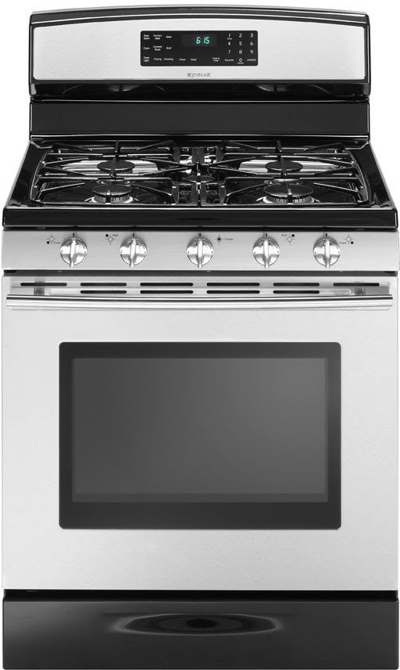
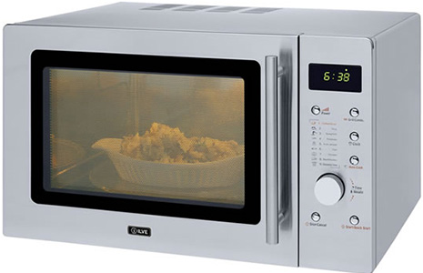
A blender, a food processor, a toaster, a microwave oven, a cooker

Slide 15
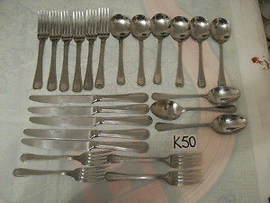
Cutlery (knives, forks, spoons)

Slide 16
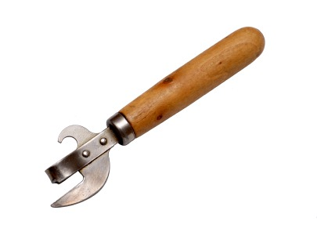
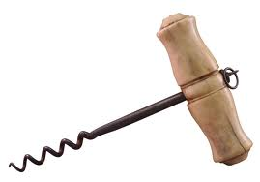
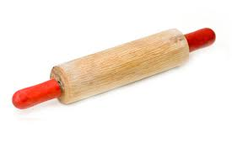
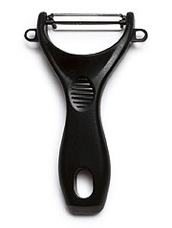
A tin opener, a corkscrew, a potato peeler, a rolling pin

Slide 17
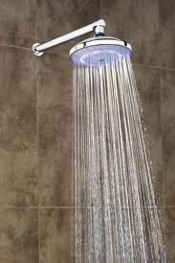
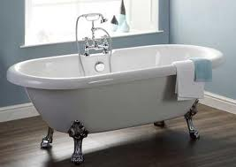
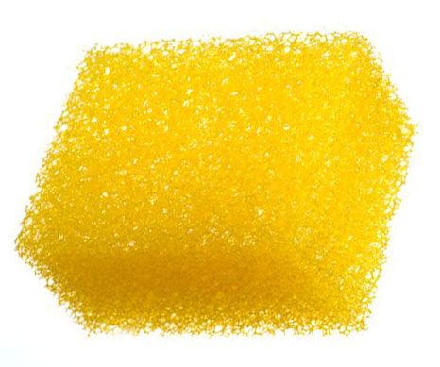
A shower, a bath, a soap dish, a sponge

Slide 18
Toilet seat, flush, brush, air freshener

Slide 19
Wash basin, a faucet (a tap), a plug, a drain

Slide 20
Idioms

Slide 21
To be a home bird

Slide 22
Home sweet home

Slide 23
East or West, home is best

Slide 24
There is no place like home

Slide 25
My home is my castle
My
is my

Slide 26
Make oneself at home

Slide 27
To keep the house

Slide 28
Apple-pie order

Slide 29
To live under the same roof

Slide 30
Not enough room to swing a cat

Slide 31
To live cooped up

Slide 32
To have a roof over head

Slide 33
To be homesick

Slide 34
Adjectives

Slide 35
cozy

Slide 36
ancient

Slide 37
spacious
ious

Slide 38
compact

Slide 39
convenient

Slide 40
cheap

Slide 41
expensive

Slide 42
huge

Slide 43
plain

Slide 44
exotic

Slide 45
charming

Slide 46
sparkling

Slide 47
oversized

Slide 48
magnificent
Notes:
Magnifying glass!

Slide 49
upscale

Slide 50
fabulous

Slide 51
stunning

Slide 52
House jobs and chores

Slide 53
To sweep – a sweeper

Slide 54
To dust – a duster

Slide 55
To mop – a mop

Slide 56
To fix – a fixer

Slide 57
To do laundry – laundry bag

Slide 58
To wash – washing machine, dishwasher, car washer

Slide 59
To clean – a cleaner

Slide 60
To dry – a clothes dryer, a hair dryer

Slide 61
To polish – nail polish, a polisher, polishing cloth

Slide 62
To scrub – a scrub brush

Slide 63
To vacuum – a vacuum cleaner

Slide 64
To throw out garbage/ waste/ litter – a garbage/ waste/ litter bin
Notes:
A throw – покрывало, легкая накидка

Slide 65
To water – a watering can

Slide 66
To shovel – a shovel

Slide 67
To rake - a rake

Slide 68
To mow – a lawnmower

Slide 69
To iron – an iron

Slide 70
To feed – a feeder

Slide 71
To set up a table – to clean up

Slide 72
To hang - hangers

