Slide 2
Chicago map shows that Chicago is located in the Midwestern United States on the southwestern shores of Lake Michigan, bordering the Illinois-Indiana State Line.

Slide 6
Chicago’s nicknames are: the Windy City, the City of Big Shoulders, the Second City, and The City That Works.

Slide 10
The Rookery building

Slide 11
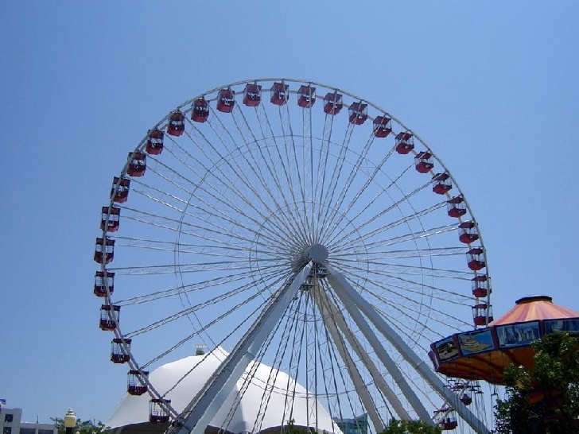
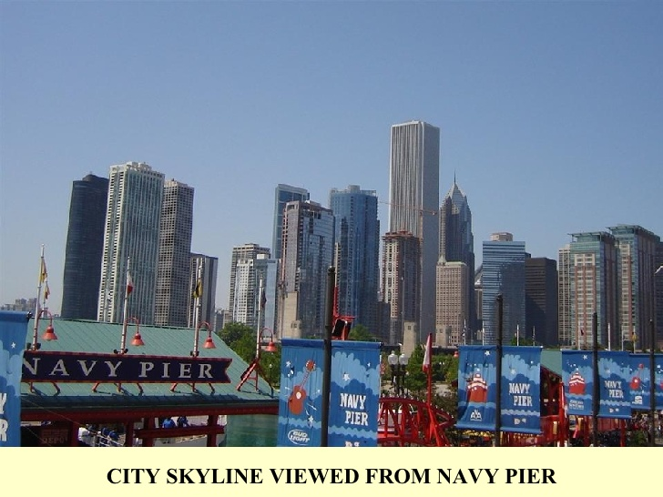
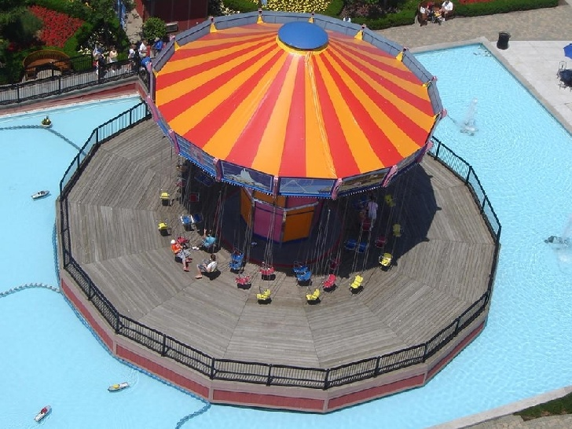

Slide 13
The building has a huge atrium and a tower with exterior glass enclosed elevators

Slide 17
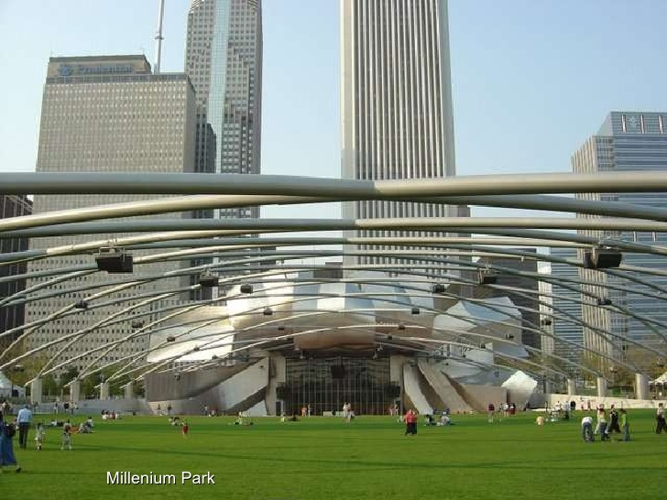

Slide 22
One day in Chicago

