Slide 1
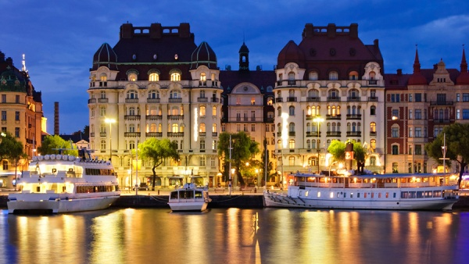
Sweden

Slide 2
WINTER STOCKHOLM
Scandinavian fairytale

Slide 3
Sweden unspoiled nature

Slide 4
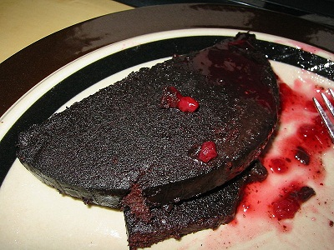
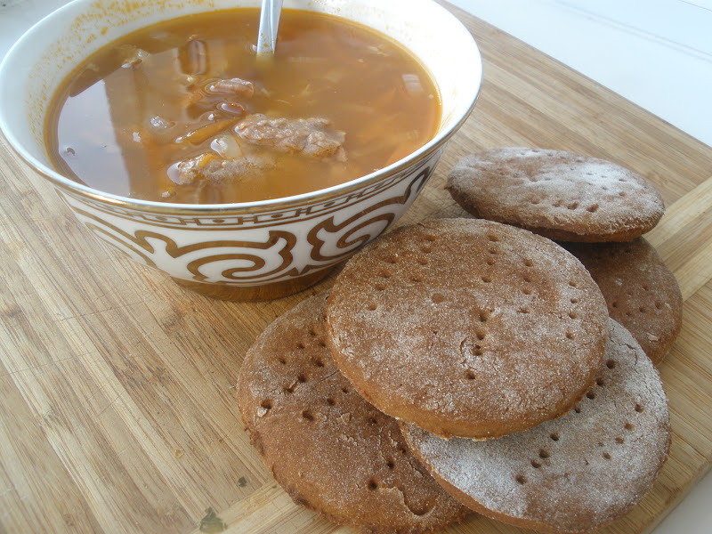
Syurstrёmming
meat with jam
salty soup with sweet cakes

Slide 5
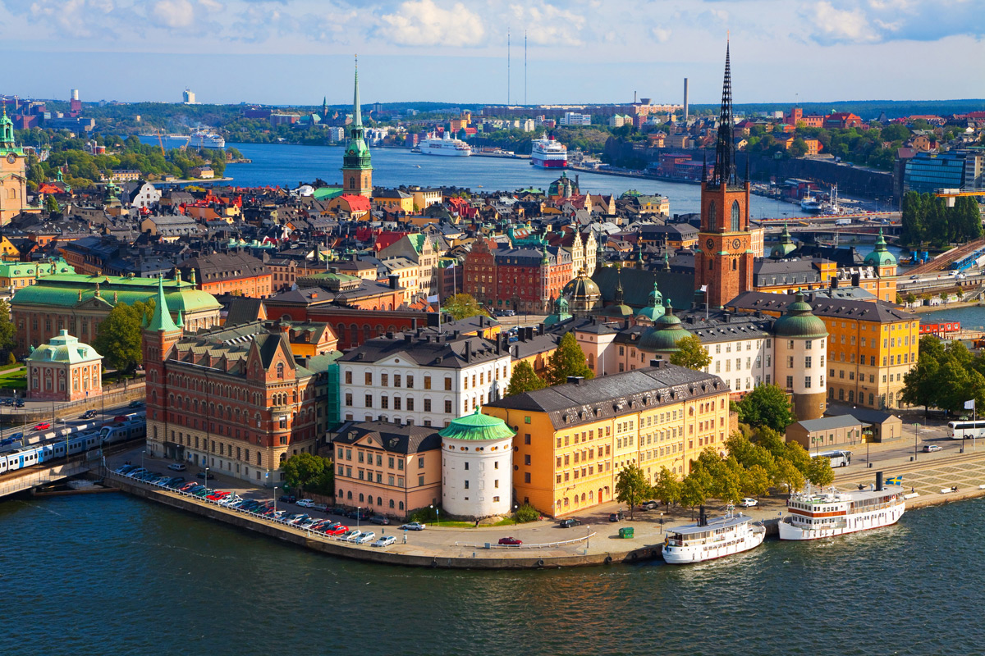

Slide 6
Stockholm

Slide 7
Birka

Slide 8
Drottningholm

Slide 9
Woodland Cemetery

Slide 10
Gamla Stan (Old Town)
Gamla Stan (Old Town)

Slide 11
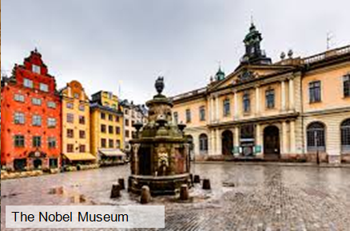
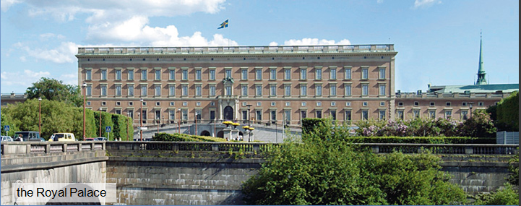
Gamla Stan (Old Town)

Slide 12
If visiting the Royal Palace be sure to catch the changing of the guard.

Slide 14
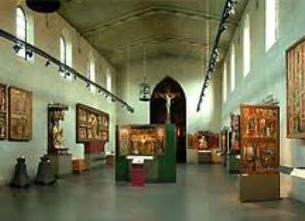
queen kristina's silver throne
the Museum of Antiquities

Slide 15
the armoury in Stockholm

Slide 16
THE TRE KRONOR (THREE CROWNS) MUSEUM

Slide 17
Vasa Museum

Slide 18
Vasa Museum

Slide 19
Djurgården

Slide 20
Djurgården

Slide 21
Djurgården

Slide 22
Djurgården
Gröna Lund amusement park

Slide 23
Skansen Open-Air Museum

Slide 24
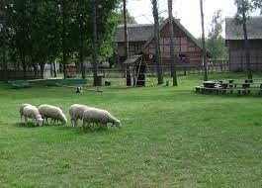
Skansen Open-Air Museum

Slide 25
Skansen Open-Air Museum

Slide 26
Sky View - The Globe

Slide 27
Sky View - The Globe

Slide 28
Sky View - The Globe

Slide 29
The City Hall (Stadshuset)

Slide 30
The City Hall (Stadshuset)

Slide 31
Drottningholm
Drottningholm

Slide 32
Drottningholm

Slide 33
Drottningholm

Slide 34
Stockholm is waiting for you!

