Slide 1


The Four Corners of the World
We will send you to the all four corners…
We work,
you have fun!

Slide 2


“The Four Corners of the World” Travel Company:
has been operating at Ukrainian travel services market since 1994
head office is located in Kiev
branch offices are in Kharkov, Donetsk, Mariupol, Lvov and Odessa
collaborates with more than 2500 travel agencies from all regions of Ukraine
provide corporate services for a number of enterprises and business entities

Slide 3
Services «The Four Corners of the World» Travel Company provides:
organization of recreation in Ukraine and abroad
individual and VIP-tourism, cruises
charter flight programs
event tourism (wedding tours, sport events, international festivals, carnivals etc.)
services for corporate clients
organization of business tours in Ukraine and abroad
wellness and treatment programs
study abroad
recreation for children and youth
foreign visitors hosting in Ukraine
booking and sales of air tickets to all countries of the world

Slide 4

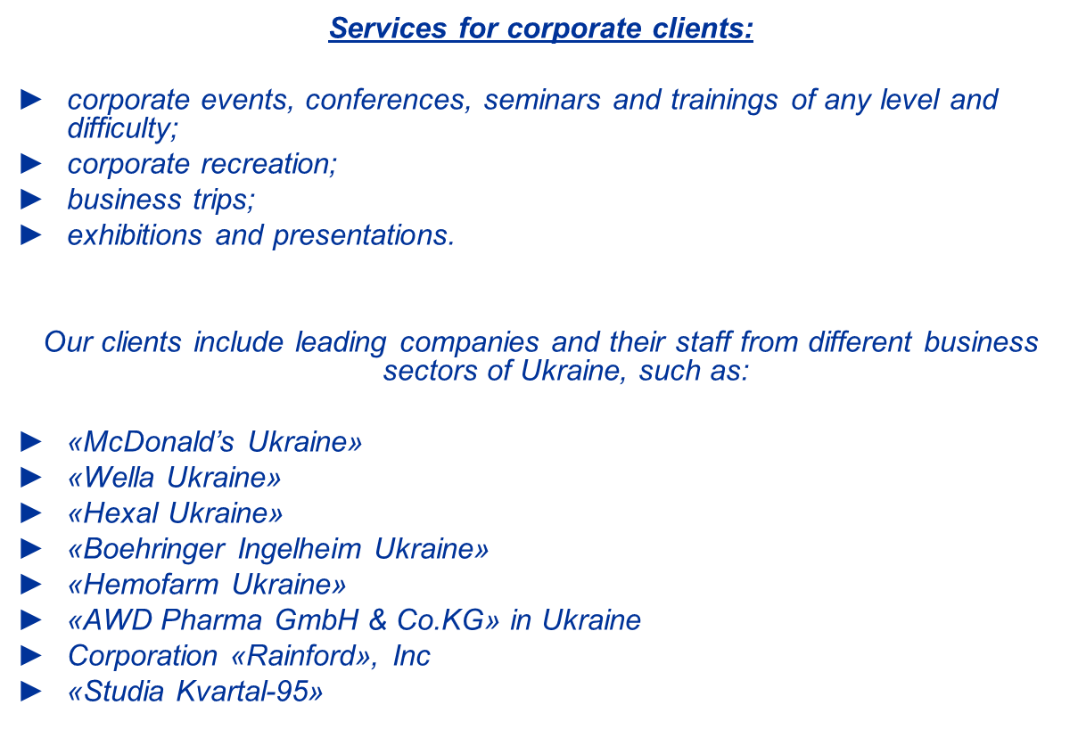

Slide 5






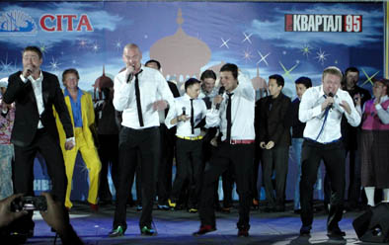
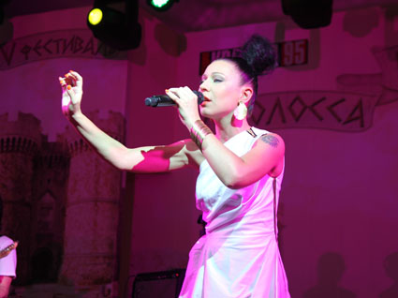
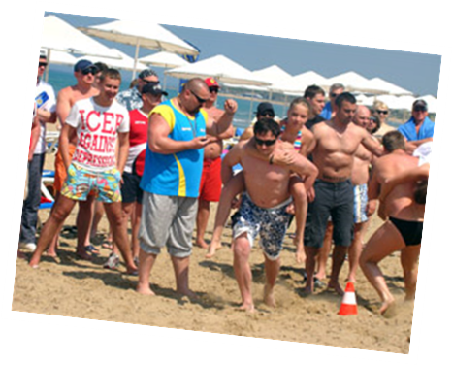

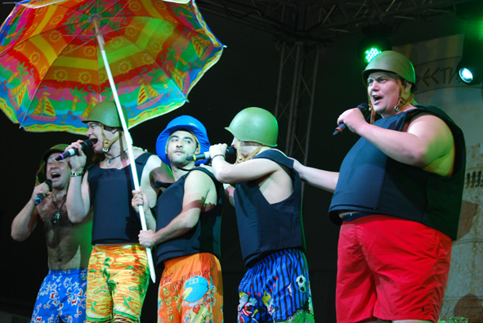

Our projects:

Slide 6
We work, you have fun!
www.fourcorners.com.ua

