Slide 1
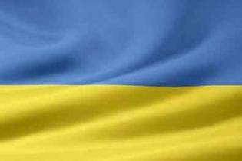
UKRAINE
Yulya Petruhno

Slide 2
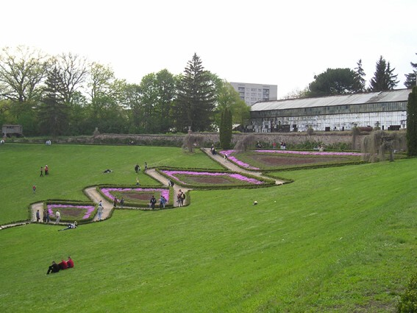
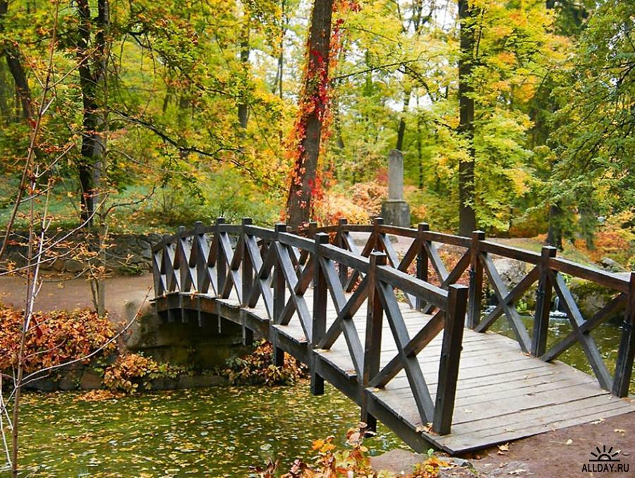
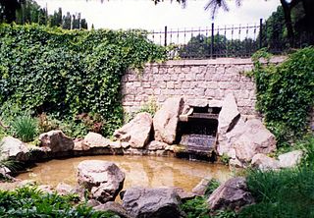
Sofiyivsky Park – the park was founded in 1796 by a Polish nobleman who helped rebuild the city of Uman. The gardens feature over 2000 local and exotic plants including flowering trees and towering pines and cypress.

Slide 3
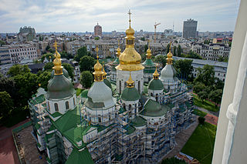
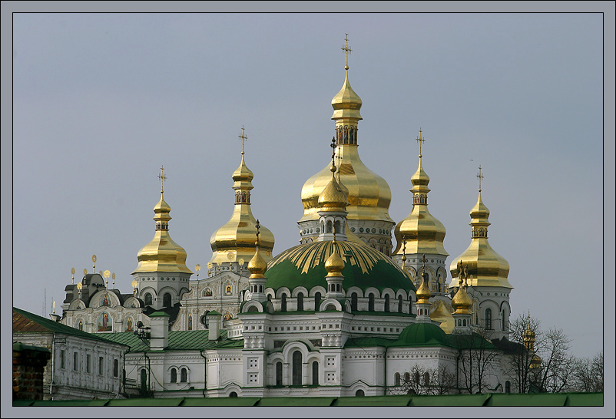
Kiev Pechersk Lavra – the Monastery of the Caves is an active destination for pilgrims and cultural tourists alike. Visitors can see the ornate Great Lavra Belltower and fine examples of Ukrainian Baroque architecture such as the All Saints church. Beneath the ground, a network of caves holds underground living quarters and chapels.

Slide 4
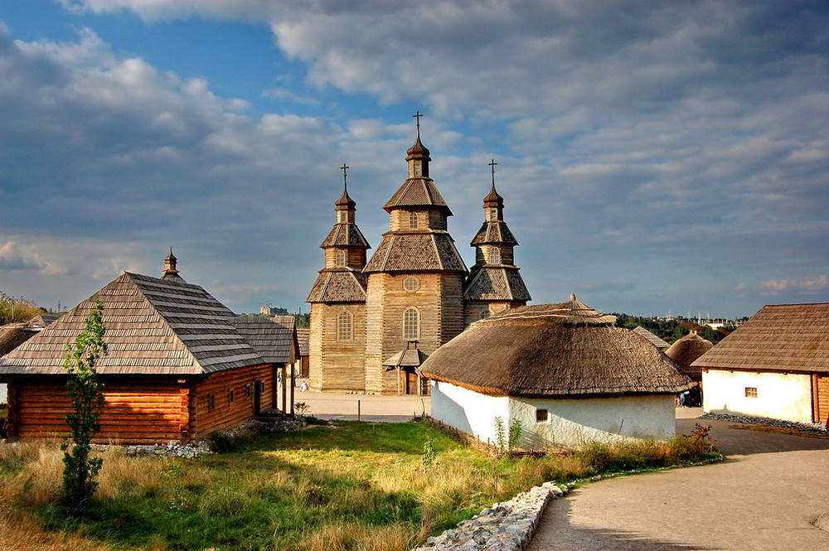
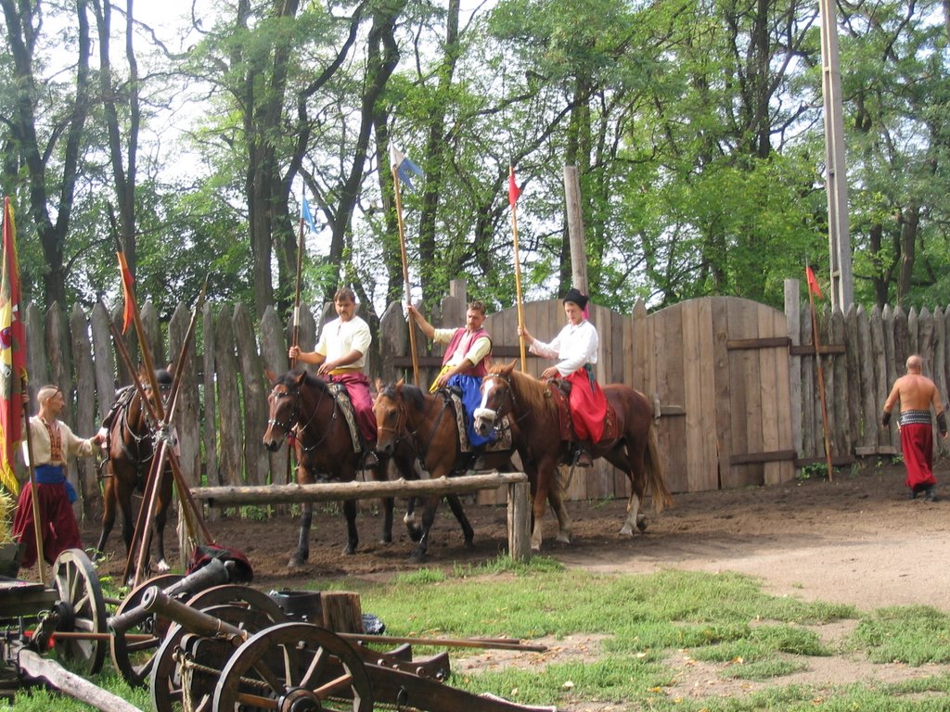
Khortytsia – Khortytsia is a national culture reserve located on the largest island in the Dnieper River. The island is known for its unique plants and animals and its large museum documenting the islands many eras. The island has been occupied by people for five thousand years, and signs of every group can be found.

Slide 5
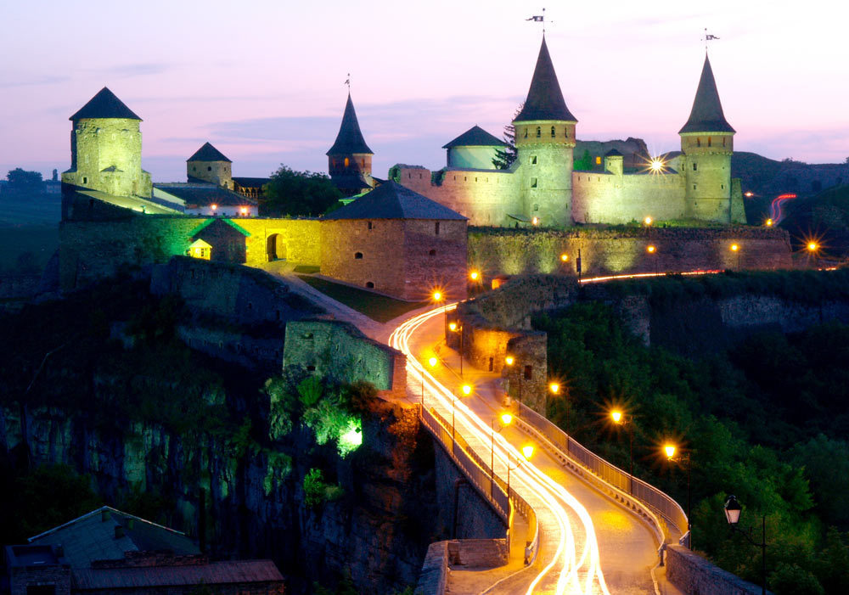
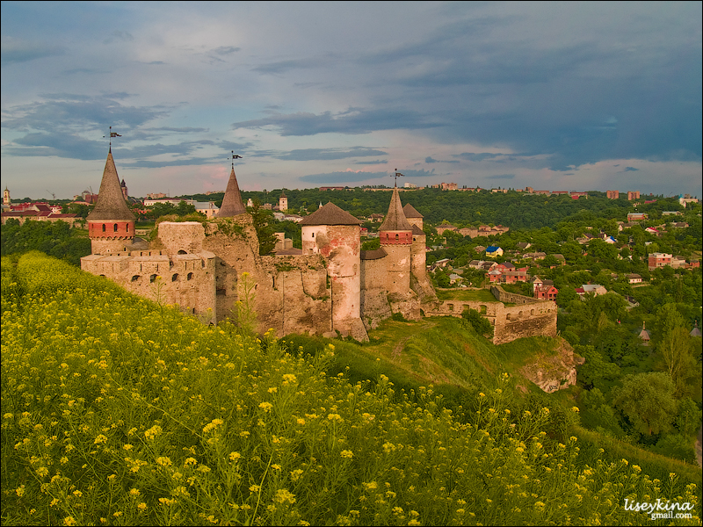
Kamianets National Historic-Architectural Reserve – The Kamianets is a Ukrainian architectural jewel. Throughout the centuries, a diverse population of Polish, Armenians and Ukrainians have occupied the city and left their mark. Among the city’s many distinctive buildings is the Kamianets-Podilskiy Castle, which has served as both a protection for the city and a prison for debtors in various eras.

Slide 6
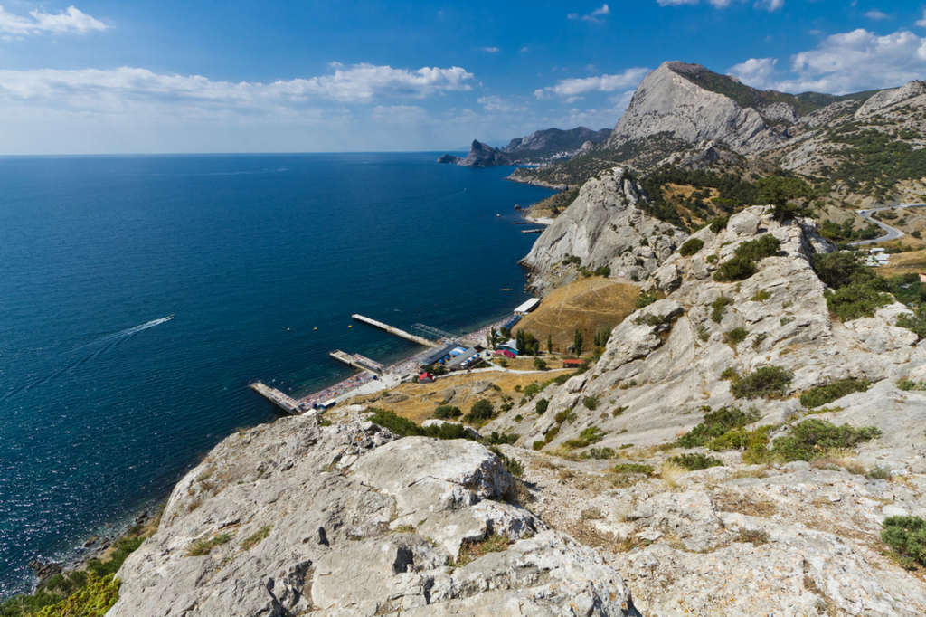
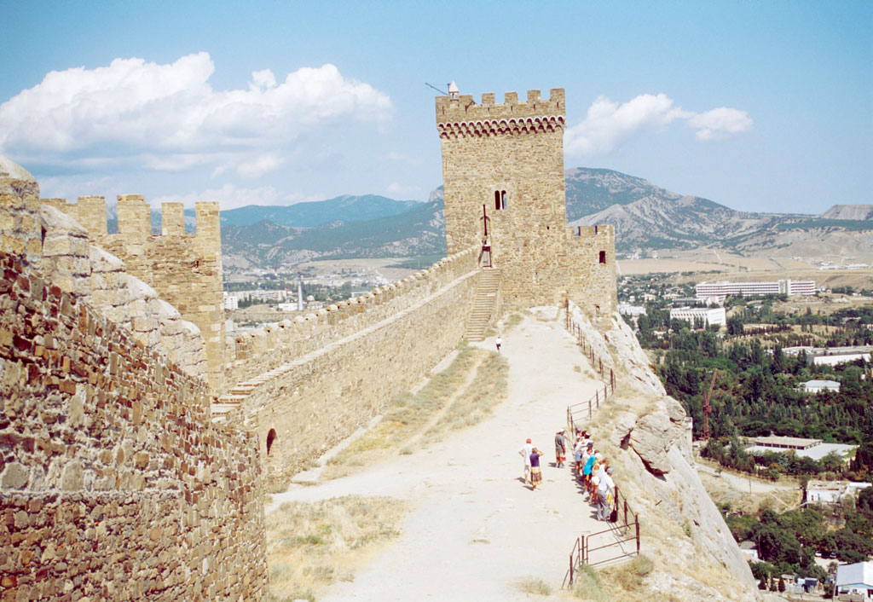
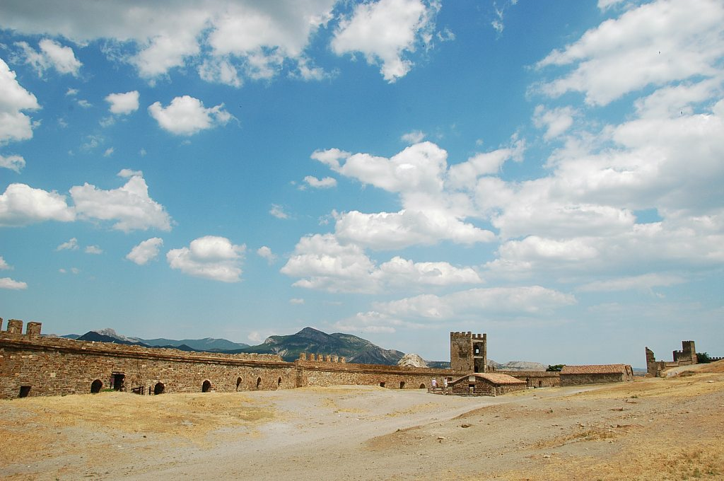
Chersonesos Taurica – this town was a Greek colony as far back as 5 B.C. Today, ancient columns still be seen in an archeological park just outside the city. Walk through the ruins with a special Ukrainian beauty for an unforgettable date.

Slide 7
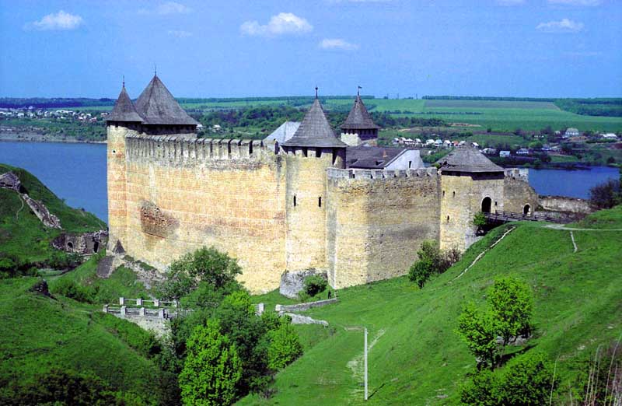
Khotyn Fortress – Khotyn is a major tourist destination for those interested in Ukrainian history; the city celebrated its 1000 year anniversary in 2002. The fortress itself was built during the 10th century and fortified and expanded over the next several centuries. It played an important role in the defense of the city, and is now a cultural learning center.

Slide 8
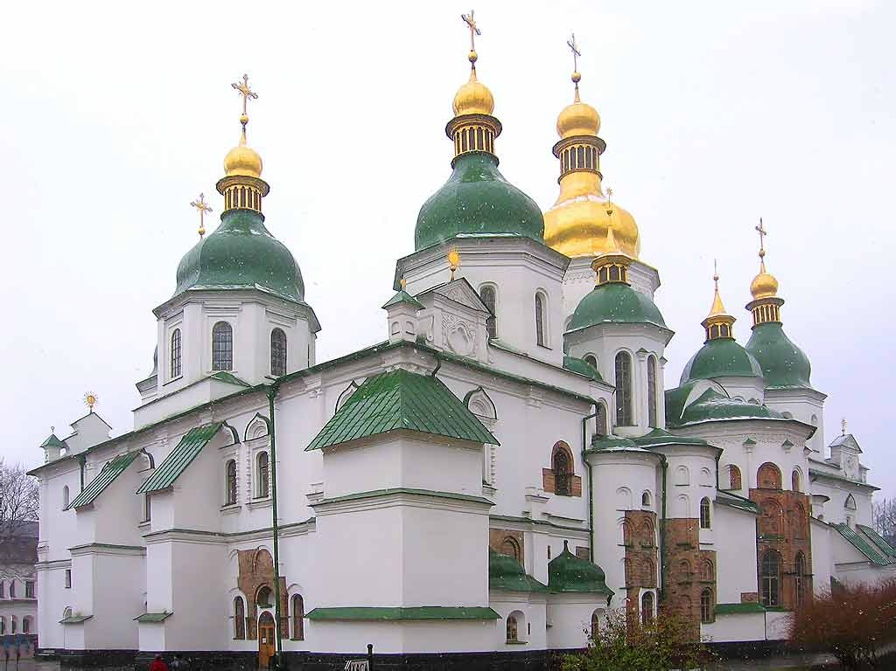
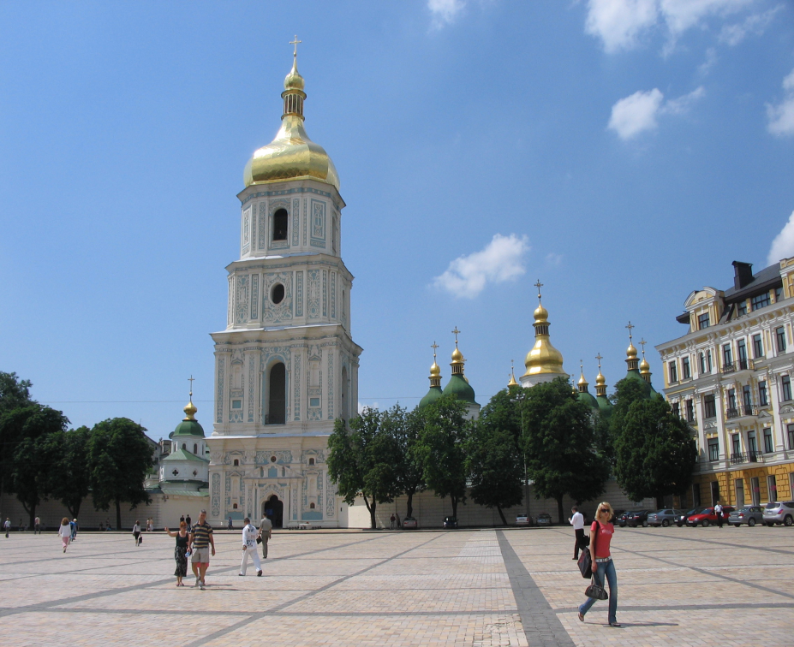
Saint Sophia Cathedral – The cathedral’s foundations were first laid in 1037 AD. The building itself, decorated with the usual pear-shaped domes that grace Orthodox cathedrals, took nearly two decades to complete. This architectural treasure was nearly lost during the Soviet era; the gorgeous buildings were to be torn down, but were saved by the efforts of Ukrainian preservationists

Slide 9

THE END!!!))))))

