Slide 1
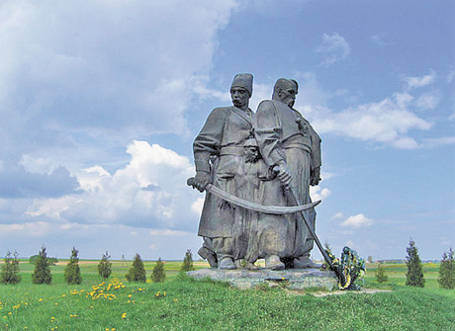
Museum-Preserve "Cossacks` Tombs"

Slide 2
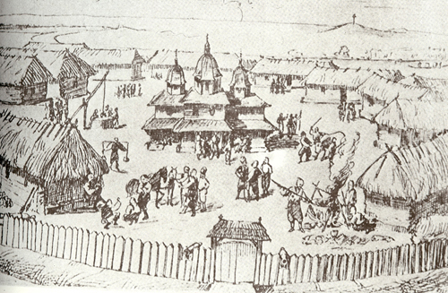
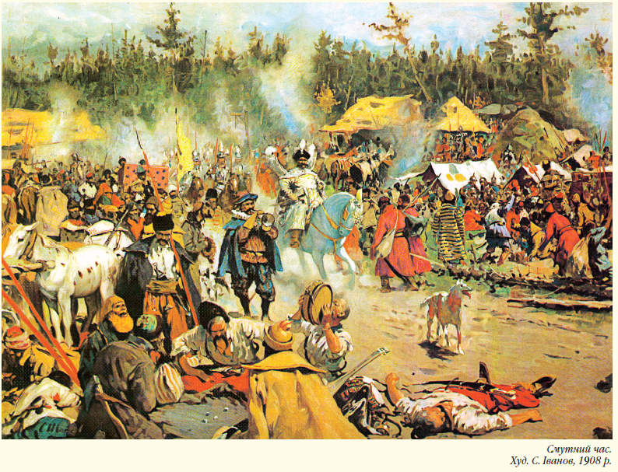
The Zaporizhian Sich
The Zaporizhian Sich is one of the most surprising features in the history of Ukrainian people, and in the history of mankind at the same time. The arousing of Ukrainian people under the influence of the Cossacks gave rise to the rapid development of folk creativity, culture, education, literary works, music, arts, architecture, chronicle writing and folk craftsmanship.

Slide 3
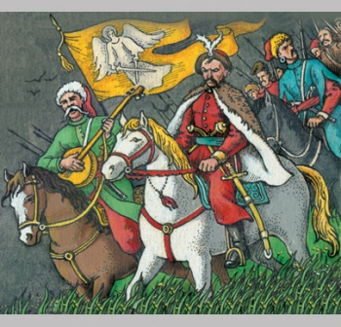
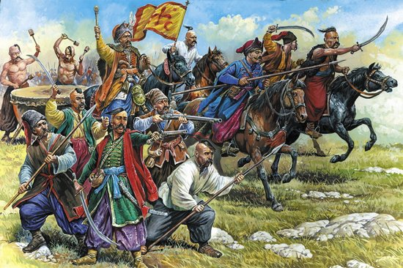
The Zaporizhian Sich emerged as a natural method of defense by the Ukrainian people against the frequent and devastating raids of Crimean Tatars, who captured hundreds of thousands of Ukrainians, Belorussians and Poles. Such slaving operations were called "the harvesting of the steppe".

Slide 4
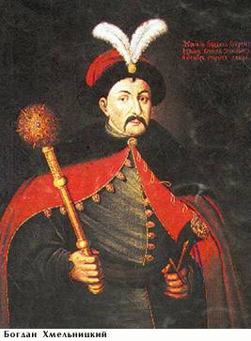
Hetman Bogdan Khmelnitsky(1595-1657)
He was the Hetman of the Zaporizhian Sich of the Crown of the Kingdom of Poland in the Polish–Lithuanian Commonwealth (now part of Ukraine). It is hard to overestimate Khmelnytsky's influence on the history of Ukraine. He not only shaped the future of Ukraine but affected the balance of power in Europe, as the weakening of Poland-Lithuania was exploited by Austria, Saxony, Prussia, and Russia. His actions and role in events were viewed differently by different contemporaries, and even now there are greatly differing perspectives on his legacy.

Slide 5
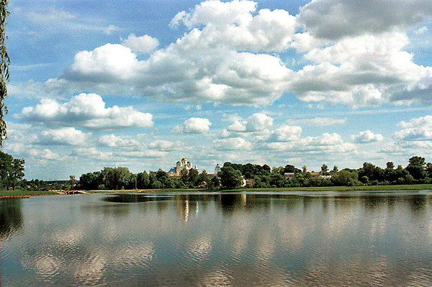
Strong, unapproachable fortress is situated on the island Zhuravlyha (Plyasheva) in Rivne region. In 1914 the greatest Cossack grave in Ukraine was equipped here to honor to that warriors who died during Berestechko Battle 1651.

Slide 6
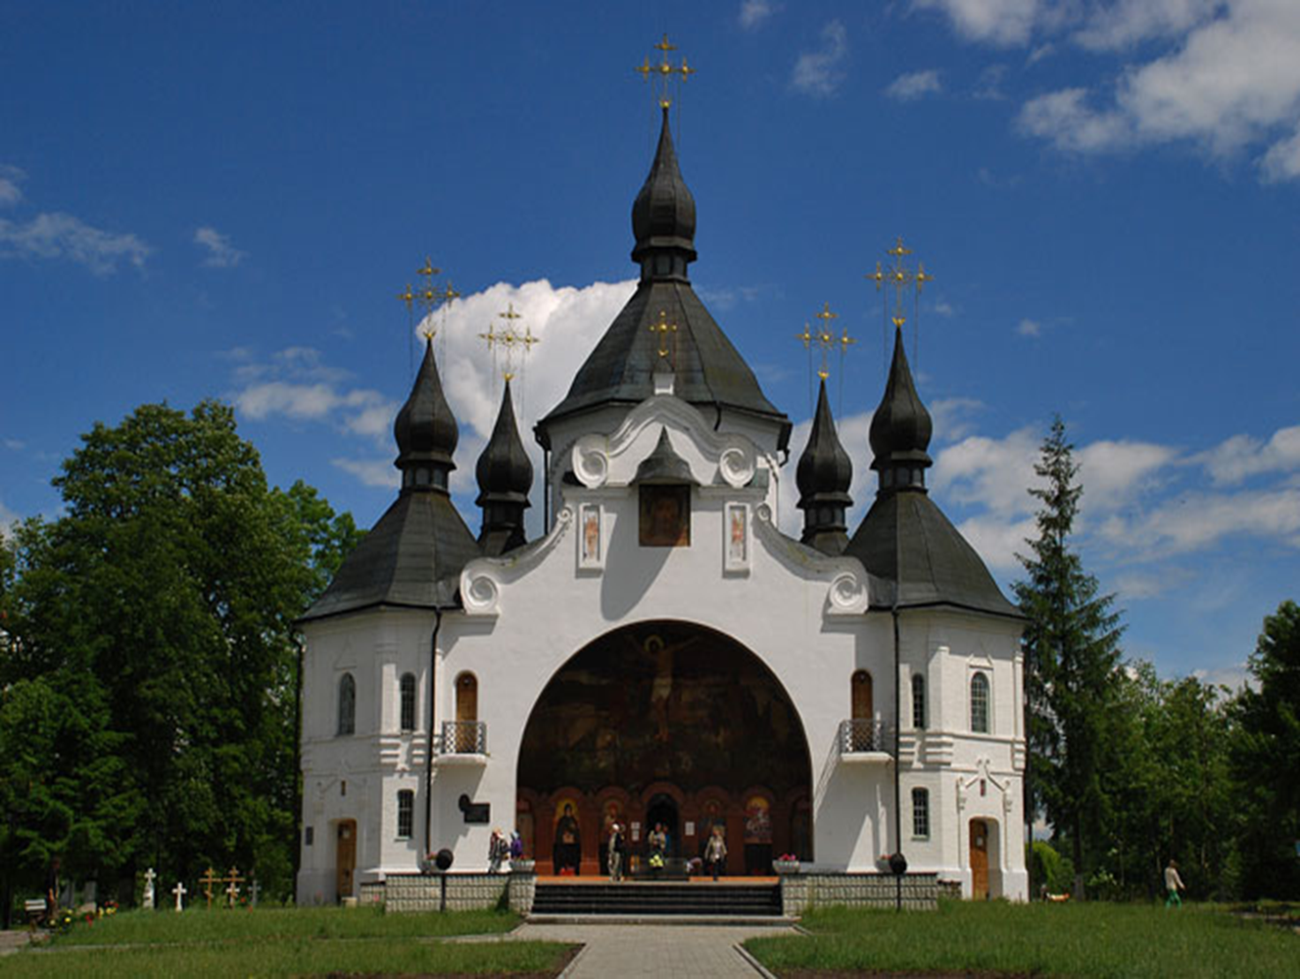
Here one can found the cossacks` graves and St. George`s Church which was erected in 1912. The pictures on the Bible theme in this church were painted by Ukrainian painter Jizhakevich.

Slide 7
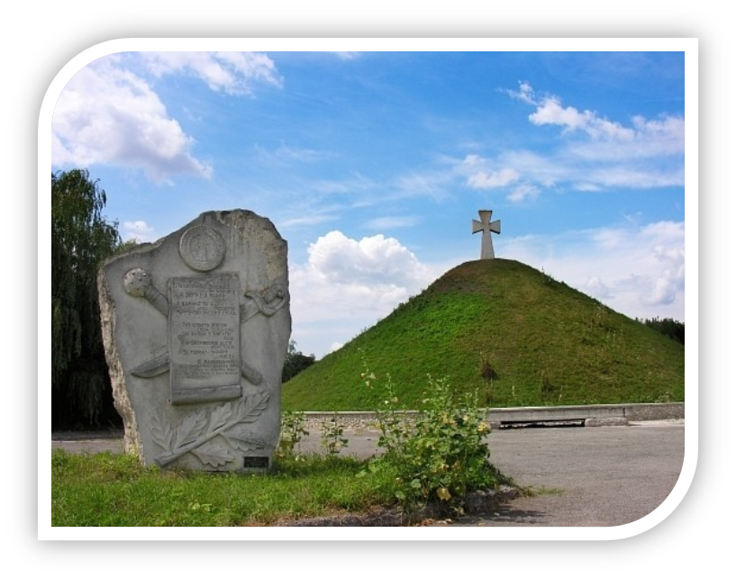
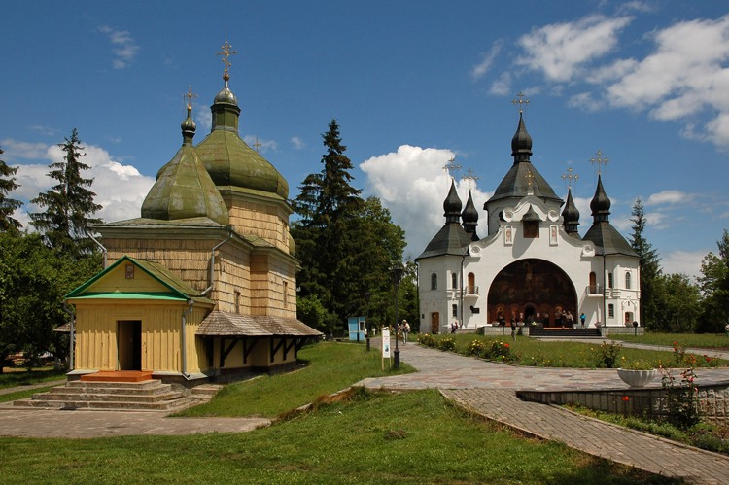
From this church through the underground passage we go to the smaller wooden St. Mickhael`s Church with the unique iconostasis of the 17th century. Here the cossac`s prayed before the battle.

Slide 8
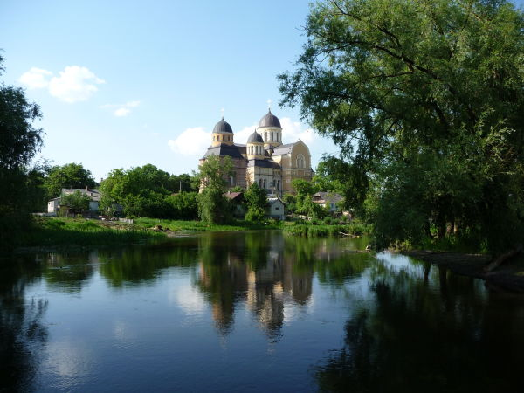
On the territory of the island there is a museum. All the exhibits of the museum, cossaks` weapons, clothes, tell the visitors about the heroic history of Ukraine.

Slide 9
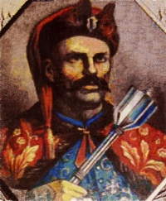
The exhibits tell us about B. Khmelnitsky and the legendary cossack Nechai by name. When all the cossacks were killed, he remained alone. Being badly wounded he was proposed to take the side of enemies. The Polish King proposed him freedom and gold, but Nechai refused. He was the last to die on the island.

