Slide 1
Leonardo da Vinci
1452 - 1519
Presented by Pogodina K. A., DK-9-4

Slide 2
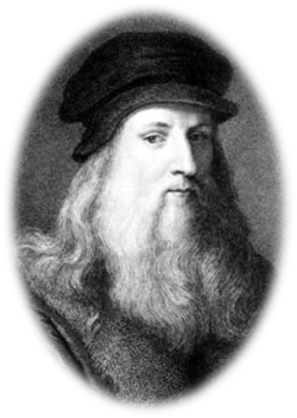
Biography
Leonardo Da Vinci (15 April 1452 – 2 May 1519, Old Style) - the illegitimate son of a 25-year-old notary, Ser Piero, and a peasant girl, Caterina, was born in Vinci, Italy, just outside Florence. His father took custody of the little fellow shortly after his birth, while his mother married someone else and moved to a neighboring town.

Slide 3
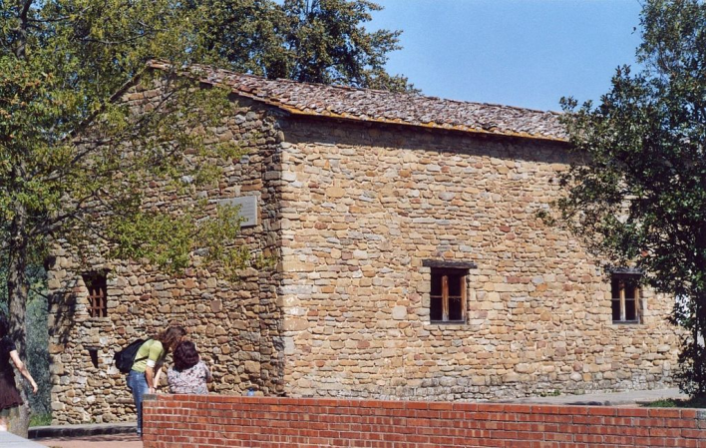
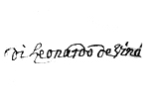
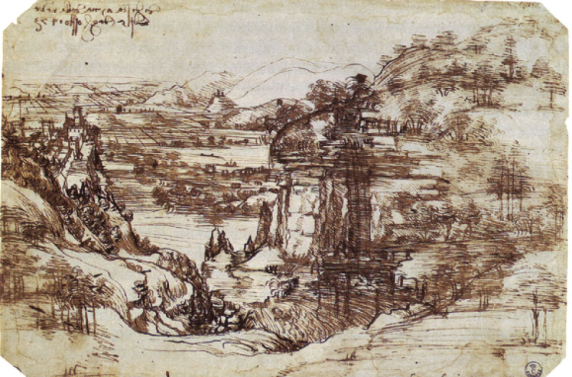
Childhood
Growing up in his father's home, Leonardo had access to scholarly texts owned by family and friends. Even as an apprentice, Leonardo demonstrated his colossal talent.
His handwriting is amazing, he wrote from right to left, the letters are reversed so that the text easier to read using a mirror.
In an era when left-handedness was considered the devil's work and lefties were often forced to use their right hand, Leonardo was an unrepentant southpaw. It was an element of his genius.
Father’s home
signature
earliest known drawing, the Arno Valley (1473)

Slide 4
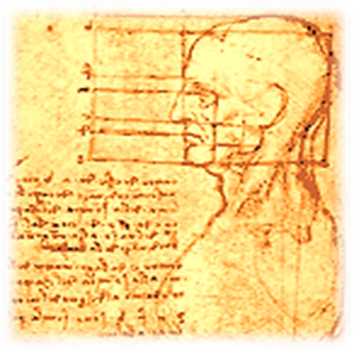
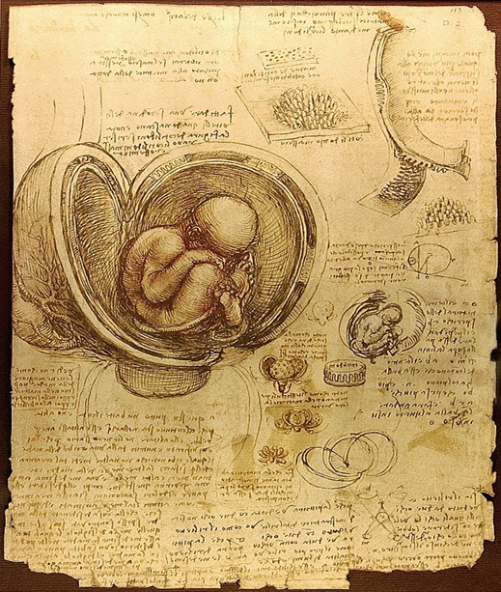
Teacher and education
Some people say that the first teacher of Leonardo, (when he was about 15 years old), was Andrea Verokkio, Italian sculptor and painter of the Renaissance. In the studio of Verrokkio, Leonardo also studied the humanities, where he gained some technical knowledges. In 1473, at the age of 20, Leonardo da Vinci was qualified as a master in the Guild of St. Luke.
Faculty of Medicine, he has learned to open the corpses of people for the study of reflexes.
A page showing Leonardo's study of a foetus in the womb

Slide 5
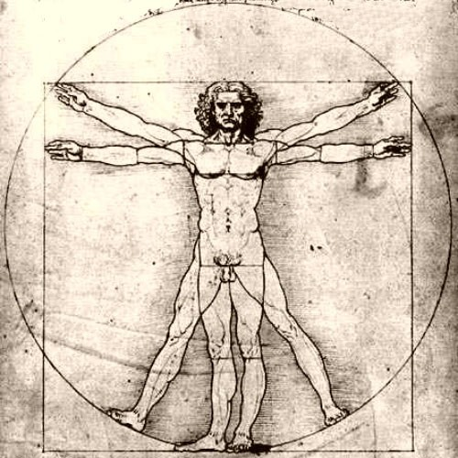
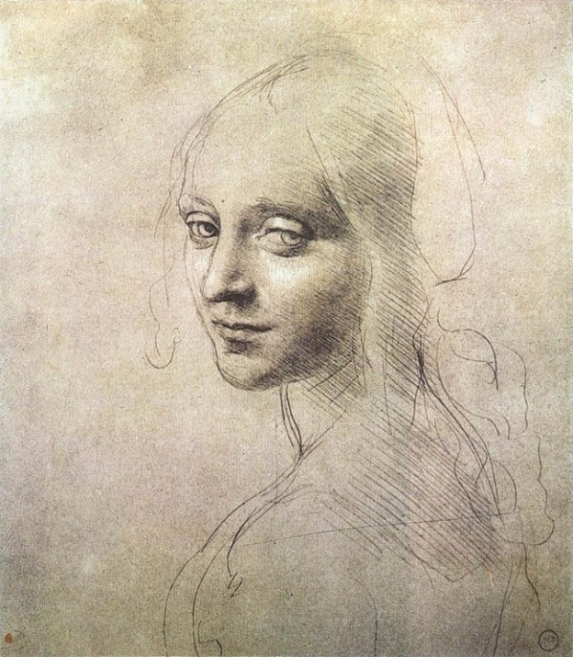
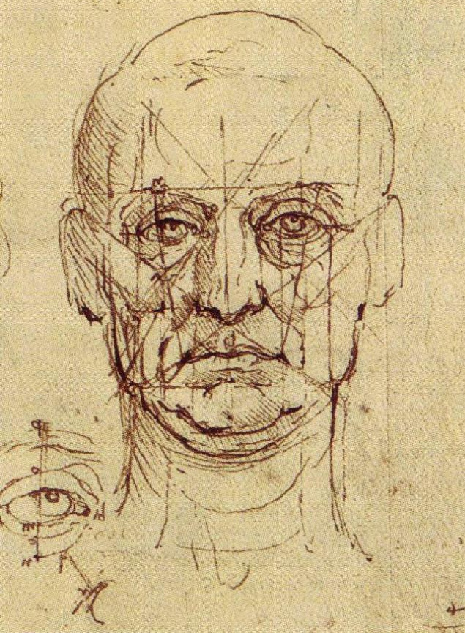
Da Vinci was the first artist to study the physical proportions of men, women and children and to use these studies to determine the "ideal" human figure.
All in all, Leonardo believed that the artist must know not just the rules of perspective, but all the laws of nature. The eye, he believed, was the perfect instrument for learning these laws, and the artist the perfect person to illustrate them

Slide 6
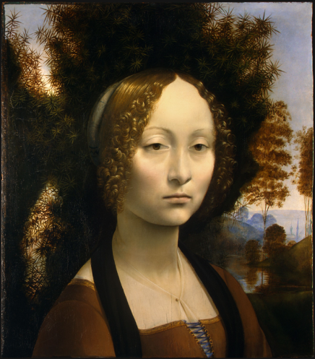
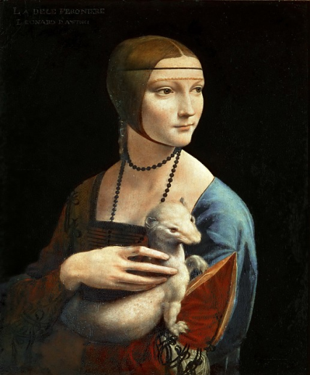
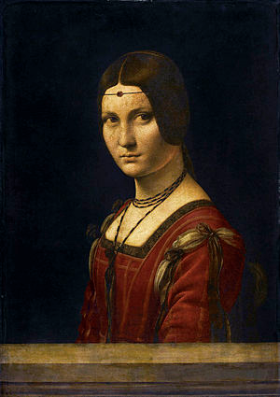
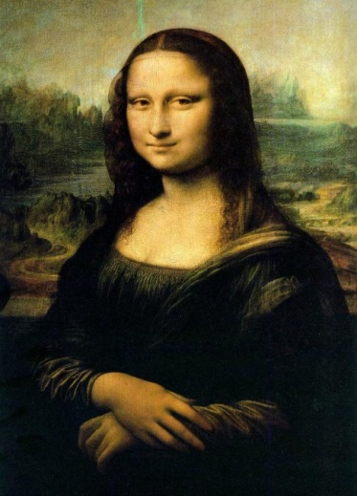
artist: portraits
Ginevra de' Benci is an oil portrait painted in 1476-1478, now situated in National Gallery of Art, Washington, D.C.
Lady with an Ermine. The subject of the portrait is Cecilia Gallerani and it’s one of only four portraits of women painted by Leonardo. 1489–90, Czartoryski Museum, Kraków.
La belle ferronnière is a name given to a portrait in The Louvre of a woman, usually attributed to Leonardo da Vinci. It is also known as Portrait of an Unknown Woman, 1490–1496, Paris.
Mona Lisa is a portrait painted in oil by Leonardo da Vinci during the Renaissance in Italy, 1503-1519. The work is owned by the Government of France and is on display at the Musée du Louvre in Paris.

Slide 7
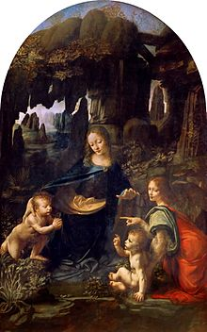
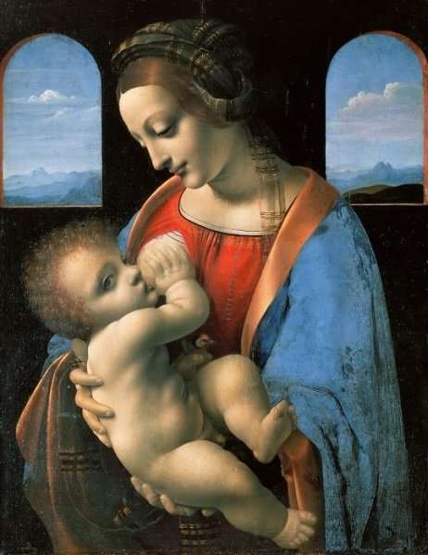
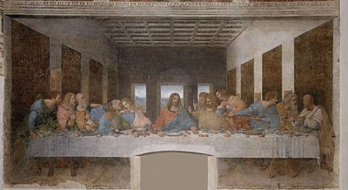
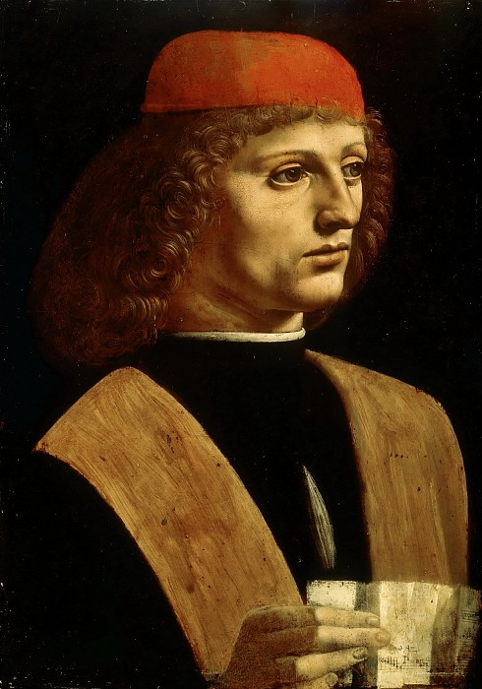
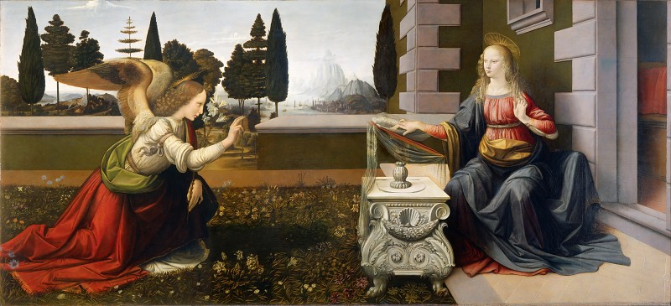
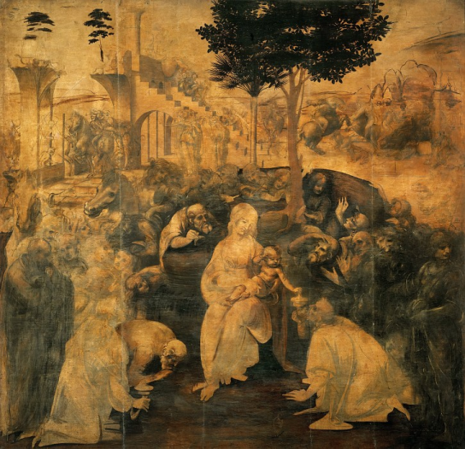
Artist: paintings and drawings
Madonna Litta
Virgin of the Rocks
The Last Supper
Annunciation
Adoration of the Magi
Portrait of a Musician

Slide 8
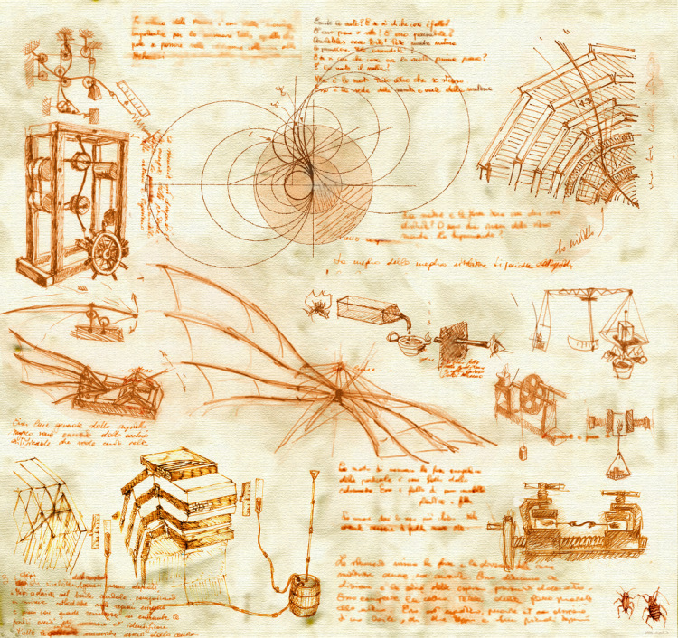
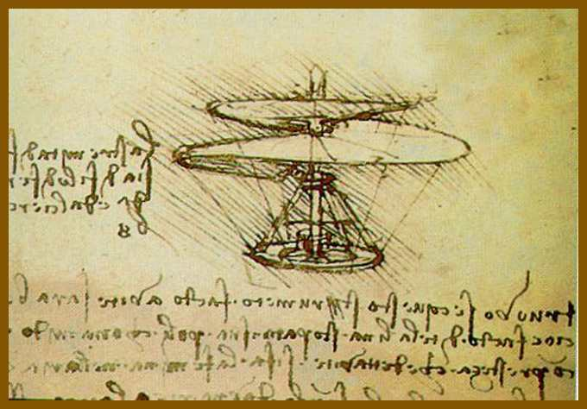
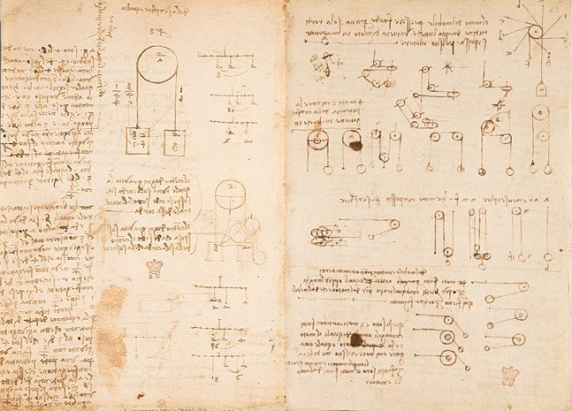
Professional activities
Leonardo da Vinci was not only a great artist, painter, sculptor and architect, but also a brilliant scientist, to study mathematics, mechanics, physics, astronomy, geology, botany, anatomy and physiology of humans and animals,
In his manuscripts there are drawings of flying machines, parachutes and helicopters, new designs and machine tools, printing, woodworking and other machines.
Page from the diary of Leonardo. Gravity research

Slide 9
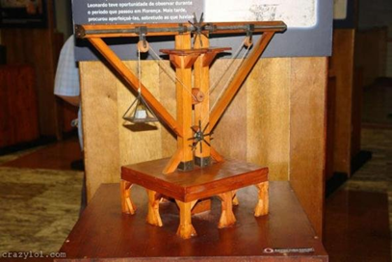
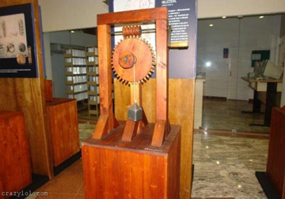
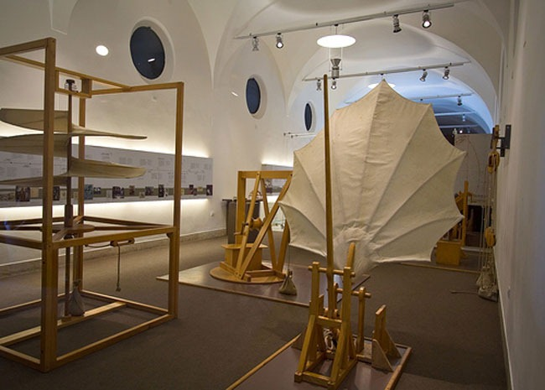
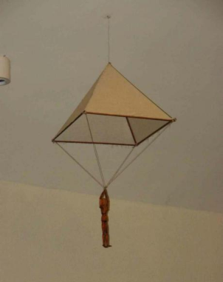
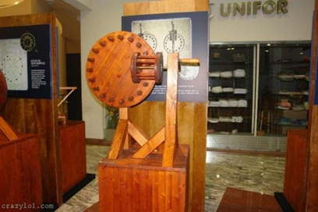
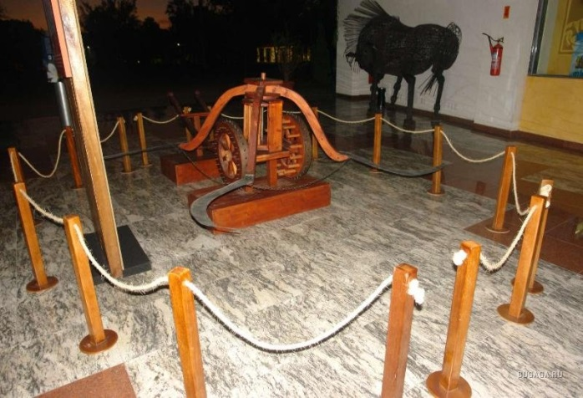
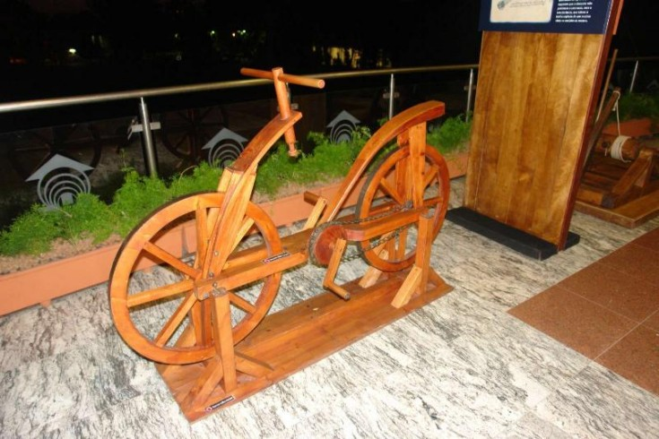
Da vinci museum
Museum dedicated to the universal genius Leonardo da Vinci, located in the heart of Florence, allowing to make a trip around the world. Opened in 1993
Da Vinci Museum located in the old cellar of the castle, which was part of an underground tunnel in 1867, built in the memory of Garibaldi. The exhibition area is about 520 square meters, where there are more than 250 exhibits.

Slide 10
Thanks for watching!

