Slide 1
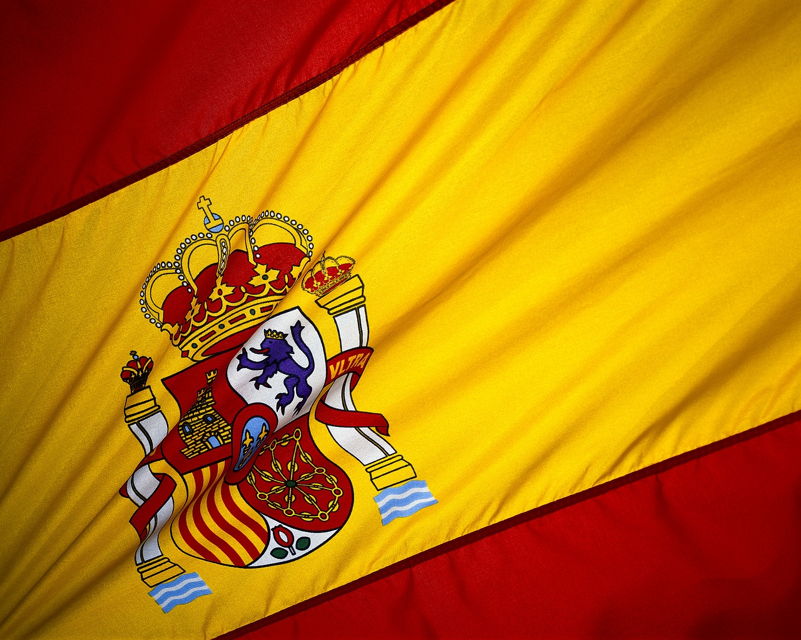
España

Slide 2
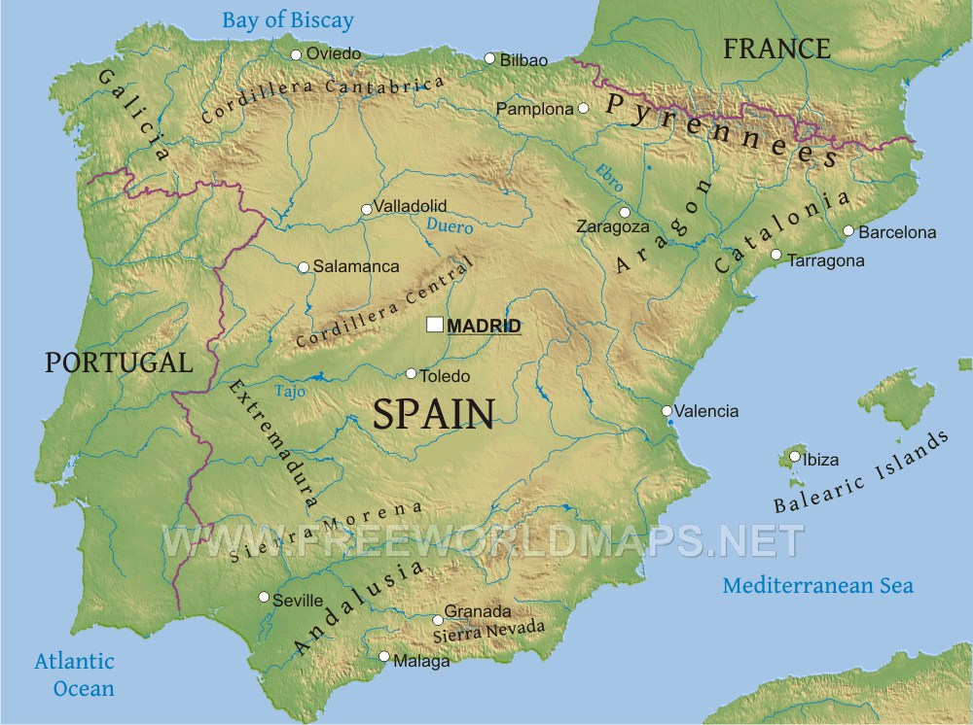
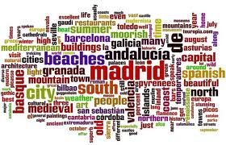
Area: 504,780 square kilometers.
Population: 40,341,462 (approx)
Currency: Euro, formerly Peseta

Slide 3
Spain is located on the Iberian Peninsula in southwestern Europe. Its mainland is bordered to the south and east by the Mediterranean Sea except for a small land boundary with Gibraltar; to the north and north east by France, Andorra, and the Bay of Biscay; and to the west and northwest by Portugal and the Atlantic Ocean. It is one of three countries (Morocco, France) to have both Atlantic and Mediterranean coastlines.

Slide 4
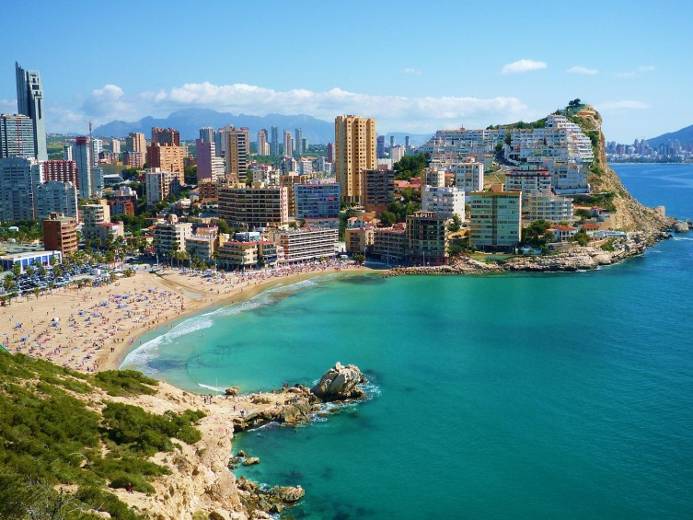
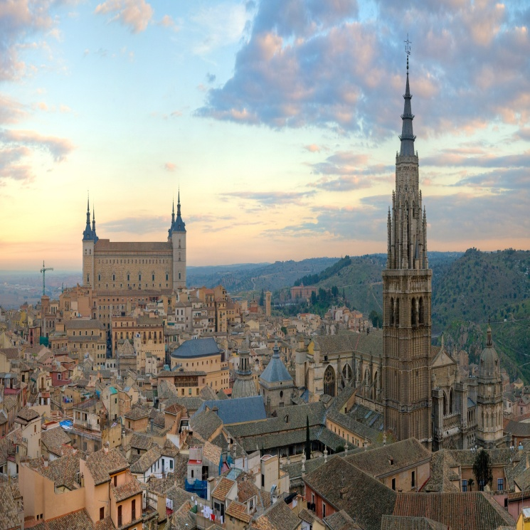
Tourism
The Spanish tourism industry has grown to become the second biggest in the world, worth approximately 40 billion Euros, about 5% of GDP, in 2006.Today, the climate of Spain, historical and cultural monuments and its geographic position together with its facilities make tourism one of Spain's main national industries and a large source of stable employment and development. The Spanish hotel star rating system has requirements much more demanding than other European countries, so at a given rating Spanish accommodations are worth more.

Slide 5
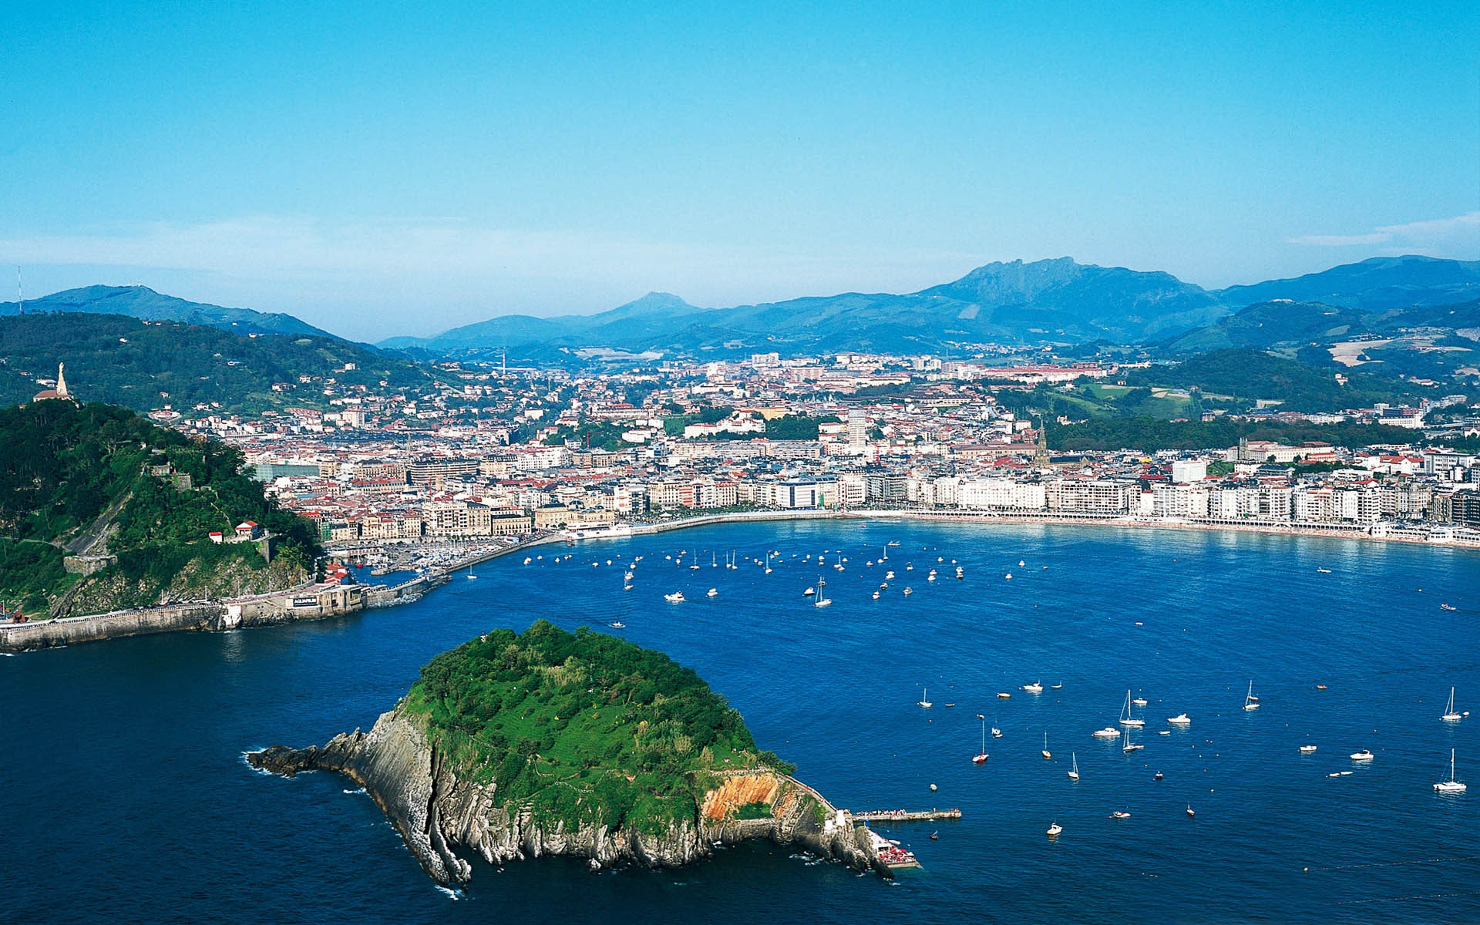
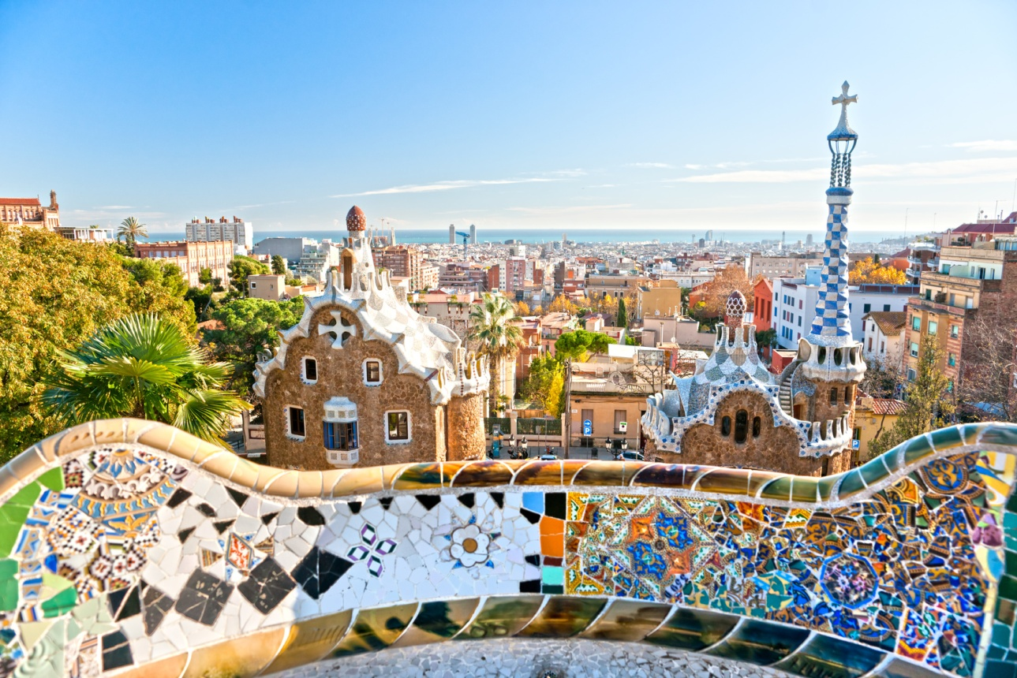

Slide 6
Cuisine
Spanish cuisine consists of a great variety of dishes which stem from differences in geography, culture and climate. It is heavily influenced by seafood available from the waters that surround the country, and reflects the country's deep Mediterranean roots. Spain's extensive history with many cultural influences has led to a unique cuisine. In particular, three main divisions are easily identified:
Mediterranean Spain – all such coastal regions, from Catalonia to Andalusia: heavy use of seafood, such as pescaíto frito; several cold soups like gazpacho and many rice-based dishes like paella from Valencia and arròs negre (arroz negro) from Catalonia.
Inner Spain – Castile – hot, thick soups such as the bread and garlic-based Castilian soup, along with substantious stews such as cocido madrileño. Food is traditionally conserved by salting, like Spanish ham, or immersed in olive oil, like Manchego cheese.
Atlantic Spain – the whole Northern coast, including Asturian, Basque, Cantabrian and Galician cuisine: vegetable and fish-based stews like pote gallego and marmitako. Also, the lightly curedlacón ham. The best known cuisine of the northern countries often rely on ocean seafood, like the Basque-style cod, albacore or anchovy or the Galician octopus-based polbo á feira and shellfish dishes.

Slide 7
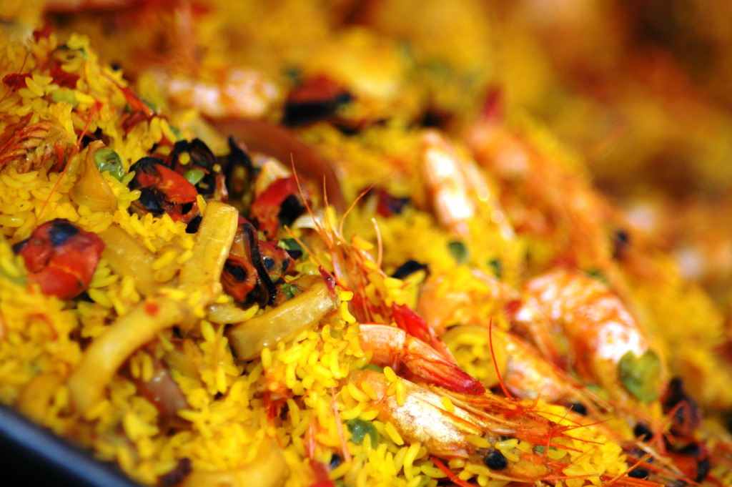
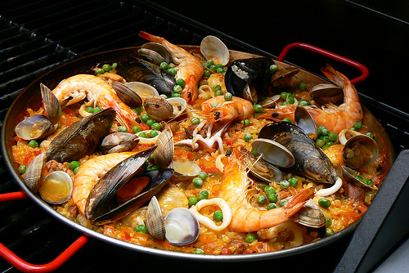

Slide 8
Public holidays and festivals
Public holidays celebrated in Spain include a mix of religious (Roman Catholic), national and regional observances. Each municipality is allowed to declare a maximum of 14 public holidays per year; up to nine of these are chosen by the national government and at least two are chosen locally. Spain's National Day (Fiesta Nacional de España) is 12 October, the anniversary of the Discovery of America and commemorate Our Lady of the Pillar feast, patroness of Aragon and throughout Spain.
In Spain there are celebrated many festivals and festivities. Some of them are known worldwide, and every year millions of people all over the world go to Spain to experience one of this festivals.
One of the most famous is San Fermín, in Pamplona. While its most famous event is the encierro, or the running of the bulls, which happens at 8:00 am from 7 July to 14 July, the week long celebration involves many other traditional and folkloric events. Its events were central to the plot of The Sun Also Rises, byErnest Hemingway, which brought it to the general attention of English-speaking people. It has become probably the most internationally renowned fiesta in Spain. Over 1,000,000 people come to watch this festival.
Other festivals include the carnivals in the Canary Islands, the Falles in Valencia or the Holy Week in Andalucia and Castile and Leon.

Slide 9
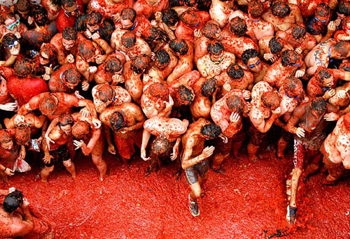

Slide 10
Thank your for your attention.

