Slide 1

World Wildlife Fund is an international non-governmental organization working in the fields of conservation, research and environmental restoration.

Slide 2
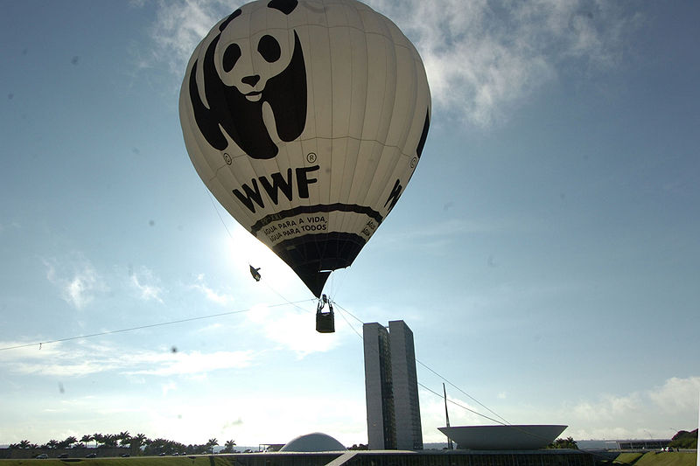
The mission of WWF is to stop the degradation of planet's natural environment and achieve harmony between man and nature. The main purpose - to save Earth's biological diversity.

Slide 3

Symbol of the World Wildlife Fund - a big panda.

Slide 4
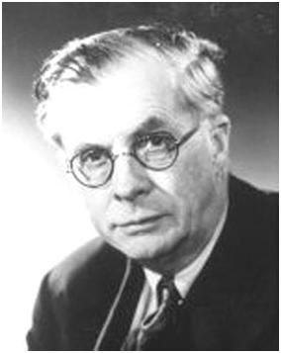

The founders of Julian Huxley
Max Nicholson
Peter Scott
Guy Montfort

Slide 5

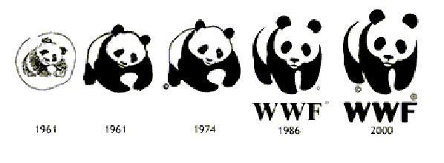
During the stay of Chi-Chi the panda at London Zoo, saw her one of the founders of the World Wildlife Fund - a scientist and animal artist Sir Peter Scott. He made a stylized portrait of a panda, and decided that the image of the good-natured, an animal in need of protection will be a wonderful symbol of the new fund.

Slide 6
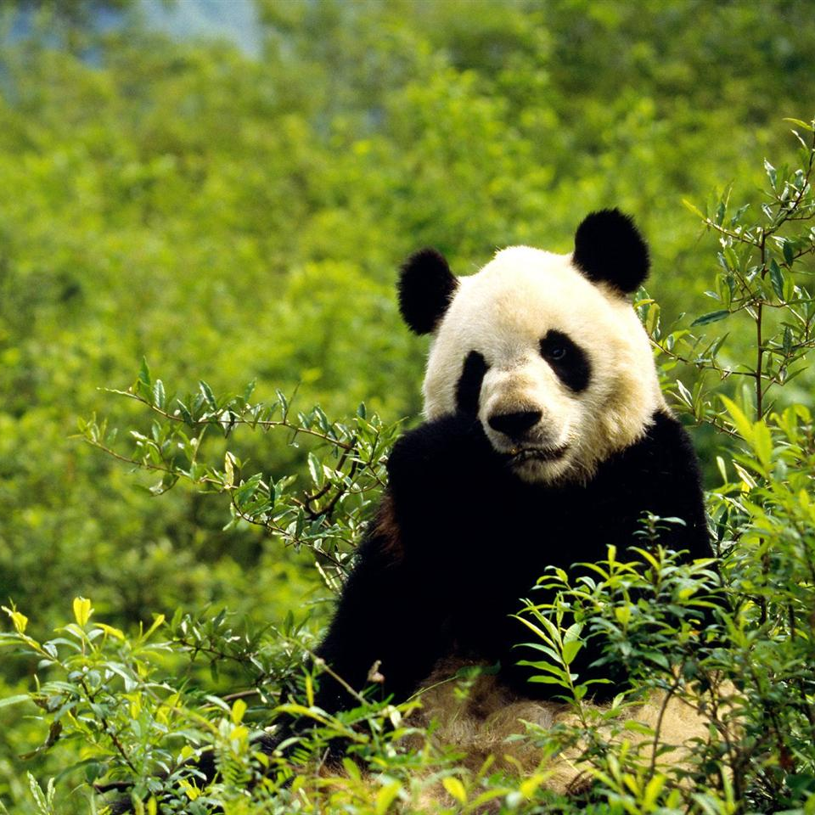
Panda - one of the rare animals listed in the International Red Book.

