Slide 1
Prepared student 10-A Сlass Andrew Pryadko
Architecture of London
21/05/14

Slide 2
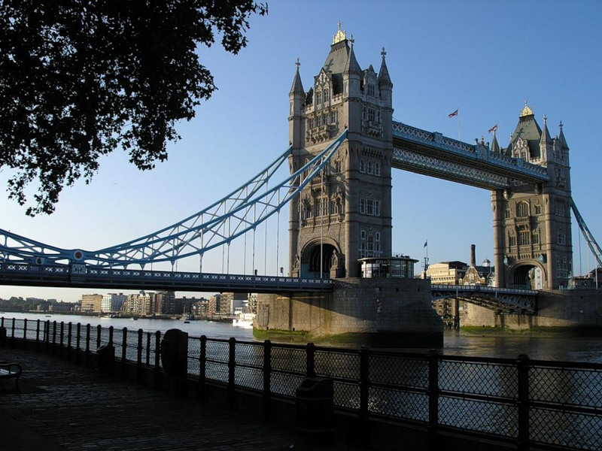
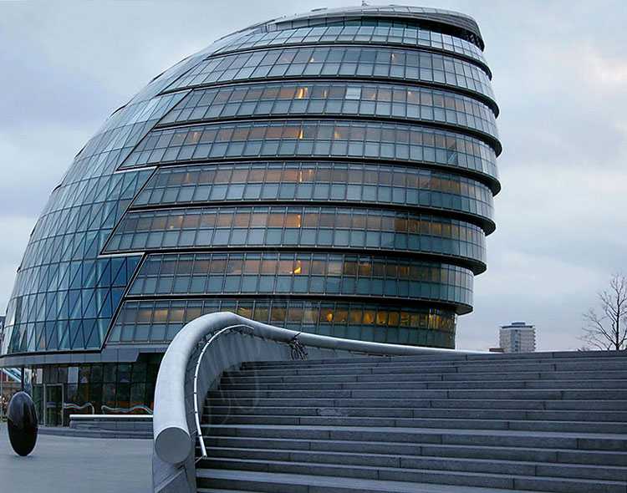
Architecture of London represented nearly all the styles from Norman to postmodernism. Many medieval buildings have not survived through the great fire in 1666 that destroyed more than 13,000 homes.

Slide 3
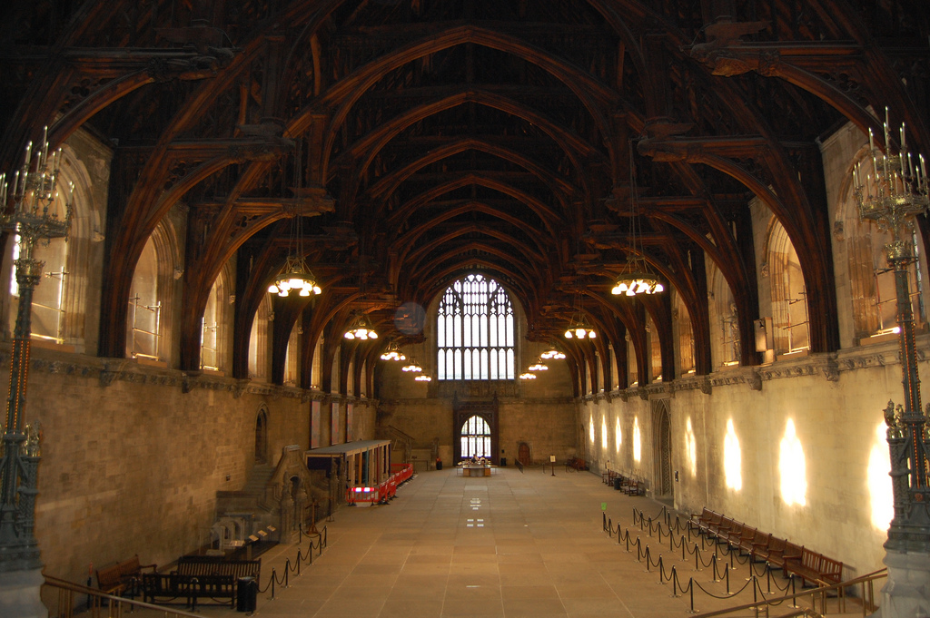
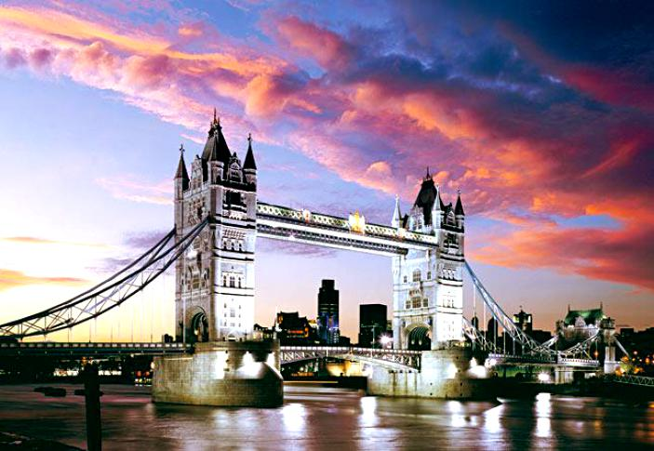
Norman architecture in England. With the Norman style buildings in London famous Tower. In the same style built in 1097 performed the Westminster reception hall.

Slide 4
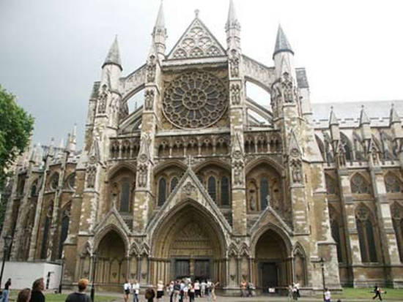
XIII century was the century of early English Gothic. One of the most striking examples of this style is Westminster Abbey. Other examples of this period in London have not survived.

Slide 5
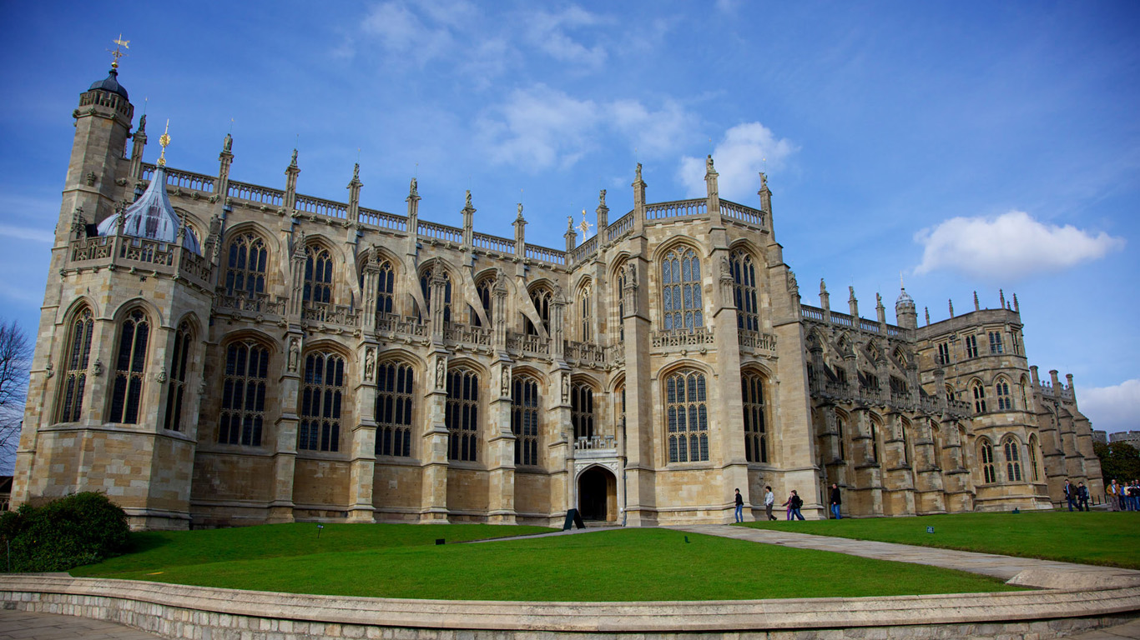
Tyudorskyy period. Architecture of the Tudor gothic like, but with significant changes in the pattern of deep and high windows. Chapel of Henry VII in Westminster and Hampton Court
Palace in Richmond

Slide 6
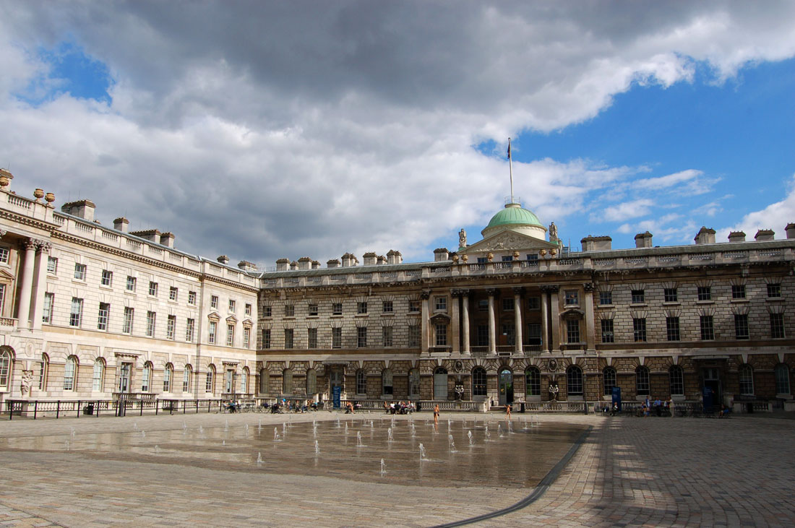
Heorhianska architecture Examples are the church, designed by Nicholas Houksmurom, the palace of Somerset House, and entertainment center "Pantheon" of Oxford Street architect James Vayetta.

Slide 7
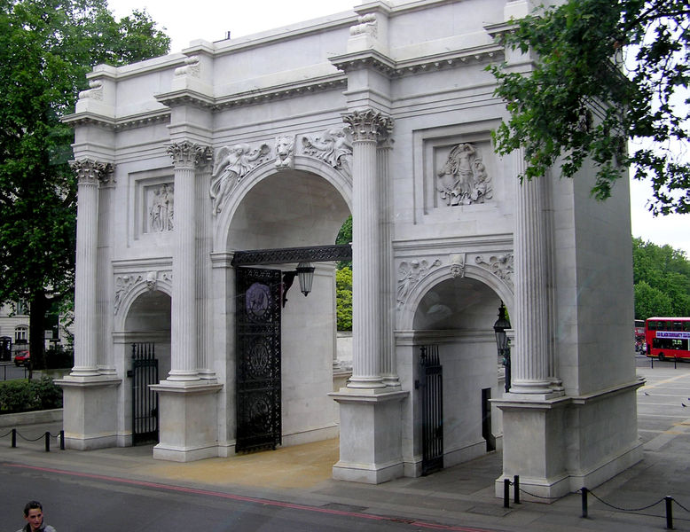
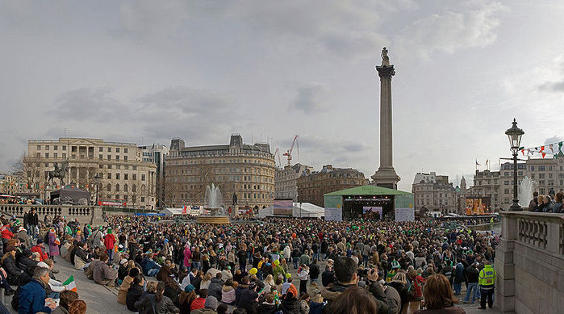
In the classical style worked John Nash, the author set Trafalgar Square, Buckingham Palace and Marble Arch; Westminster Cathedral is an example of neo-Byzantine style.

Slide 8
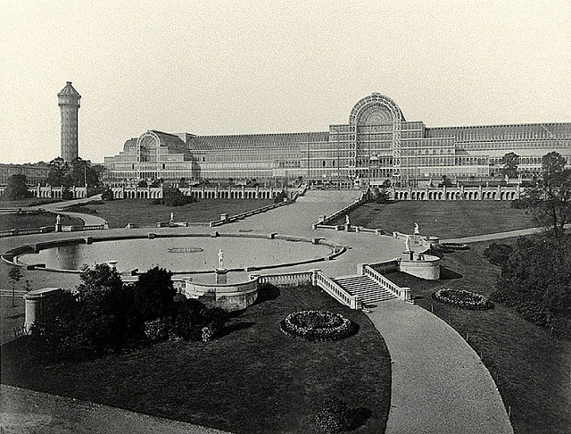
Now defunct Crystal Palace related to the industrial style.

