Slide 1
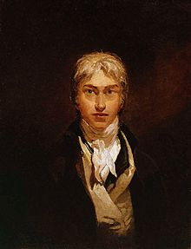
William Turner (23 April 1775 – 19 December 1851)
He was one of the most famous landscape painters of 19 century. He was an English Romantic landscape painter

Slide 2
We need to consider and understand his work. He painted waves and storms, clouds and mists with a great skills.

Slide 3
WELCOME to personal gallery William Turner!

Slide 4
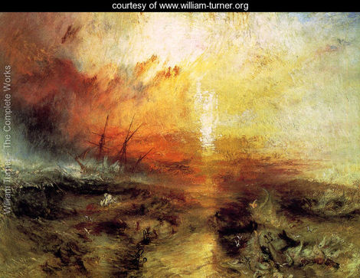
Title:The Slave Ship Location:Museum Of Fine Arts, Boston, USA Year:1840 Orientation:Landscape

Slide 5
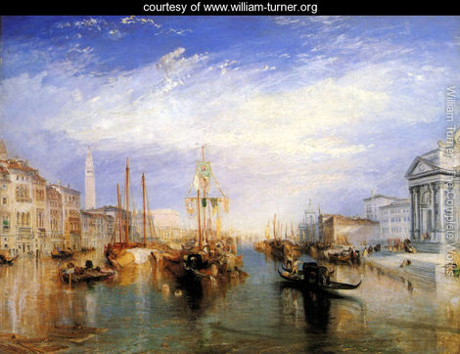
Title:The Grand Canal, Venice Location:Metropolitan Museum Of Art,, New York, Year:1835 Orientation:Landscape

Slide 6
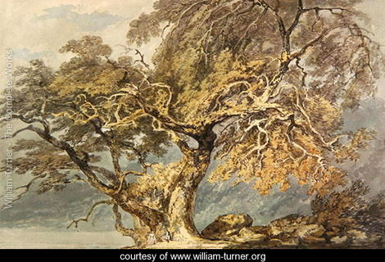
Title:A Great Tree Location:Yale Centre For British Art, Hartford, Connecticut Year:1796 Orientation:Landscape

Slide 7
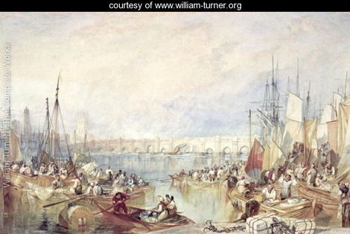
Title:The Port of London Location:Victoria And Albert Museum, London, England Orientation:Landscape

Slide 8
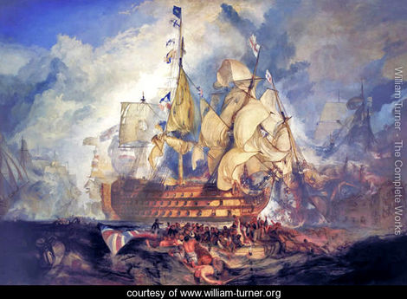
Title:The Battle of Trafalgar Orientation:Landscape

Slide 9
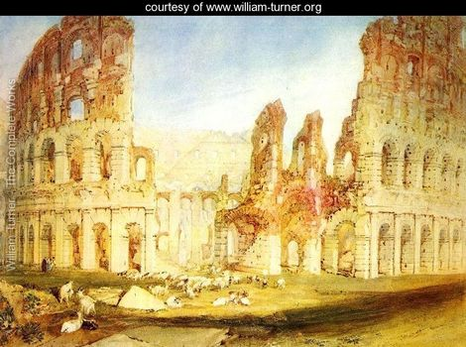
Title:Rome The Location:British Museum, London, England Orientation:Landscape

Slide 10
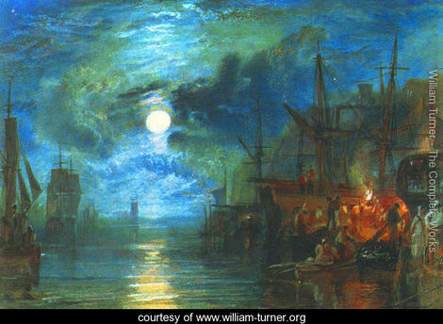
Title:Moon on the River Location:Tate Gallery, London, England Orientation:Landscape

Slide 11
Exit

Slide 12
Thank you for your attention!

