Slide 1
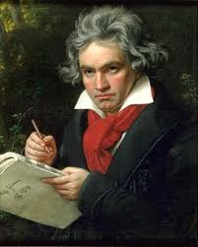
Ludwig Van Beethoven

Slide 2
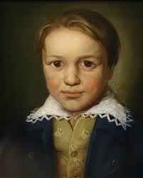
Biography
Ludwig van Beethoven is one of the greatest composers of all time. His works and genius have influenced life for over two centuries. He pushed the envelope of musical composition previously known. He was able to turn turmoil into musical triumphs. Many experts have conflicting opinions on his life history and what drove him to compose certain works, but they all agree that his musical genius changed the world of music forever!
Ludwig van Beethoven was born in Bonn, Germany on December 16, 1770, according to most historians. In the 1770’s the main record kept about new children was their baptism date. There is official documentation that Beethoven was baptized on December 17, 1779. Beethoven’s mother was Maria Magdalena and his father was Johann van Beethoven.
Ludwig van Beethoven at 13 years old

Slide 3
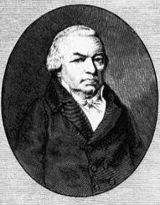
Maria Magdaleana was already a widow and a mother when she met Beethoven’s father Johann van Beethoven. It seems their marriage was unhappy from the start since Ludwig van Beethoven (Johann’s father) didn’t agree with the marriage, but she was devoted to her husband. Beethoven’s mother Maria ended up having a total of 6 children, but only 3 of them lived to maturity. She died at age 40 from consumption.
When Beethoven’s father Johann van Beethoven was 22 years old he became a court musician. He also taught piano and voice lessons. It seems that he was not successful at either of those professions, and it seems all he was really good was drinking. He was an alcoholic and eventually ended up getting banished from Bonn because of it.
Ludwig van Beethoven was named after his grandfather, Ludwig van Beethoven. At the age of 49 he became the Kapellmeister. Which made him manager of all things music in the city of Bonn. He held this position until he passed away in 1773. Even though his grandfather only lived a few weeks past Ludwig’s third birthday there are records that indicated he remembered his grandfather and spoke of him often. And as an interesting side note, Beethoven’s grandfather also owned a wine business, his wife was an alcoholic and so was Johann, his son.
Beethoven’s Father

Slide 4
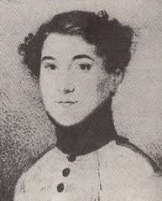
Ludwig van Beethoven had two younger brothers. Nikolaus Johann van Beethoven (1776-1848) was a pharmacist, and actually ended up doing very well for himself. These two brothers defiantly did not get along. Nikolaus decided to just go by Johann when he moved to Vienna and Beethoven hated that. Also, Beethoven tried to stop Johann from marring his housekeeper, Therese Obermeyer, but did not succeed. Ludwig’s other brother was Caspar Carl van Beethoven (1774-1815), earlier in life he followed in his brother’s footsteps and shadow. He taught piano lessons, using the fact that he was Beethoven’s brother to his advantage and even acted as his agent for a short time. Ludwig also had issues with Carl’s choice in a wife, which really seemed to negatively affect their relationship until Carl also became ill with consumption. At that time he reunited with his brother and his 6-year-old nephew.
Beethoven’s father began to teach him music around the age of three in a very strict way. His father would beat him every time he made mistakes, and would even lock him in the cellar if did not play to his father’s expectation. His father taught him the violin and clavier and he also took lessons to learn the organ. He was very musically talented, even at such an early age. He was becoming proficient by the age of five and had his first public concert at seven. His father dreamed that he would have another Mozart and wanted to cash in on his talent.
Beethoven’s Nephew, Karl Beethoven

Slide 5

In school he struggled with simple math and other lessons. At age 10 he quit school and he went to study music full time with Christian Gottlob Neefe, a Court Organist. At the age of 12 he published his first composition. At 14 years old, his father’s alcoholism was getting out of control and he auditioned to be an assistant court organist to support his family. In 1787, the court sent Beethoven to Vienna to study music. He was able to get an audience with Mozart who was immediately impressed with Beethoven and said, “Keep your eyes on him; some day he will give the world something to talk about.” Unfortunately it seemed as soon as he arrived he had to rush back home because his mother had become very ill with consumption and died. He remained working as a Court Musician in Bonn for several years to support his younger brothers and alcoholic father. His horrible home life drove him to become bitter

Slide 6
When Beethoven was 19 years old he created his first masterpiece! He was asked to compose a musical memorial for the Roman Emperor Joseph II. He didn’t end up performing this piece, but more than a century later Johannes Brahms discovered the composition called Cantata on the Death of Emperor Joseph II.
In 1792 Beethoven left Bonn for Vienna. He went to study with Joseph Haydn. At that time his father died but he did not return for the funeral. He was able to completely focus on studying music while in Vienna. The musical knowledge he acquired with his impeccable work ethic, made Beethoven one of the most knowledgeable composers of his time. He quickly became well known in musical circles. He often performed for the rich people of his time, and received many gifts and money. His first official concert in Vienna was in March 1795. It is debatable, but many scholars feel he performed his first piano concerto in C Major. He also published Opus 1, the Trios for Piano. In this time period, it was very hard to get your own work published, but it seems right from the get go Beethoven had his worked published.
He was known for his difficult arrangements and his music was much more important than the feelings of the musicians. His compositions did not follow the normal patterns of the day. It has been said the when a violinist asked him to change his work he replied, “Do you think I give a damn about your miserable violin when the muse visits me.”(A&E Biography “Beethoven: The sound and the Fury”) He put his full emotion into every piece he composed.
Click to view biography video

Slide 7
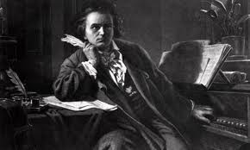
In the spring of 1800, Beethoven performed his Symphony No. 1 in C Major at the Royal Imperial Theater in Vienna. During his 20’s he had a ringing start in his ears and physicians told him he would lose his hearing. He became more withdrawn and rude, but he continued to publish many pieces while desperately struggling with the fact that he was becoming deaf. He composed what is now known as the Moonlight Sonata in 1801, perhaps as a way of coping with his deafness, or as some speculates as a tribute to a love interest. A note was found in Beethoven’s room after his death, it was dated 1802 and was written to his brothers as final words and a will. It explains that if it weren’t for his art, he would have ended his life because of the affliction on being deaf.
Even though he continued to go deaf “From 1803-1812, what is known as his "middle" or "heroic" period, he composed an opera, six symphonies, four solo concerti, five string quartets, six string sonatas, seven piano sonatas, five sets of piano variations, four overtures, four trios, two sextets and seventy-two songs. The most famous among these were symphonies No. 3-8, the "Moonlight Sonata," the "Kreutzer" violin sonata and Fidelio, his only opera,” according to biography.com. Composing this many different original, creative pieces, especially when he’s losing his hearing, was an incredible feat that has yet to be done again in history.
Beethoven Composing

Slide 8
Beethoven did not have many close people in his life. In fact he would often get angry with those around him and withdraw from them. He never married, although he had several relationships. In his notes after he died there were notes to his “immortal beloved.” When his brother Carl died he had a very long, ugly fight with his sister-in-law to get custody of his nephew. In the end, Beethoven won the five year long custody battle, but never seemed to win over his nephew.
Beethoven was very shy and not very attractive. He was only about 5’4 and had a pox marked face, from small pox, and unruly hair. He almost always had a very sour expression on his face. During his later life he did not care about himself, often wearing the same clothes for weeks. He was kicked out of several apartments for ruining them with his piles of papers and rubbish. He was even arrested for being a beggar due to his unkempt appearance
During this later time in his adult life, even though he was struggling with family, was sick and completely deaf, he wrote some of his greatest music. He wrote a mass the Missa Solemnis, and some hauntingly beautiful compositions for string quartets. His Symphony No. 9 is the first symphony to ever use a chorus as part of the composition. He set his music to the word of a poem by Friedrich Schiller. This symphony was written when he was totally deaf. It was received with huge acclaim with those in attendance cheering. Beethoven had to be turned around, by a musician, so he could see the applause of the audience.
Click to view video with words from biography

Slide 9
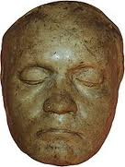
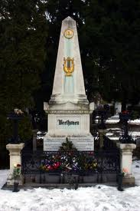
Beethoven became ill as he was trying to write a 10th symphony and on the 22nd of March, 1827 he was given last rights. During a tremendous storm Beethoven raised his fist to a lighting flash and then collapsed. Beethoven at 56 on was dead on March 26, 1927. In his will, he left everything to his nephew, Karl. Over 20,000 people attended his funeral services because his music was known as being so grand. After he died his belongings were not well taken care of, in fact, after his death anyone was allowed to walk into his home. So many manuscripts and other documentations were lost.
The great master Beethoven overcame personal struggles for his art and he creative muse was his passion. He wrote music that emotion was primary not the musical rules. His musical talents have enriched each of our lives. His music is so revered that it was sent on the Space Shuttle Voyager and played as the Berlin Wall was torn down. We have been blessed and will continue to be touched by his works.
Beethoven’s Death Mask
Beethoven’s Grave

Slide 10
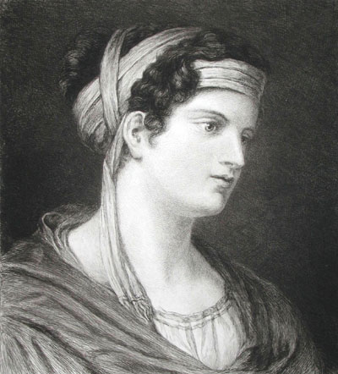
History of Beethoven’s Symphony No. 5 in C Minor
Beethoven’s Symphony No. 5 in C Minor is one of the most widely known classical pieces. The opening four notes have been heard all over the world.
Beethoven composed his Symphony No. 5 during the years 1804 – 1808. Not much is known about his actual the actual compositions meaning. There has been speculation that it might have been written about a love affair that was doomed, to either Therese von Brunswick or Giulietta Guicciardi (taken from Dr. Richard E. Rodda). Beethoven’s associates, Ferdinand Ries or Anton Schindler, have also suggested that Beethoven meant it to be “Fate knocking at the door.” There is no documentation to substantiate either claim. We do know that during the time frame it was one of his most productive. According to Dr. Richard E. Rodda, program annotator, writer, and professor, he also composed piano sonatas, at least three opuses, a piano concerto, two symphonies, a violin concerto as well as five to six other works during those years. As was Beethoven’s habit he made many revisions to his symphony over the course of time. He never stopped the rewriting process until he completed his musical vision.
Therese von Brunswick

Slide 11
The symphony made its performance debut on December 22, 1808 in Vienna at the Theater an der Wien. According to history.com it was a very cold night and it was a very long concert since several pieces made performance debuts. Symphony No. 5 was not played to Beethoven’s satisfaction that night. In fact he stopped his musicians and had them start a passage again. It was soon after recognized as his greatest work to date. In 1810 critic Hoffmann said he had surpassed Haydn and Mozart, when he stated about the symphony that it, “opens the realm of the colossal and immeasurable to us…evokes terror, fright, horror, and pain, and awakens that endless longing that is the essence of Romanticism.”(www.history.com)
Click to view interesting facts about Beethoven

Slide 12
Symphony No. 5 has four distinct sections. The most famous being the first, due to its opening notes. It starts almost dark and menacing. Then the symphony moves to a second lighter section. The third section is a Scherzo and returns to a darker feel. The final section ends with a triumphant feel. Beethoven magically weaves his four note theme throughout the symphony tying it all into one flowing piece.
Beethoven’s Symphony No. 5 has been used in movies such as Casino Royale and television shows like The Mentalist, House and Family Guy. The opening notes were even used in England during WWII “to open broadcast of the BBC because it mimicked the Morse-code “V” for “Victory”, according to history.com. The symphonies opening notes and rhythms have been used in many pop songs. The most famous is Electric Light Orchestra’s “A Fifth of Beethoven,” arranged by Walter Murphy. ELO uses the basis of Beethoven’s original symphony and adds a techno pop or disco feel with its electric guitars and synthesized keyboards. They arranged a Beethoven song you could dance to.
Beethoven’s work is known the world over and is used many times in our modern day lives. We still appreciate his Symphony No. 5 over 200 years later.
Click to view timeline of Beethoven’s Life

Slide 13
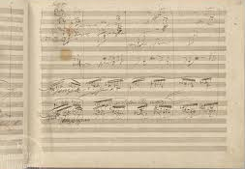
Symphony No. 5 in C Minor, Op. 67 First Movement – Listening Guide
Click to Play Composition
Exposition
i. 0:00 Theme 1 is extremely concise and the harmonic basis is strikingly simple and very familiar, (Bach’s famous Fate motif). The strings state and repeat, twice, a distinctive four note short-short-short-long motif as the C minor key is established. Both motifs are played urgently, as the last note in each motif is sostenuto. The listener can immediately connect to this dramatic opening theme, sounding as though “fate is knocking at the door. The appeal of Theme I is timeless for many listeners. This motif appears frequently in popular cultures, from disco to rock and roll, to appearances in film and television.
ii. 0:08 Motif A is treated sequentially as the violins play piano, making a second statement of the 4 note motif. The instruments take turns passing around Motif A.

Slide 14
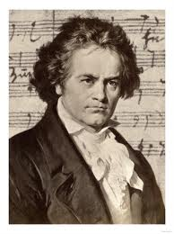
iii. 0:18 Cadence, there is a momentary pause and the violins hold and carry a chord in C minor beyond the pause. The motif continues repeating itself as the instruments take turns passing around the 4 note ‘fate’ motif..
iv. 0:26 A-full motif statement is made. The fate motif continues and an exciting crescendo builds leading to another long pause. Only the violins continue to be heard. There is another pause, the motif is repeated by the different instruments as tension builds.
v. 0:48 The Bridge; is very short and is stated by the optimistic French horns in fortissimo as they modulate to the key of E-flat major and announce the second theme with fanfare using ‘Fate’ rhythm, and create an expansion from the 4 note motif. More hope is created as the passion in life becomes more vivid.
vi. 0:56 Theme II in E-flat major, contrasting with hopeful
violins, corresponds, at its onset, to the principal motif derived
directly from the motif of the opening 4 measures with a
flowing melody with rhythmic alterations. As the melody is
played the contrabass are in the background playing Motif A.
The intensity continues building.

Slide 15
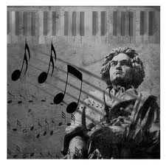
vii. 1:14 Theme II in E-flat major and Theme I motifs speak to each other. Motif A begins again.
viii. 1:25 The closing theme is a descending staccato passage and then the 4 note motif is returns.
ix. 1:34 Theme I the Exposition is repeated in its entirety and reverts back to the beginning key of C minor.
Development.
3:05 The beginning of the development is in Motif A and is announced by horns and clarinets as clarinets answer by interrupting the flow of music. There is a descending sequence that manipulates the 4 note motif. There are melodic variations and intervals filled in and inverted. Motif A is passed among the instruments and the mood is transformed from victory to foreboding.
3:20 The orchestra builds into a dissonant climax and expansion through repetition of Motif A, which begins to lead into recapitulation.
3:33 Theme II begins as the horns call in the strings.
3:42 There is fragmentation of Theme II as the strings compete
with the winds. The bridge motif is used to move the harmony.
3:55 The battle between the strings and winds recedes, with
the exception of one last volley and one lonely note.
4:22 Repetition of the bridge motif restates the bridge from
the exposition. There is a dramatic return to the opening section,
the recapitulation begins.

Slide 16
Recapitulation
4:31 There is a recap of Theme I in C minor which starts out with two dramatic fortissimo phrases, the famous motif commanding the listener’s attention.
4:52 The violins end abruptly, there is a break in time and the oboe plays its small solo cadenza, a mournful oboe cadenza from out of nowhere in a quasi-improvisatory style.
5:02 Theme II returns with the horns calling and is followed by the main Theme. Thematic development through the sequencing of Motif A continues.
5:26 Bridge-Theme II returns in C major as the bassoon creates the bridge from C minor to C major and plays out the struggle of parallel major and minor tonalities. The mode changes from serious struggle to glorious overcoming of fate with accents on the up beat.
5:28 Theme II in C major begins with the same tonal center and some notes in the C scale are higher to create an optimistic, warm feeling. The lower strings play Motif A underscoring the melody.
6:05 Motif A is tied together getting ready for a change, getting ready for the Coda.
Click to view video of Symphony No. 5

Slide 17
History of Für Elise
Für Elise is one of the most well know compositions in the world. Many children learn the beginning section of the piece while taking piano lessons. We hear it in many places such as a ring tones on cellphones. It has been used as background music in movies, like Patch Adams, You Got Served, Rosemary’s Baby and Bill and Teds Excellent Adventure. Many television shows have used it as well, such as in Charlie Brown Specials, Dancing with the Stars, The Simpson and Monk to name a few. It has even been the background music in commercials for companies such as Starbucks and Victoria Secret. Some of the popular musical groups of today have incorporated sections of the piece adding a different beat and words to it. There are many YouTube Videos that have been submitted with both children and adults playing the piece. Some people might not know the name of the composition but if you hum it they will hum along with you since it is so recognizable.
The piece Für Elise, meaning for Elise in English, was originally publish about 1867 by Ludwig Nohl from an autographed manuscript dated April 27th. It was estimated that it was composed in 1810 but the date was not on the manuscript. After historians examined some of Beethoven’s notes they believe that there is a possibility that the piece was started as early as 1808, he then put it aside for 2 years. This is due to sketches found next to other pieces that were published at that time. The publication of Für Elise was 40 years after the death of Beethoven.
Click to view website about Fur Elise

Slide 18

There is some controversy of whether it was really dedicated to Elise or if due to Beethoven’s poor hand writing that it should have been dedicated Therese Malfatti a friend and student that he proposed to. The manuscript used to publish the composition has been lost so we will never know.
A composer during that time rarely named their pieces but usually gave them a name that was a description of the type of work followed by its key signature and then by the number that was determined by his previous works. Another name for the piece Für Elise is Klavierstücke which means piano piece. Also composers would give their published works an opus number. In 1955 unnumbered works by Beethoven were given a number of WoO by Georg Kinsky, which means an opus without a number. So Für Elise also became known as Bagatelle in A minor WoO 59.
After the publication in 1867 of Für Elise another similar version was found in Beethoven’ notes that included some significant changes. These changes were made approximately in 1822 since Beethoven was preparing his bagatelle-like pieces, which are short piano pieces. During that time he made many revisions to early pieces bringing them more update and with more intricate melodies. The later piece of music he had made changes to the original ink notes with pencil notations. Although he had made significant changes he never published this work.
Für Elise by Ludwig van Beethoven is still considered one of the most recognized pieces from a classical composer. People today here the
melody and think of romance due to its light and airy feel at the
beginning. As you listen to the piece you can feel the range of
emotions one feels when in a relationship. This contributes to why
the piece Für Elise is used over and over in other genres such as
movies, television shows and commercials. It will continue to be
a piece learned by aspiring young musicians.

Slide 19

Fur Elise - Listening Guide
Click to Play Composition
i. 0:00 - A - Phrase A begins softly with a simple melody, with an Arpeggio being played underneath it alternating between major and minor chords. Notice how the notes played by the left hand descend while the right hand ascends and vice versa. It has the sound of growing and shrinking due to the cresendos and decresendos. This is repeated twice.
ii. 0:23 - B - In Phrase B the right hand melody changes slightly with the left hand playing a similar part. The arpeggios continue moving the piece gently forward.
iii. 0:32 - A - Phrase A is repeated but is played softer with slightly more intensity and more dynamics.
iv. 0:41 - B - Briefly goes back into Phrase B and is played similarly to the first time Phrase B is played.
v. 0:52 - A - Runs through Phrase A twice before transitioning into Phrase C.
vi. 1:02 - C - Phrase C changes to a more complex melody which is very upbeat and happy. It picks up speed here and is more staccato.
It sounds hurried, almost like a chase.

Slide 20
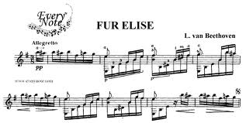
vii. 1:14 - C - At this point the melody becomes even more complex and textured. It continues to crescendo and pick up speed.
viii. 1:21 - A drastic retard then a quick transition back into Phrase A.
ix. 1:25 - A - Phrase A is played more loudly this time.
x. 1:35 - B - Also played loudly.
xi. 1:45 - A - Phrase A is repeated again here with no noticeable changes compared to the last time it was played.
xii. 1:54 - D - Up until now the song is played very gracefully, In Phrase D there is a very noticeable beat that is being played by the left hand in sixteenth notes that are all the same note. The right hand is very staccato as well. This phrase sounds very angry. This is emphasized by it being played fortissimo. It makes you feel like there is an intense fight happening. A single note played in the top octave.

Slide 21
xiii. 2:10 - It sounds like it changes key right here and gives you the feeling that the fight has been resolved.
xiv. 2:19 - E - Phrase E is played very Legato and in a descending Chromatic scale. This also resolves the negativity from phrase D.
xv. 2:27 - A - Phrase A is played very graceful again bringing it back to the beginning melody in Rondo format.
xvi. 2:36 - B
xvii. 2:46 - A
xviii. 2:57 - The song concludes with extreme ritardando. We end very softly on a
Click to view video of Fur Elise

Slide 22
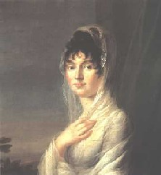
History of Moonlight Sonata
Moonlight Sonata was composed during the summer of 1801. At this time Beethoven was staying with the Brunswick family, who were family to one of his lovers, in Hungary.
The original name on the first score was “Sonata Quasi una fantasia”. In 1832 however, poet and music critic Ludwig Rellstab gave it the name Moonlight Sonata.
Moonlight Sonata was dedicated to one of his students, Guilietta Gucciardi. Beethoven had a passion and love for this 17 year old student. Guilietta did not share this love for her instructor. Historians have said that the unshared love of Guilietta was the inspiration for the sonorities of the first part of Moonlight Sonata.
Guilietta Gucciardi

Slide 23
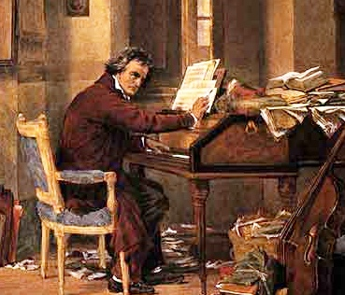
However some people have different opinions as to the theme of Moonlight Sonata. Fischer stated that he attributes this atmosphere in Moonlight Sonata to the feeling that overwhelmed Beethoven when he took watch at the side of a friend who prematurely died. Fischer believed that the Sonata does not tell the story of a romance in the moon lit night, but instead a solemn funeral.
Beethoven’s instructions on how to play this piece were “One must pay this whole piece very delicately and without dampers”. The modern piano has a longer sustain time that which Beethoven used, making his instructions impossible to follow without creating an unpleasant dissonant sound. Due to this fact, adjustments had to be made with the pedals to make the composition sound like it was meant to.

Slide 24
Moonlight Sonata was divided in to three movements. Movement One is the well-known introduction. This has been used in many movies, commercials, etc. The introduction seems almost haunting, and some have even called it a dark whisper. The main melody is played and developed and then similarly played again.
Movement Two was written in D flat major. The form is scherzo. Movement two is also the smallest movement of the three. This movement has a denser feeling and puts off a meditative feel.
Movement Three is different than the other two. It’s rapid, invigorating, and powerful. Beethoven’s notes say to play this “piano” or soft, but Beethoven used sforzandos and fortissimos to make the piece sound as if it were fortissimo.
This sonata is one of Beethoven’s most timeless pieces. He created a strong emotional piece that drives people from all generations. Not many pieces from the early 1800’s are commonly listened today, but Moonlight Sonata is one that is loved by all.
Click to view quotes by Beethoven

Slide 25
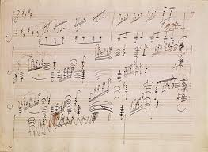
Moonlight Sonata First Movement – Listening Guide
Click to Play Composition
0:00 This composition begins with the exposition of a soothing and quiet solo in C minor, played solely on the piano. The right hand plays the melody in long sustained notes, accompanied by a smooth wave like motion of triplets (triplet ostinato) the movement is serene and sostenuto (sustained).
0:28 Phrase A enters with movement almost too slow and has the feeling of sadness, such as a funeral march or a very sad ending of a love affair. The left hand hits its lowest chords while the right hand plays the melody more forcefully and is more noticeably in the forefront. The melody continues to float from one level to another of feelings sometime sad and sometimes soothing.
0:55 Phrase A’ The chords become dissonant and begin to slow down and then suddenly become more lonely and discordant. The lower chords the left hand plays take over and move to the foreground. In the middle ground are long bass notes.

Slide 26
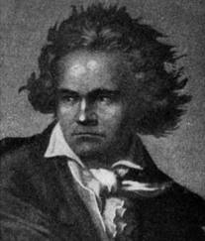
1:23 Phrase B Right hand continues with a different melody in triplets and both treble and bass take turns being in the forefront. The melody becomes somewhat slower and evocative, even sorrowful, and is reminiscent of sorrow and weeping.
2:10 Phrase A is repeated, however, the melody becomes more insistent. The bass, in the forefront, begins to play lower chords, while the right hand plays a melody that walks up and down the keyboard and moves to the forefront.
B Section
2:56 The melody is taken over by the right hand again and it deliberately moves up and down the keyboard, with a momentary rise in feeling and then a foreboding feeling all over again as the melody that is woven throughout the Sonata begins again.

Slide 27
A ‘Section
4:03 The right hand plays the melody (phrase A) the same pitch as it did in the beginning
4:11 Phrase A’ is played again as the right hand plays the melody in a higher pitch
4:38 The right hand repeats Phrase B again played in a higher pitch and the left hand or Bass also plays in a higher pitch
5:07 Phrase B is repeated and there is a rise in the melody, as the left hand, the bass, moves to the forefront with strong chords that descend to the depths. The piano continues to sing the tragic story. There are some long stretches and pauses with the same harmony.
5:38 Phrase A” returns the left hand plays very low dramatic chords as the right hand purposefully plays one lonely note at a time calmly and peacefully dying down. The left hand plays a final set of very low chords and the Sonata ends without any warning.
Click to view video of Moonlight Sonata

Slide 28
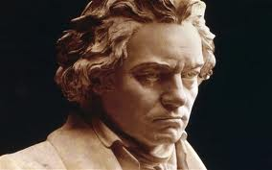
A ‘Section
4:03 The right hand plays the melody (phrase A) the same pitch as it did in the beginning
4:11 Phrase A’ is played again as the right hand plays the melody in a higher pitch
4:38 The right hand repeats Phrase B again played in a higher pitch and the left hand or Bass also plays in a higher pitch
5:07 Phrase B is repeated and there is a rise in the melody, as the left hand, the bass, moves to the forefront with strong chords that descend to the depths. The piano continues to sing the tragic story. There are some long stretches and pauses with the same harmony.
5:38 Phrase A” returns the left hand plays very low dramatic chords as the right hand purposefully plays one lonely note at a time calmly and peacefully dying down. The left hand plays a final set of very low chords and the Sonata ends without any warning.

Slide 29
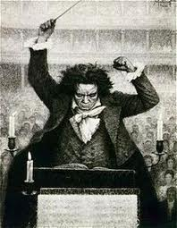
History of Pathetique
Sonata No. 8 in C minor, Op. 13, or Pathetique as we commonly know it, was composed in 1797 and published in 1799. Beethoven was 27 at the time he wrote this sonata. The composition was written for Austrian Prince Karl von Lichnowsky, a friend of Beethoven’s. The name Grande Sonate Pathetique actually came from Beethoven’s publisher. The name was inspired by the composition’s tragic sonorities.
Pathetique was one of the earlier songs in Beethoven’s career. Technically Pathetique was considered to be part of the classical era of music, but had many characteristics of the romantic era. Beethoven started to become known for “breaking the rules” and not using all the standards that others did use during the classical ear. After this piece Beethoven began to earn the title ‘Master of Passion’.
Many believe that Haydn was a big influence for this piece of work. Elements of “Drumroll” by Haydn seem to be involved in Pathetique. However, Mozart was a large influence in Beethoven’s musical style. Many
musicologists have argued that Pathetique was inspired by Motzart’s
piano sonata K. 457. There are also traces of Jan Ladislav Dussek’s
work in Pathetique.
The sonata has three movements. The Grave, Adagio
cantabile, Rondo.

Slide 30
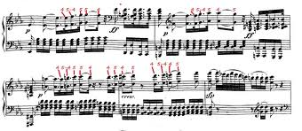
Beethoven started out with the Grave: Allegro di molto e con brio. This movement starts heavy and dark, which then accelerates with a great melody. There are several dramatic crashes in the opening. This movement is written in a key that Beethoven largely favored, C minor.
The next movement, Adagio cantabile, became slow and calm. The dark music turns warm and reflects the composers feelings very well. In this movement the melody is repeated 3 times. This movement was been called on of Beethoven’s most beautiful.
The Rondo : Allegro, the last movement, is fast and joyful. He creatively was able to bring together 3 different modes in 3 different movements seamlessly.
Pathetique is a piece that began to show Beethoven’s brilliance. As one of his earliest pieces this composition foretold of what was to come. He shared his soul through this sonata and did so in ways that had not been practiced. Many of his methods were considered unorthodox, as he would commonly “break rules”. From this rule breaking came some of the greatest works of art.

Slide 31
Pathetique Sonata 2nd Movement – Listening Guide
Click to Play Composition
i. 0:00 – This sonata starts off in the slow introductory theme referred to as the Adagio cantabile. Starts in Theme A.
ii. 0:26 – The melody that was played at the beginning (the first theme) is repeated but in a higher octave, it has a very graceful feeling to it.
iii. 0:57 – Introduction ends and it is the beginning of the Middle Section. It contains a gradual increase with a lot of chords and is a little bit more upbeat and quicker. It is also a little louder. Is now Theme B
iv. 1:28 – The lower notes are being played more during this section; it has a deeper darker pitches.
v. 1:45 – Now begins with Theme A’.
vi. 2:15 – A new section. Repetition on a single key that is repeated multiple notes. It is more upbeat and the notes are played quicker and it is less smooth. Now begins with Theme C.

Slide 32
vii. 2:32 – The dynamic has a sharp increase getting louder involving a Crescendo
viii. 2:42 – A Repetition of the previous section with the repeated chords/notes. There is a climactic feeling. The melody is growing the tension is building.
ix. 3:05 – A return of the beginning theme again, but this time it seems a bit quicker. Returns to Theme A.
x. 3:38 –The main theme that has the melody returns again, but this time is in an octave higher. It contains pitches from the low and high end of the keyboard. The tension seems to be resolved.
xi. 4:08 – This begins the conclusion, it has repeated notes, and has some ideas from the beginning of the main melody.
xii. 4:30 – the song ends with 3 groups of chords, getting lower and lower in pitch, finally ending on the lowest pitch of all. The ending contains a short coda.
Click to view video of pathetique

Slide 33
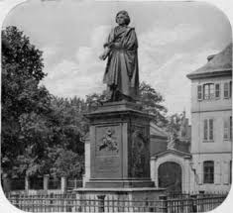
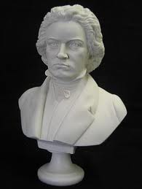
The End

Slide 34
Bibliography
"A Formal Analysis of Beethovenâ™s Pathetique." A Formal Analysis of Beethovenâ™s Pathetique Â« Open Source Music. Open Source Music, 22 June 2009. Web. 01 June 2012. <http://opensourcemusic.org/?p=748>.
"Beethoven, Ludwig Van - Fur Elise Sheet Music." - 8notes.com. Web. 01 June 2012. <http://www.8notes.com/scores/457.asp>.
"Beethoven's Fifth Symphony given World Premiere in Vienna." History.com. A&E Television Networks. Web. 04 June 2012. <http://www.history.com/this-day-in-history/beethoven39s-fifth-symphony-given-world-premiere-in-vienna>.
"Beethoven Pathetique SonataTragically Beautiful." Beethoven Pathetique Sonata. 2010. Web. 02 June 2012. <http://www.favorite-classical-composers.com/pathetique-sonata.html>.
"Beethoven's Moonlight Sonata." Beethoven and the Moonlight Sonata| Beethoven Sonata in C Sharp Minor Op. 27 No. 2. 2004. Web. 02 June 2012. <http://www.all-about-beethoven.com/moonsonata.html>.

Slide 35
Biography." Beethoven: The Sound and the Fury. A & E Television Network. 1998. Television.
Cooper, Barry. "Beethoven's Revisions to 'Fur Elise'" JSTOR. Musical Times Publications Ltd., 06 Feb. 2012. Web. 01 June 2012. <http://www.jstor.org/stable/963688>.
"Fur Elise Bagatelle in A Minor WoO 59." Www.forelise.com. 2006. Web. 02 June 2012. <http://www.forelise.com/bagatelle>.
Green, Aaron. "Brief Histories of Beethoven Symphonies." About.com Classical Music. Web. 04 June 2012. <http://classicalmusic.about.com/od/onestopbeethoven/a/beethovensympho.htm>.
Green, Aaron. "Beethoven's Moonlight Sonata." About.com Classical Music. 18 July 2005. Web. 02 June 2012. <http://classicalmusic.about.com/b/2005/07/18/beethovens-moonlight-sonata.htm>.
Green, Aaron. "Beethoven's Moonlight Sonata." About.com Classical Music. Web. 31 May 2012. <http://classicalmusic.about.com/od/onestopbeethoven/a/moonlightsonata.htm>.

Slide 36
Green, Aaron. "Brief Histories of Beethoven Symphonies." About.com Classical Music. Web. 04 June 2012. <http://classicalmusic.about.com/od/onestopbeethoven/a/beethovensympho.htm>.
Rodda, Richard E. "Symphony No. 5 in C Minor, Op. 67, About the Work." The John F. Kennedy Center for the Performing Arts. 24 June 2009. Web. 04 June 2012. <http://www.kennedy-center.org/calendar/?fuseaction=composition>.
Suchet, John. "Welcome to Www.madaboutbeethoven.com." Welcome to Www.madaboutbeethoven.com. Web. 01 June 2012. <http://www.madaboutbeethoven.com/>.
"Welcome to All About Beethoven." All About Beethoven. 2004. Web. 01 June 2012. <http://www.all-about-beethoven.com/>.
Yang, Ming. "Fur Elise, circa 2000: Postmodern Readings of Beethoven in Popular Context." Popular Music and Society 29.1 (2006): 1-15. Routledge Taylor and Francis Group. Web. 2 June 2012.
Ferrin, Craig. “Online Content” http://webcom3.grtxle.com/musicapprec/index.cfm?pageid=10791

Slide 37
"Ludwig Van Beethoven Biography." Bio.com. A&E Networks Television, 2012. Web. 01 June 2012. <http://www.biography.com/people/ludwig-van-beethoven-9204862>.
Prevot, Dominique. "Biography: Beethoven's Life." Biography: Beethoven's Life. Dec. 2001. Web. 05 June 2012. <http://www.lvbeethoven.com/Bio/BiographyLudwig.html>.

