Slide 1
Volcanic Eruptions
Kate Krepark

Slide 2
Plan: -What is a volcano? -What is an eruption? -How many active volcanoes are there in the world? -10 of the most catastrophic volcanic eruptions - The most disastrous volcanic eruptions

Slide 3
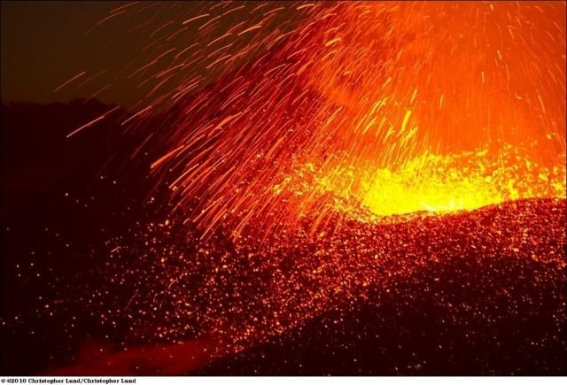
What is a volcano?

Slide 4
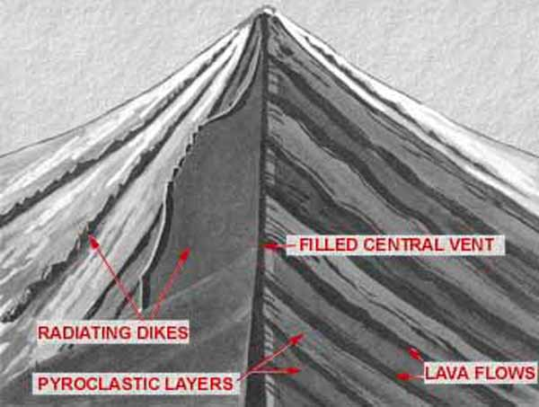

Slide 5
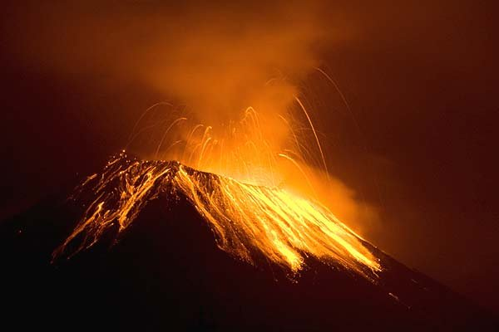
What is an eruption?

Slide 6
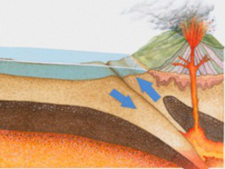

Slide 7
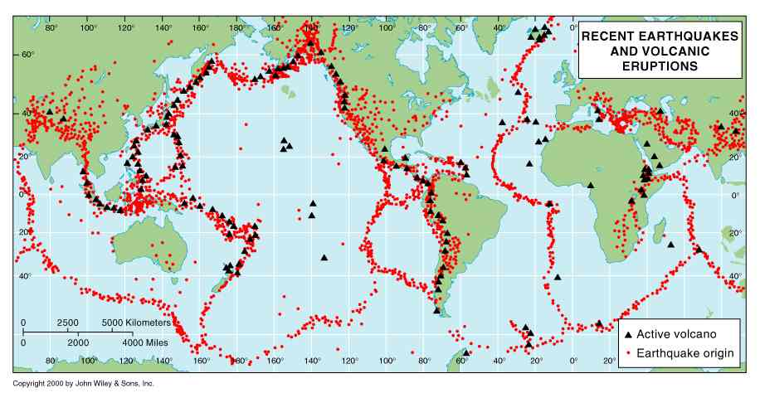
How many active volcanoes are there in the world?

Slide 8
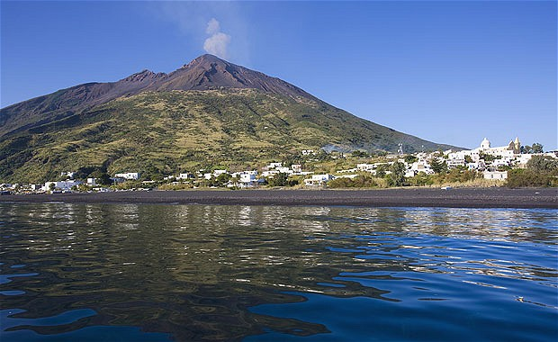

Slide 9
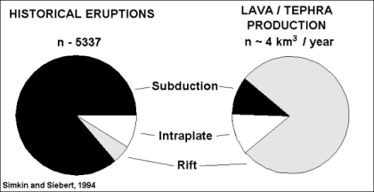
Erupting now: perhaps 20 Each year: 50-70 Each decade: about 160 Historical eruptions: about 550 Known Holocene eruptions (last 10,000 years): about 1300 Known (and possible) Holocene eruptions: about 1500 Note that these figures do not include the large number of eruptions (and undescribed volcanoes) on the deep sea floor. Estimates of global magma budgets suggest that roughly 3/4 of the lava reaching Earth's surface does so unnoticed at submarine midocean ridges (see below).

Slide 10
10 of the most catastrophic volcanic eruptions

Slide 11
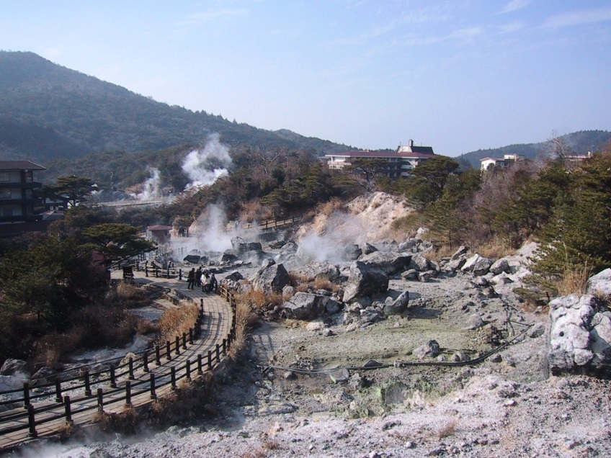
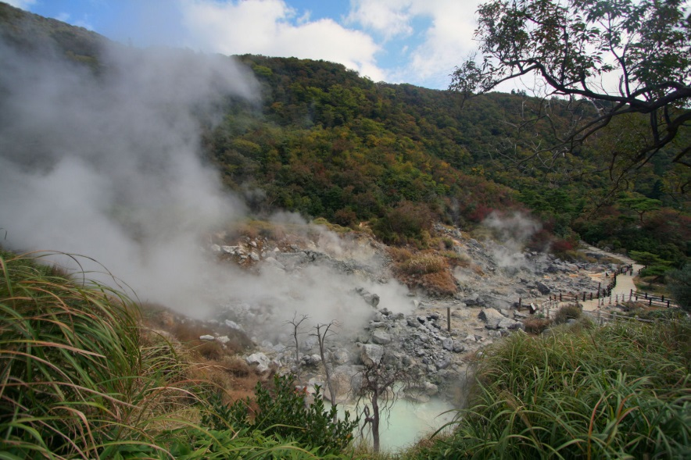
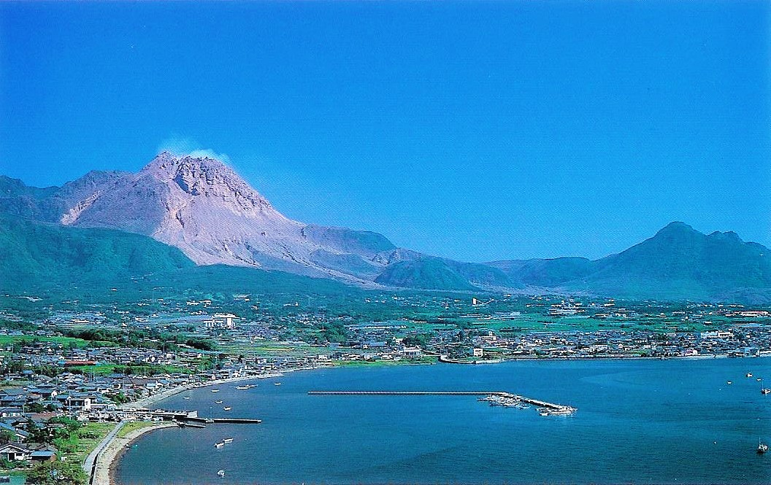

Slide 12
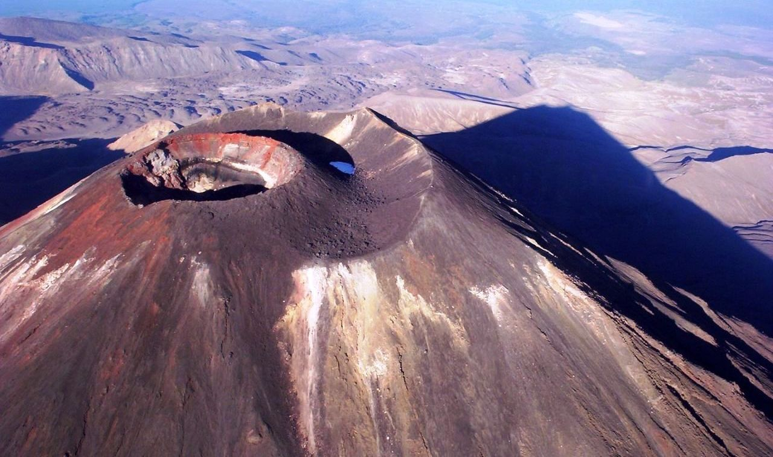
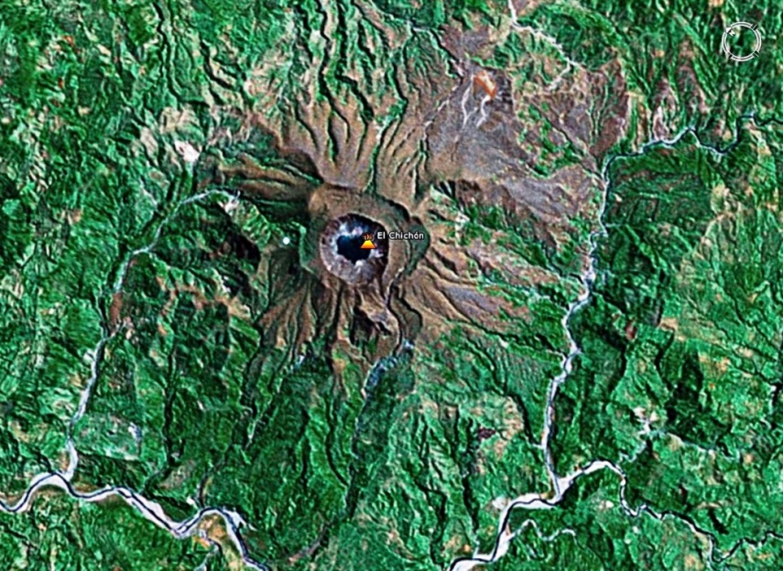
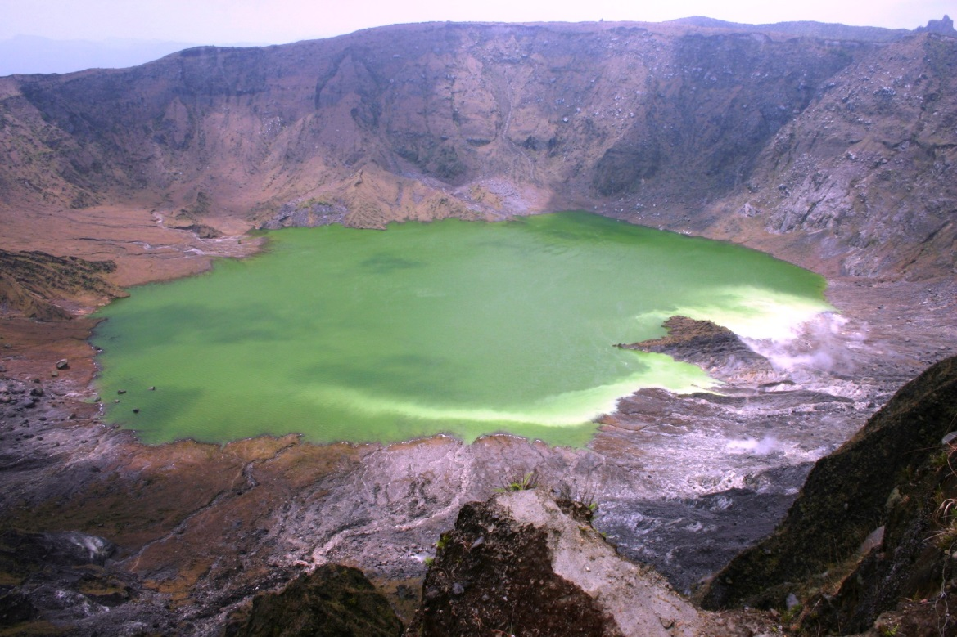

Slide 13
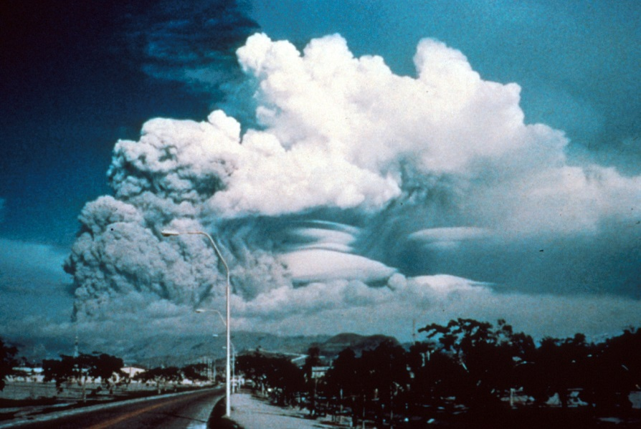
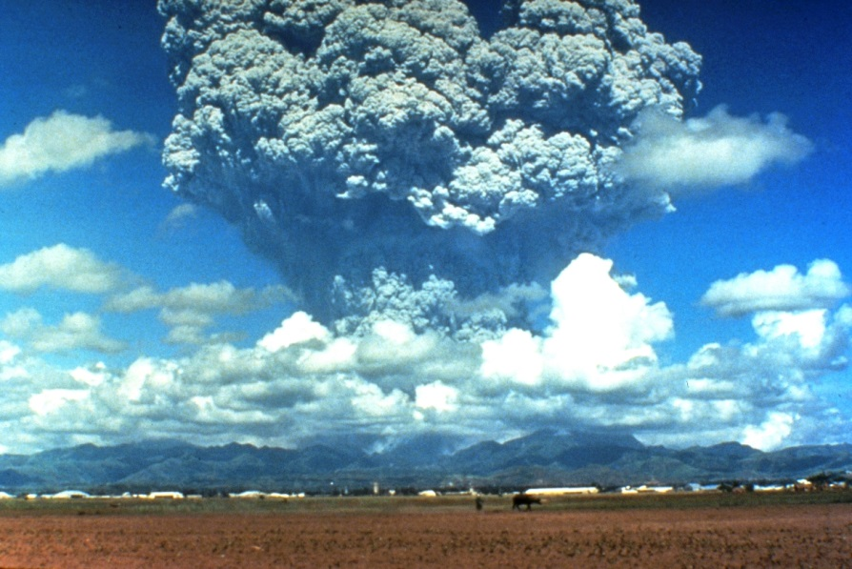
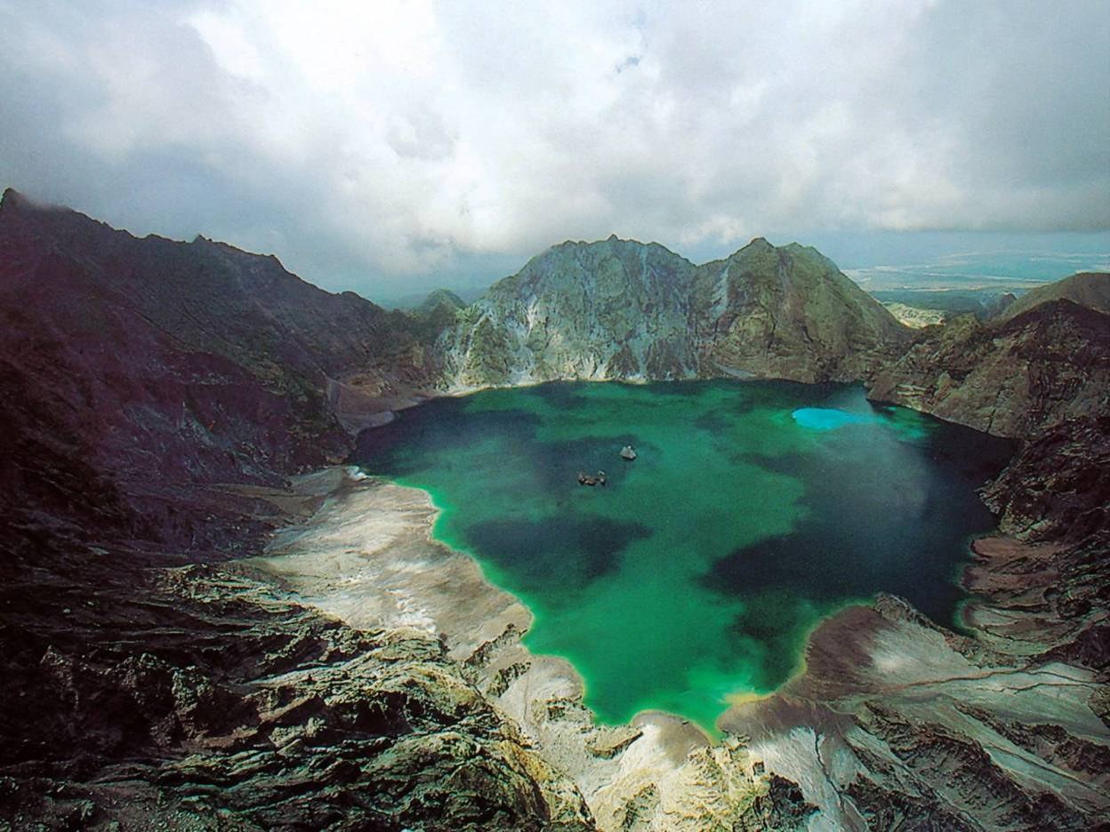

Slide 14
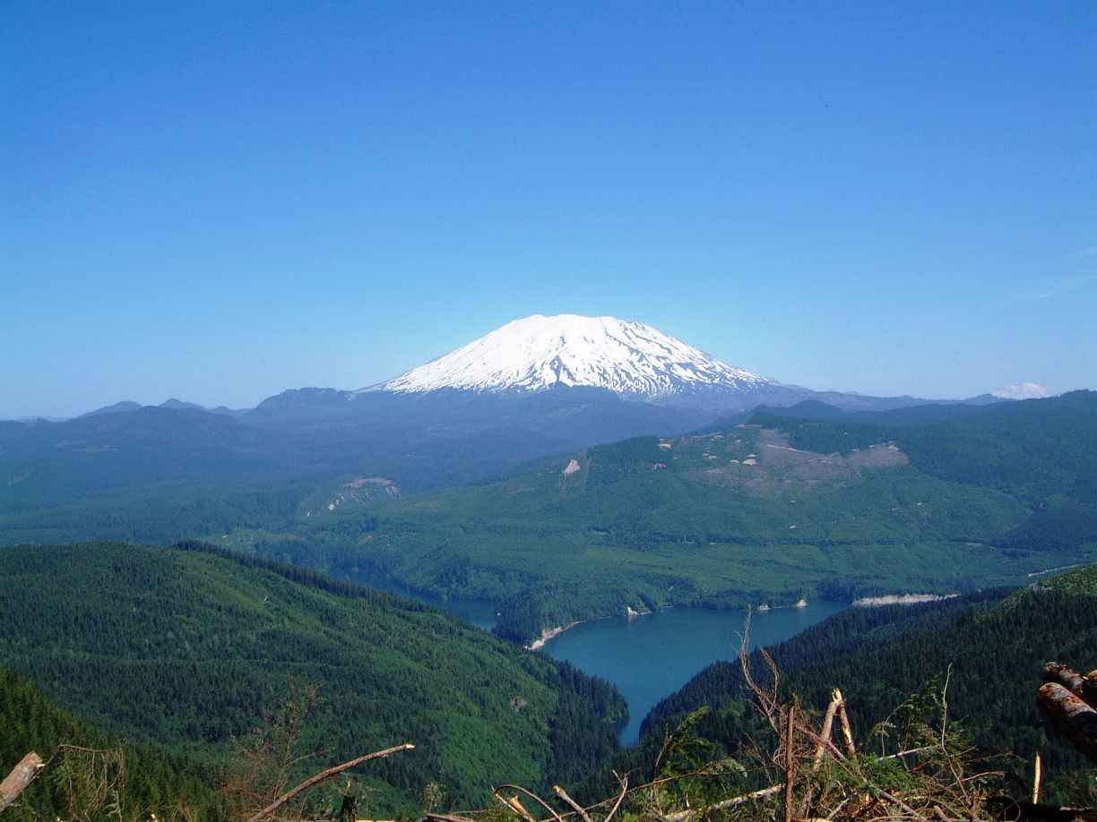
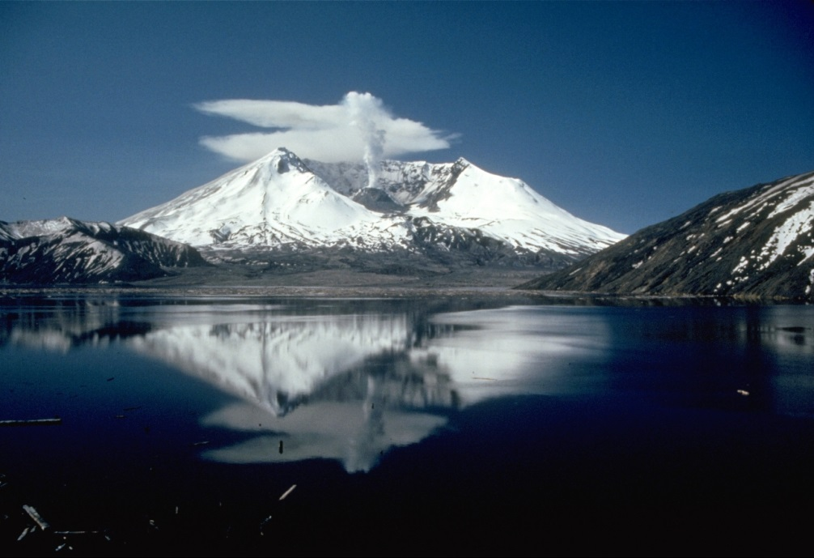
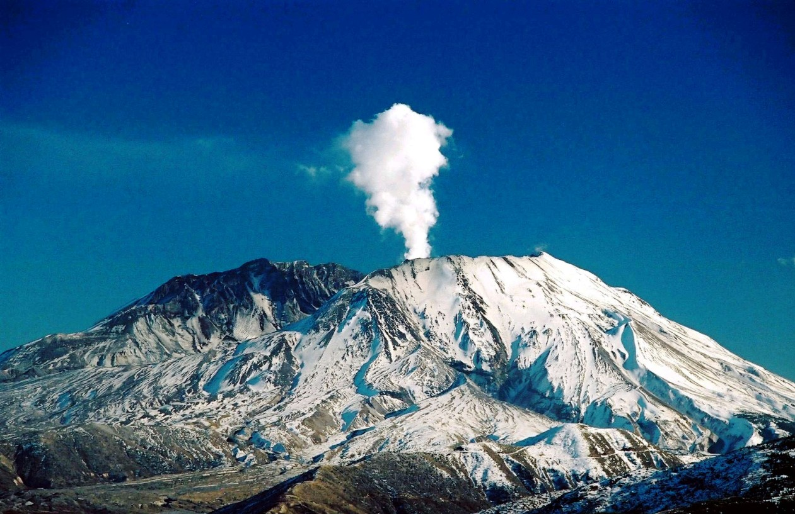

Slide 15
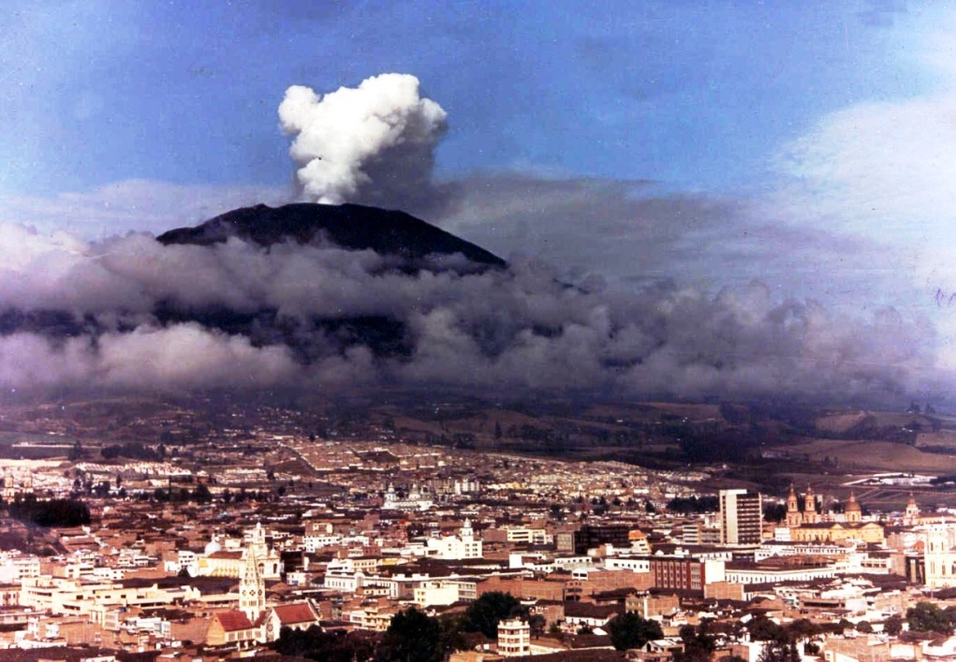
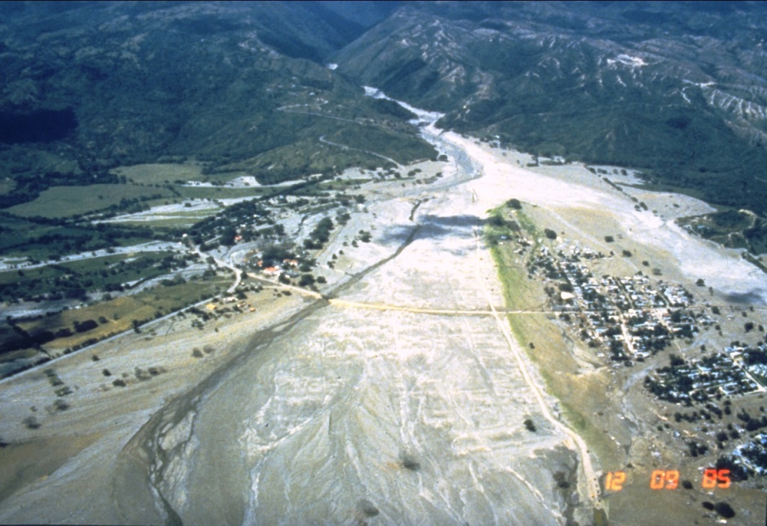
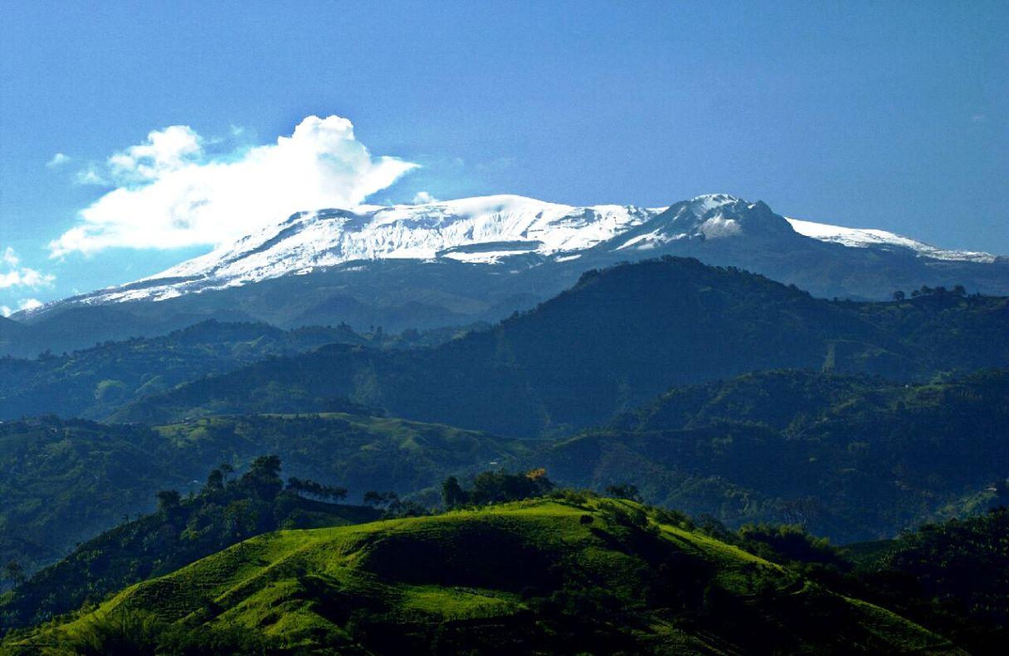

Slide 16
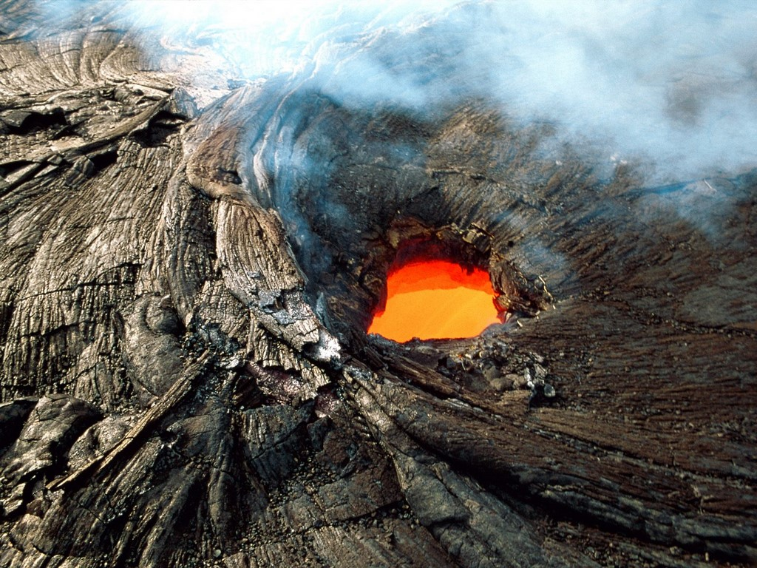
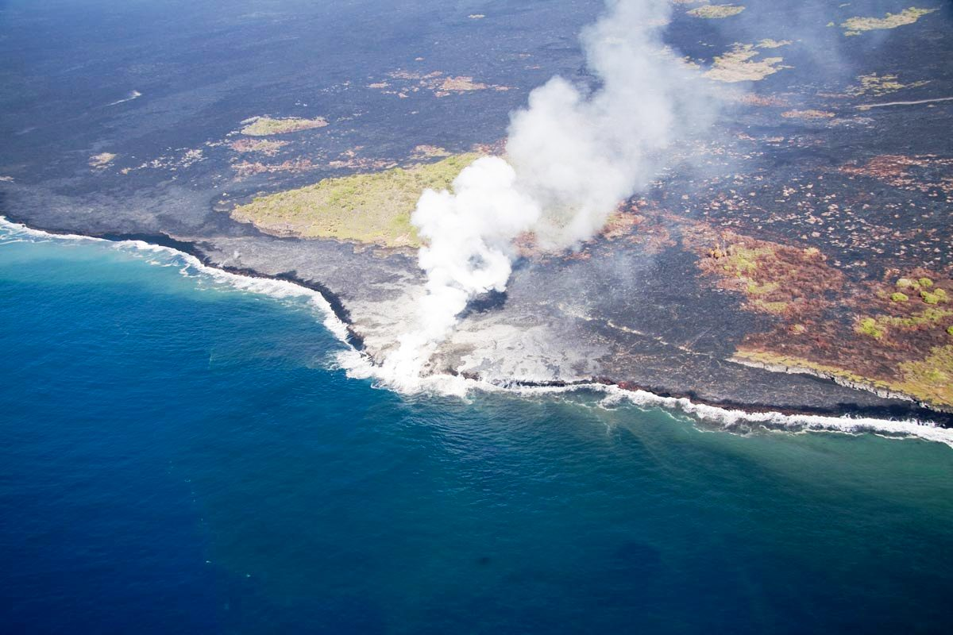
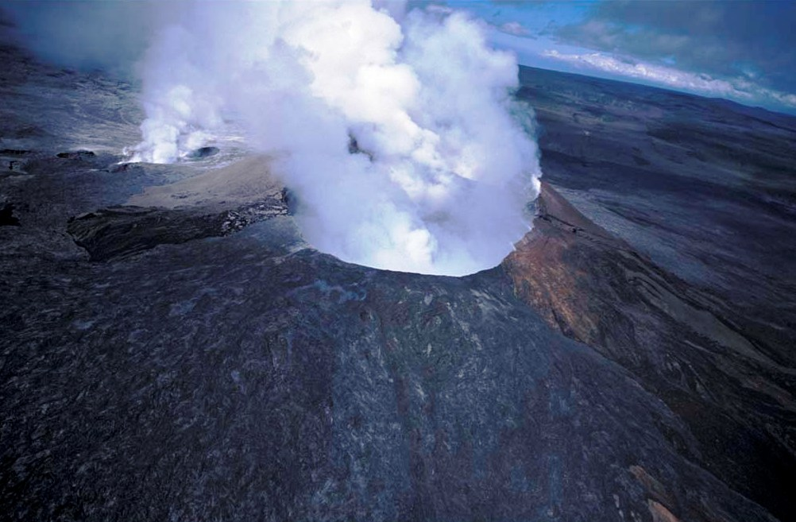

Slide 17
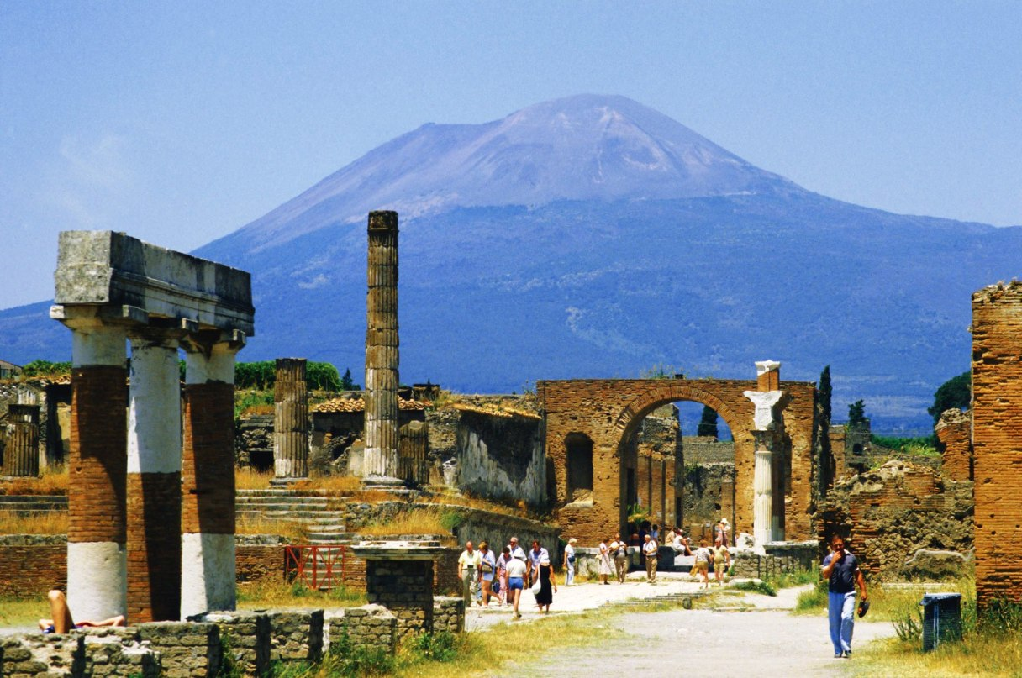
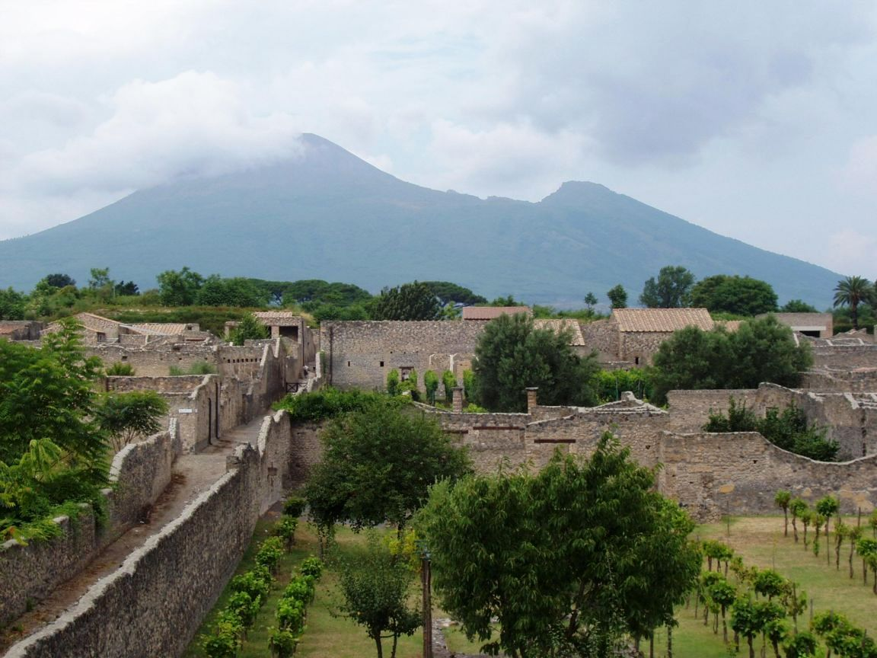
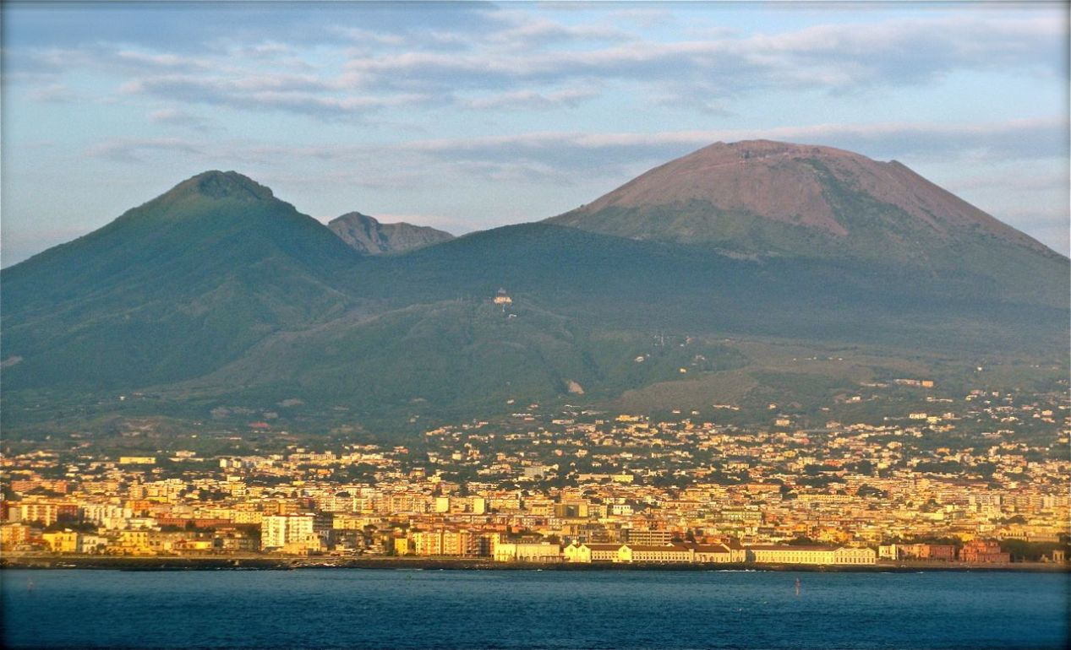

Slide 18
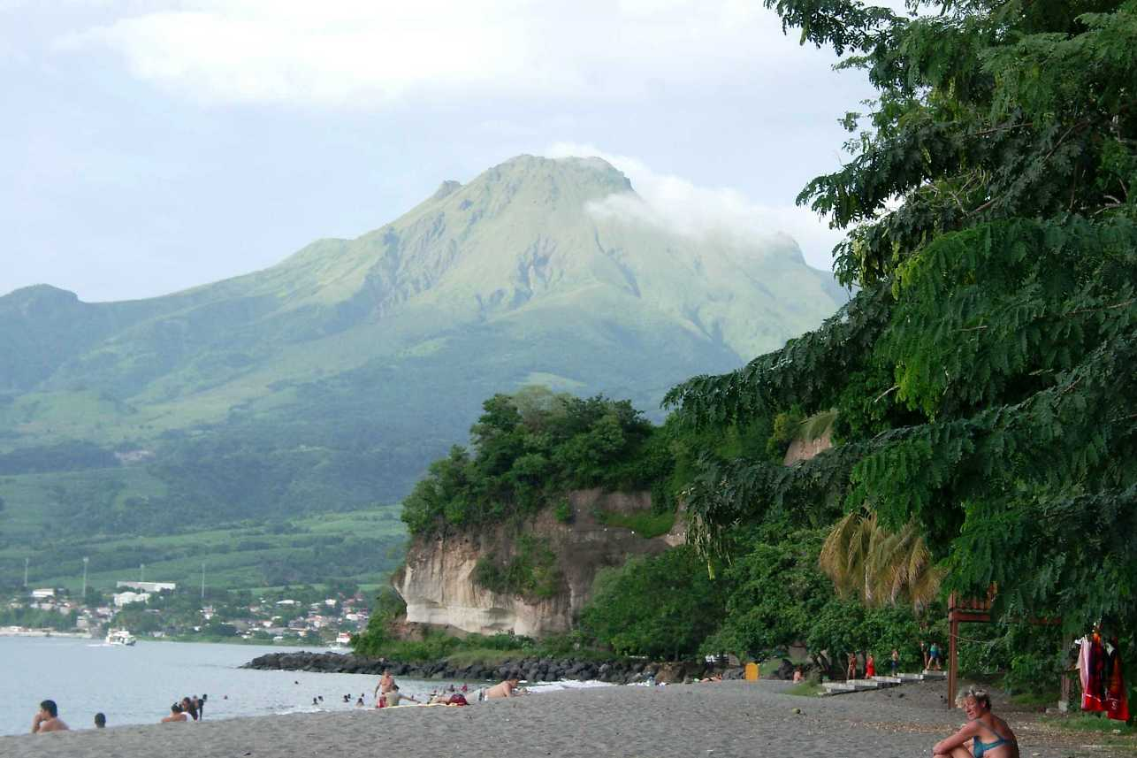
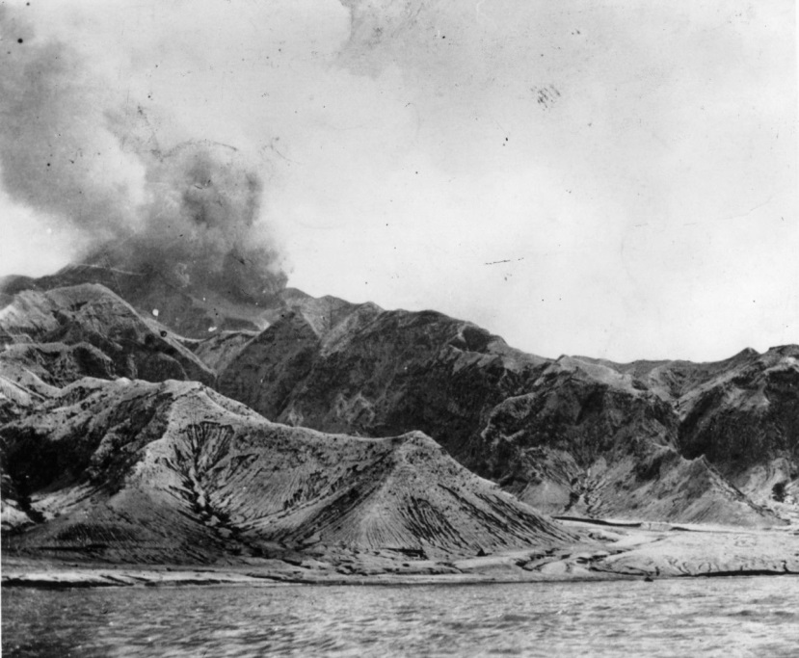
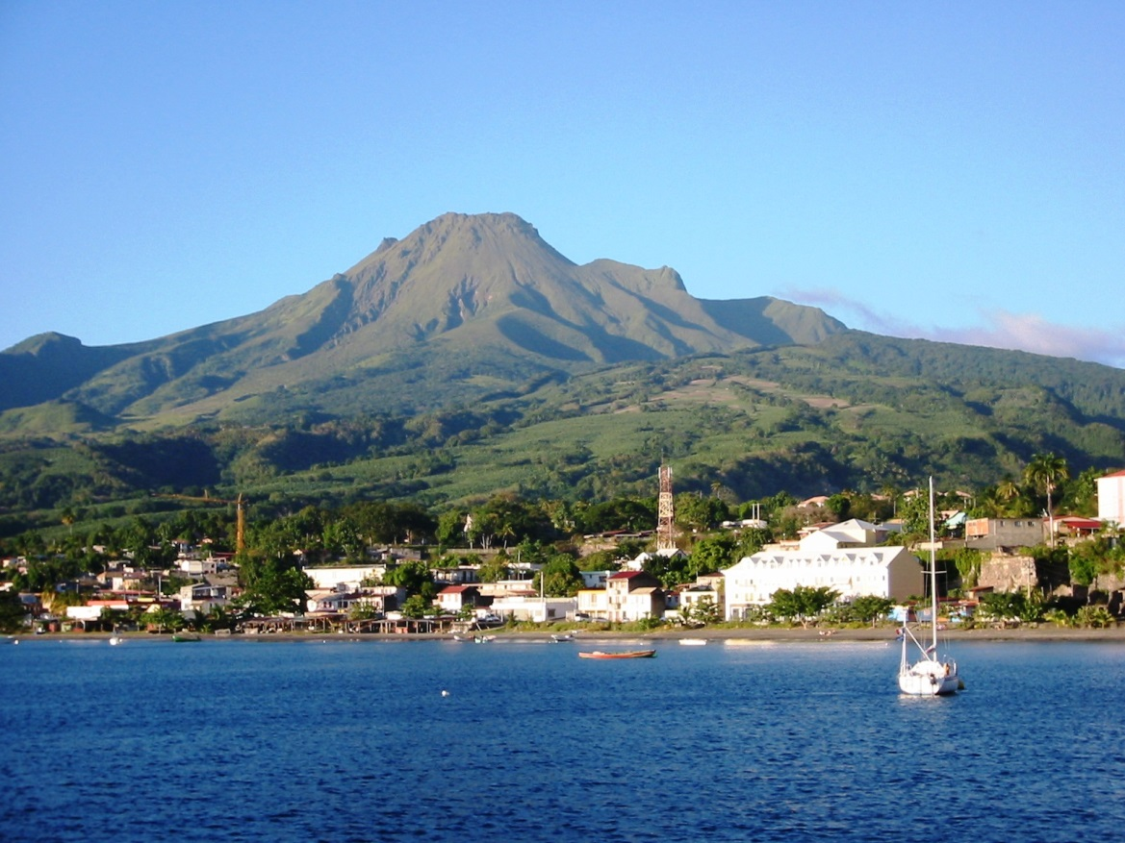

Slide 19
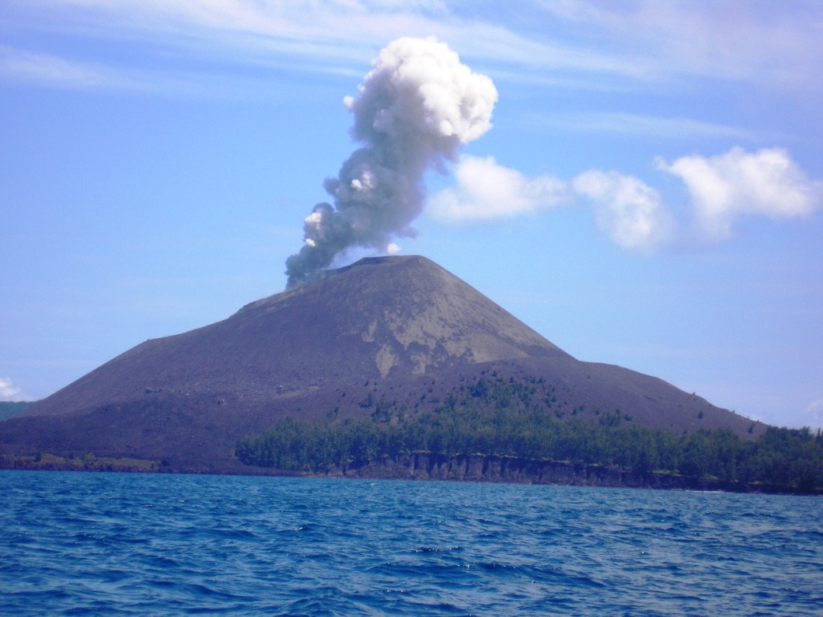
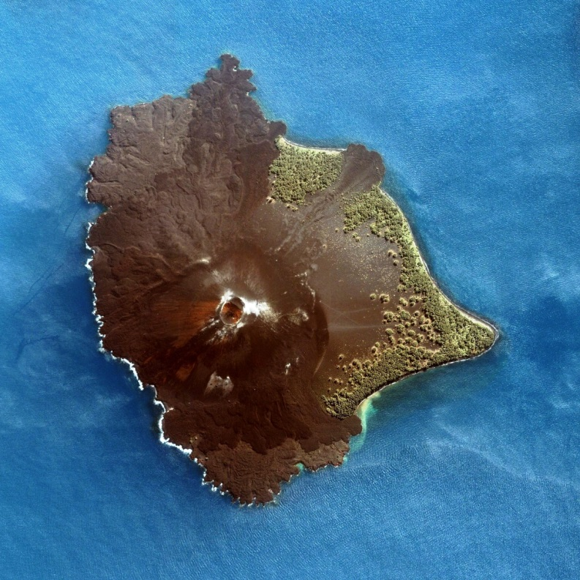
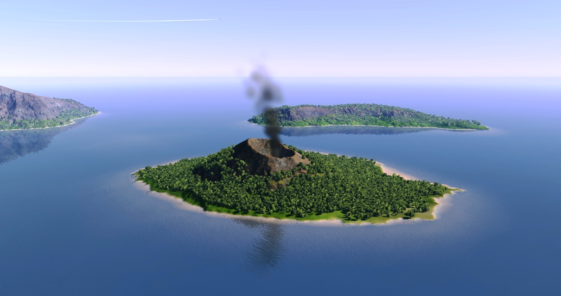

Slide 20
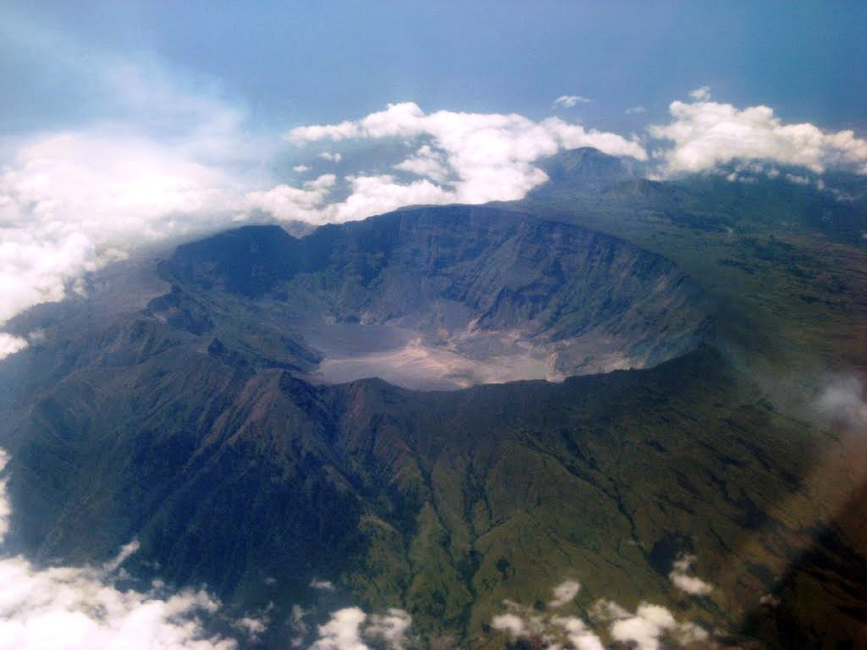
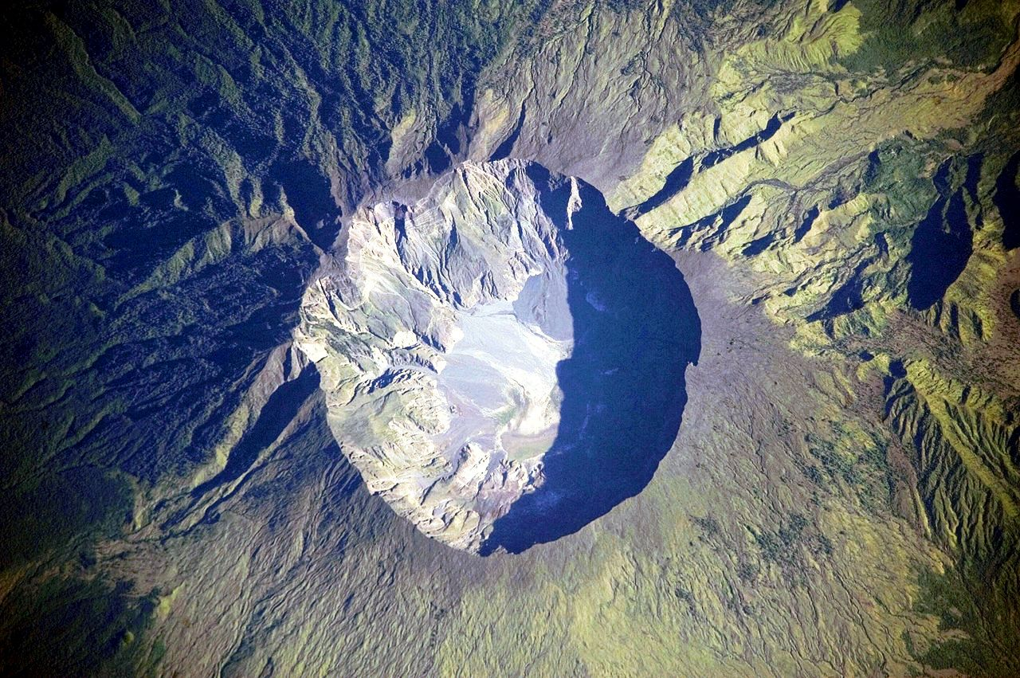
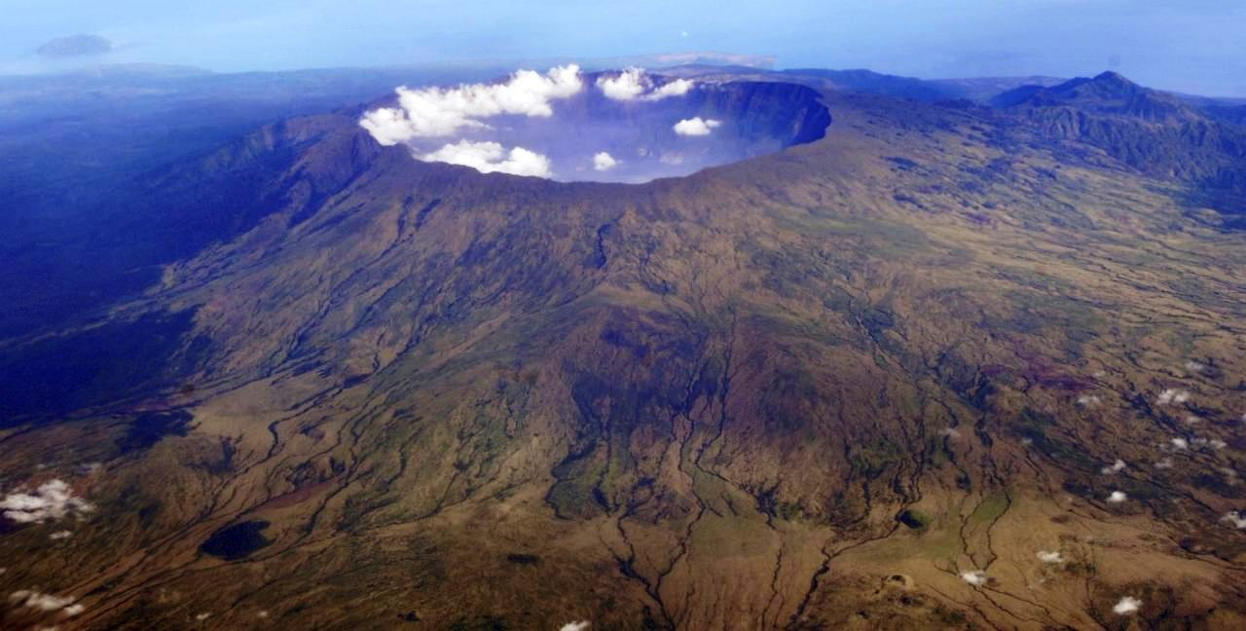

Slide 21
The most disastrous volcanic eruptions Table lists the most catastrophic eruption of the volcano in the world, indicating: the name of the volcano, the year of the eruption, the number of deaths. The table shows the disaster eruptions number of victims more than 500 people.

Slide 22
the number of deaths

Slide 23
Thanks for your attention

