Slide 1

The history of British ballet

Slide 2

British ballet is most recognised for two leading methods.
The identifying characteristic of British ballet is the focus on clean, precise technique and purity of line that is free of exaggeration and mannerisms.

Slide 3
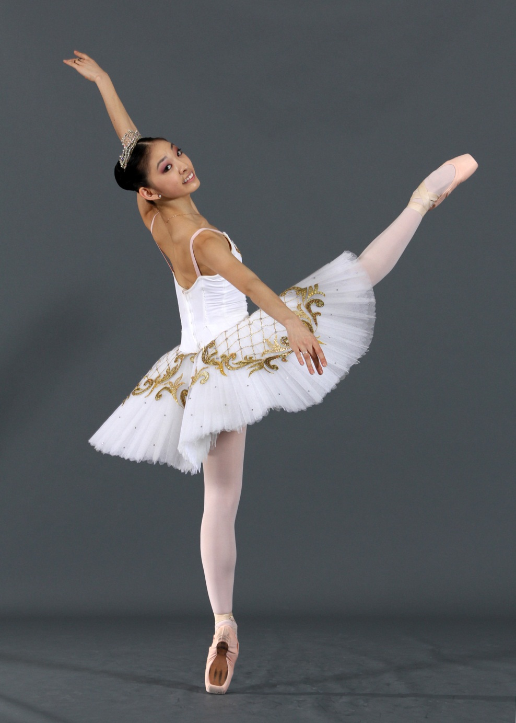
The training of dancers in Britain is noted for its slow progression, with a great deal of attention paid to basic technique. British ballet methods operate on the principle that establishing correct technique and strength slowly makes it much easier for the student to adapt to more difficult vocabulary and techniques later on.

Slide 4
Technique
Cecchetti influence

Slide 5

The Cecchetti method was vital in the development of Classical Ballet in the United Kingdom and contributed heavily to modern day British teaching methods. Enrico Cecchetti and his wife opened a ballet school in London in 1918, and his pupils included some of the most influential names in British Ballet, many also influencing ballet throughout the world.

Slide 6
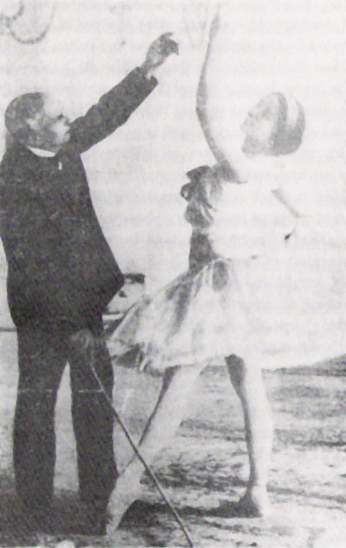
The British writer and dance historian Cyril W. Beaumont was a close friend of Cecchetti and, in 1922 he collaborated with Cecchetti to codify the technique into a printed syllabus, The Cecchetti Method of Classical Ballet, which has become the foremost reference for Cecchetti method teachers worldwide.

Slide 7
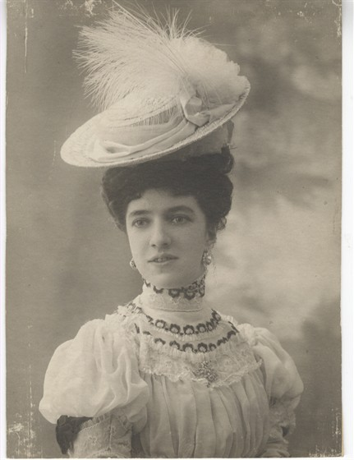
Vaganova influence
Britain became one of the first Western countries to be influenced by the Vaganova method. The method was introduced to Britain by the renowned teacher Vera Volkova who became one of the first teachers at the Sadler's Wells Ballet School.

Slide 8
Notable companies & schools
Birmingham Royal Ballet, sister company of the Royal Ballet, based in Birmingham
Elmhurst School for Dance, official associate school of the Birmingham Royal Ballet
English National Ballet, leading rival of the Royal Ballet companies
English National Ballet School, official associate school of the English National Ballet
Northern Ballet Theatre, ballet company based in Leeds, specialising in theatrical dance productions
The Royal Ballet, widely regarded amongst the leading classical ballet companies in the world
Royal Ballet School, official associate school of the Royal Ballet
Scottish Ballet, the national ballet company of Scotland

Slide 9
