Slide 1
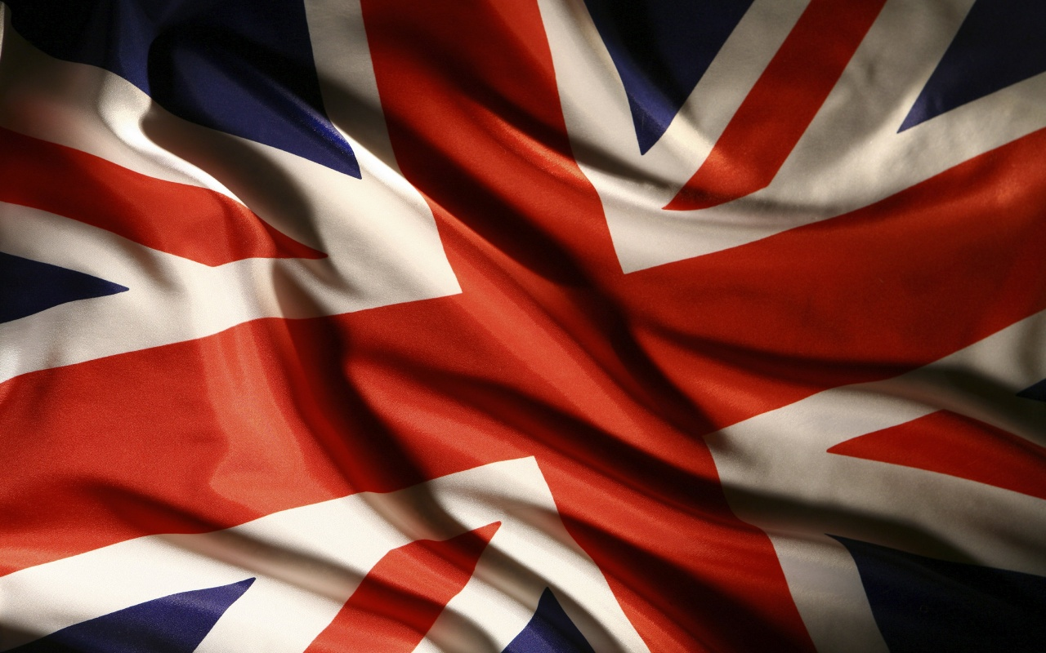

England
Підготувала учениця
10 класу
Лемак Андріана

Slide 2
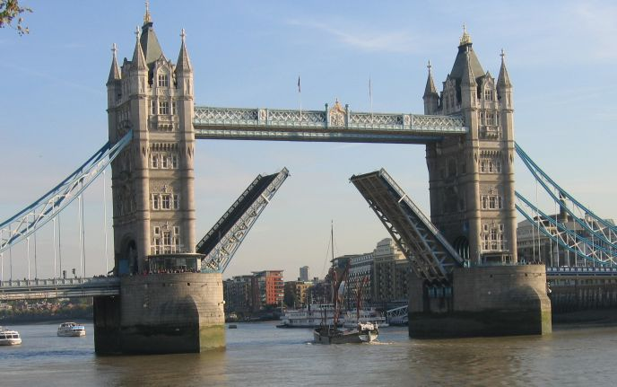
England is a country that is part of the United Kingdom. It shares land borders with Scotland to the north and Wales to the west. The Irish Sea lies north west of England, whilst the Celtic Sealies to the south west. The North Sea to the east and the English Channel to the south separate it from continental Europe.

Slide 3
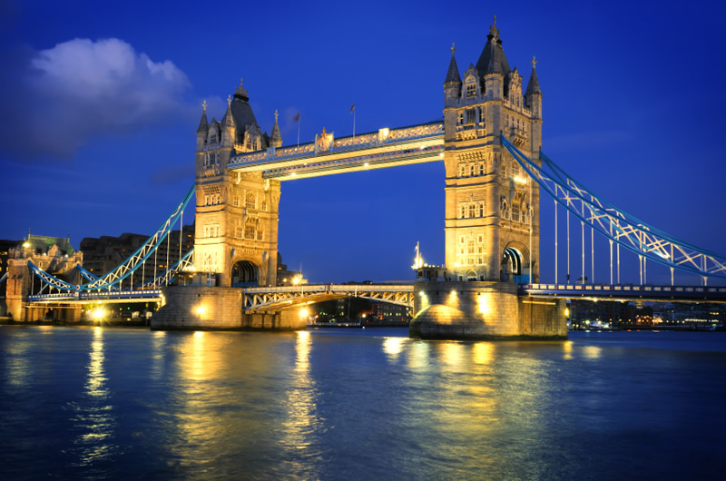
There are a lot of places of interest in Great Britain.
There are both modern and ancient monuments, like Stonehenge and Hadrian Wall, Durham castle and York Cathedral.
Britain also has many interesting museums. For example one can visit the Steam Boat Museum in Embleside . The oldest ship in this museum — her name is “Dolly” — is 150 years old. In York the tourists are usually attracted by the National Railway Museum. It contains the history of Stephenson’s invention of steam locomotive.
But the main attraction, no doubt, is London places of interest. Among them there are: Westminster Abbey, the Houses of Parliament, Buckingham Palace, St Paul’s Cathedral, London Bridge, the Tower of London. On the Houses of Parliament one can see the famous Tower Clock Big Ben, the symbol of London. Big Ben is the real bell which strikes every quarter of an hour. Another place which you can admire is Buckingham Palace. It’s the residence of the Queen. London is also famous for its beautiful parks. Hyde Park is the most democratic park in the world, as anyone can say anything he likes there. Regent’s Park is the home of London Zoo.
Visiting this country, don't forget about its natural attractions such as the Highlands, Loch Ness, where some people think a large monster lives and the Lake District, the place, associated with the history of English literature.

Slide 4
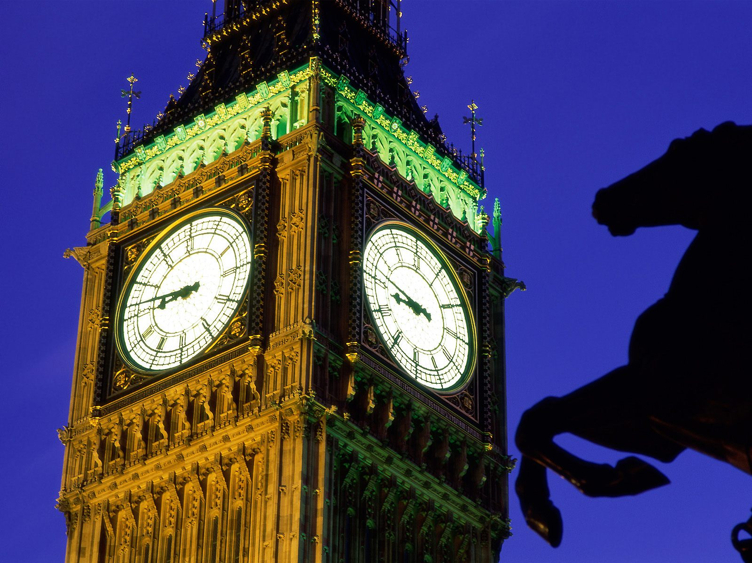
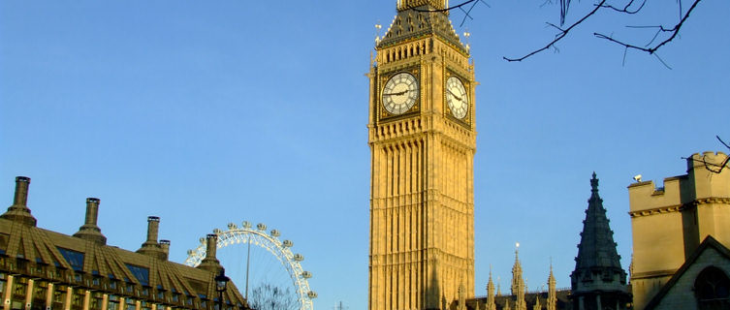
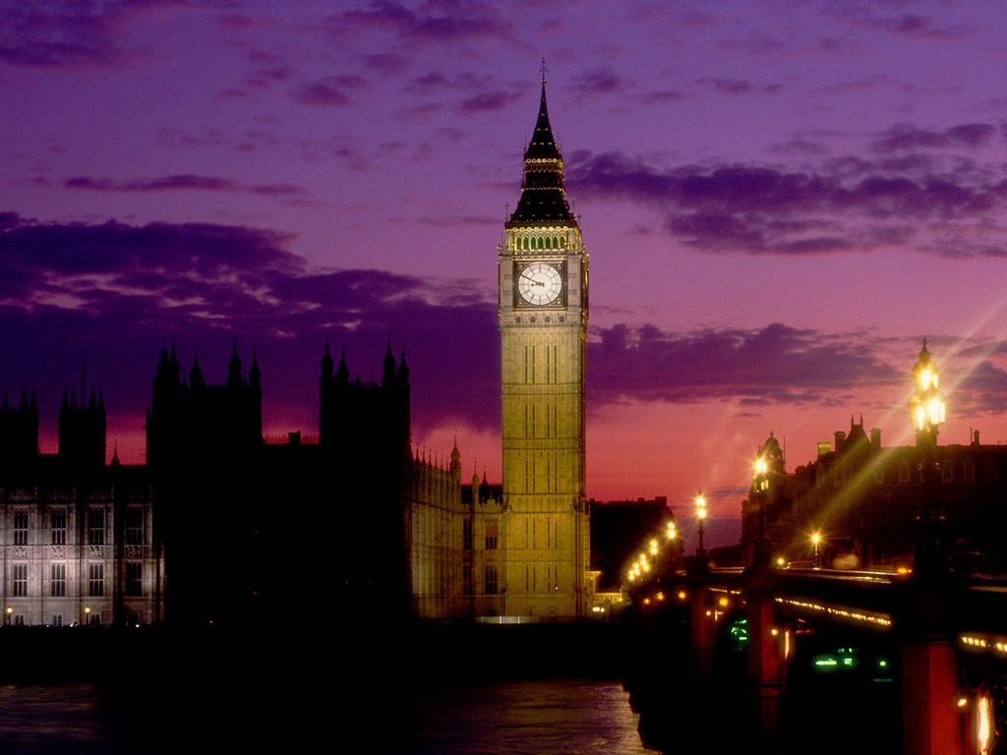
The name "Big Ben" is generally known to describe the clock tower as a whole. However, "Big Ben" is actually the principal bell within the tower.
There are two theories of how the bell got its name. The first suggests that it was taken from the nickname of a champion heavyweight boxer of the time called Ben Caunt. The second and more probable explanation, is that it was named after the bulky Welshman Sir Benjamin Hall, who was First Commissioner of Works from 1855 to 1858 and whose name was inscribed on the bell.
The Clock Tower is 96.3m (316 ft) tall and the Bell weighs 13.8 tonnes. From the ground floor there are 292 steps to the clock room, 334 steps to the belfrey and 393 steps to the lantern (known as the Ayrton Light)
A light shines above the clock face whenever Parliament is at work after dark.
Big Ben is not open to the public.

Slide 5
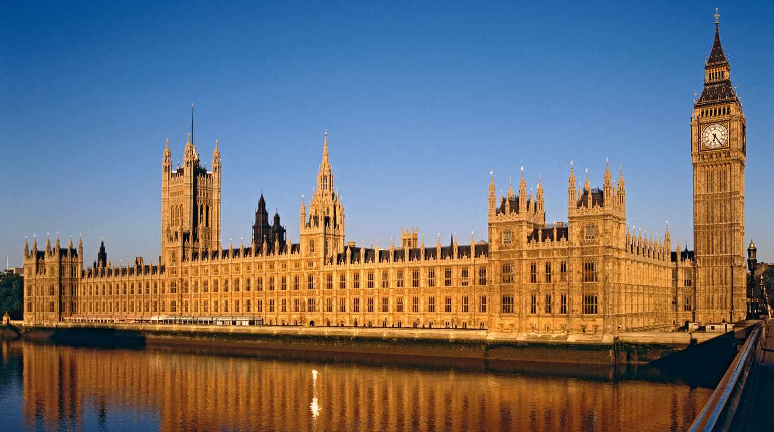
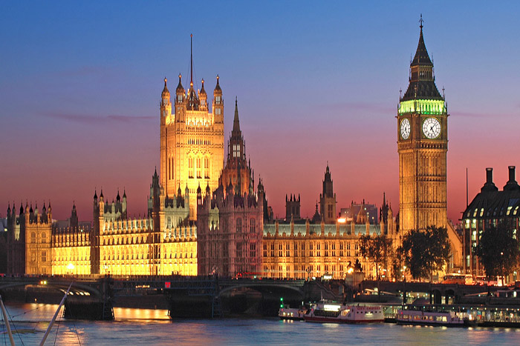
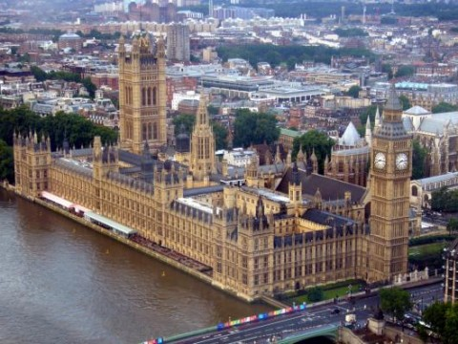
THE HOUSES OF PARLIAMENT
Tourists can take a tour of the Houses Of Parliament in annual Summer Opening in August and September. The guided tour visits the House of Commons and the House of Lords. The Ticket Office opens from mid-July and is located on Abingdon Green, opposite Parliament & The Victoria Tower Gardens.

Slide 6
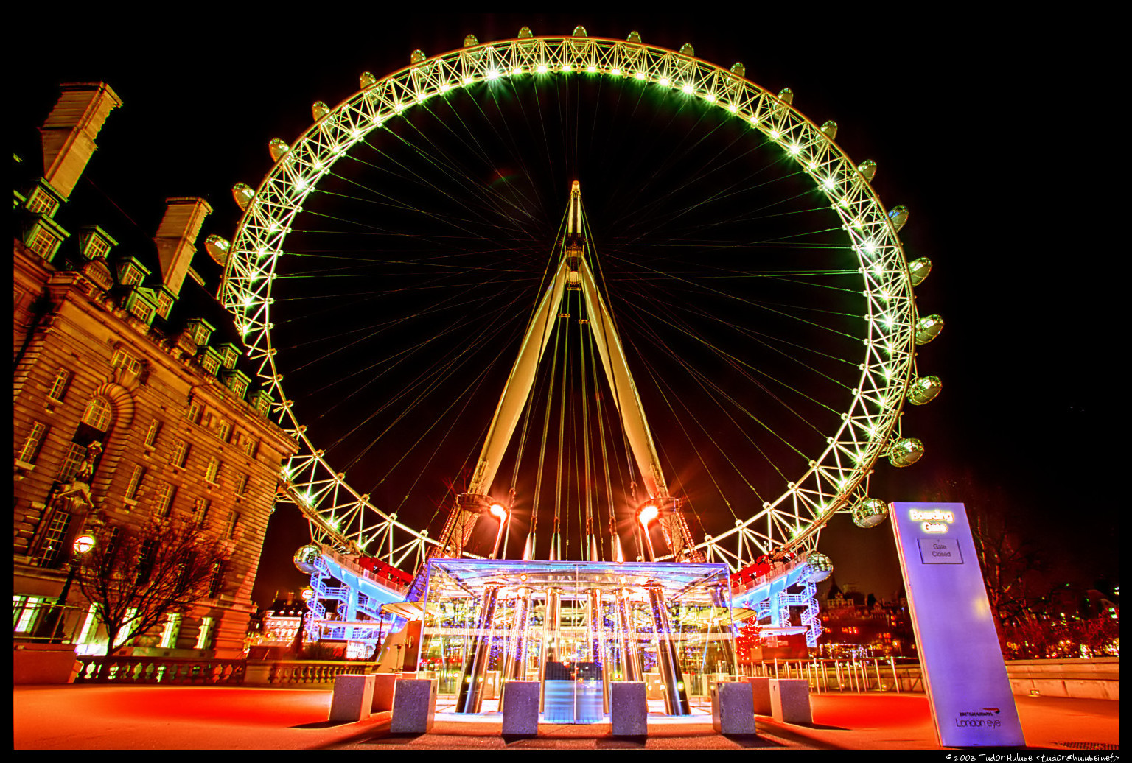
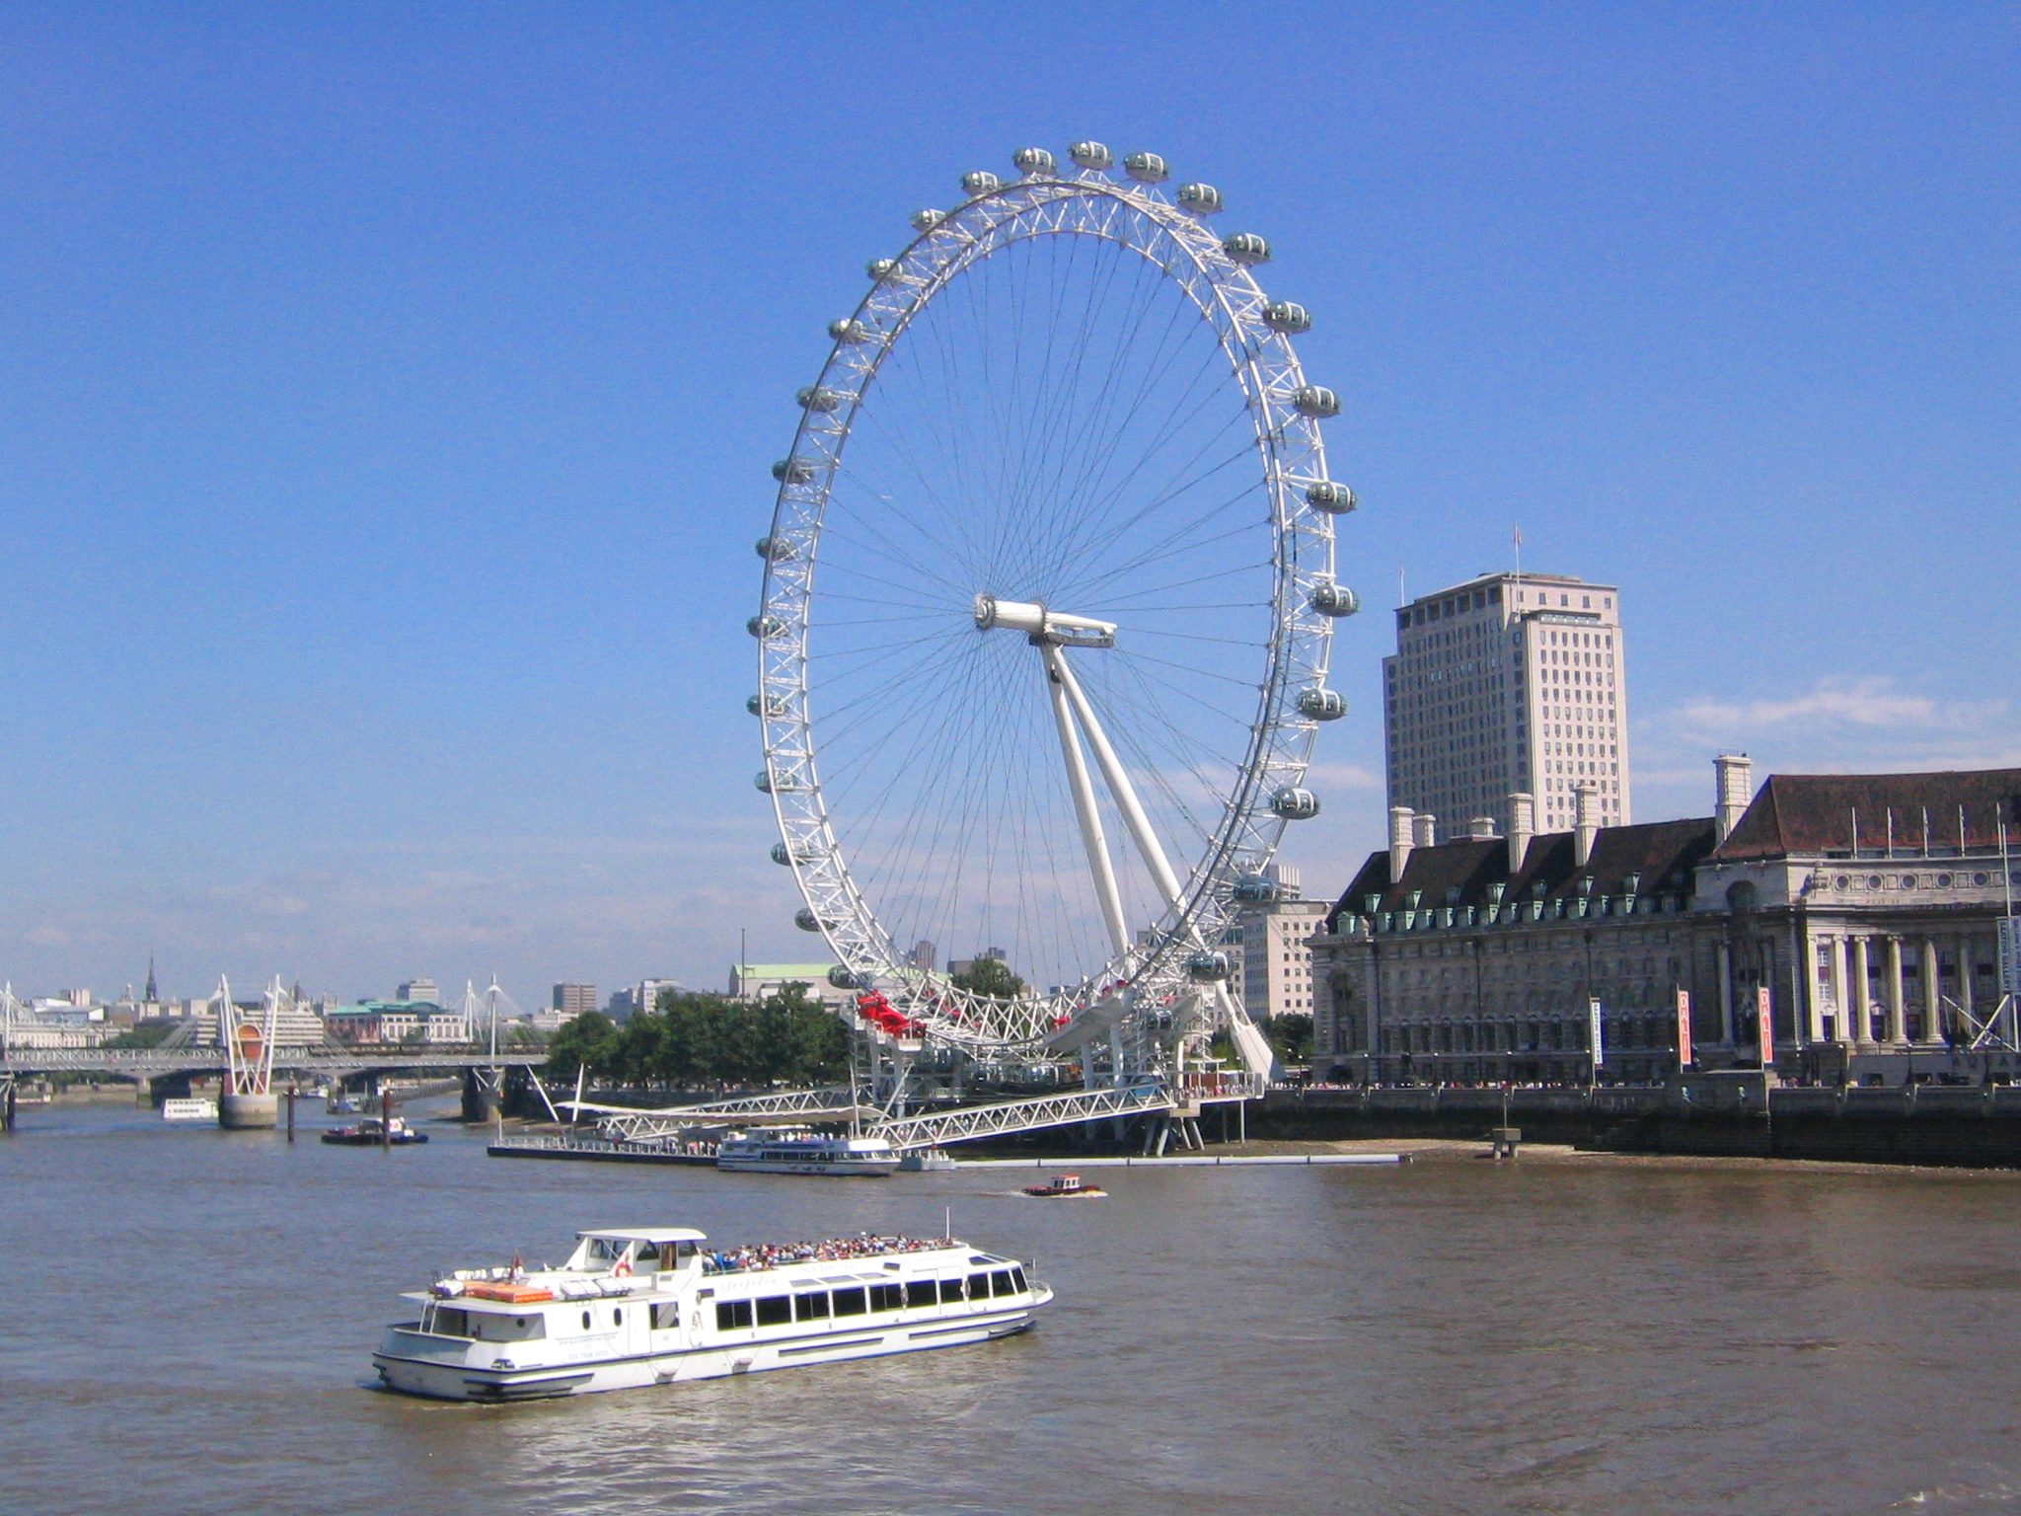
THE LONDON EYE
On a clear day you can see up 25 miles from the top of this 32 capsule giant ferris wheel on the South Bank of the River Thames.

Slide 7
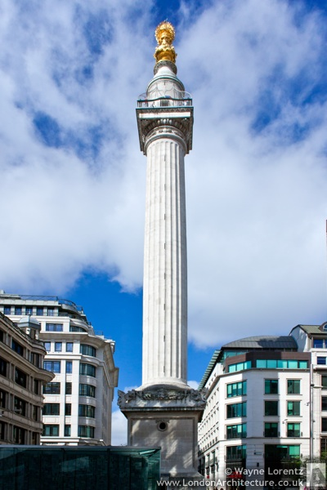
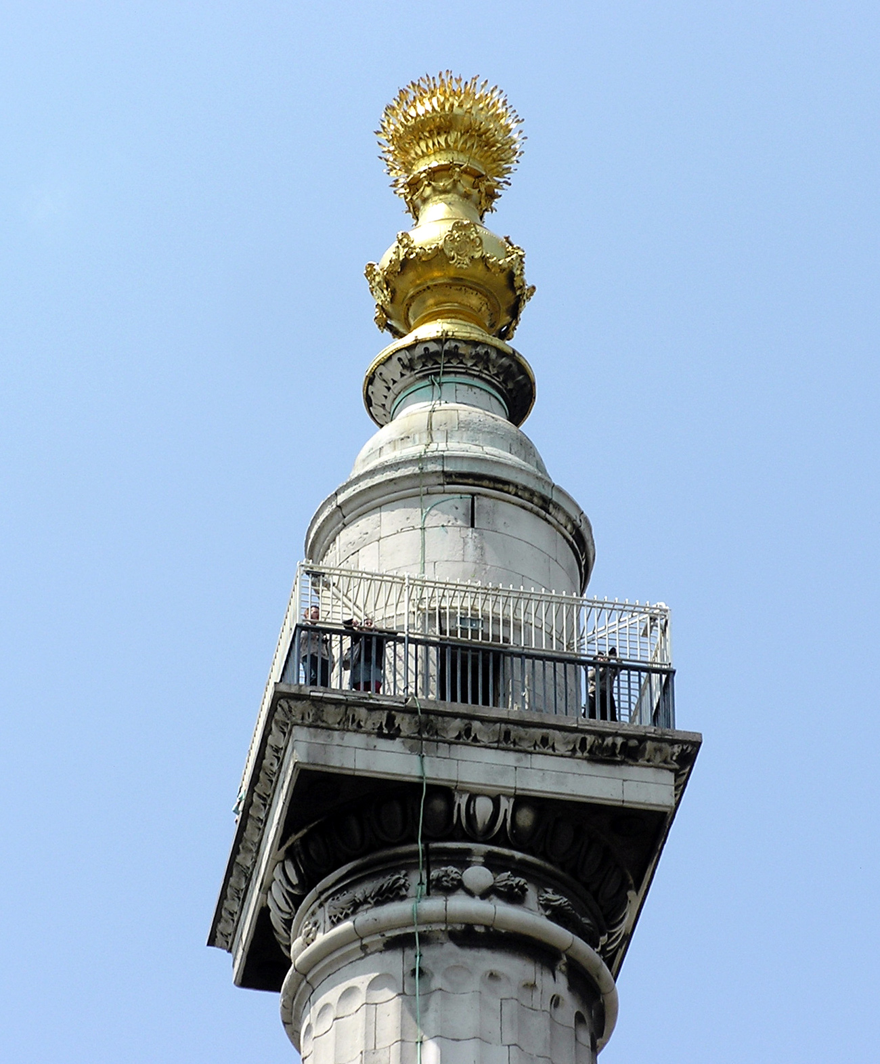
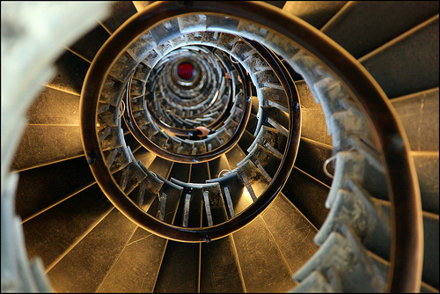
The Monument
Visitors to the Monument can climb the cantilevered stone staircase containing 311 steps to see some of the most breathtaking views of London. This may not be suitable for those with disabilities or a weak heart but there is a web cam at the bottom of the Monument showing live images from the top.

Slide 8
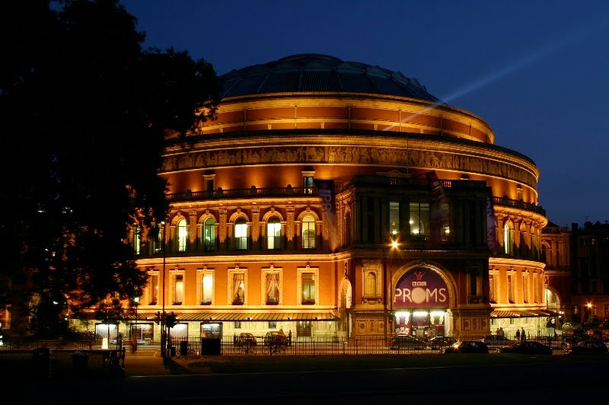
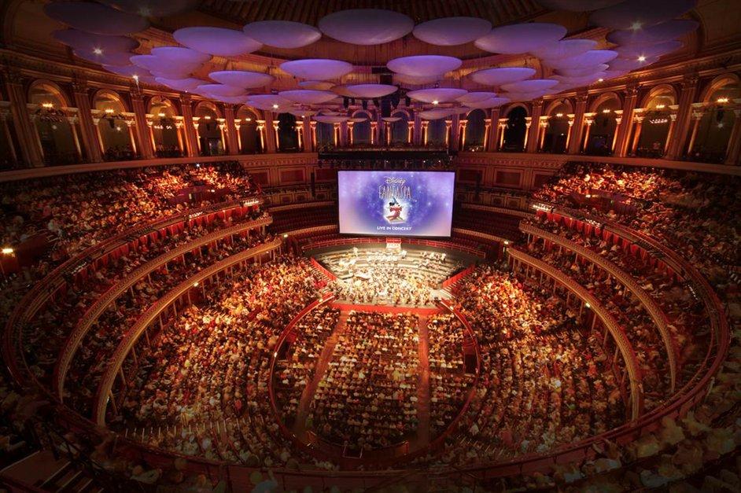
Royal Albert Hall
The Royal Albert Hall is one of London's most famous art venues. Each year, the venue is host to more than 350 performances ranging from local and community events to rock concerts, opera and lavish banquets.

Slide 9
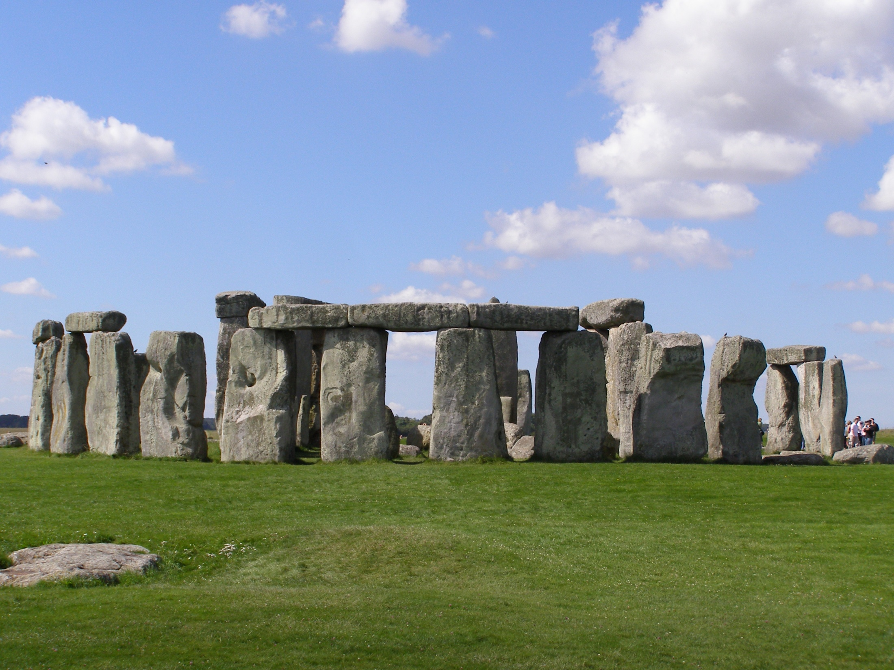
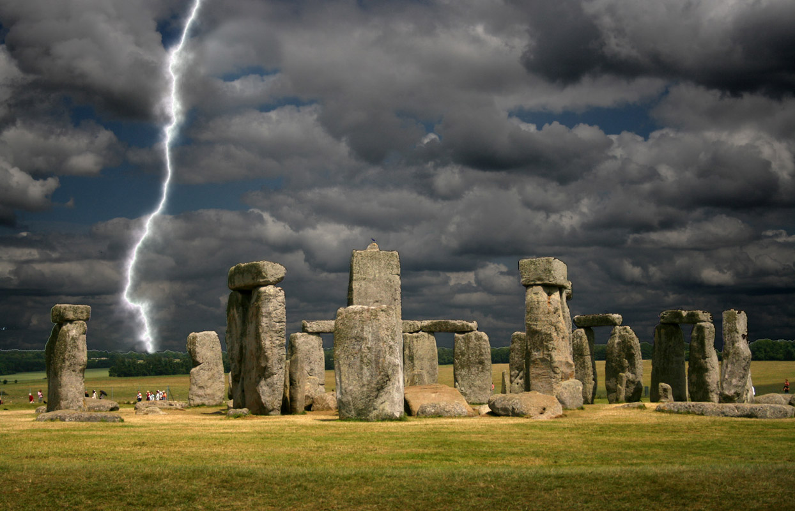
Stonehenge
Stonehenge is a circle of ancient stones erected between 3000BC and 1,600BC. It is one of the most important prehistoric monument sites in Britain.

Slide 10
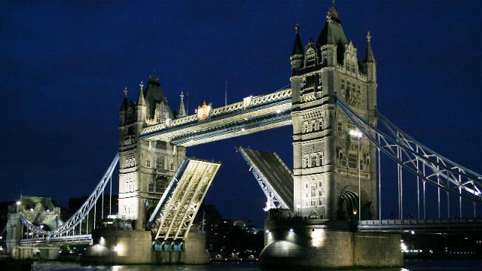
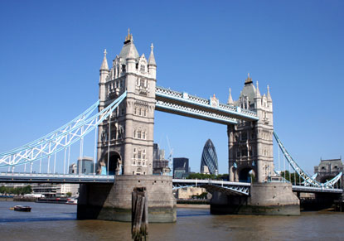
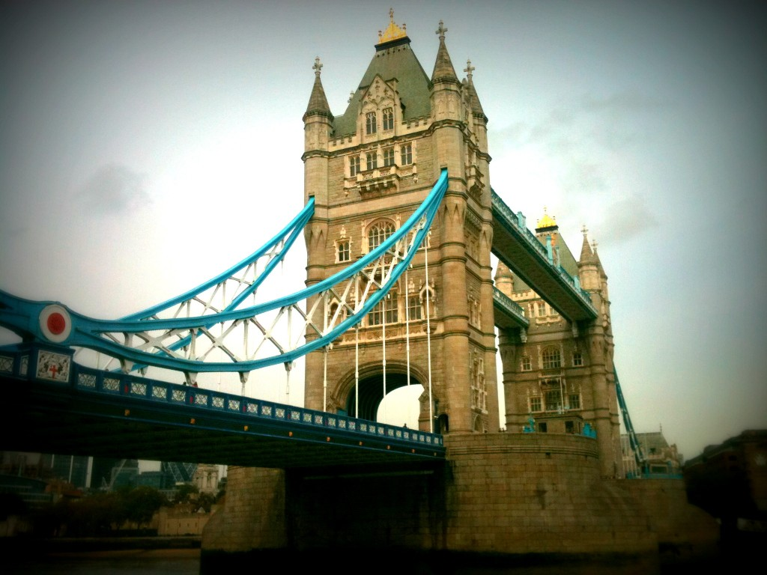
Tower Bridge Exhibition
Tower Bridge is one of London's iconic sights and visitors to the exhibition will learn all about its history and how the bridge works.

Slide 11
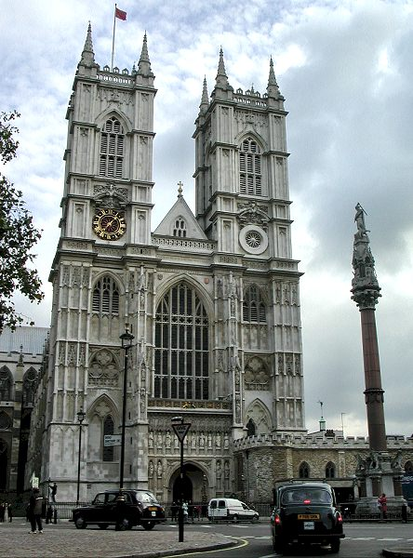
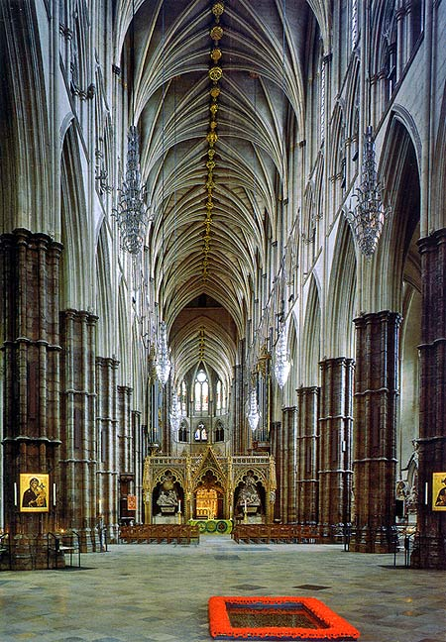
WESTMINSTER ABBEY
The Collegiate Church of St Peter, Westminster, which is almost always referred to as Westminster Abbey, is a mainly Gothic church, on the scale of a cathedral. It is the traditional place of coronation and burial site for English monarchs.

Slide 12
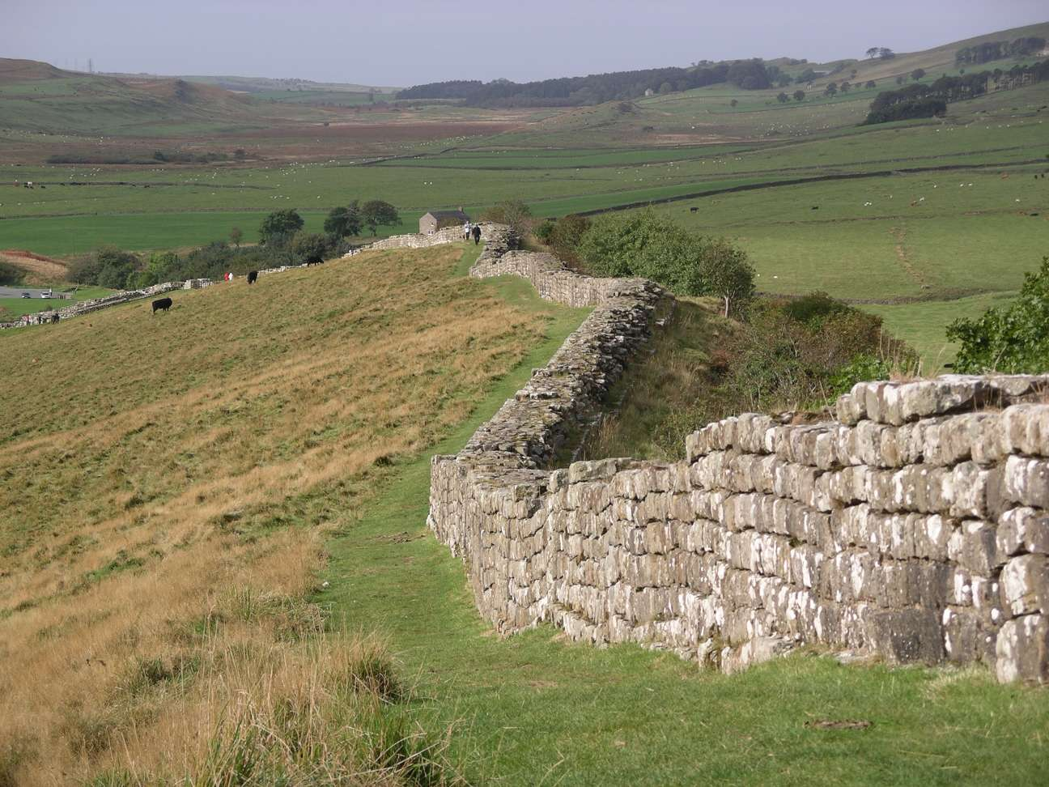
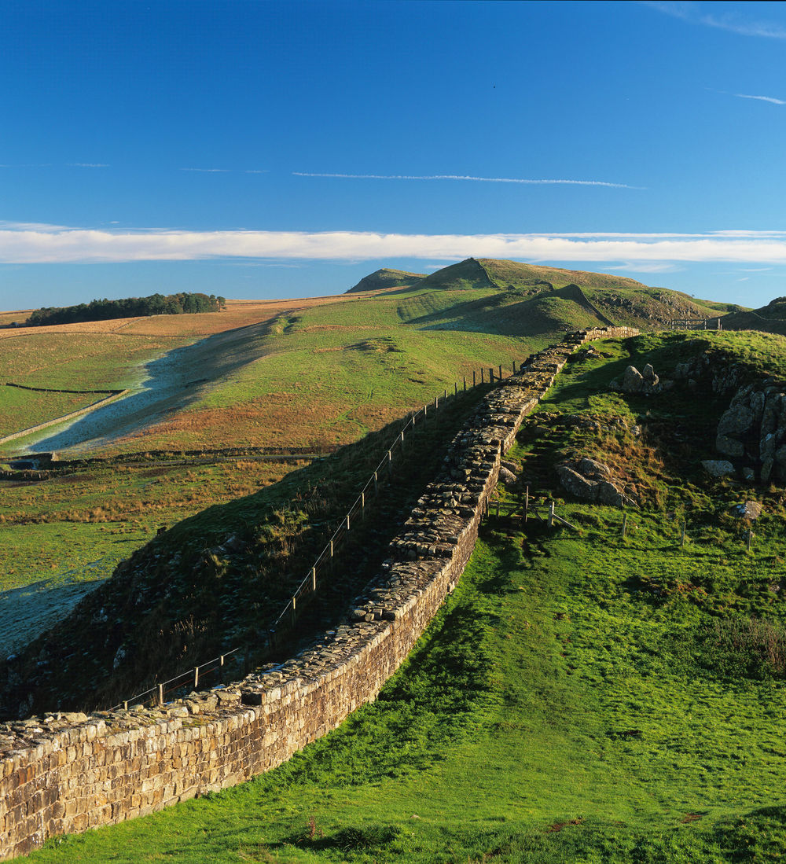
Hadrian's Wall
Hadrian's Wall was built in AD122 and stretched for 73 miles from the east to west coasts in northern England.

Slide 13
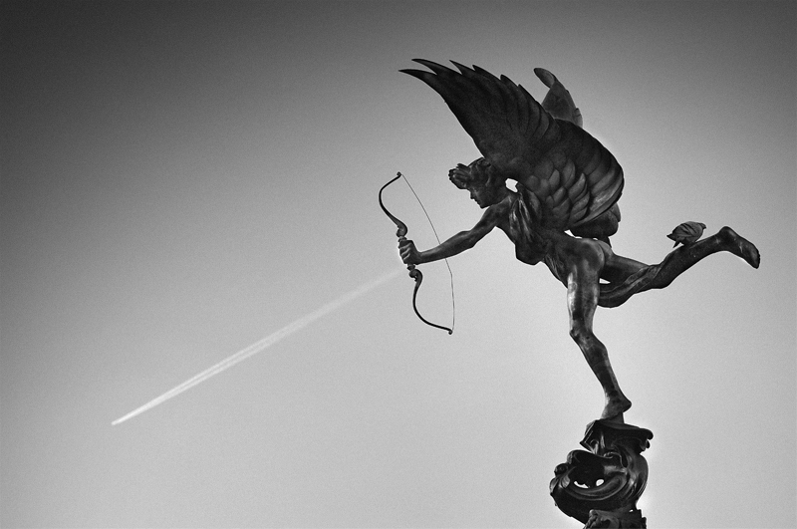
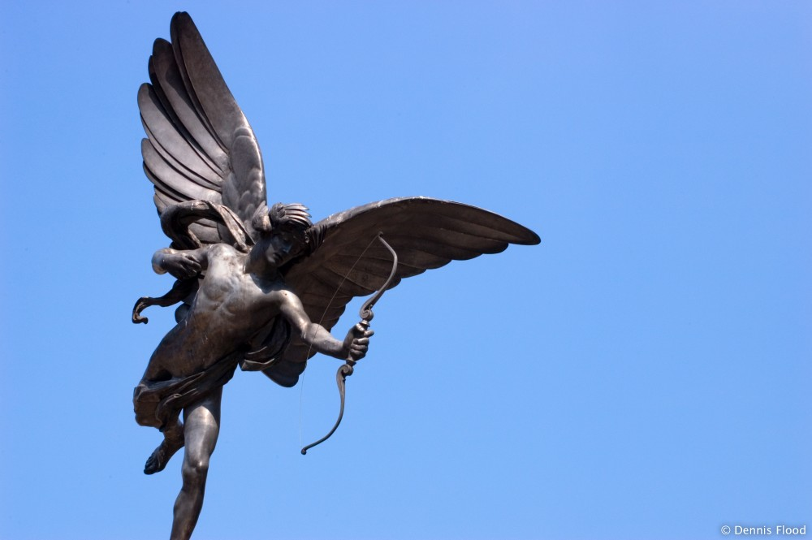
Eros Statue
Eros is a famous statue located on top of the Shaftesbury Avenue Memorial fountain in Piccadilly Square, London

Slide 14
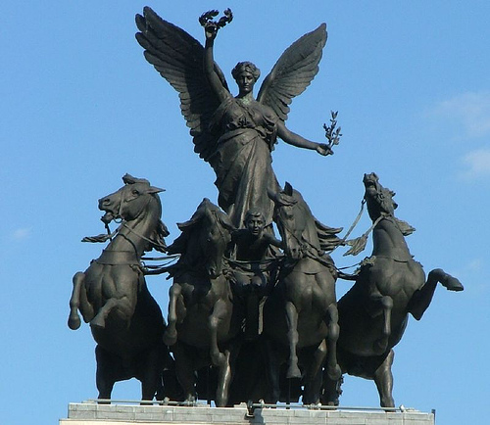
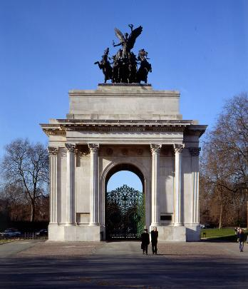
Wellington Arch
Wellington Arch is a triumphal arch situated at Hyde Park Corner, between Green Park and Hyde Park.

Slide 15
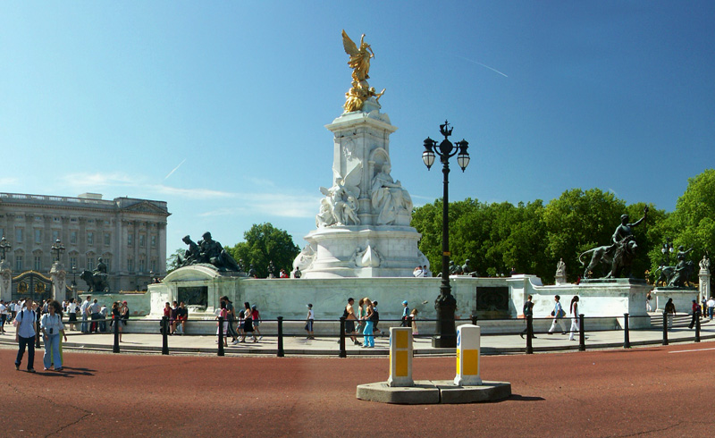
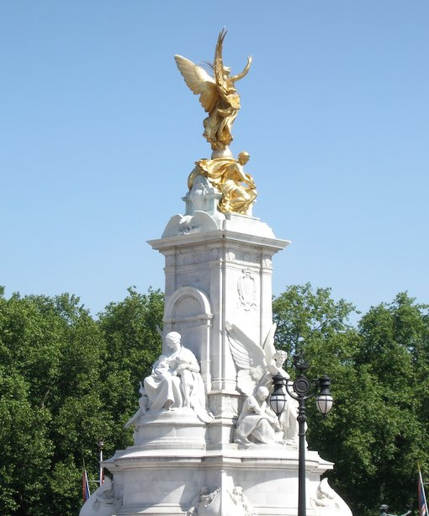
Victoria Memorial
The Victoria Memorial is a statue in front of Buckingham Palace in London, placed at the centre of The Queen's Gardens.
The golden statue on top is of Queen Victoria facing north-eastwards down The Mall.

Slide 16
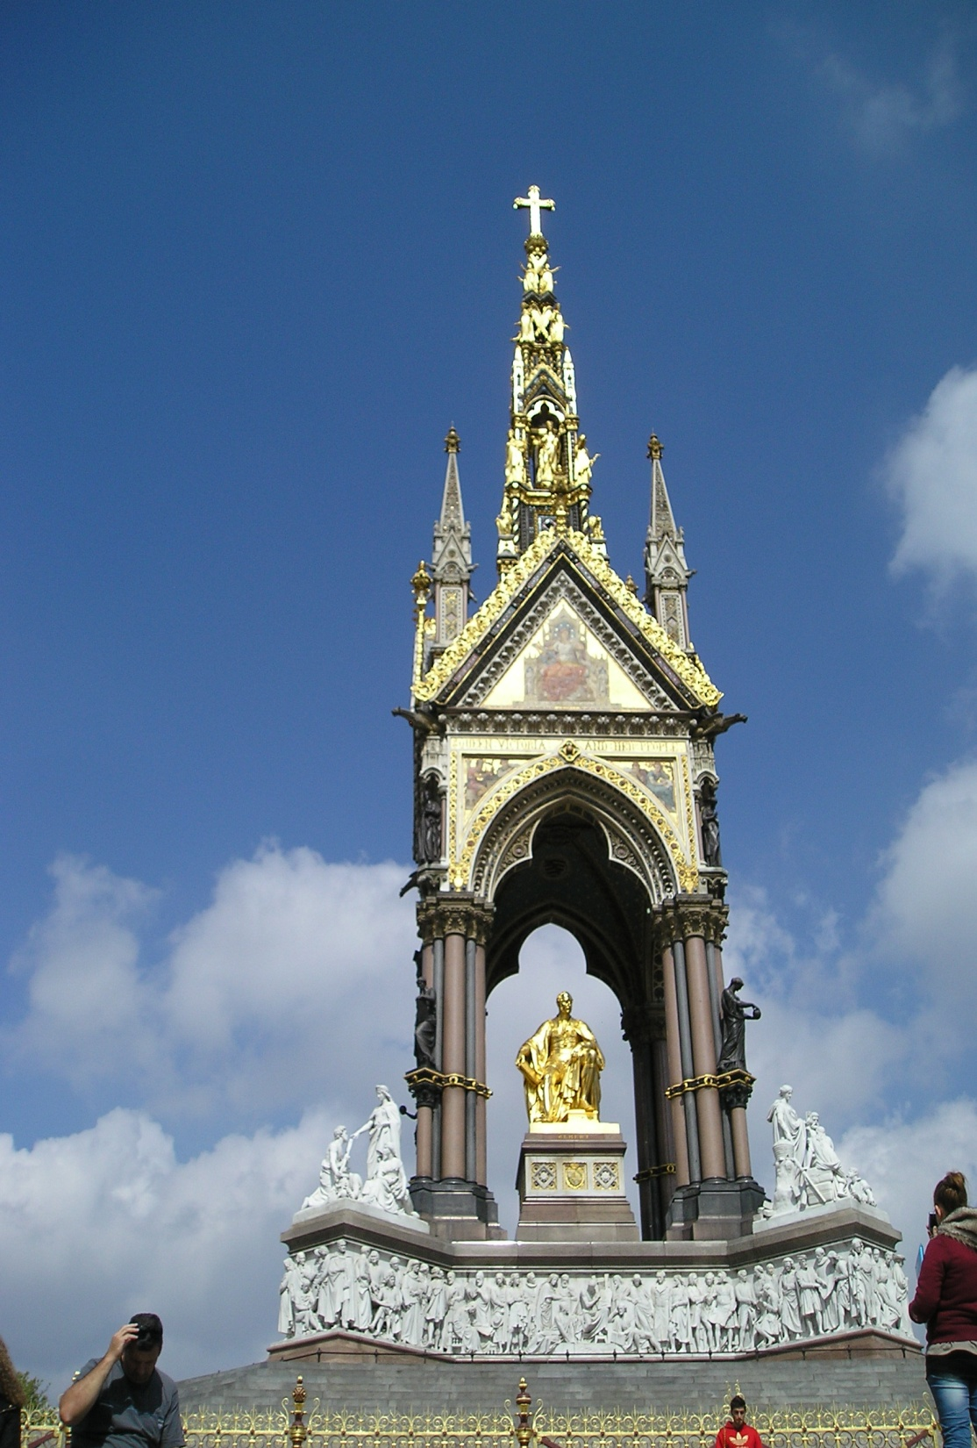
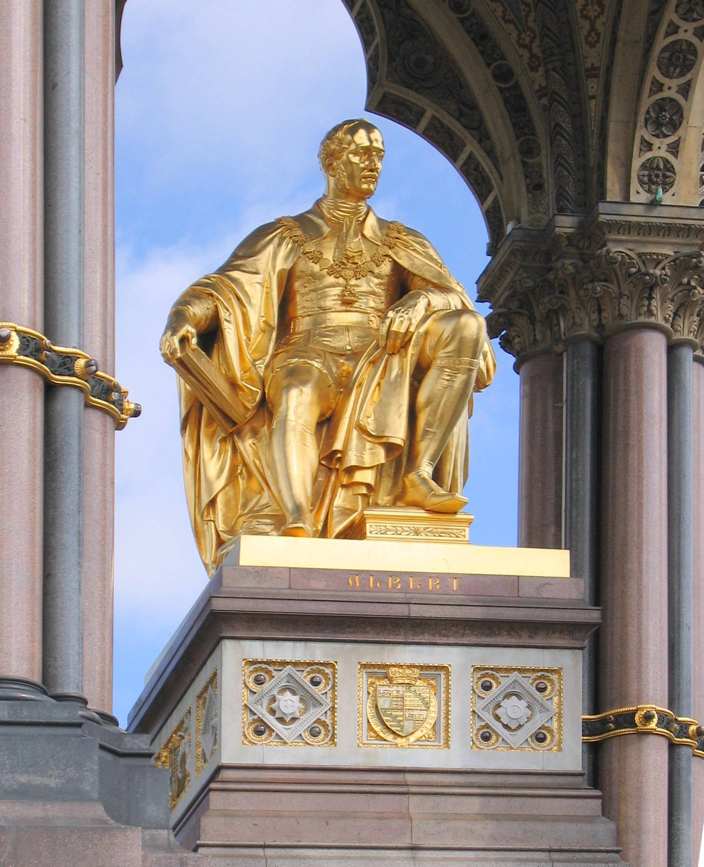
The Albert Memorial
The Albert Memorial was commissioned by Queen Victoria in memory of her beloved husband, Prince Albert who died of typhoid fever in 1861, aged 42. It was designed by Sir George Gilbert Scott in the Gothic Revival style and opened in July 1872 by Queen Victoria. The memorial is 176 feet tall, took over 10 years to complete, and cost £120,000. The cost was met by public subscription.

Slide 17
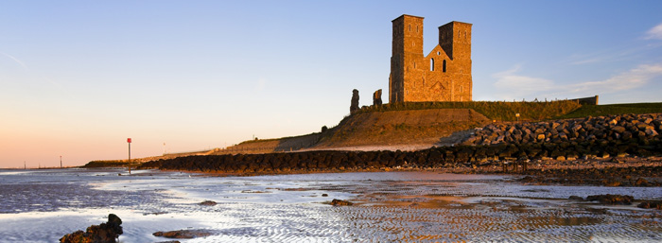
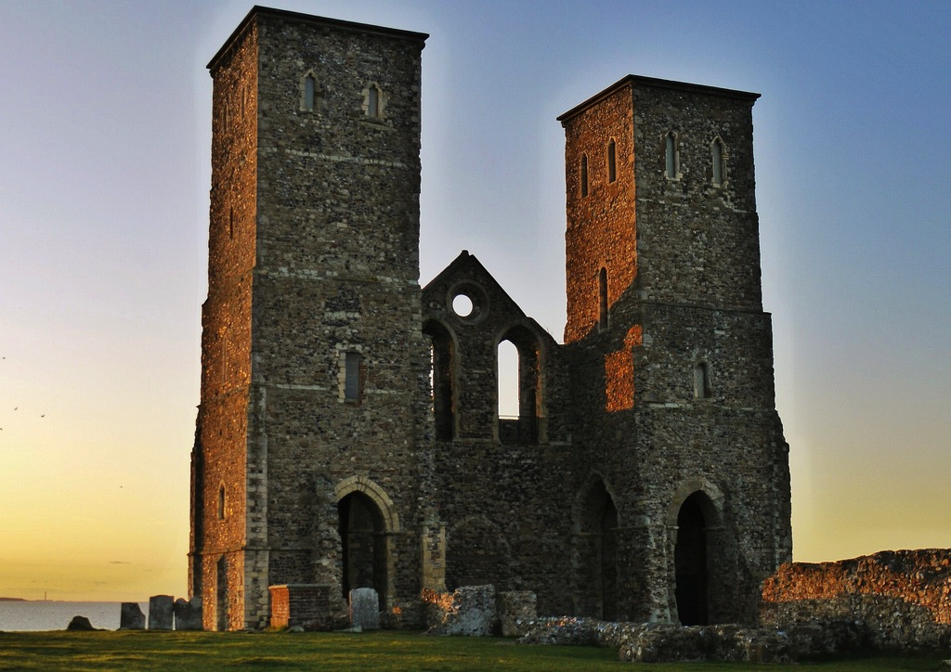
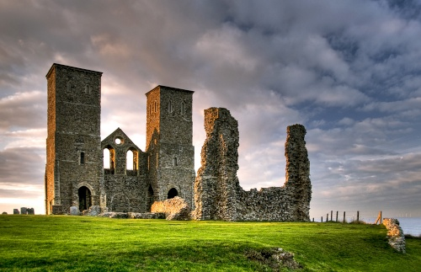
Reculver Tower and Roman Fort
The hamlet of Reculver once occupied a strategic location at the western end of the Wantsum Channel, between the Isle of Thanet and the Kent mainland. This inspired the Romans to build a small fort, probably around 43 AD, and, starting late in the 2nd century, they built a "castrum" called Regulbium, which later was part of the chain of Saxon Shore forts.

Slide 18
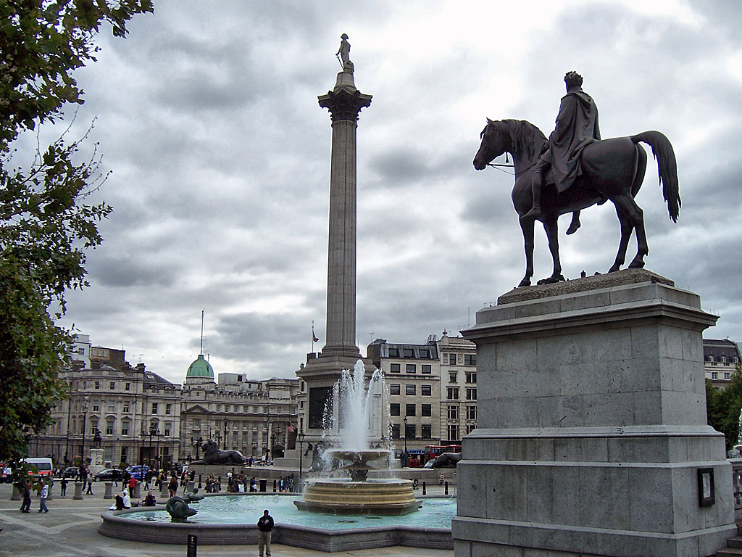
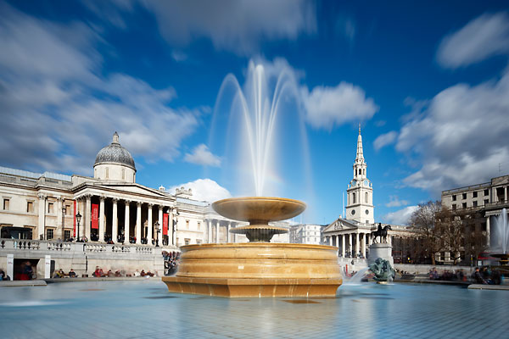
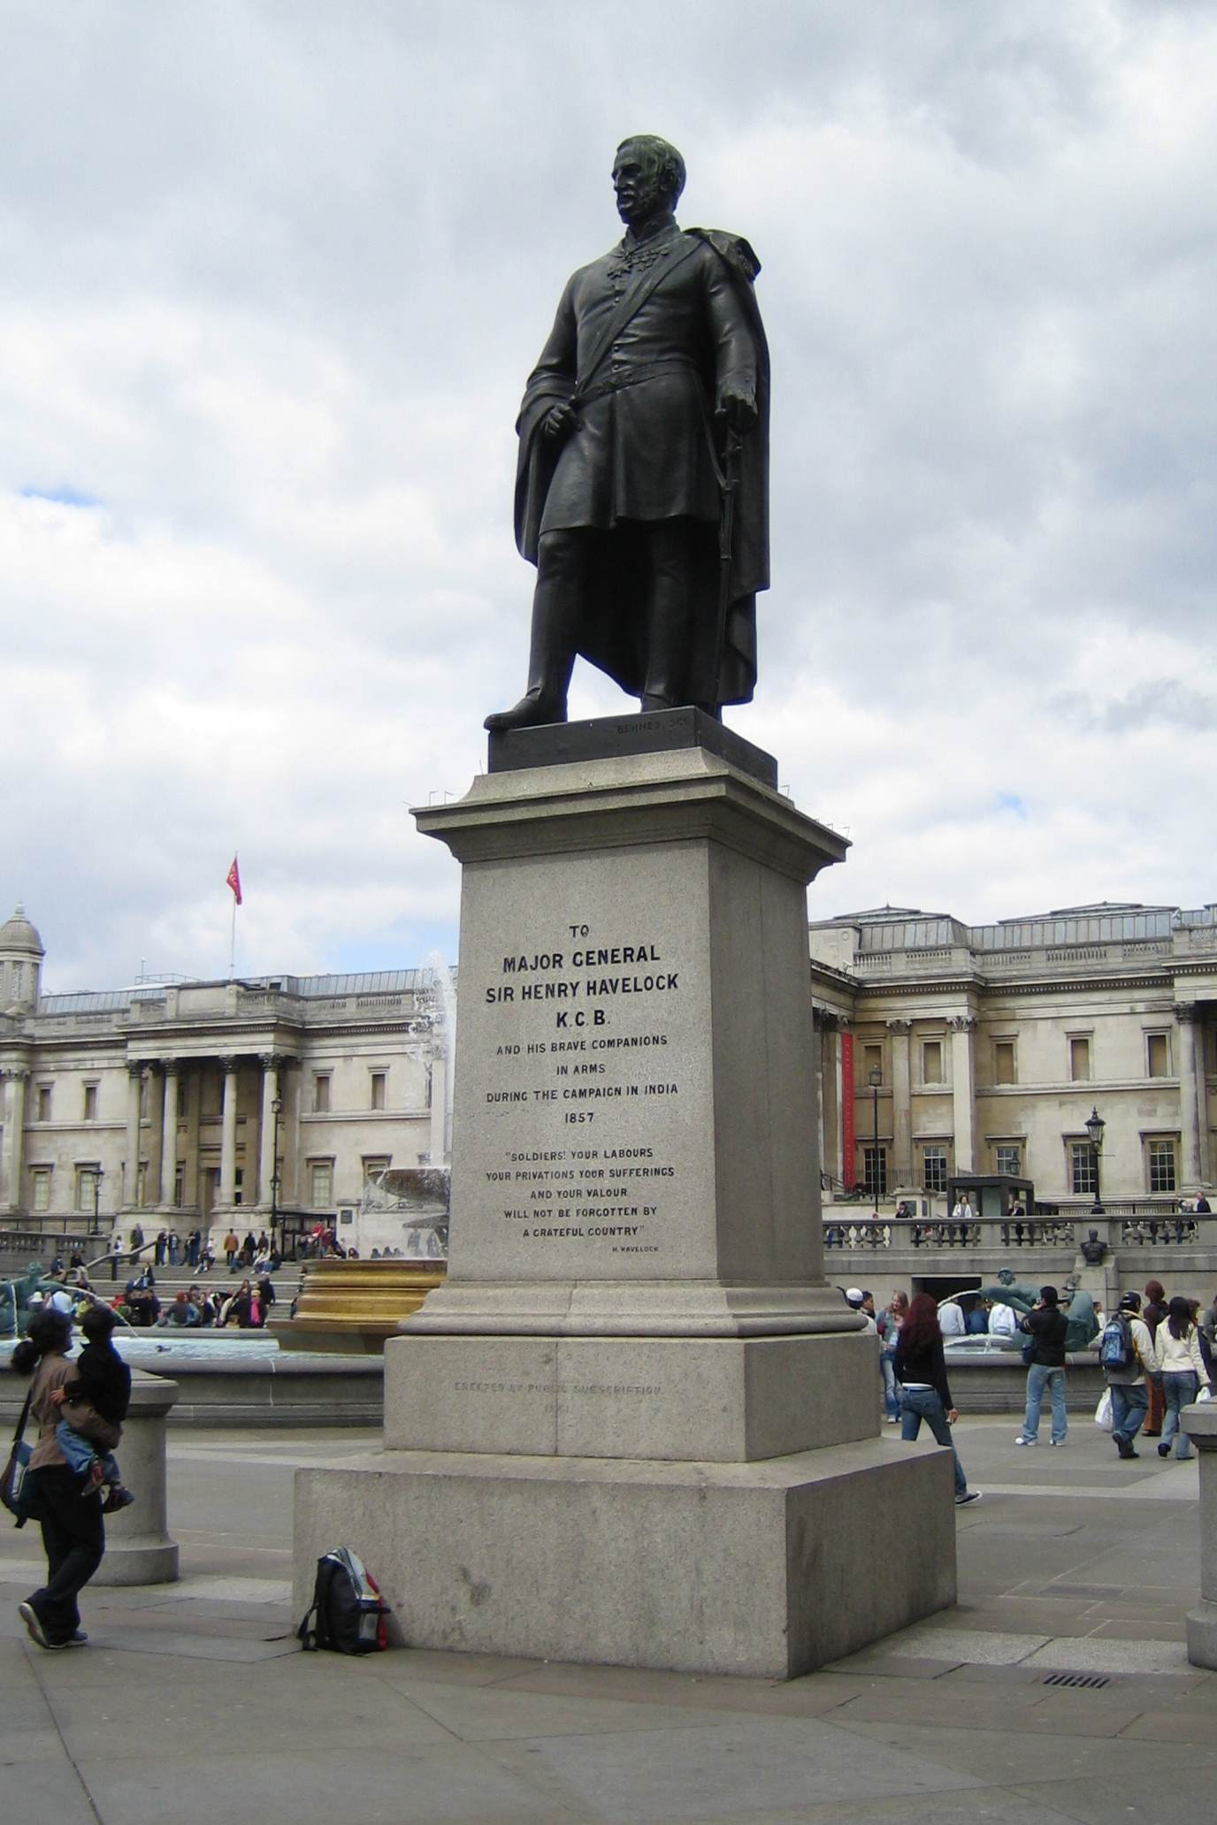
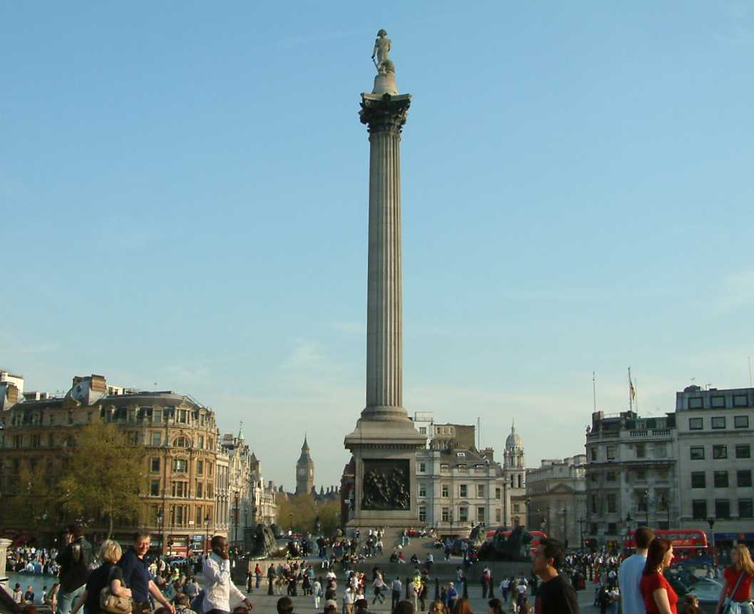
Trafalgar Square
Trafalgar Square is a square in the centre of London and is named after the battle of Trafalgar. The focal point of Trafalgar Square is Nelson's Column which towers 151ft above the square with an 18ft statue of Nelson on top.

Slide 19
