Slide 1
Italian cuisine

Slide 2
Italy is country in a south Europe. This country has a glorious history and a rich cultures.

Slide 3
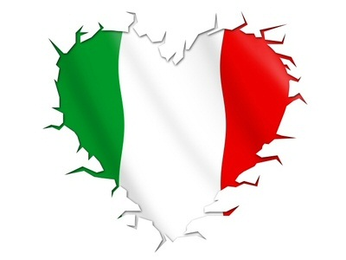
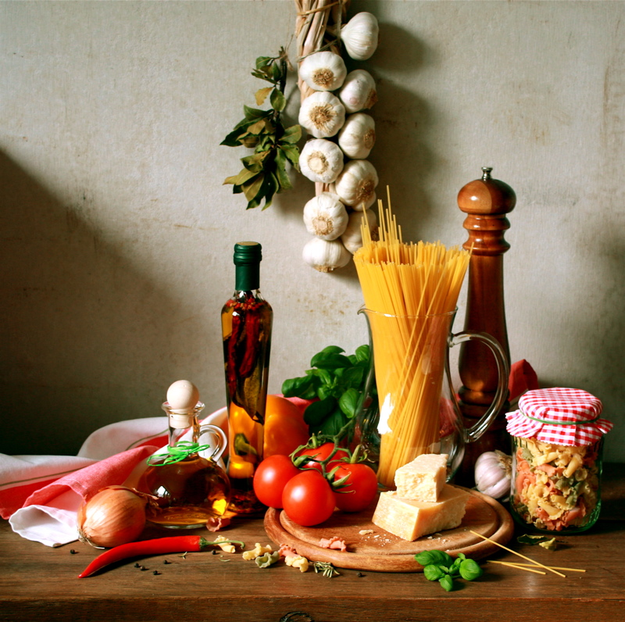
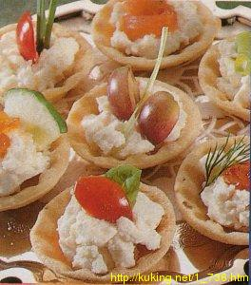
Italian dishes are very popular in the world. Italian food is one of the best in Europe.

Slide 4
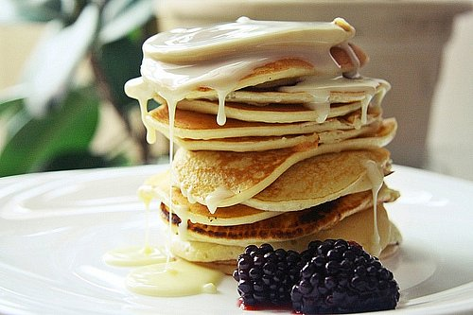
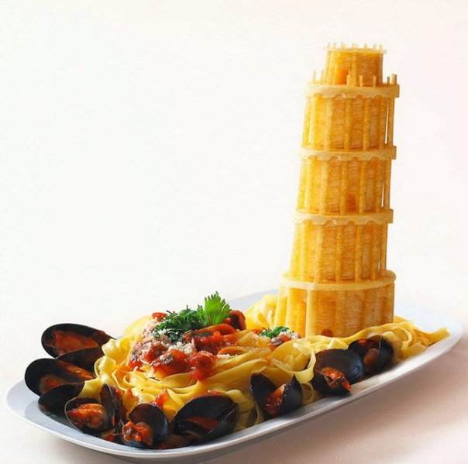
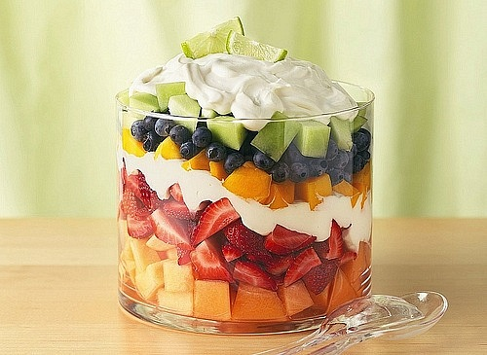
This food is diverse and link many nutty tastes.

Slide 5
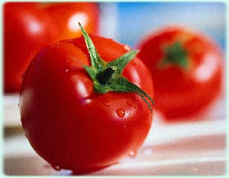
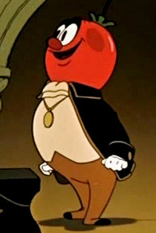
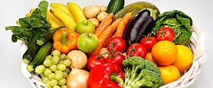
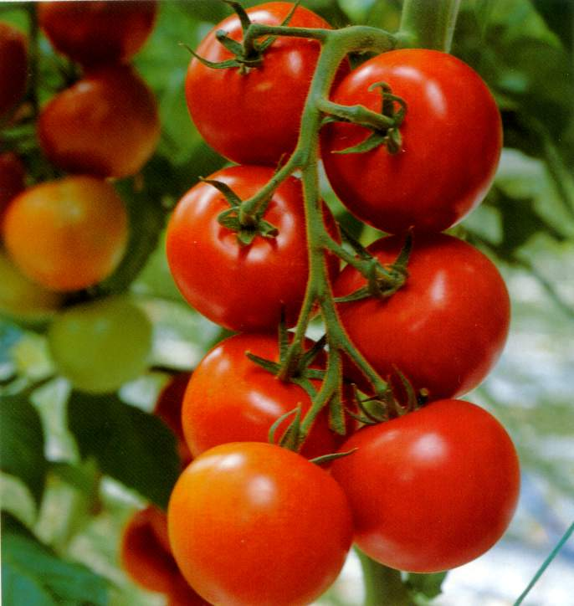
Vegetables rules in Italian kitchen, but their king is tomato.

Slide 6
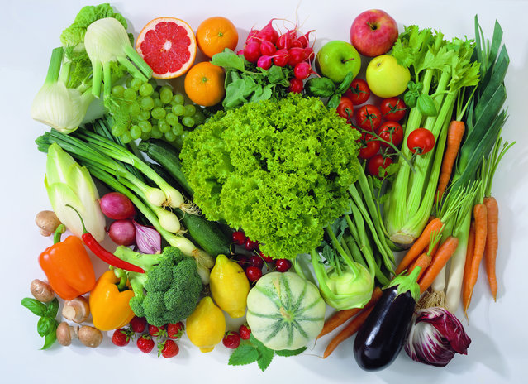
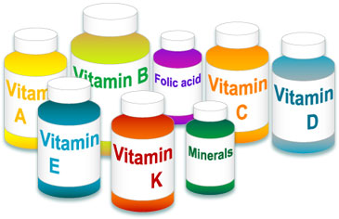
Italian food is very useful, because majority dishes consist of vegetables. Italians use only naturals products. Their food has many vitamins and nutrients . So italians are very healthy.

Slide 7
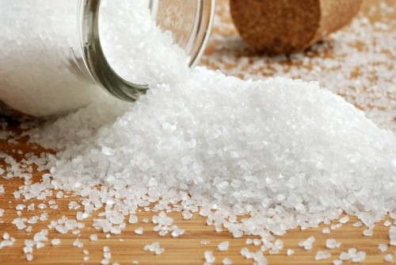
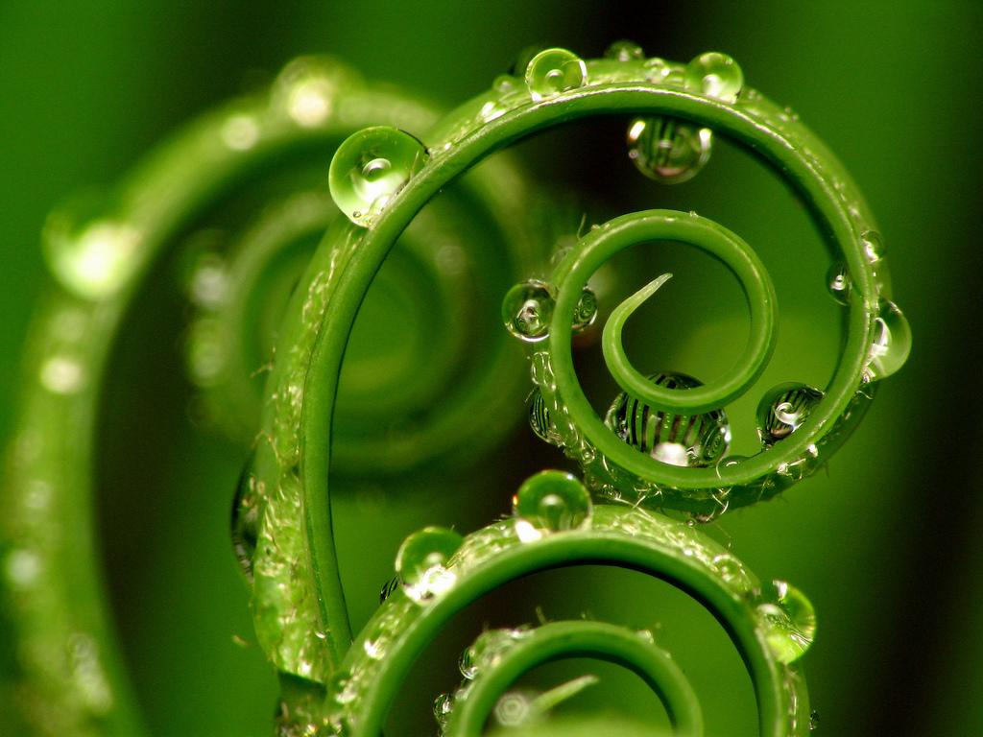
Salt is the main seasoning. They use greenery and cheese too.

Slide 8
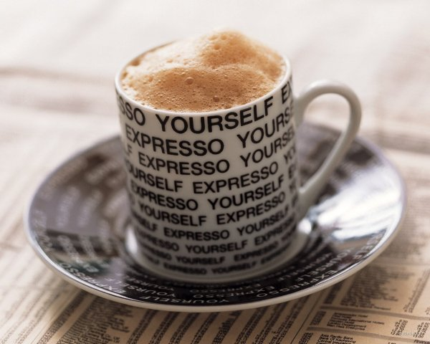
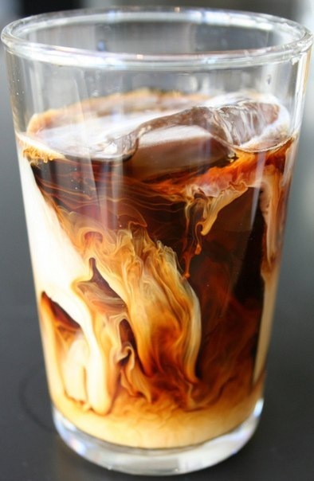
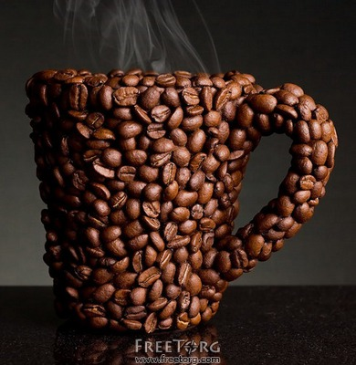
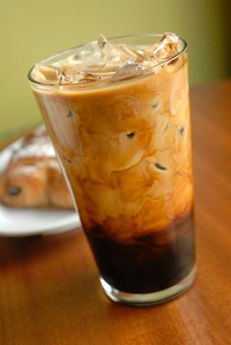
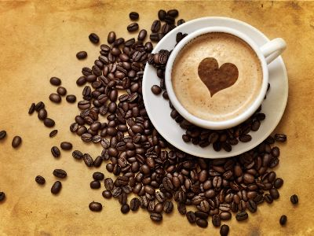
The favourite drink in Italia is coffee. Every people in Italia start your day with cup of coffee.

Slide 9
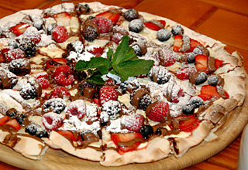
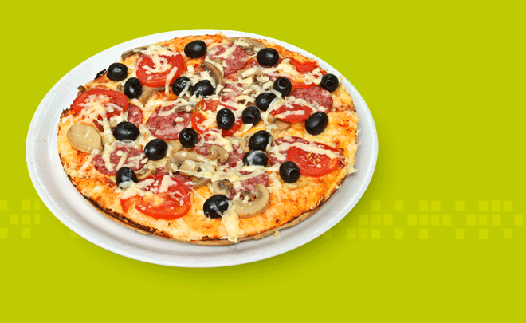
The popular Italy food:
Pizza

Slide 10
Lasagna

Slide 11
Calzone

Slide 12
Pasta

Slide 13
Risotto

Slide 14
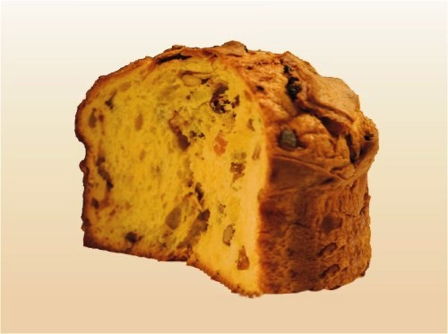
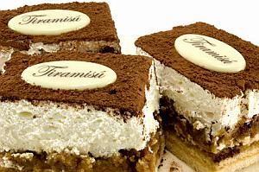
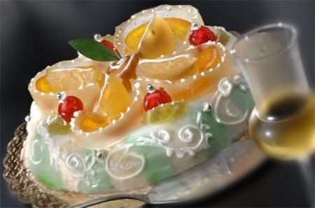
Italian cuisine has many delicious desserts.
Tiramisu
Panettone
kasata

Slide 15
Filonovych Vika form 11 – B class

