Slide 1
Geographical Position of the USA
Юркова Ирина
10-Б класс

Slide 2
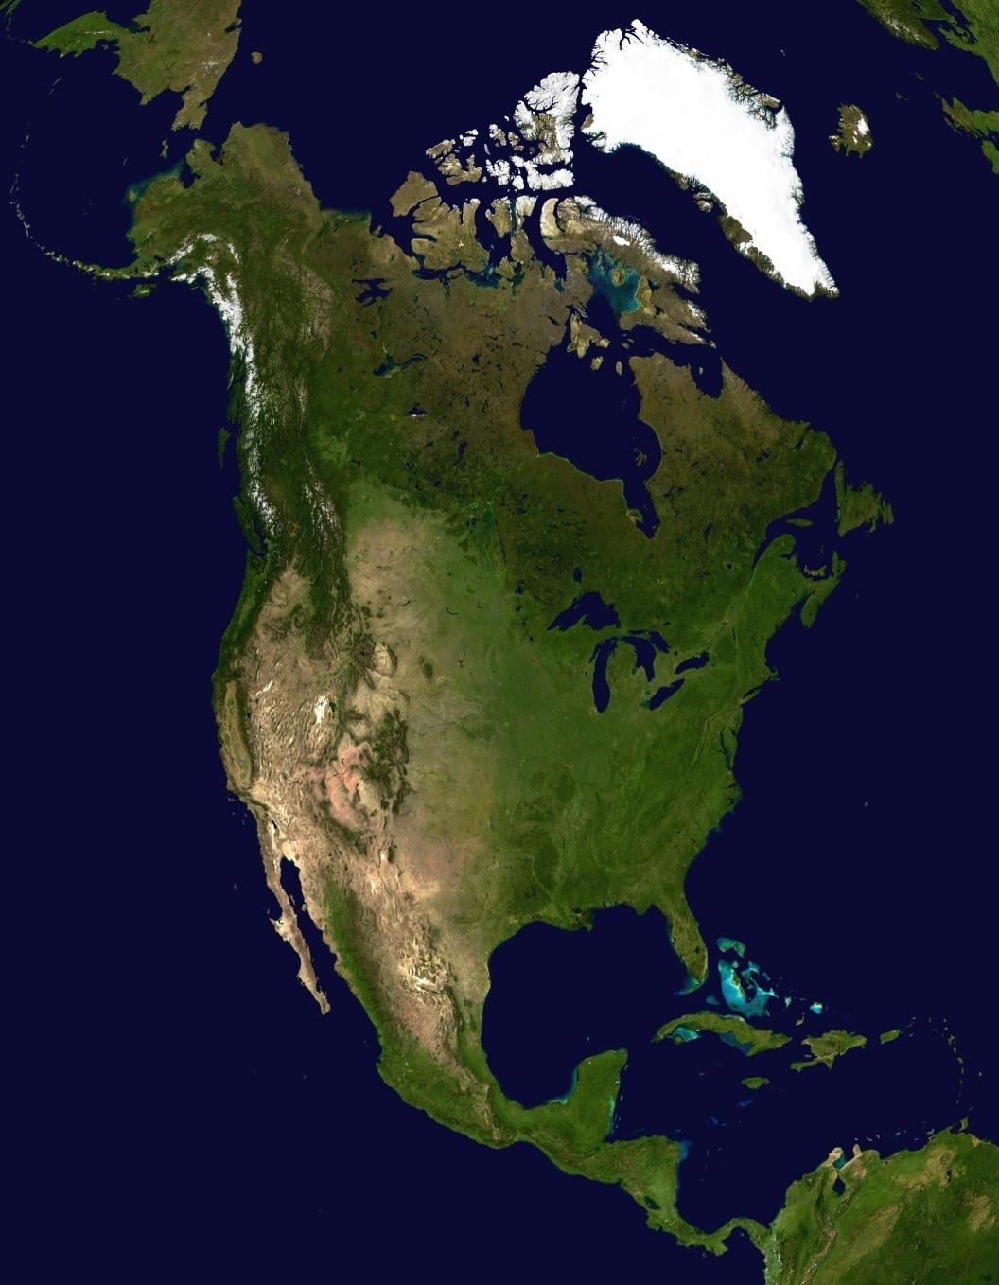
The USA occupies the central part of the North American continent. It borders on Canada in the north and Mexico in the south. It is washed by the Atlantic Ocean in the east, by the Pacific Ocean in the west and by the Gulf of Mexico in the south. the central part of the Pacific Ocean.

Slide 3
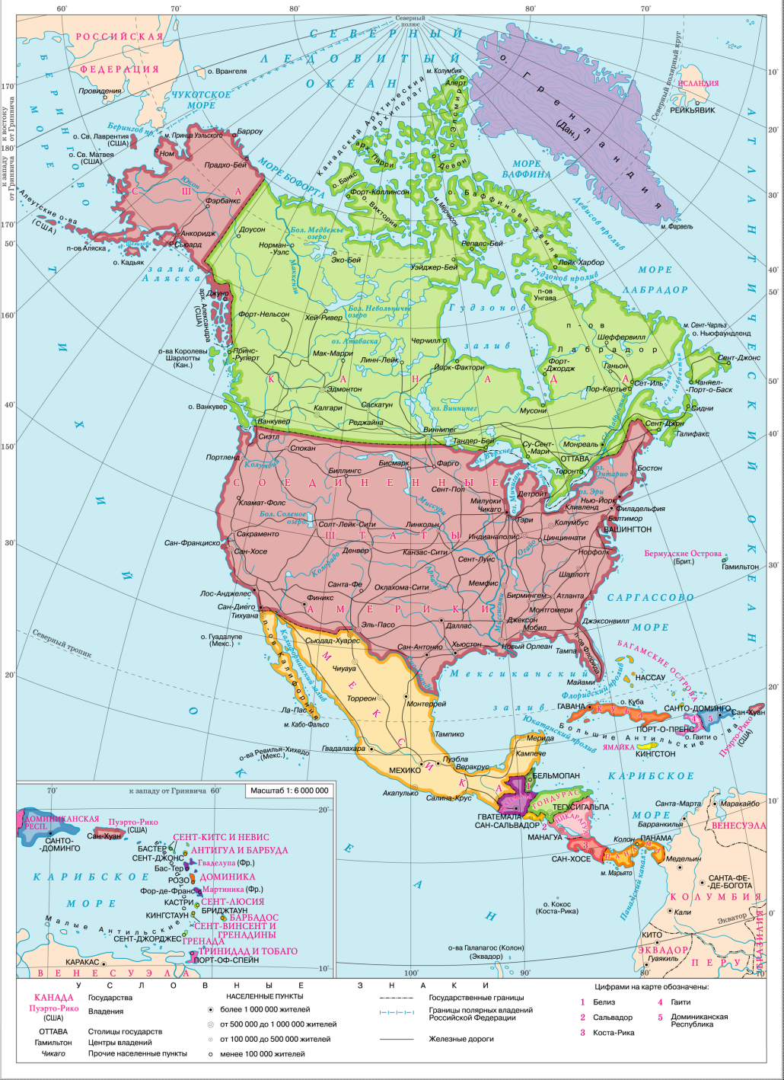
The present territory of the USA consists of three separate parts. The USA proper and Alaska are situated in North America. The Hawaii are situated in

Slide 4
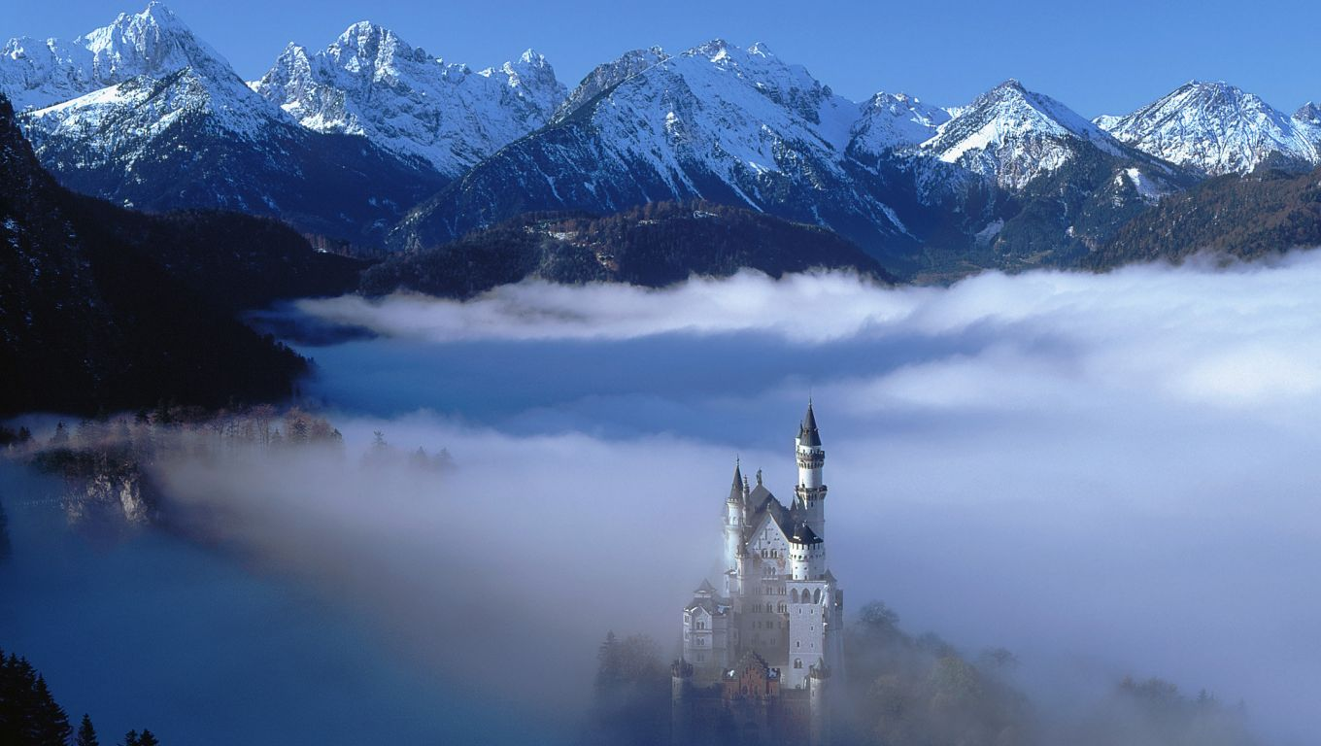
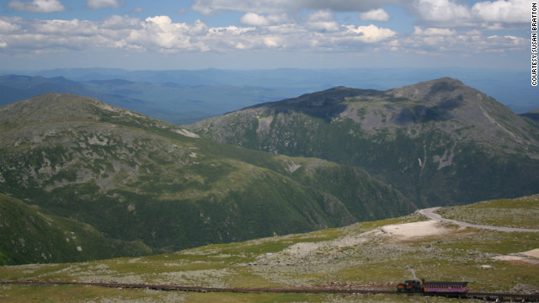
USA is a country of mountains and prairies, valleys and deserts. About one half of the territory in the west is occupied by the Cordilleras. In the east there are the Appalachian Mountains. Between these great mountain chains central and large valleys lie.

Slide 5
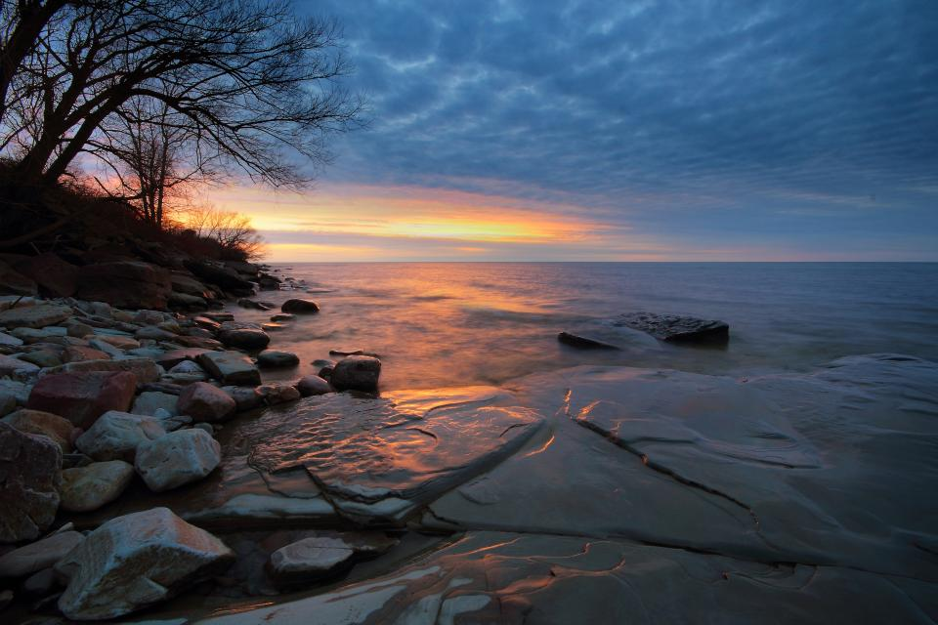
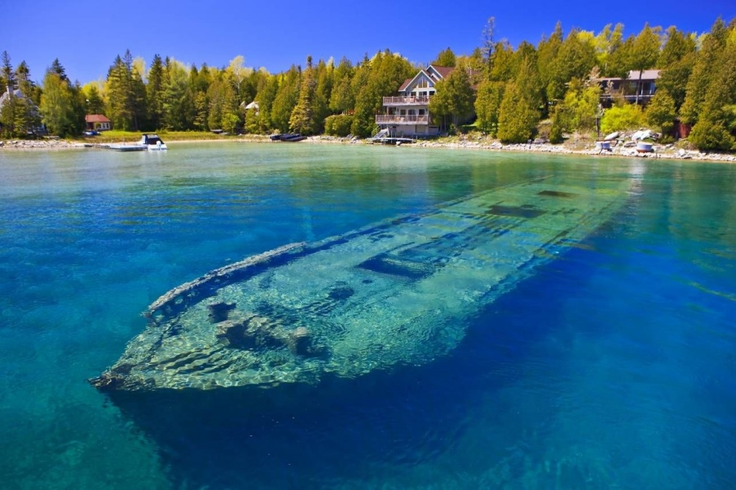
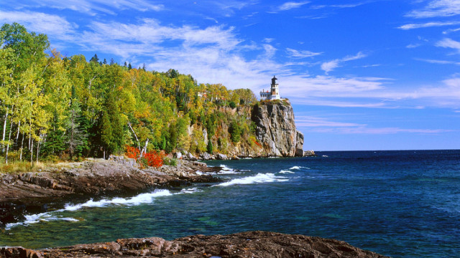
The Great Lakes are situated in the north-east of the country. They are Lake Ontario, Lake Huron, Lake Erie, Lake Superior, Lake Michigan

Slide 6
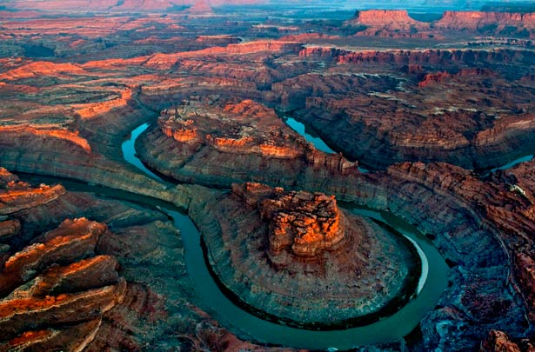
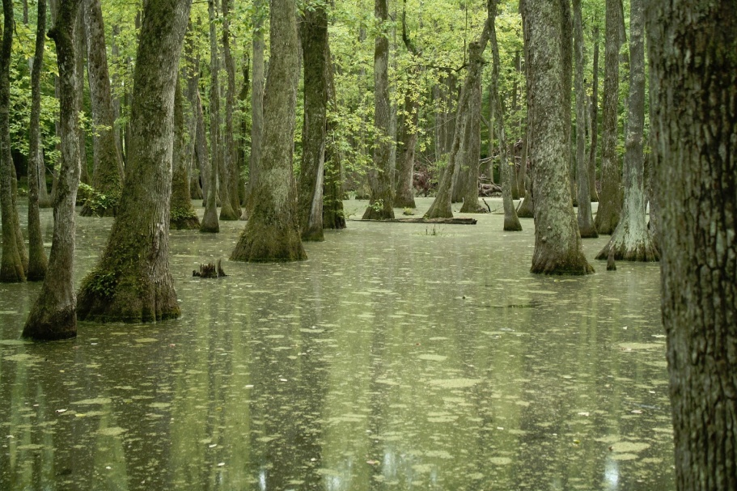
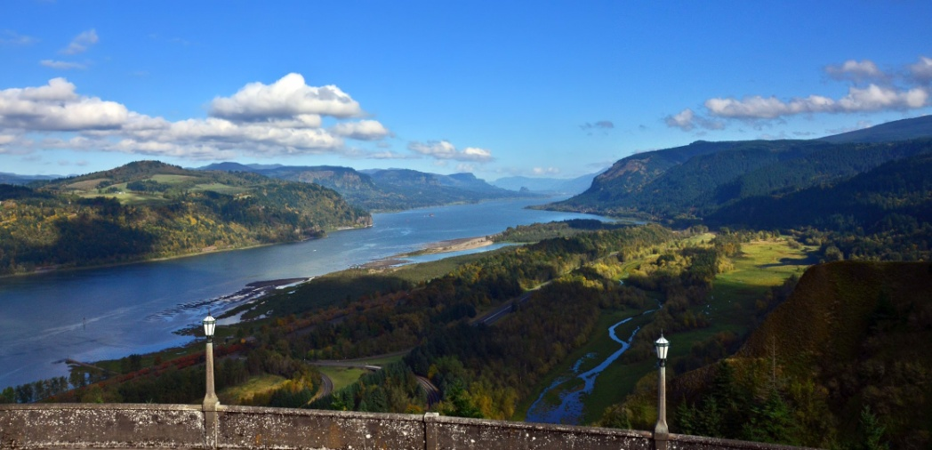
The largest rivers of the USA are the Mississippi, the Missouri, the Columbia, the Colorado, and the Yukon. American rivers have very expressive names: the Snake River, the Milk River, the Green River, the Sweetwater River, the White River.

Slide 7
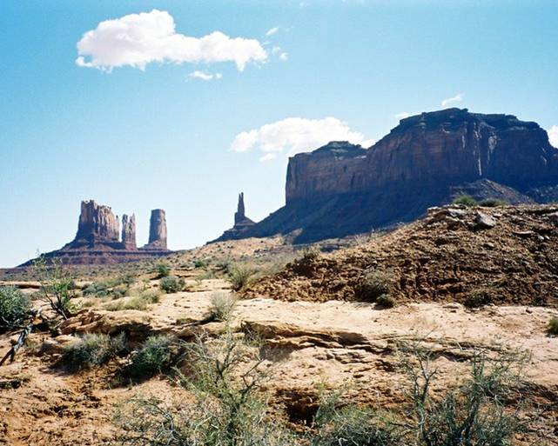
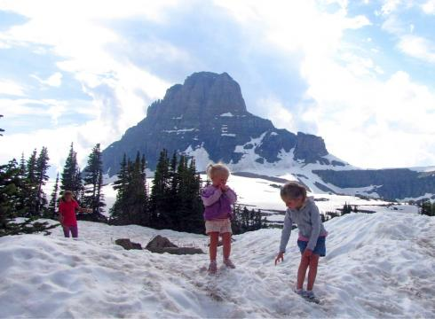
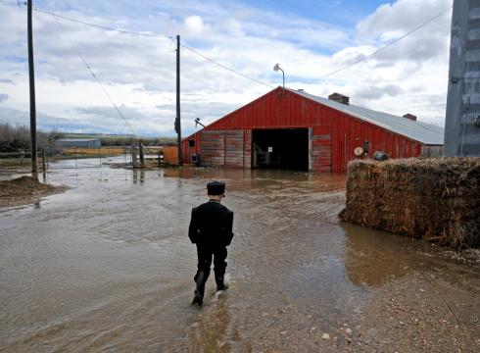
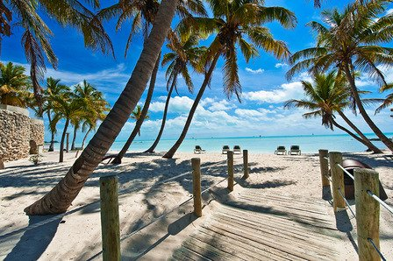
Most of the territory is marked by sharp differences between winter and summer. Average winter temperature is about 25 degrees below zero in Alaska and up to 20 degrees above zero in Florida. Average summer temperature varies from 14 degrees above zero in the western part and up to 32 degrees above zero in the southeast.

