Slide 1
Preliminary English Test

Slide 2
An exam consist of:
Reading and Writing,
Listening,
Speaking.

Slide 3
Reading (5 tasks - 35 questions)
Writing
(3 tasks 7 questions)
Contains
tasks-choice from a variety of options proposed
tasks on correlating text and the associated human
task to choose true / false.
Contains
a task to the compilation sentences identical with this,
writing short notes or letters,
writing a letter or story (optional).

Slide 4
Listening
Task 1 | 7 short conversations, each of which you must choose one of the three proposed images
Task 2 | Monologue or interview and 6 questions to him with the choice of the correct answer from the three choices
Task 3 | Monologue. You must fill in 6 passes in the text after listening
Task 4 | Dialogue. You must define true or false each of these 6 offers after listening

Slide 5
Speaking
Answers to the
questions of the
examiner (mostly
about themselves)
2. The examiner gives the candidate a picture and describes the situation. Necessary in a conversation with the other candidate to come to the decision that it would be the best choice of action in this situation
3. The examiner gives a color photo, which the applicant must describe
4. Conversation both candidates on topic started in the task three (on photographs)

Slide 6
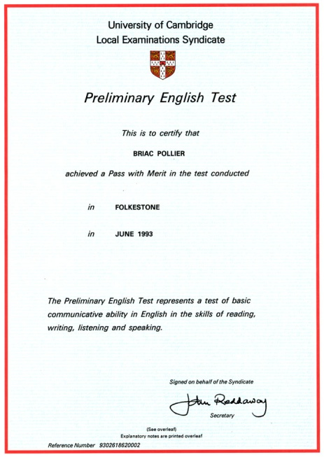
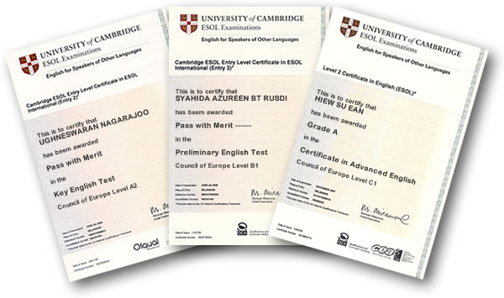
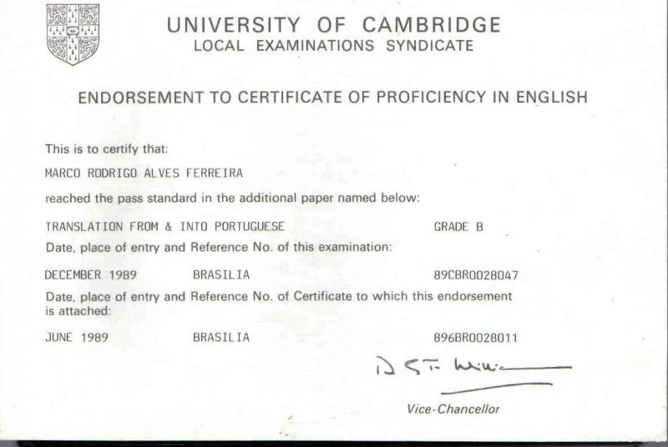
Certificate is recognized by several organizations as proof that confirms proficiency in English at a basic level

