Slide 1
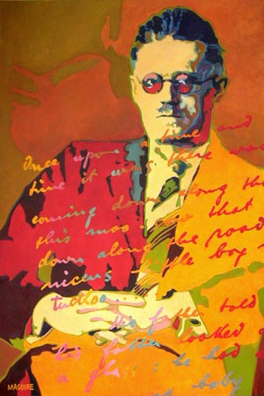
James Joyce (2 February 1882 – 13 January 1941)
The demand that I make of my reader is that he
should devote his whole Life to reading my works.

Slide 2
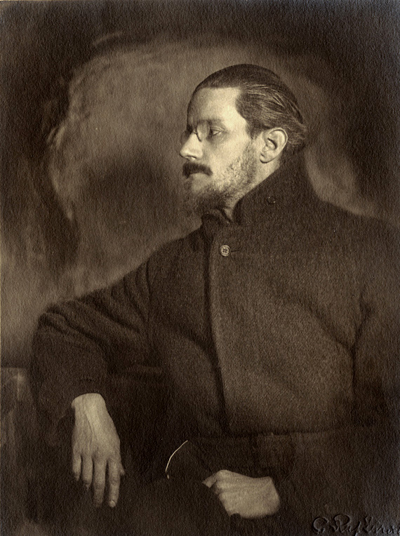
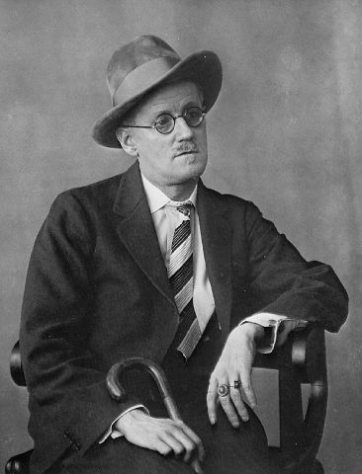
James Augusta Aloysius Joyce was
an Irish novelist and poet, considered to be one
of the most influential writers in the modernist
avant-garde of the early 20th century.
His complete oeuvre also includes three books of poetry, a play, occasional journalism, and his published letters.

Slide 3
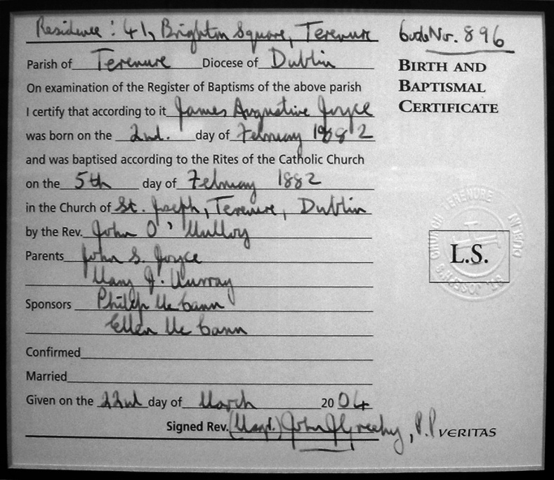
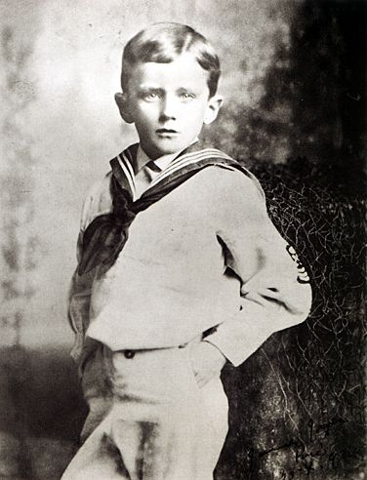
James Augusta Aloysius Joyce was born on 2 February 1882 to John Stanislaus Joyce and Mary Jane "May" Murray in the Dublin suburb of Rathgar.
He was baptised in the nearby
St. Joseph's Church in Terenure
on 5 February by Rev. John O'Mulloy.
He was the eldest of ten surviving children; two of his siblings died of typhoid.

Slide 4
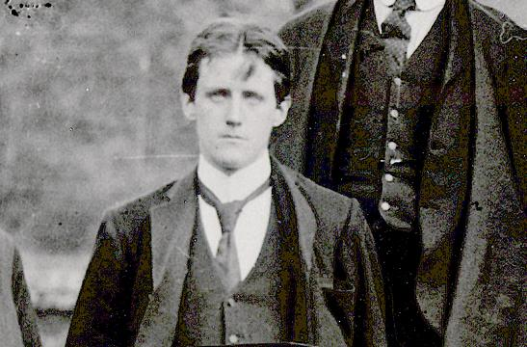
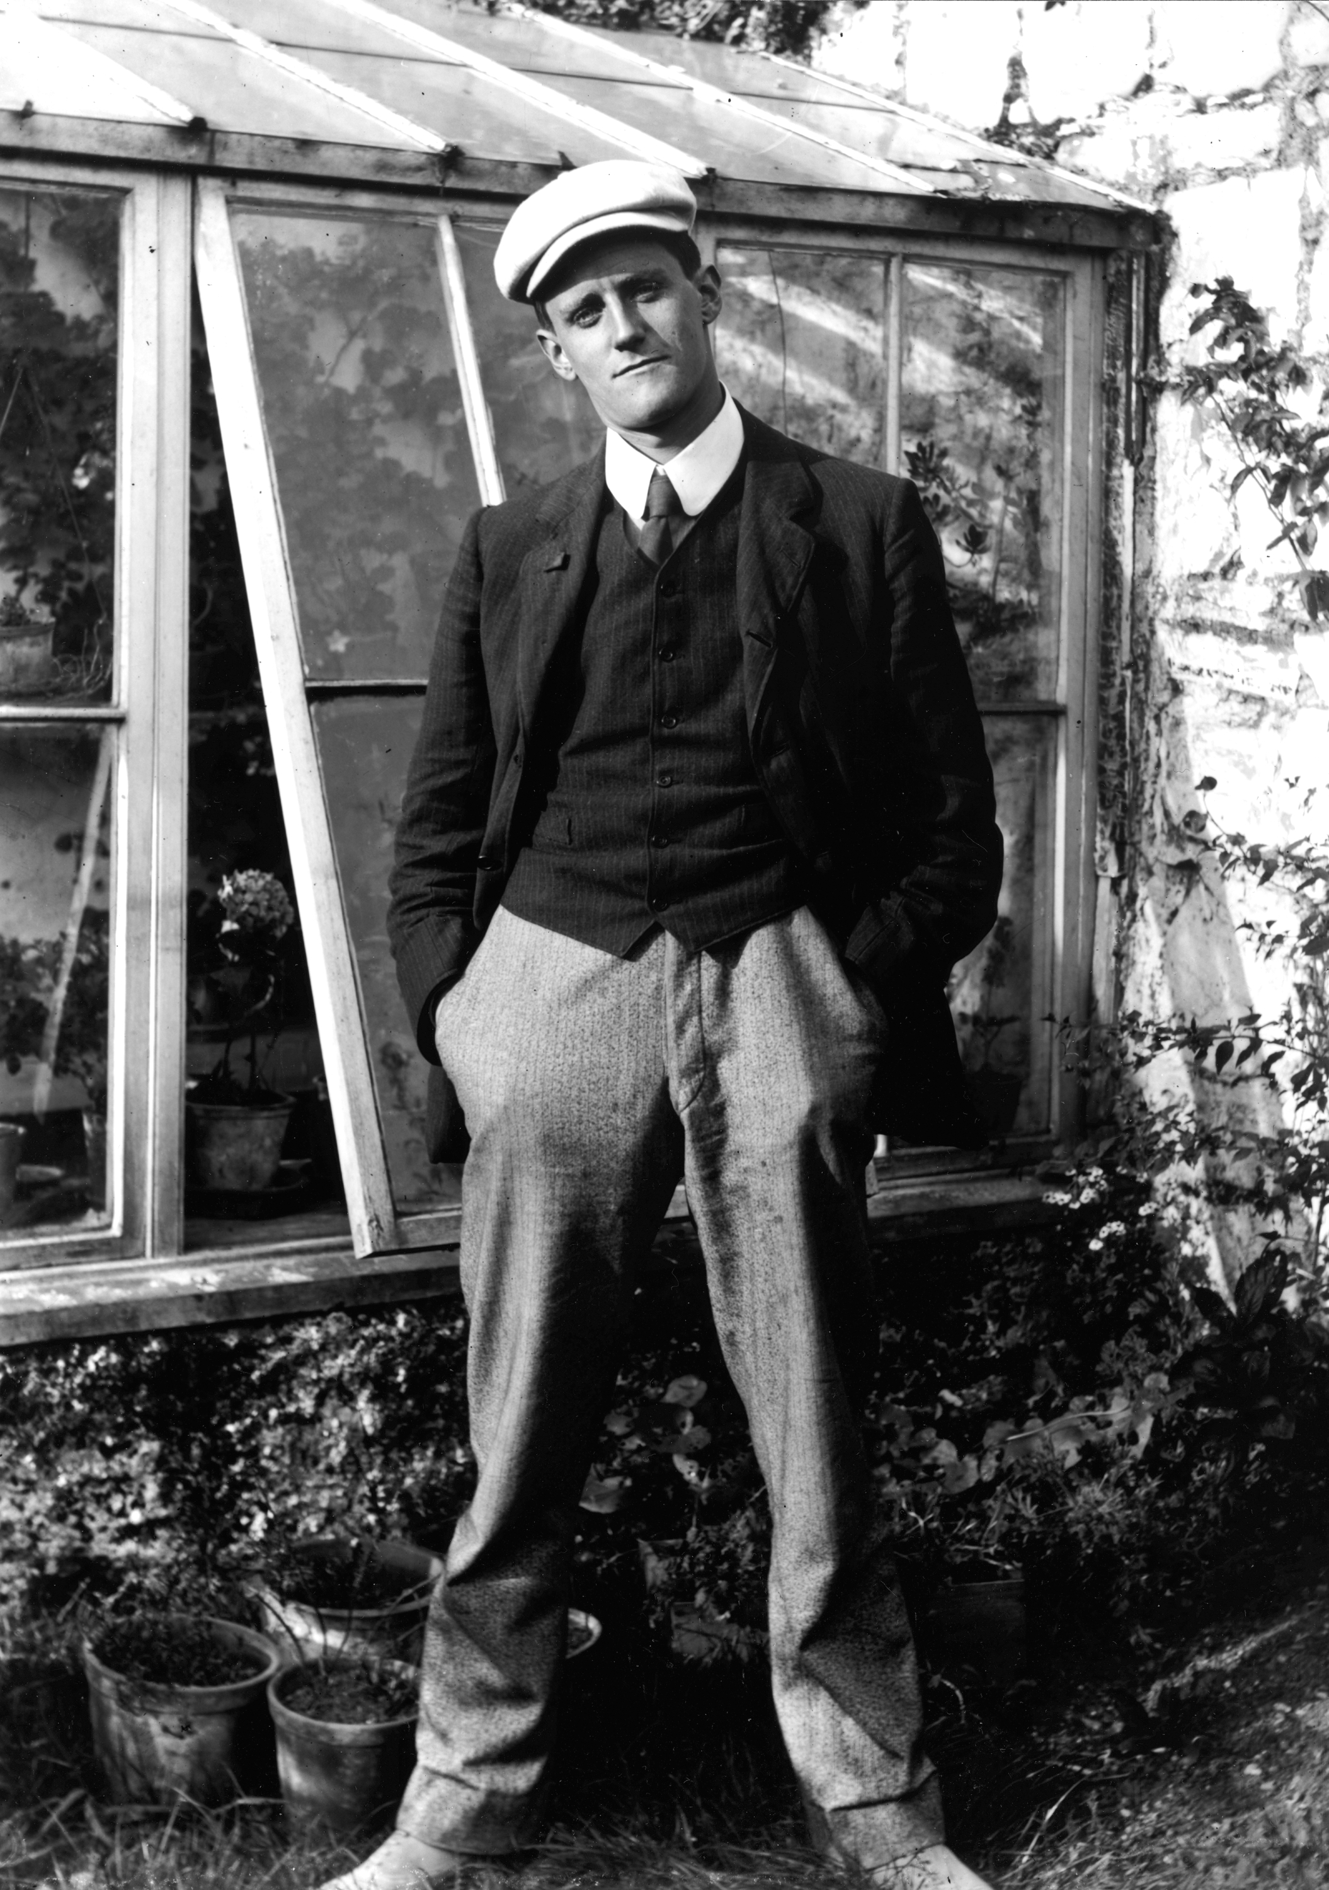
Joyce had begun his education at
Clongowes Wood College, a Jesuit
boarding school near Clane in 1888 but had to leave in 1892 when his father
could no longer pay the fees.
On 1904 he met Nora Barnacle, a young woman from Connemara, who was working as a chambermaid. They first stepped out together, an event which would be commemorated by providing the date for the action of Ulysses.

Slide 5
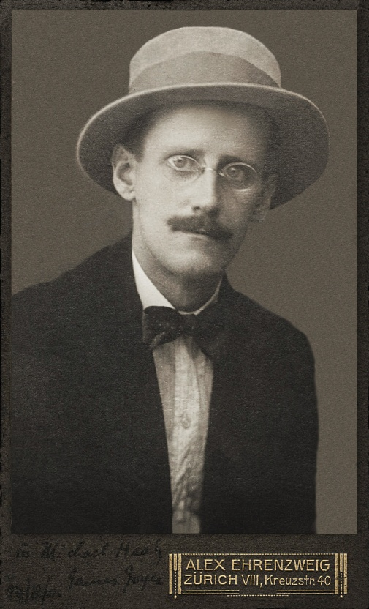
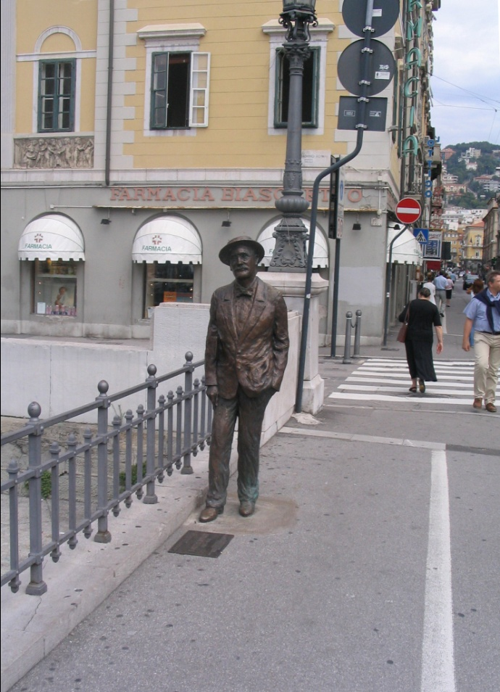
Joyce and Nora went into self-imposed exile, moving first to Zurich, where he had supposedly acquired a post to teach English at the Berlitz Language School through an agent in England.
It turned out that the English agent had been swindled, but the director of the school sent him on to Trieste
Joyce's statue in Trieste →

Slide 6
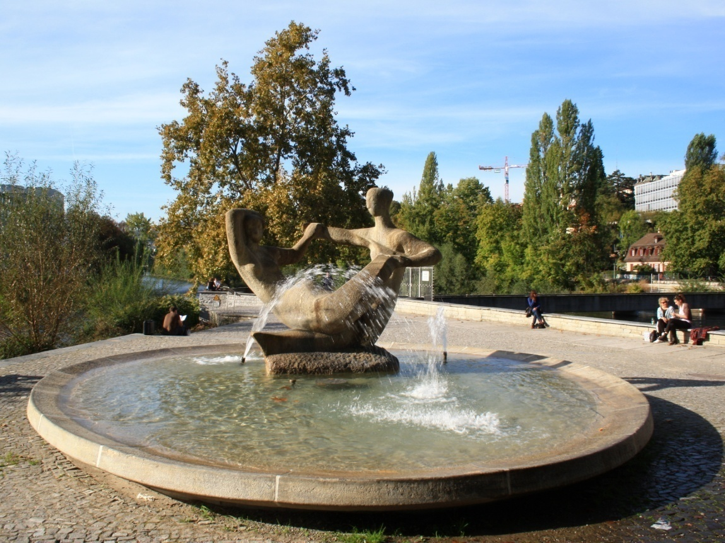
In 1915, after most of his students were conscripted in Trieste for World War I, he moved to Zurich.
The so-called James-Joyce-Kanzel
(plateau) at the confluence of the Sihl
and Limmat rivers in Zurich where
Joyce loved to relax →
There, he met one of his most enduring and important friends, Frank Budgen, whose opinion Joyce constantly sought through the writing of Ulysses and Finnegans Wake.

Slide 7
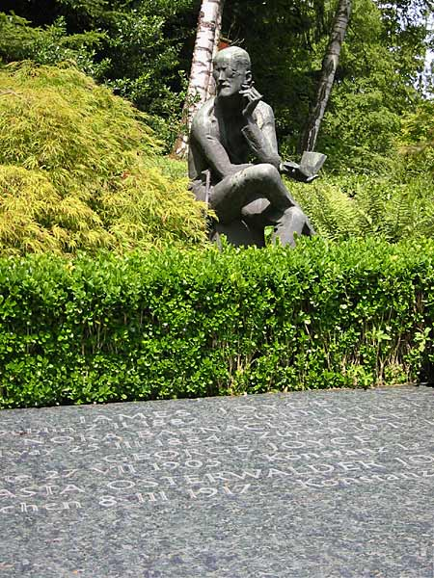
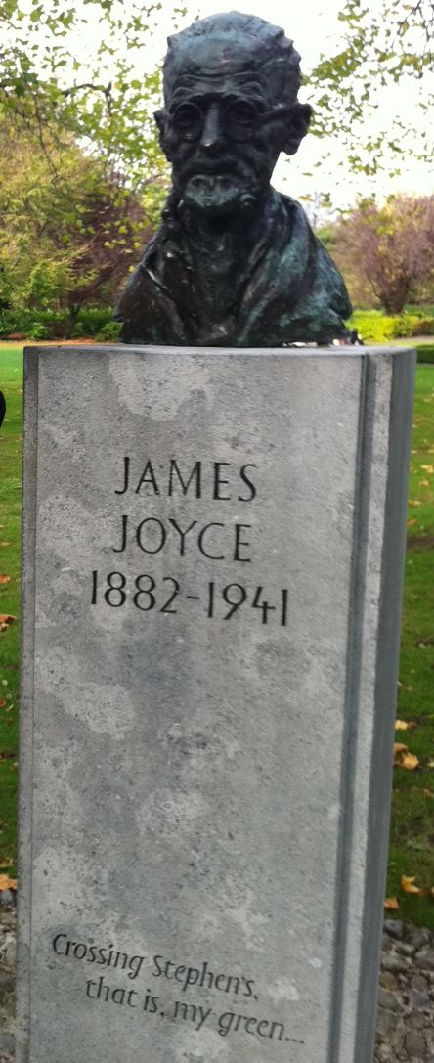
Joyce headed to Paris in 1920 at an invitation from Ezra Pound, supposedly for a week, but he ended up living there for the next twenty years.
On 11 January 1941, he underwent surgery for a perforated ulcer. The following day he fell into a coma. He awoke at 2 a.m. on 13 January 1941, and asked for a nurse to call his wife and son before losing consciousness again. They were still on their way when he died 15 minutes later.

Slide 8
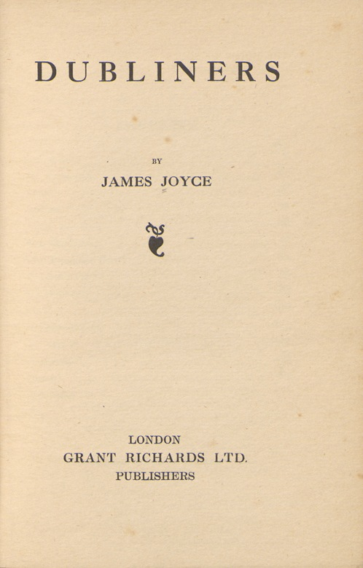
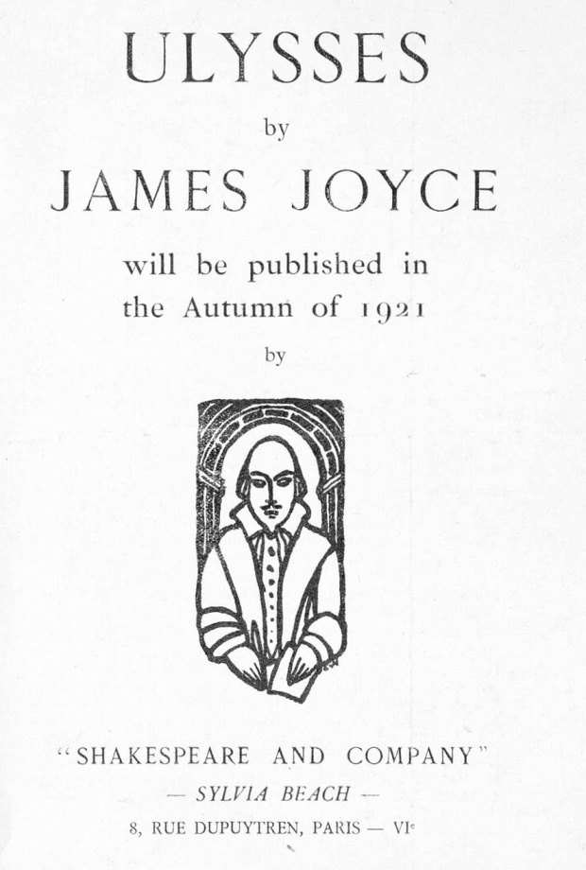
Major works
Joyce's Irish experiences constitute an essential element of his writings, and provide all of the settings for his fiction and much of its subject matter.
As he was completing work on Dubliners in 1906, Joyce considered adding another story featuring a Jewish advertising canvasser called Leopold Bloom under the title Ulysses.

Slide 9
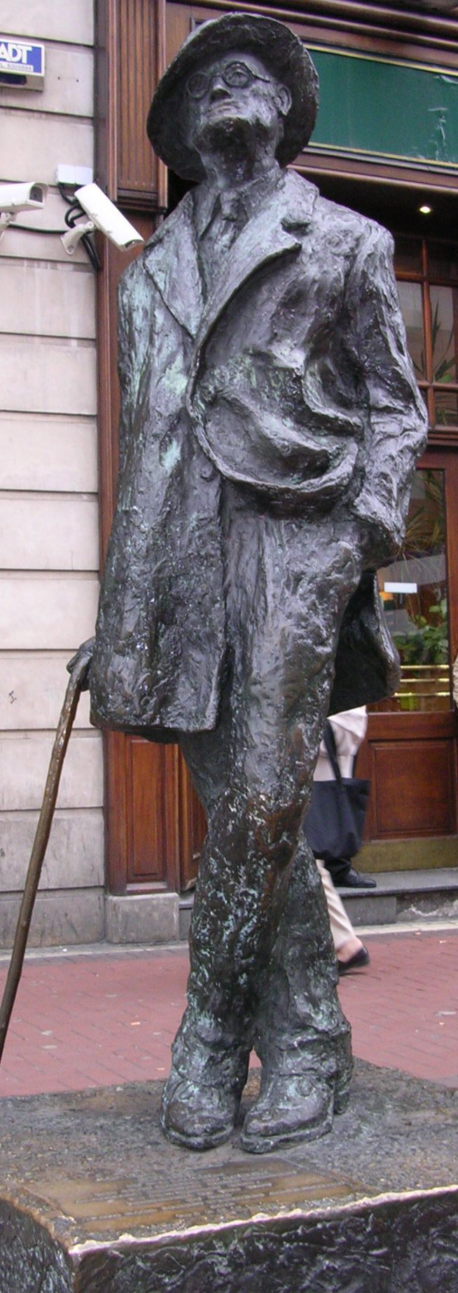
THE END
Presentation prepared
by the student of 10-B form
Yash Kostya
Thank you for viewing…

