Slide 1
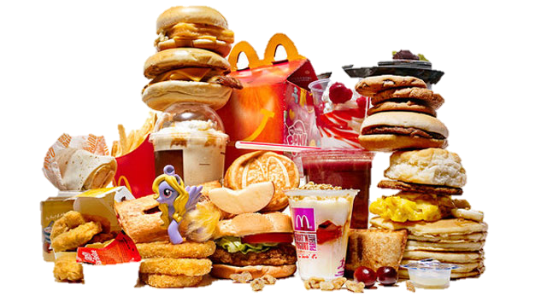
Fast Food
Victoria Sotnichenko 10-B

Slide 2
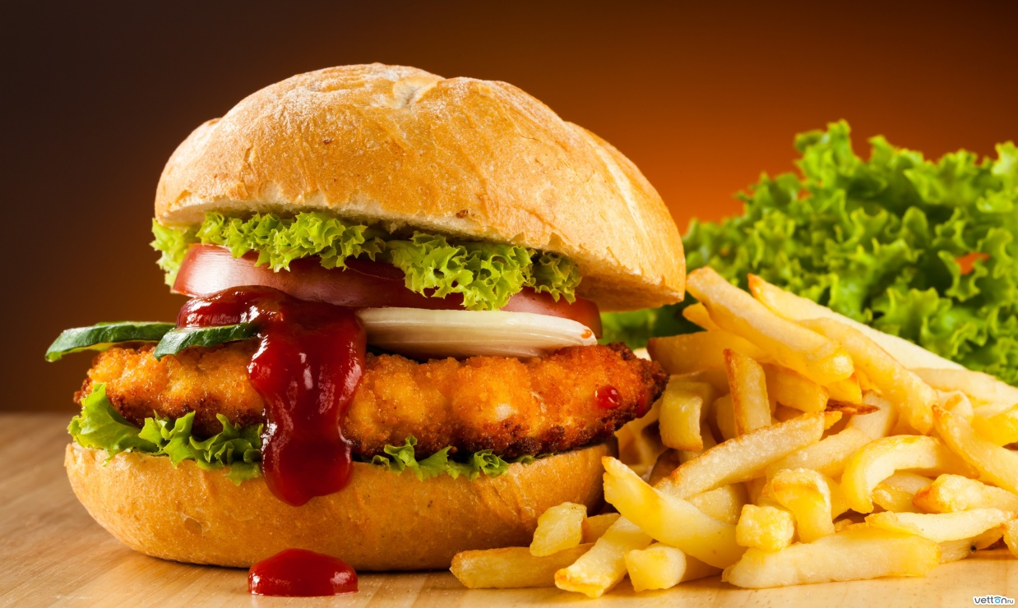
The history of fast food - began in antiquity.
Fast Food ancient Romans were fresher and healthier than modern hot dogs and hamburgers.

Slide 3
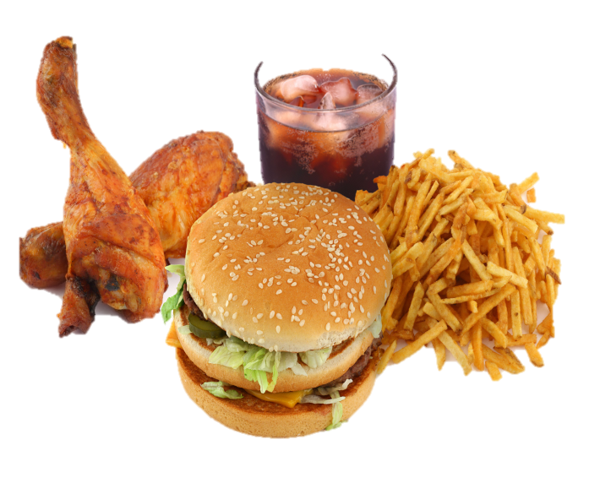

This food is prepared and served very quickly, most popular in 1950 - years in the United States.
The current era of fast food began March 2, 1955.

Slide 4

Already in 1963, the amount rose to implement hamburgers million a day, and a chain of stores rapidly expanded.
Today only Americans spend annually on such food more than $ 100 billion.

Slide 5
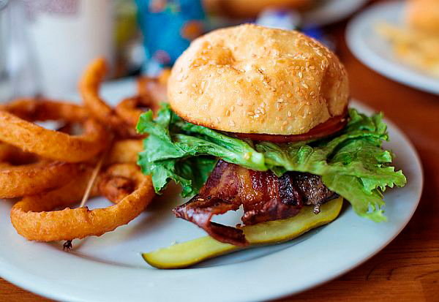
The term refers to food sold in a restaurant or store with preheated or precooked chemical ingredients, and served to the customer in a packaged form for take-out.

Slide 6
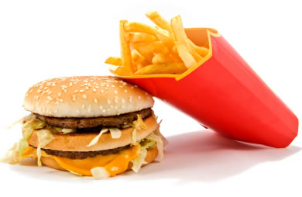
The advantages of fast food is its speed and cost .
The demand of fast food has become a necessity. Most people replace our usual breakfast , lunch and dinner in these fast foods.

Slide 7
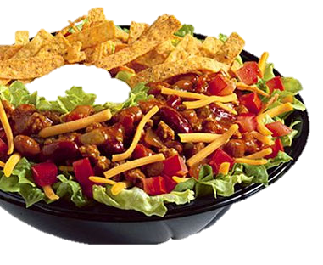
Fast food has long been an integral part of the life of modern man. For decades, Ukraine and so deeply internalized this " achievement " of Western civilization that many people no longer imagine life without a hamburger , hot dog or fries.

