Slide 1
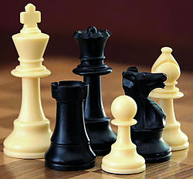

Сhess as a sport

Slide 2

Those who lean towards chess as being a sport look to broad definitions of sport to find a way to fit chess into that category. While they admit that cheese doesn't fit under the umbrella of athletics, they say that sport is a wider category. There’s tradition for this definition dating back to the ancient Olympics of Greece, where artistic skills and more were grouped under the heading of sports.

Slide 3
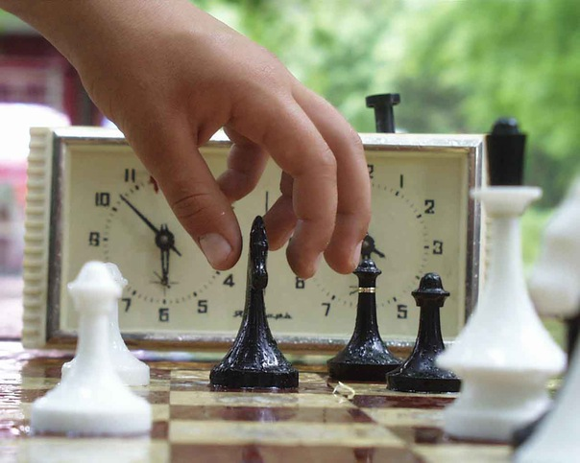
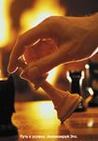
For those who don’t like that argument or insist on using only the modern definition of a sport, advocates of this side of the debate can point out that athletic prowess may not be required to play chess, but it certainly helps. Modern grandmasters almost universally do what they can to say in shape, as chess players (along with those in other pursuits like poker) have discovered that the mind works better when the body is in shape.

Slide 4

This fitness can pay off. Those who regard chess as a sport point out that while games may start of as mentally demanding, the stress and fatigue of a six-hour game (and especially after several such games in a tournament or match) begins to make playing physically draining as well.
And while that might not be perfectly analogous to football or track, it is certainly similar to some other activities that are generally considered sports (if not universally so), such as golf, motor racing, and archery. None of these sports requires the same kind of athleticism as a sport where players are constantly running and jumping, and yet being in shape is virtually a requirement for professional competitors, and even more so for the elite in those sports. Certainly, then, an argument can be made that chess is a sport in the same way that those activities are.

Slide 5
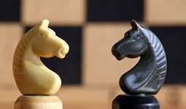
In the end, the argument over chess as a sport isn’t particularly important; how chess is classified isn’t critical to the important or prestige of the game. True, calling the game a sport might make a small impact on the opportunities available for players around the world. But on the list of issues facing the chess world, this is at best a minor one despite the amount of time that is spent debating it.

Slide 6
Chess is played on a square board of eight rows (called ranks and denoted with numbers 1 to 8) and eight columns (called files and denoted with letters a to h) of squares. The colors of the 64 squares alternate and are referred to as "light" and "dark" squares. The chessboard is placed with a light square at the right-hand end of the rank nearest to each player, and the pieces are set out as shown in the diagram and photo, with each queen on a square of its own color.
The pieces are divided, by convention, into white and black sets. The players are referred to as "White" and "Black", and each begins the game with 16 pieces of the specified color. These consist of one king, one queen, two rooks, two bishops, two knights, and eight pawns.

Slide 7
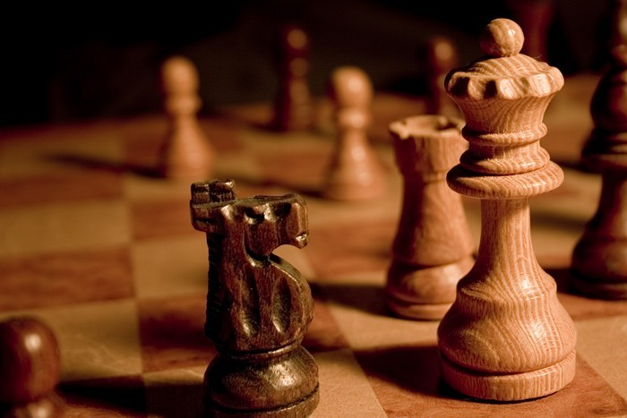
A response to a check is a legal move if it results in a position where the king is no longer under direct attack (that is, not in check). This can involve capturing the checking piece; interposing a piece between the checking piece and the king (which is possible only if the attacking piece is a queen, rook, or bishop and there is a square between it and the king); or moving the king to a square where it is not under attack. Castling is not a permissible response to a check. The object of the game is to checkmate the opponent; this occurs when the opponent's king is in check, and there is no legal way to remove it from attack. It is illegal for a player to make a move that would put or leave his own king in check.

Slide 8
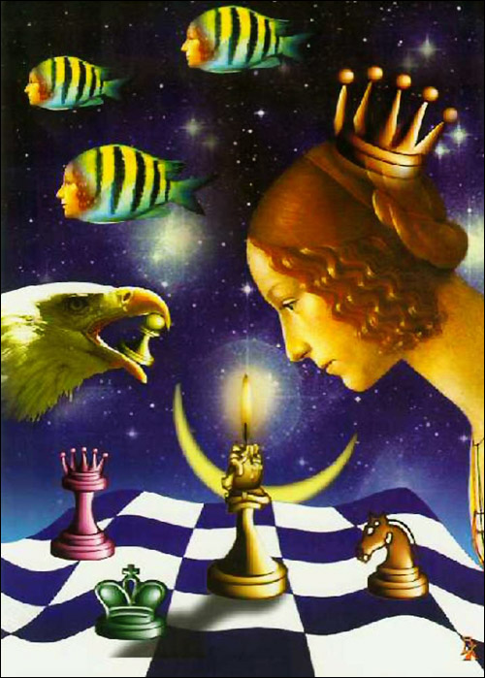
The current crop of top players have learned from the mistakes of their Soviet predecessors, but those outside the world elite haven’t. Too many are overweight, keen to have a drink, too sedentary – and then they try to play this game which makes huge demands on mind and body. I know, because I do it too.

Slide 9
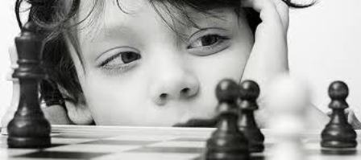
So next time someone suggests a nice, quiet game of chess, or paints it as an intellectual pursuit played by wimps, tell them they’ve got it all wrong: this is a fight to the finish played in the tensest of circumstances by two players who are physically and mentally living on the edge. We all need to get fitter to play this demanding game, and society should recognise it for what it is – a sport as challenging, dramatic and exciting as any other. Such recognition would be a tribute of sorts to the two players who sadly played their final games in Tromso.

