Slide 1
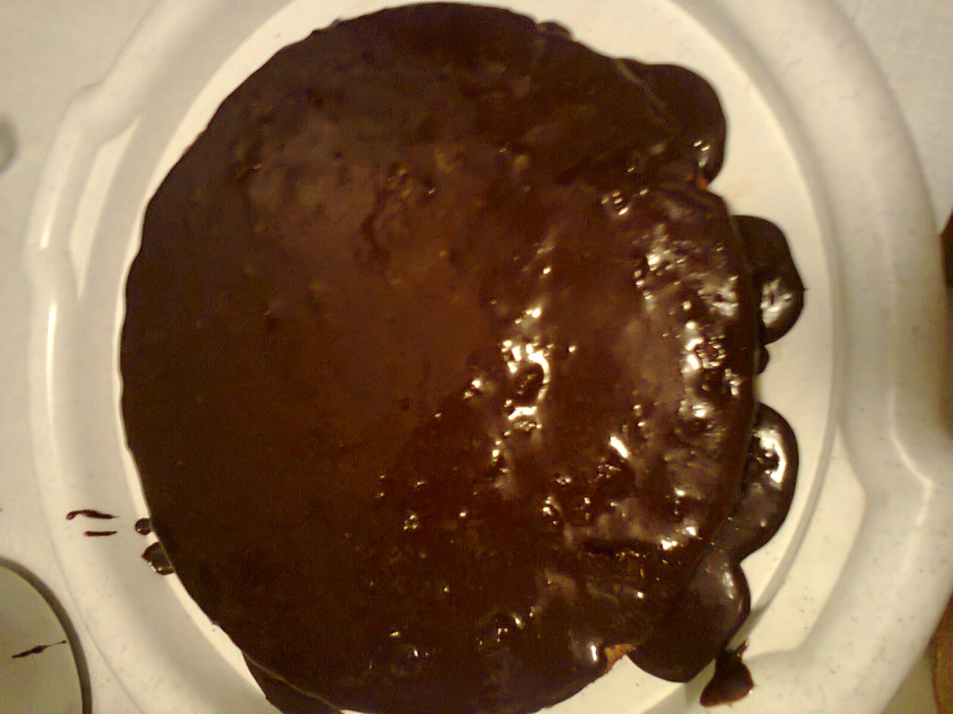
Chocolate cake
Presentation of a prescription completed pupil of the 10th form
Helen Mykheydina

Slide 2
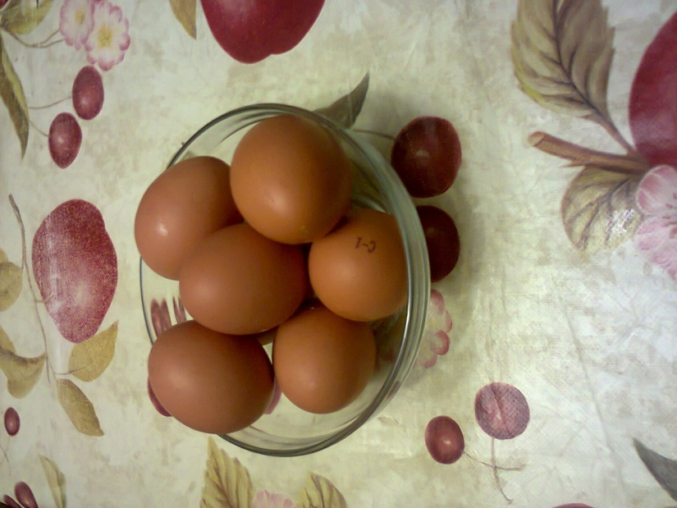
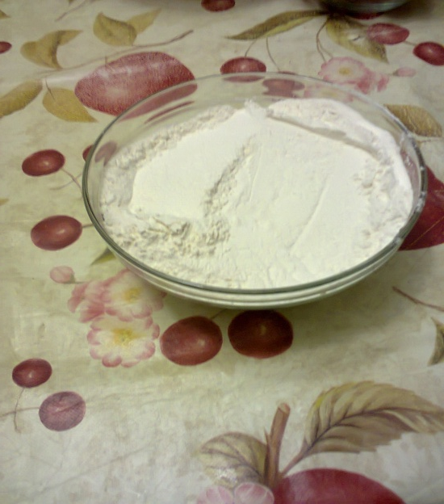
Ingredients
flour - 200 g
eggs - 8 PCs;

Slide 3
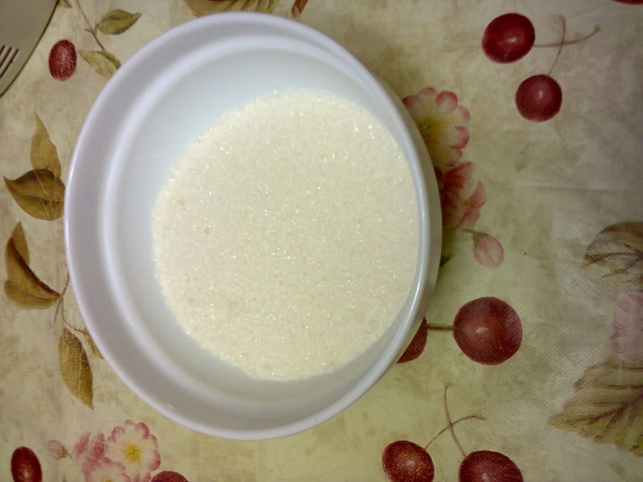
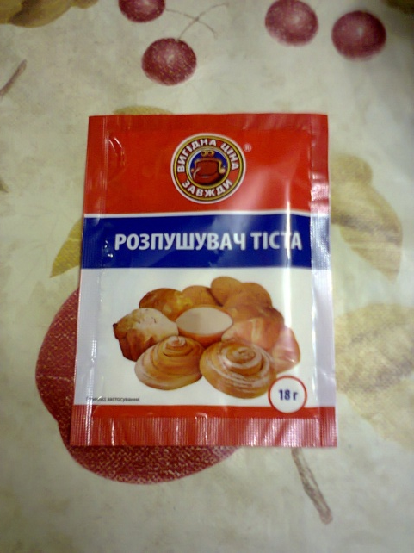
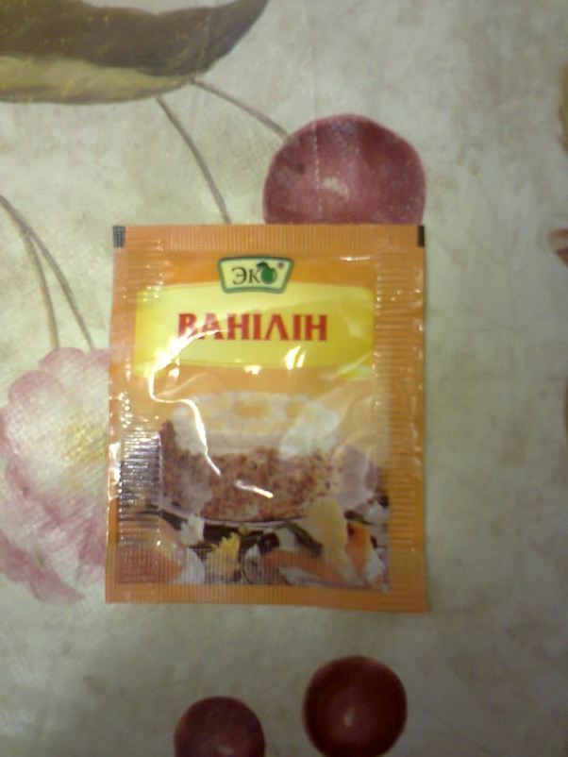
sugar - 300 g,
vanilla sugar- 15 g
soda to test butter to grease
the form

Slide 4
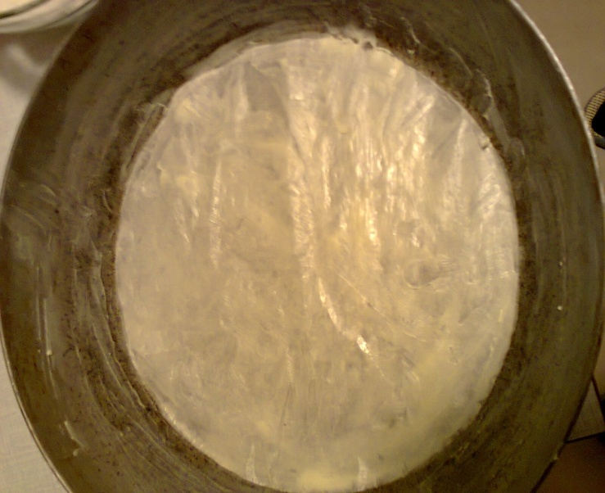
Preparation of cake
Form for baking oil lightly and covered with parchment paper.

Slide 5
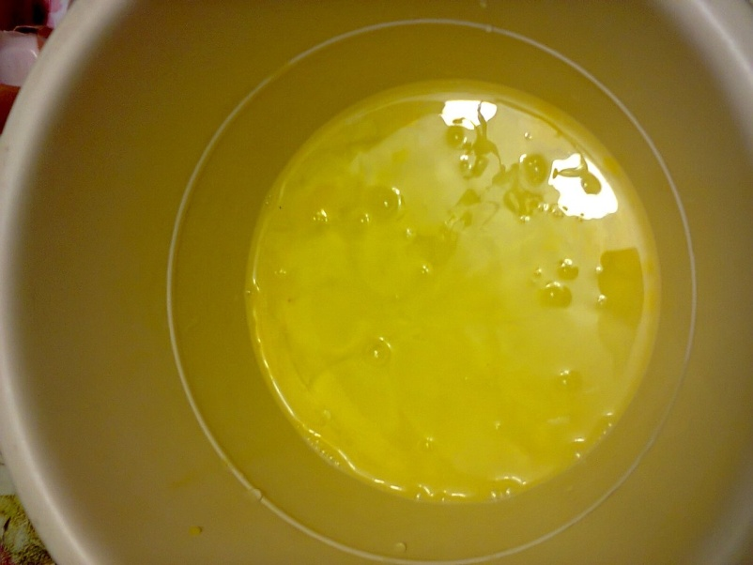
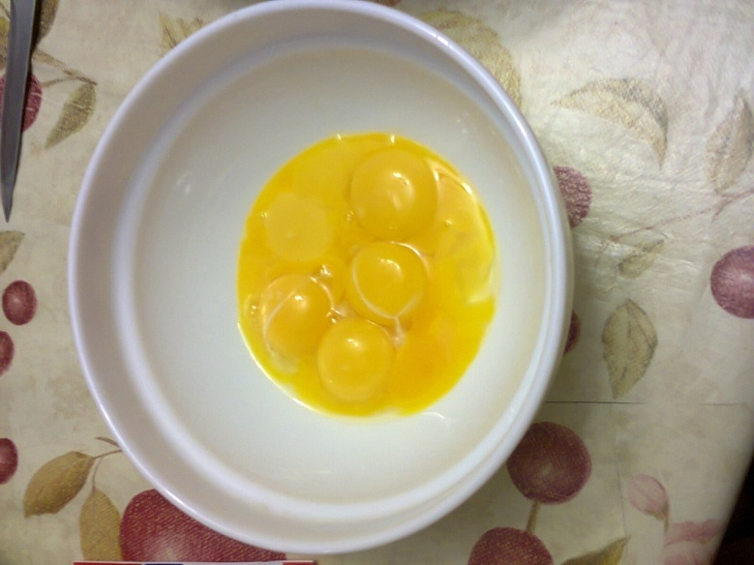
Sift flour several times. Eggs separated from yolks.

Slide 6
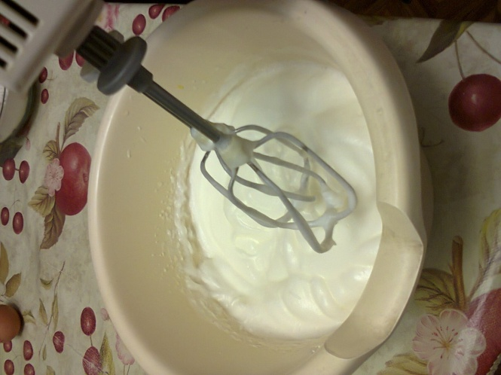
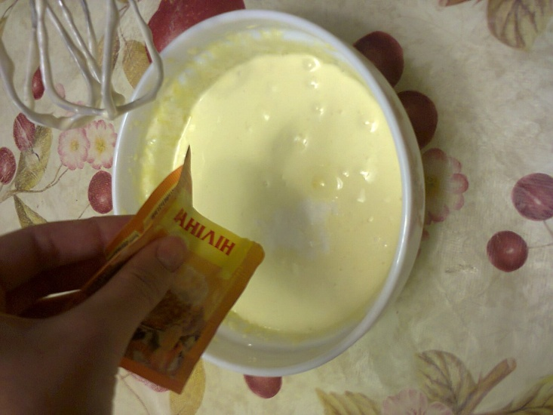
Yolks put in a bowl whisk ,add
half the sugar andvanilla
sugar.Well-pound yolks with
the sugar until the increase
in the volume and pobelenija
mass.Yolks you can grind
with a fork, the Corolla or a
blender .

Slide 7
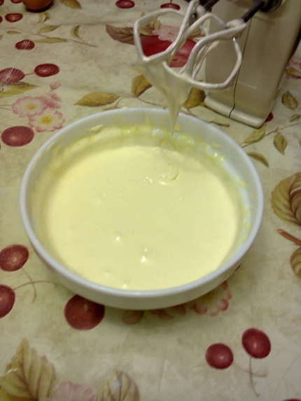
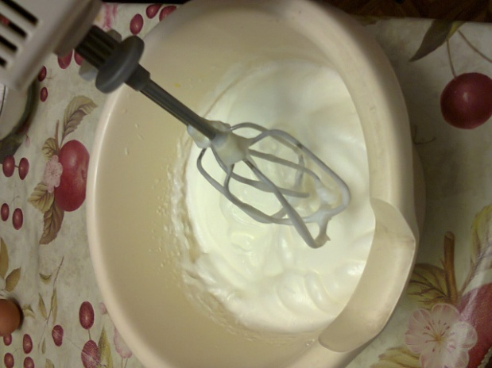
Proteins put in a bowl and
beat on low or medium speed
mixer until the formation of
the light lush foam.Increase
the speed of the mixer to
medium or maximum (speed
depends on the power of the
mixer) and, without stopping
whipping, pour in a thin stream
of sugar.
When added all the sugar,
continue to beat until the
tilting (or rolling) of the
bowl proteins will not be
out of it spill out.

Slide 8
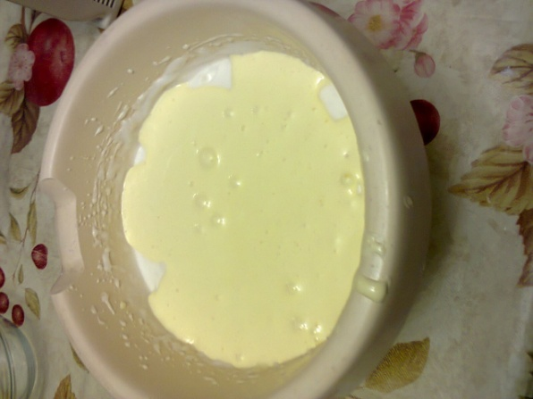
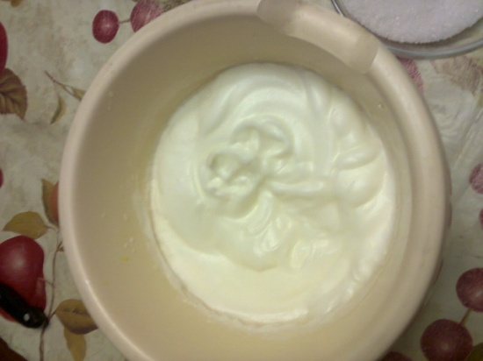
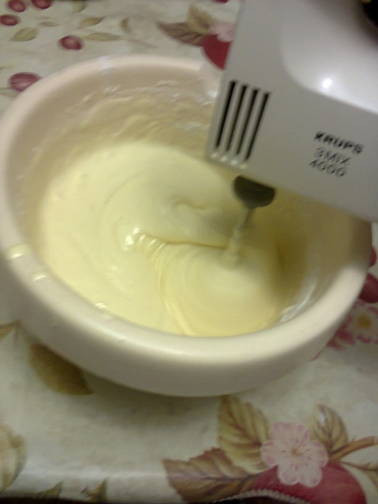
The third part of whipped protein and add carefully, bottom-up, stir.Add the yolk mass sifted flour and mix well.

Slide 9
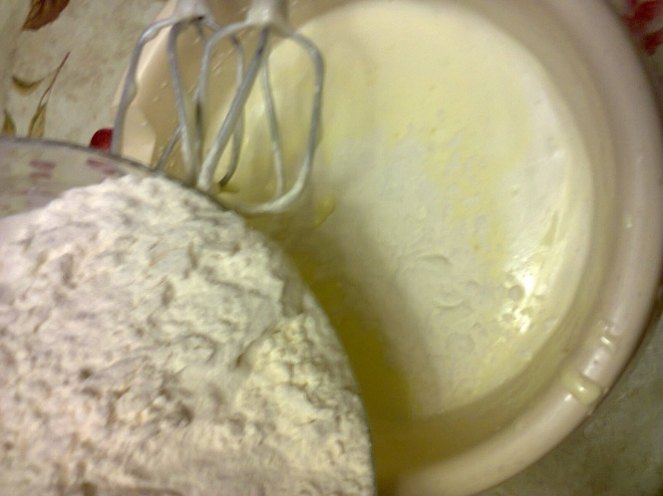
Then add the remaining egg whites, and very carefully, movements from below-upwards as if raising a layer behind a layer, mix the dough.

Slide 10
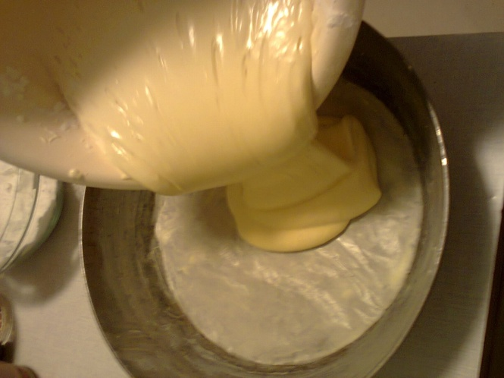
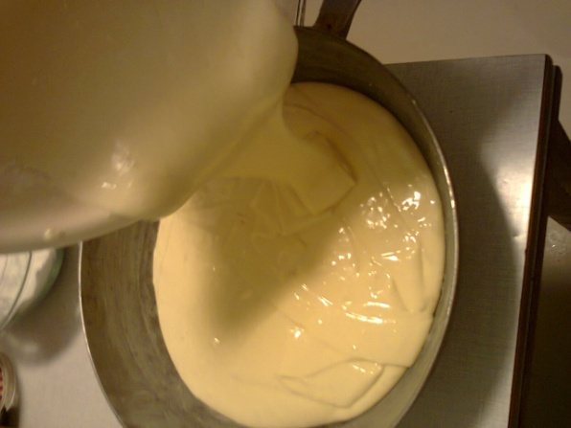
Put the batter into the pan and smooth the surface. Bake cake in a pre-heated to 180 C oven for about 30-35 minutes. Council. During the baking process, the oven door, it is desirable not to open the first 20-25 minutes, otherwise the biscuit might drop off. But, if not necessary, the door is better not to open during the entire time baking cakes. Sponge cake is ready, if he cringed a bit,

Slide 11
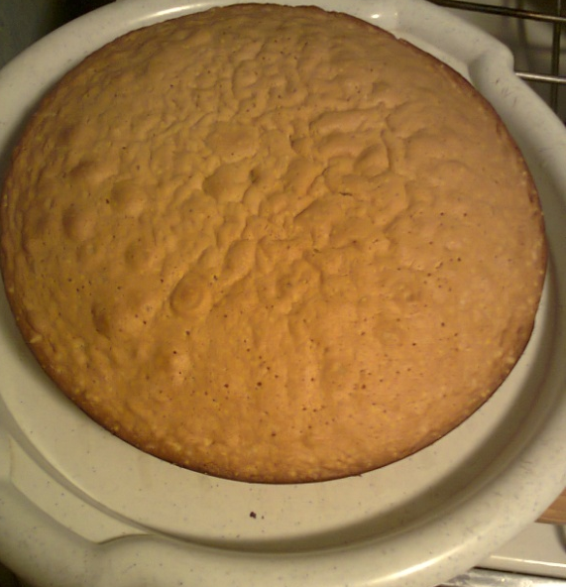
YOUR CAKE
IS READY!

