Slide 1
The Black Gem
Kate Fedorenko

Slide 2
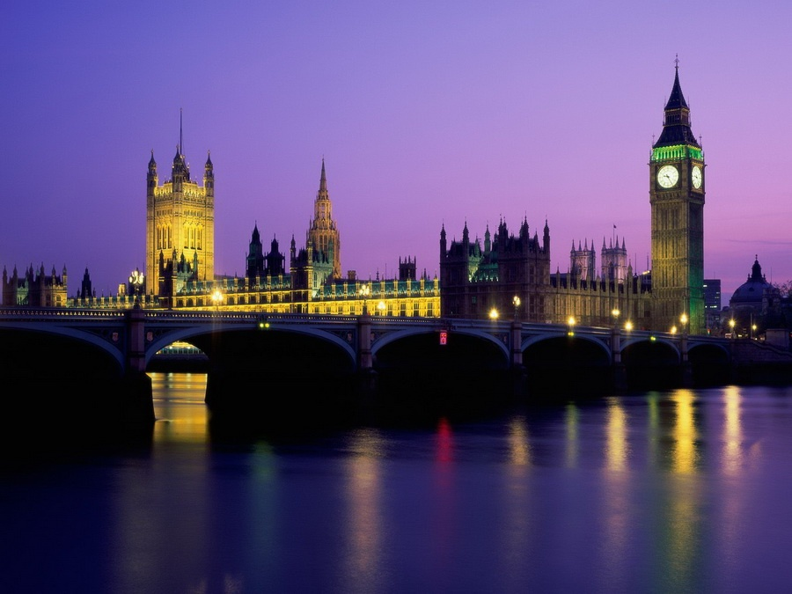
My hotel is situated in the centre of London, not far from Parliament House…

Slide 3
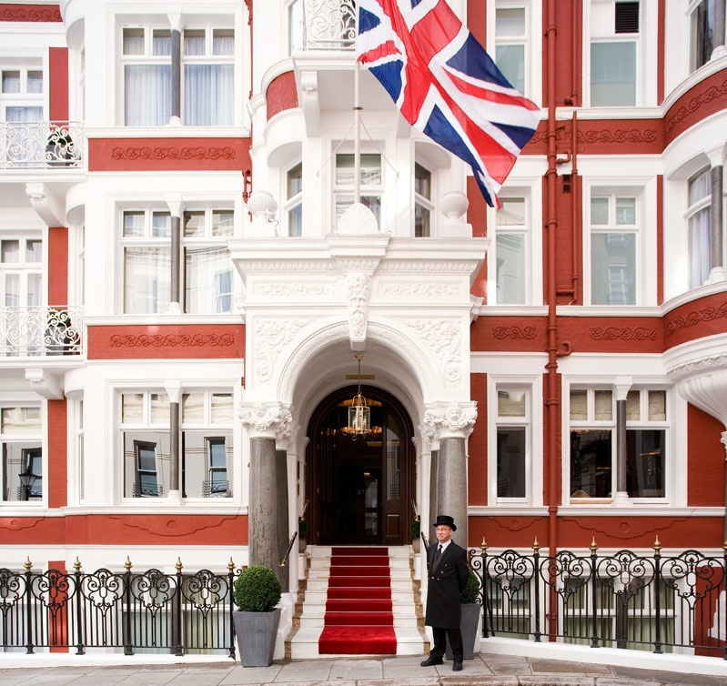
Our hotel offers you a wide range of services in the world of beauty and health in a calm and relaxing atmosphere.
It is a perfact place to escape from everyday worries and the hustle and to dive into the inque wellness-world.

Slide 4
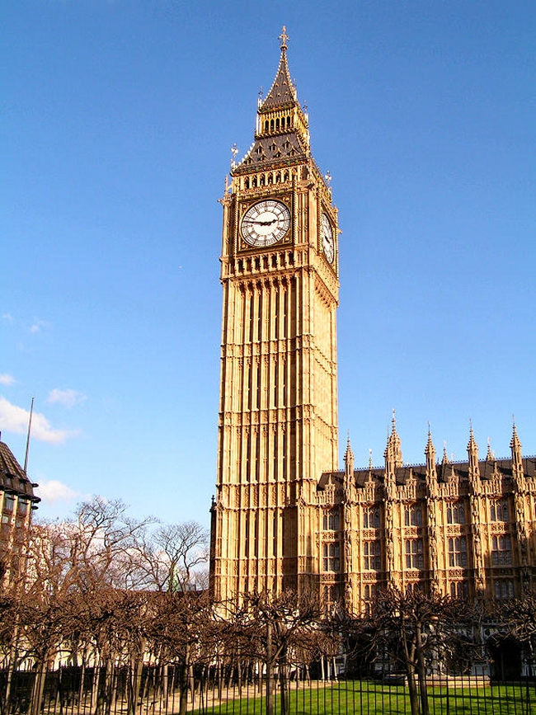
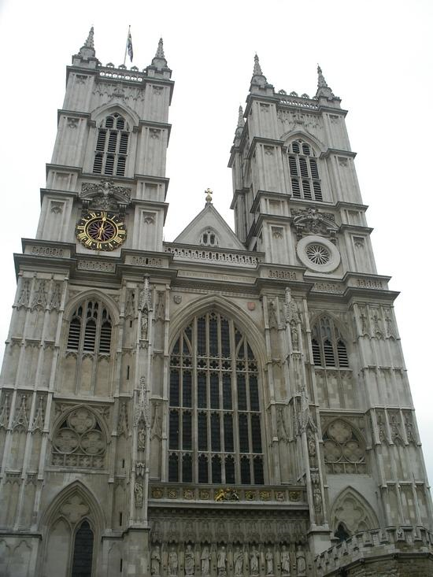
You are in the historical heart of London…

Slide 5
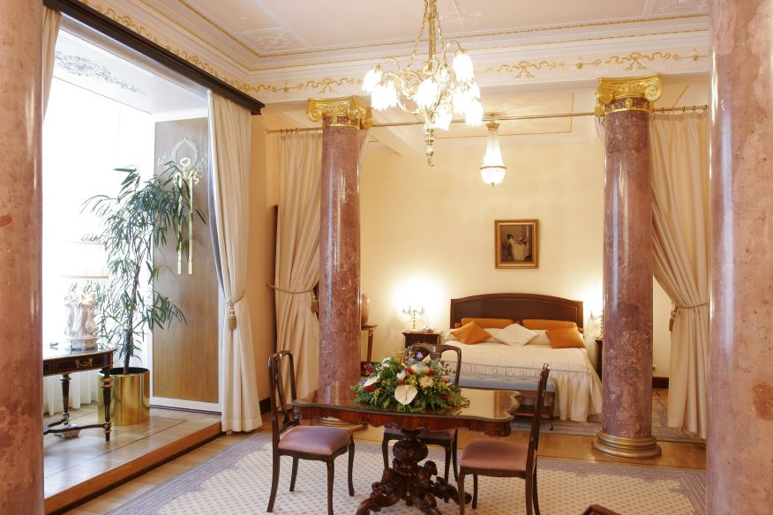
You have at your disposal two kinds of rooms: single or double, soundproofed Rooms. There are telephone, air-conditioning, bathroom, newspaper stands, central heating, mini bar, Free Wi-Fi Internet Access Included, Television with Cable, breakfast in the room.

Slide 6
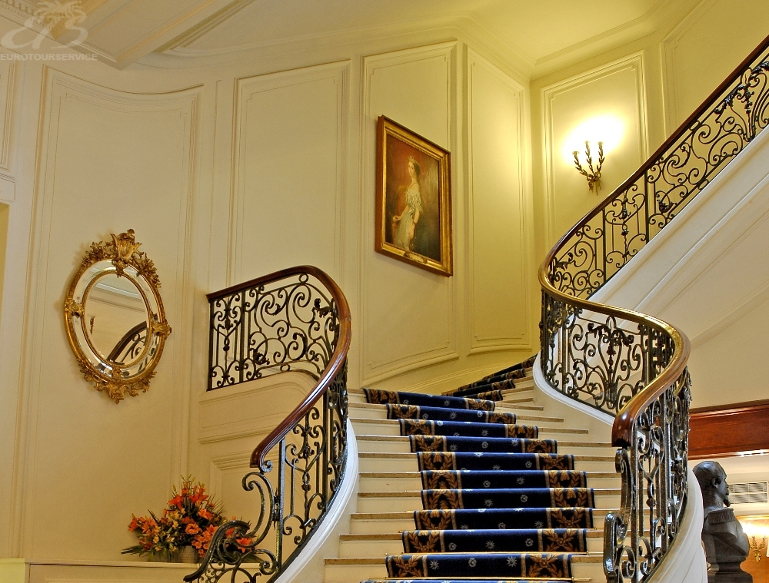
At the restaurant you can taste the French, Italian, Japanese kitchen. The best English cooks will prepare for you different dainty dishes. Also, your supper will be accompanied by live orchestra. After that you can go to the billiards room. Of course, there are Non-Smoking and Smoking Rooms. The main staircase is covered with blue carpet.

Slide 7
Very soon, the royal family will celebrate William`s wedding day. We were honored to receive guests from other countries. . We are carefully preparing for this important event.

Slide 8
Thank you for your attention!
I & my management wishes you a very pleasant stay!
Don`t forget to reserve a room in advance.

