Slide 1
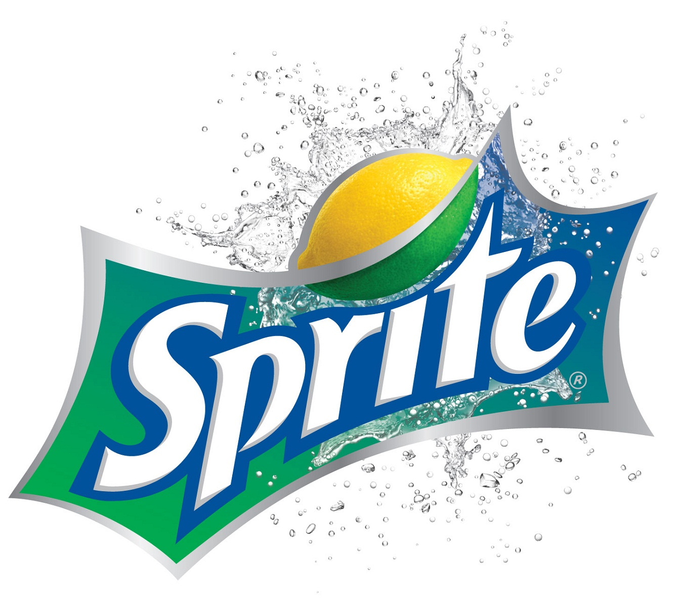
Why I choose sprite?
Tasty
Freshly
+ Lemon flavor

Slide 2
Inexpensive but effective cosmetic products
for different types of young skin

Slide 3
I know that fast food
is harmful
but I'm loving for it's rich taste

Slide 4
A wide range of quality sportswear, footwear and accessories

Slide 5
Powerful and
ultramodern devices
with excellent design

