Slide 1
William Faulkner «The Sound and the Fury»
Made by
Skorokhvatova Liza 11-A

Slide 2
The Sound and the Fury
«The Sound and the Fury» is a novel written by the American author William Faulkner. It employs a number of narrative styles, including the technique known as stream of consciousness. Published in 1929, The Sound and the Fury was Faulkner's fourth novel, and was not immediately successful.

Slide 3
The Sound and the Fury
In 1931, however, when Faulkner's sixth novel, Sanctuary, was published—a sensationalist story which Faulkner later claimed was written only for money—The Sound and the Fury also became commercially successful, and Faulkner began to receive critical attention.

Slide 4
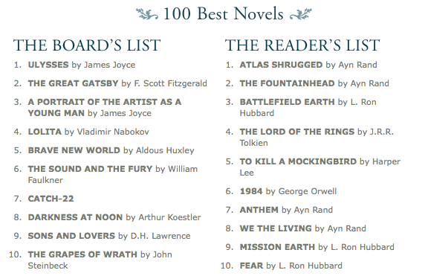
The Sound and the Fury
In 1998, the Modern Library ranked The Sound and the Fury sixth on its list of the 100 best English-language novels of the 20th century.

Slide 5
The Sound and the Fury
Plot
The Sound and the Fury is set in Jefferson, Mississippi. The novel centers on the Compson family, former Southern aristocrats who are struggling to deal with the dissolution of their family and its reputation. Over the course of the 30 years or so related in the novel, the family falls into financial ruin, loses its religious faith and the respect of the town of Jefferson, and many of them die tragically.

Slide 6
The Sound and the Fury
The novel is separated into four distinct sections.
The first, April 7, 1928, is written from the perspective of Benjamin "Benjy" Compson, a cognitively disabled 33-year-old man.
In the third section, April 6, 1928, Faulkner writes from the point of view of Jason, Quentin's cynical younger brother.
In the fourth and final section, set a day after the first, on April 8, 1928, Faulkner introduces a third person omniscient point of view.
The second section, June 2, 1910, focuses on Quentin Compson, Benjy's older brother, and the events leading up to his suicide.

Slide 7
The Sound and the Fury
The four parts of the novel relate many of the same episodes, each from a different point of view and therefore with emphasis on different themes and events.

Slide 8
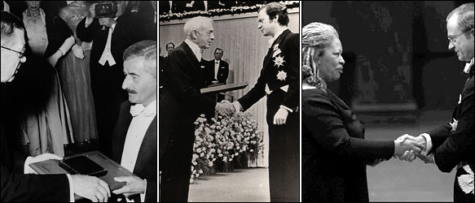
The Sound and the Fury
The novel has achieved great critical success and a prominent place among the greatest of American novels. It played a role in William Faulkner's receiving the 1949 Nobel Prize in Literature.

