Slide 1
Realism
Realism in the arts may be generally defined as the attempt to represent subject matter truthfully without artificiality and avoiding artistic conventions, implausible, exotic and supernatural elements.

Slide 2
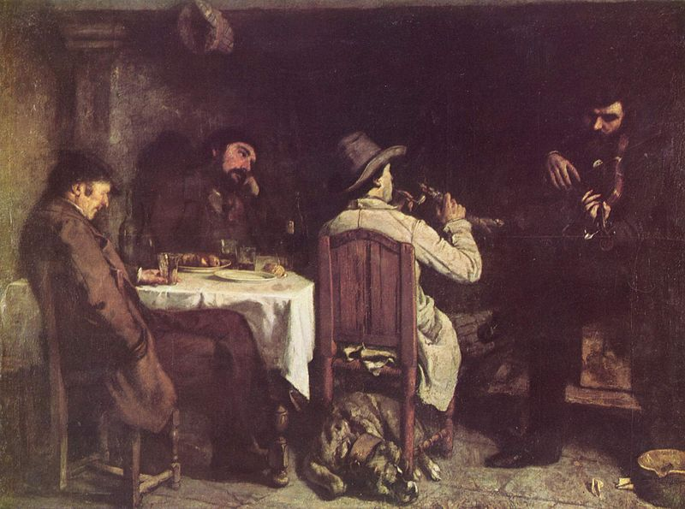
Gustave Courbet, After Dinner at Ornans, 1849

Slide 3
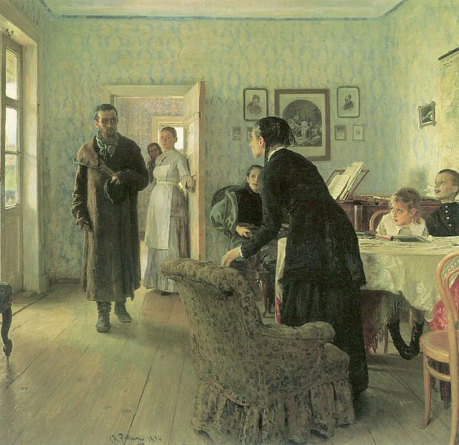
In its most specific sense, Realism was an artistic movement that began in France in the 1850s, after the 1848 Revolution. [1] Realists rejected Romanticism, which had dominated French literature and art since the late 18th century
Ilya Repin, They did not Expect Him, 1884-1888.

Slide 4
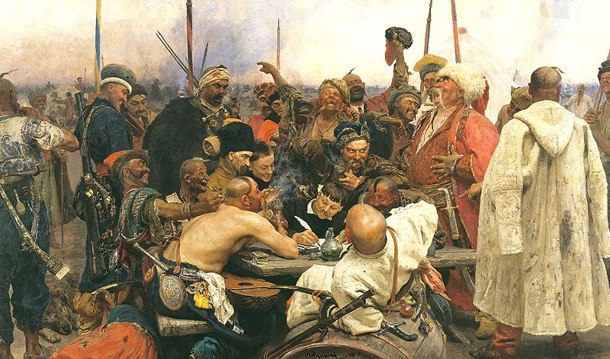
Ilya Repin
Ilya Yefimovich Repin 1844 – 29 September 1930 was a leading Russian painter and sculptor of the Peredvizhniki artistic school. An important part of his work is dedicated to his native country, Ukraine. His realistic works often expressed great psychological depth and exposed the tensions within the existing social order.
Cossacks write a letter to the Turkish Sultan

Slide 5
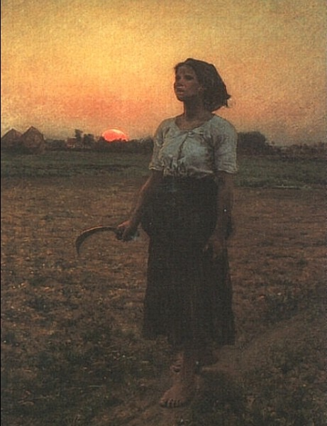
Jules Breton
Jules Adolphe Aimé Louis Breton (1 May 1827 – 5 July 1906) was a 19th-century French Realist painter. His paintings are heavily influenced by the French countryside and his absorption of traditional methods of painting helped make Jules Breton one of the primary transmitters of the beauty and idyllic vision of rural existence.
The Song of the Lark, 1884

Slide 6
The end
Polischuk Misha

