Slide 1
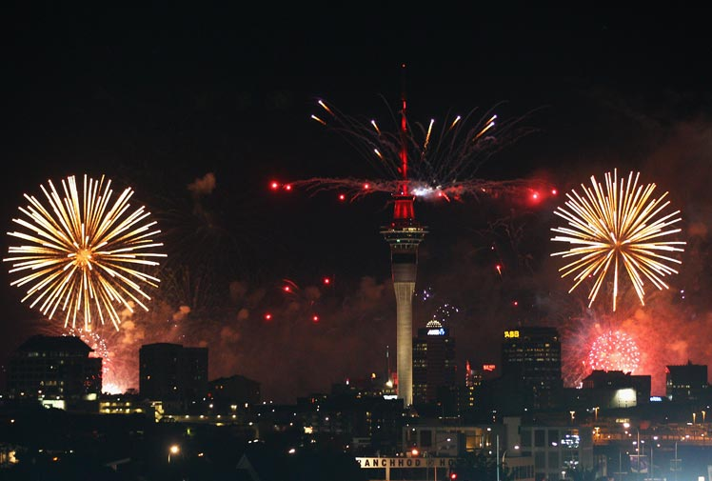
New Year’s Eve In New Zealand

Slide 2
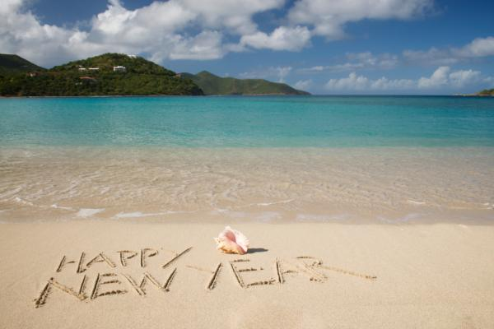
New Zealand is one of the first countries to observe the New Year, on January 1. New Year’s Day and the Day after the New Year are public holidays throughout the country.

Slide 3
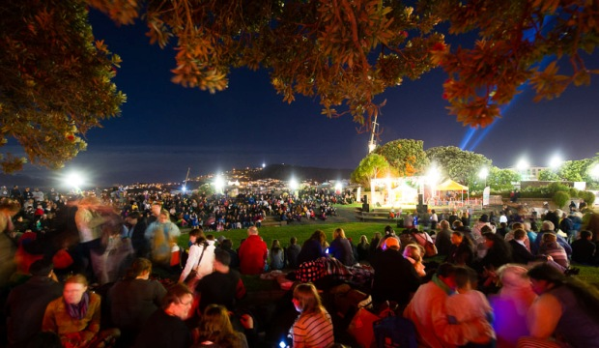
What do people do?
Due to its geographical position close to the International Date Line, New Zealand is one of the first countries in the world to welcome the New Year. Many people use New Year’s Day to relax after celebrating New Year’s Eve and the countdown to the New Year. Some people visit family and friends, while others attend events such as New Year’s Day horse racing carnivals and summer day fairs. Cricket is a sporting event that many New Zealanders watch during the New Year’s Day holiday.

Slide 4
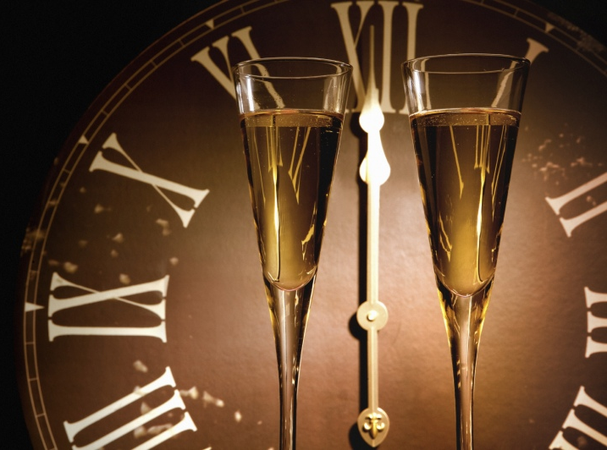
Public life
New Year’s Day is a statutory public holiday in New Zealand, so schools, government offices, and many private businesses are closed. New Year’s Day is also in the middle of the school summer holidays in New Zealand.

Slide 5
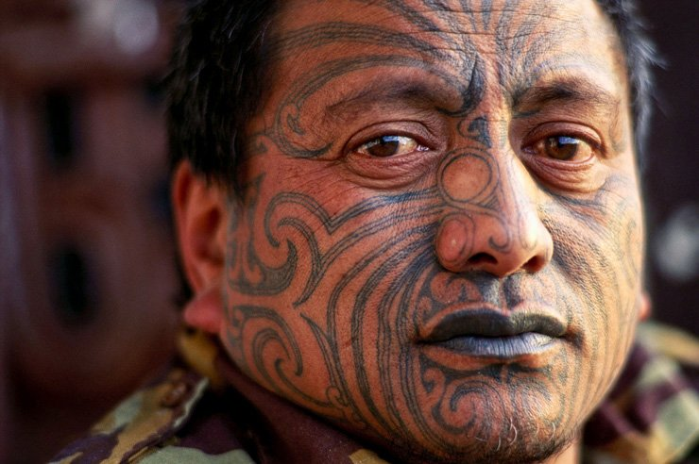
The Matariki
The Maori New Year is called after the group of stars Matakari also known as the Pleiades star cluster or the Seven Sisters. It has two meanings. Mata Riki means “tiny eyes” while Mata Ariki means “eyes of God”.

Slide 6
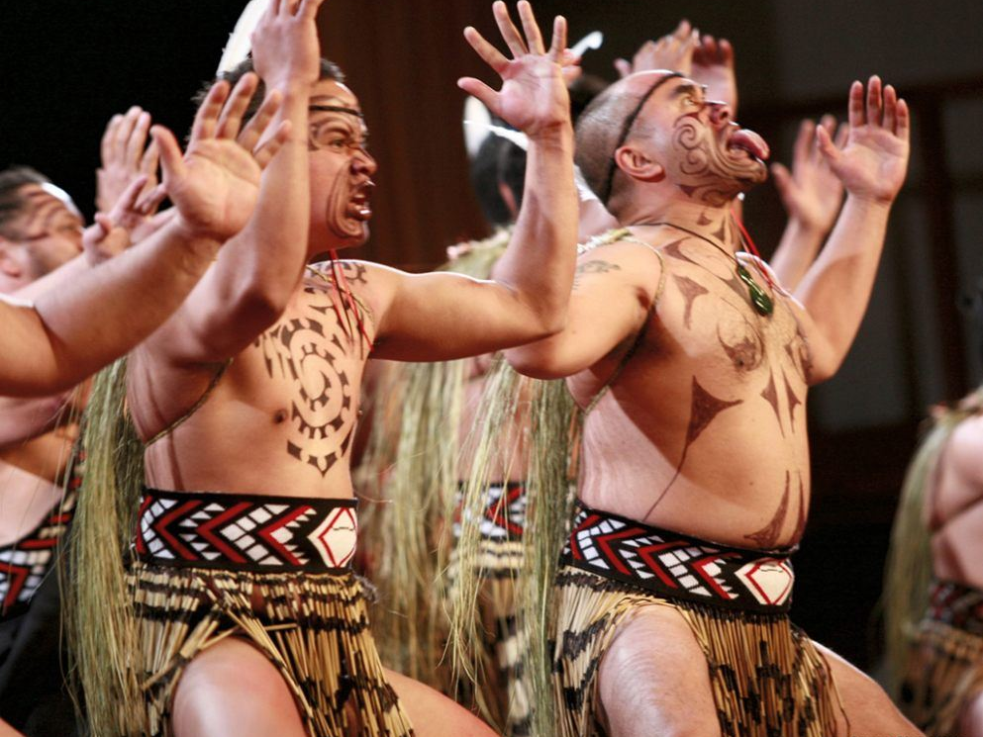
The Matariki
The dawn rise of Matariki can be seen during the last few days of May every year and the New Year begins at the sighting of the next new moon which takes place during June. Matariki tribal celebrations are held at different times by different Iwi (maori tribes). Some tribes celebrate New Year when Matariki is first seen, while some others celebrate New Year during the full moon after Matakari rises.

Slide 7
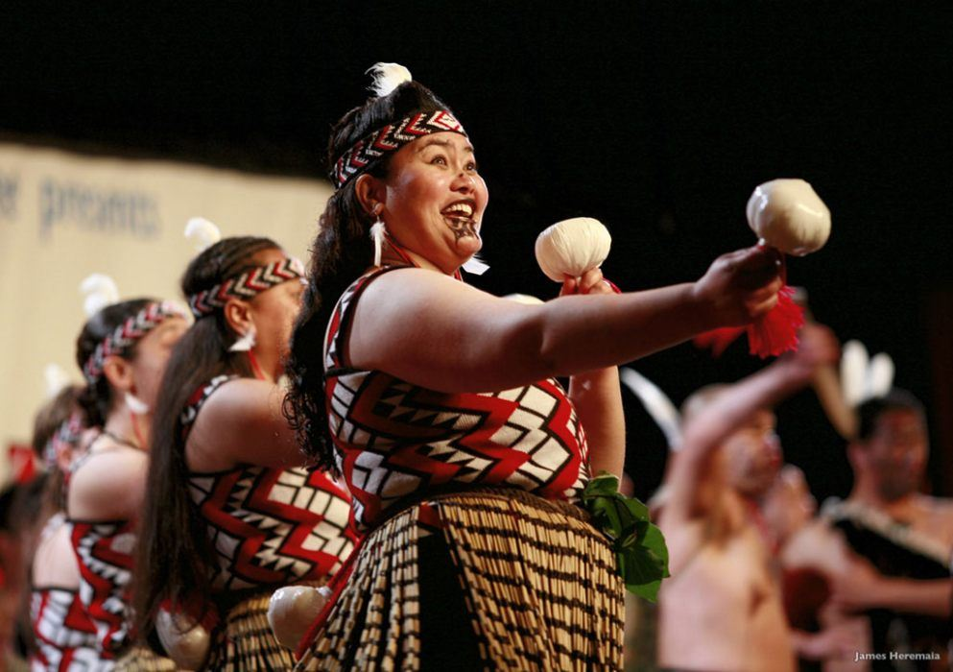
The Matariki
Traditionally, the coming season’s crop was thought to be determined by the visibility of Matariki. The brighter the stars, the warmer the season would be and therefore, a more productive crop. Matariki was also seen as an essential time with the coming together of family and friends. It is a time of sharing knowledge, history, storytelling, song & dance, weaving & carving, traditional ceremonies.

Slide 8
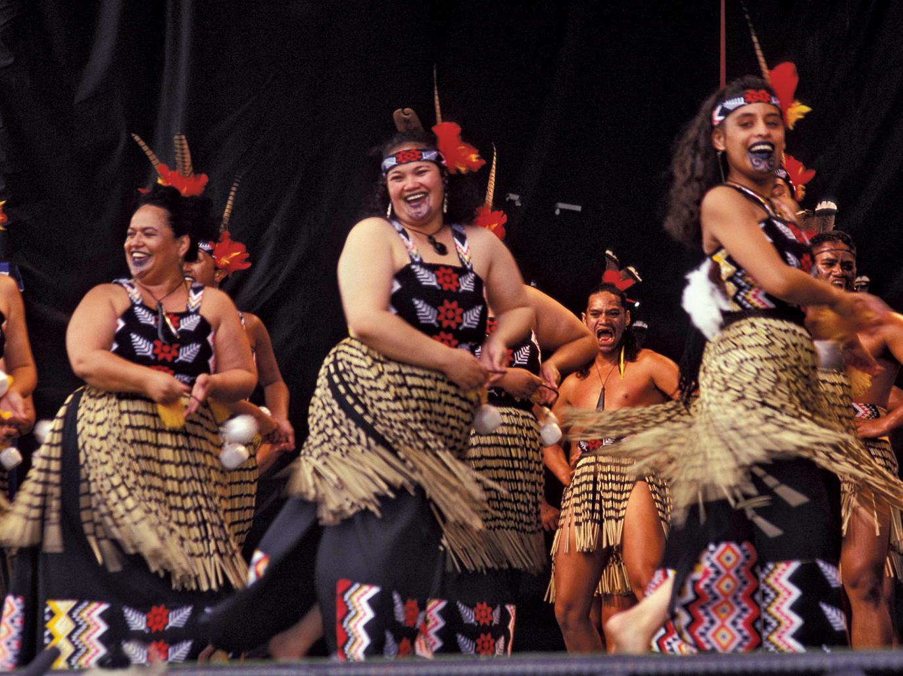
The Matariki
There are many ways to celebrate Matariki. Most Maori tribes celebrate the New Year through the performance of art & sport activities, the study of stars’ meanings & their history, or the making & sharing of traditional food for instance.

