Slide 1
Nashville

Slide 2
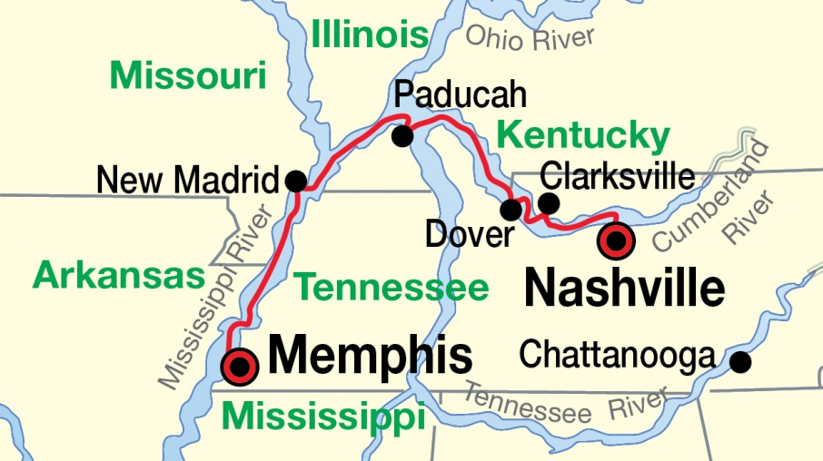

Slide 3
Music city

Slide 4
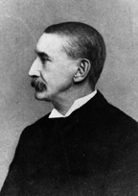

Slide 5
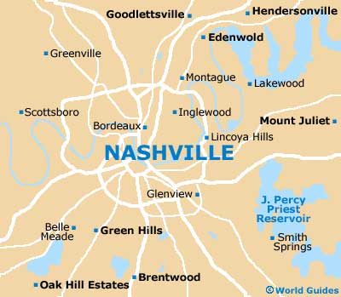
Nashville has a humid subtropical climate with generally cool to moderately cold winters, and hot, humid summers.

Slide 6
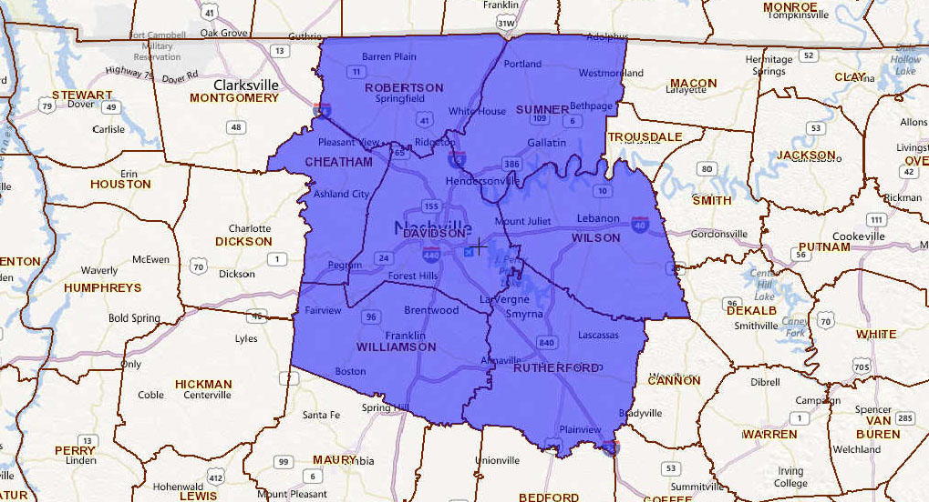
Nashville has the largest metropolitan area in the state of Tennessee, spanning 13 counties

Slide 7
Grand Ole Opry

Slide 10
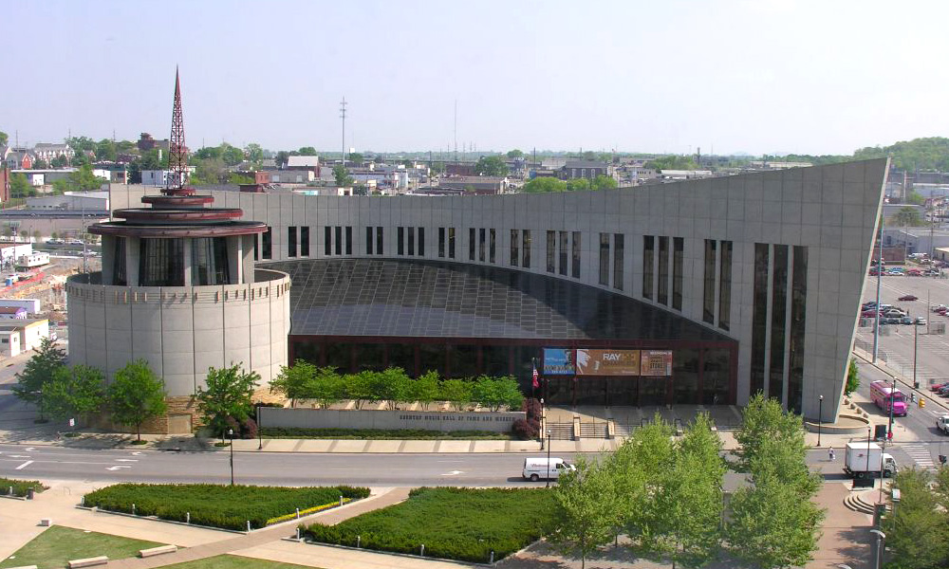
Country Music Hall of Fame and Museum

Slide 11
Parthenon (Nashville)

Slide 12
Tennessee State Capitol

