Slide 1
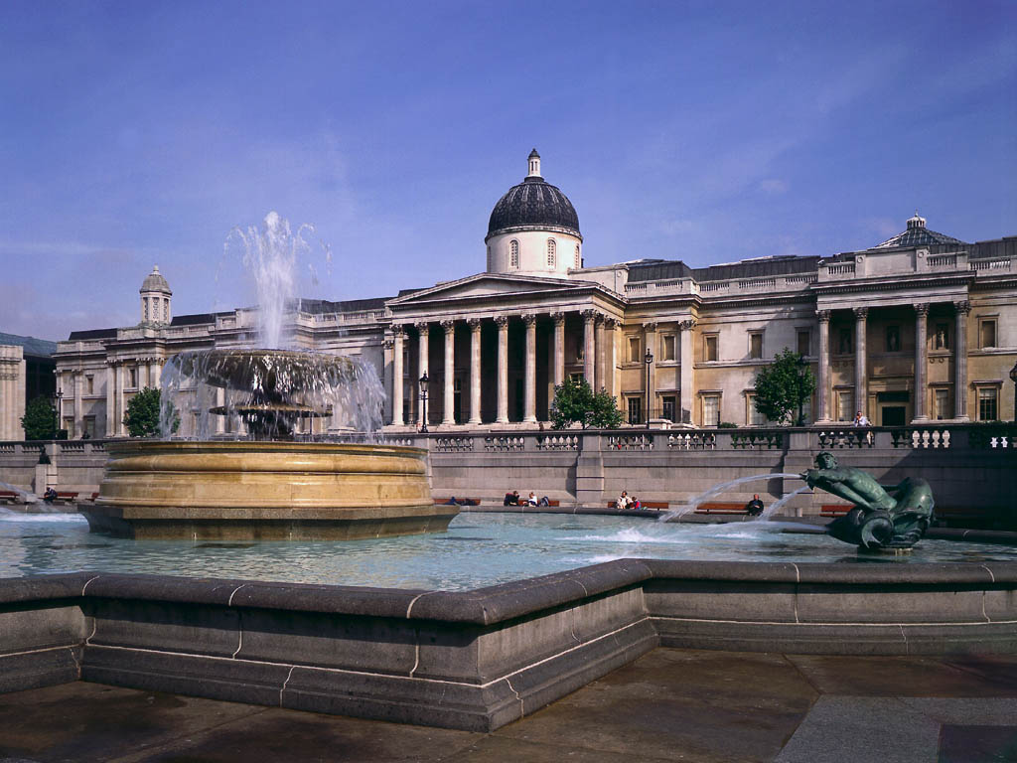
The National Gallery
By Sheveleva Mariya 11-A form

Slide 2
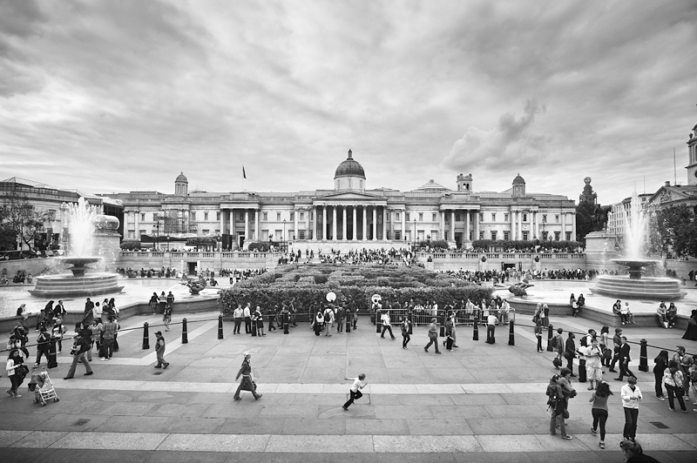
British National Gallery has one of the best collections of Western European painting, which contains almost all the paintings of great artists and there are all the schools of European pictorial art.

Slide 3
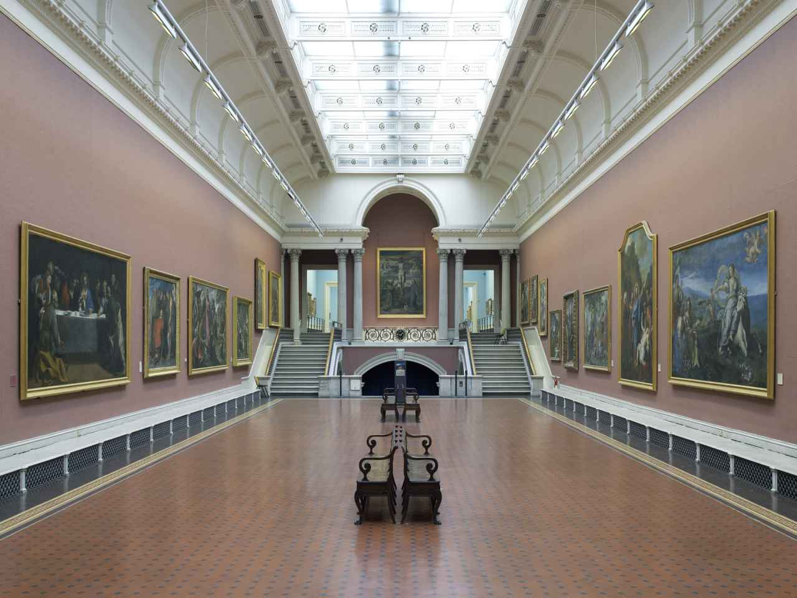
Today, the gallery contains over 2,500 paintings, which belong to the 13-20 century. All works are exhibited in galleries in chronological order

Slide 4
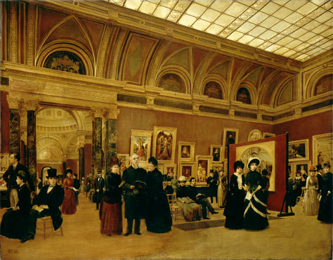
British National Gallery was founded in 1824. During this year the first collection was bought. It consisted of 38 paintings and belonged to the famous banker Angershteyn. These 38 paintings became the basis for future gallery (money for such a valuable asset allocated House of Commons).

Slide 5
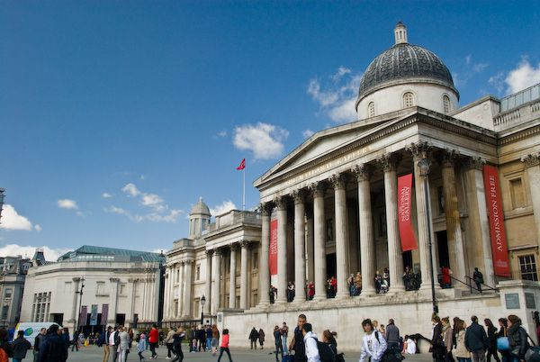
The first time the painting of the National Gallery were exhibited in the Angershteyn’s house. The existence of the museum was kept by the British Parliament, which gave to the needs of the gallery large sums of money. At all times there were patrons who gave generous gifts to the gallery.

Slide 6
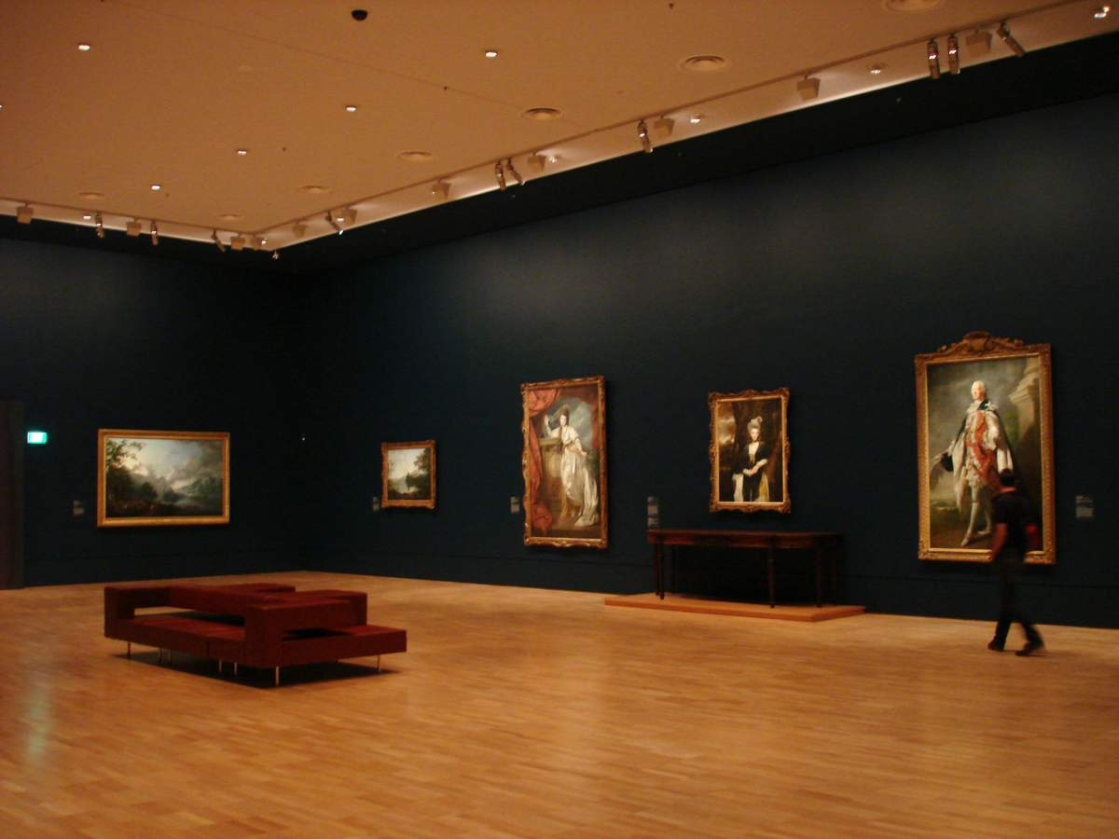
The collection of paintings of the museum is regularly updated. The main sources of these completions were donations and legacies from collectors, various organizations’ help sometimes the state’s help.

Slide 7
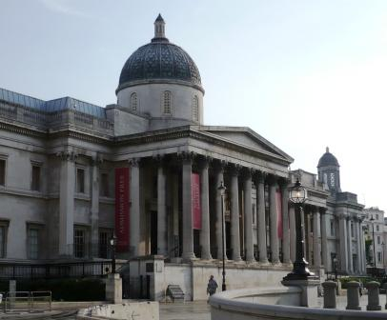
In 1831, a decree was issued to move the British National Gallery. The museum demanded a separate building, because the banker’s house was too small for collection.
The building project was designed by Wilkins. The museum building was built in Trafalgar Square, and in 1838 was the grand opening of the gallery.

Slide 8
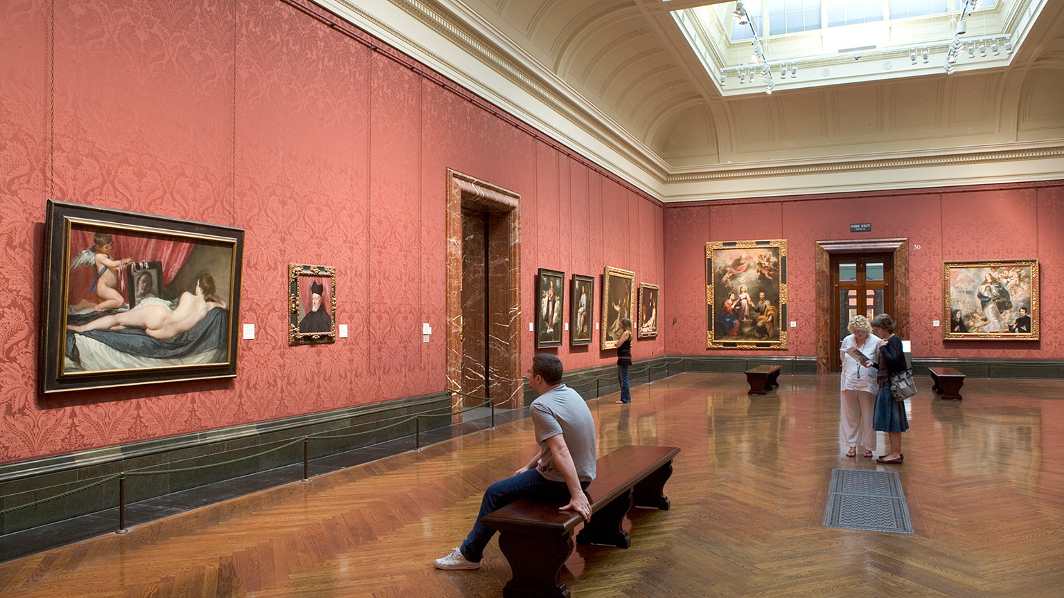
During the Second World War, the building was damaged by ten bombs, but pictures didn’t affect all exhibits were evacuated in advance. Museum was rebuilt, and since January 1946, he again takes the guests.

Slide 9
Five of the most famous paintings of the National Gallery

Slide 10
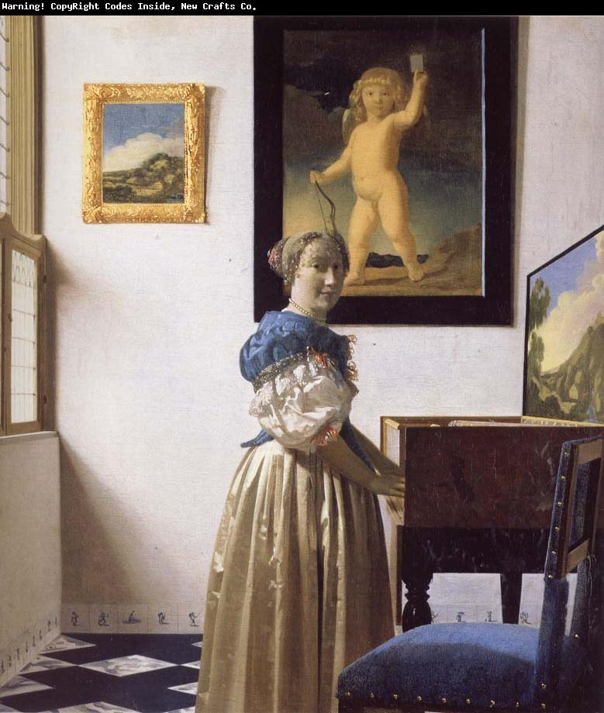
A Young Woman standing at a Virginal
Johannes Vermeer
about 1670-2

Slide 11
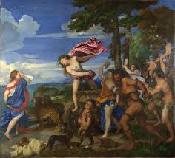
Bacchus and Ariadne
Titian
1520-3

Slide 12
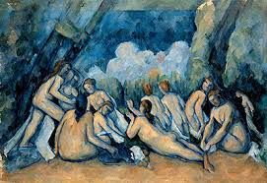
Bathers (Les Grandes Baigneuses)
Paul Cézanne
about 1894-1905

Slide 13
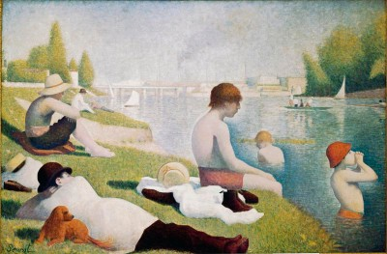
Bathers at Asnières
Georges Seurat
1884

Slide 14
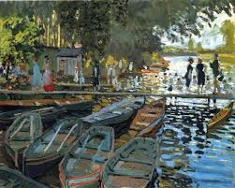
Bathers at La Grenouillère
Claude Monet
1869

