Slide 1
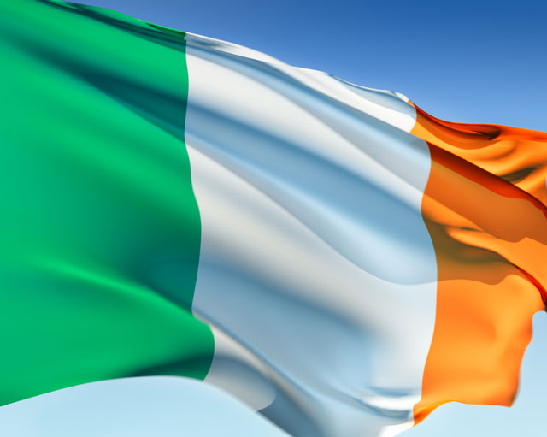
Republic of Ireland

Slide 2
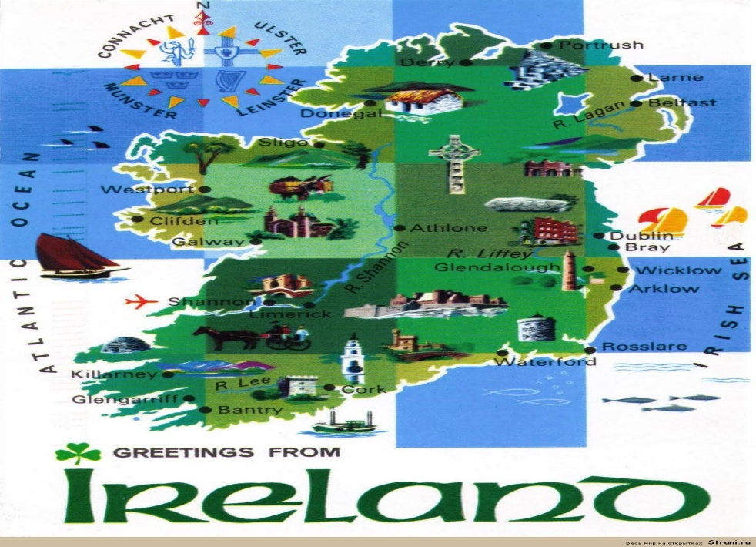
Ireland is a sovereign state in Europe occupying about five-sixths of the island of Ireland. The capital and largest city is Dublin, located in the eastern part of the island, whose metropolitan area is home to around a quarter of the country's 4.6 million inhabitants.

Slide 3
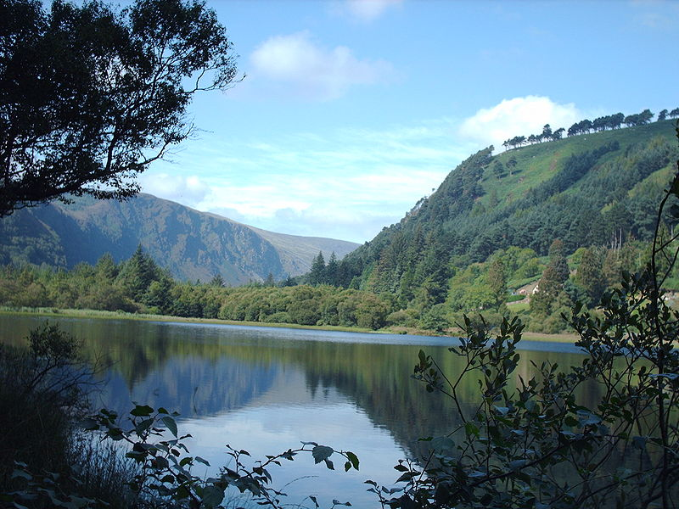
Climate
The Atlantic Ocean and the warming influence of the Gulf Stream affect weather patterns in Ireland. Temperatures differ regionally, with central and eastern areas tending to be more extreme. However, due to a temperate oceanic climate, temperatures are seldom lower than −5 °C (23 °F) in winter or higher than 26 °C (79 °F) in summer.

Slide 4
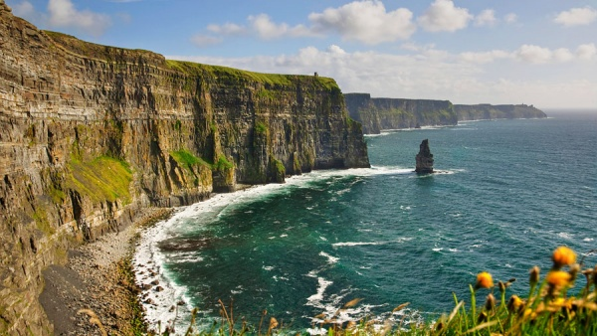
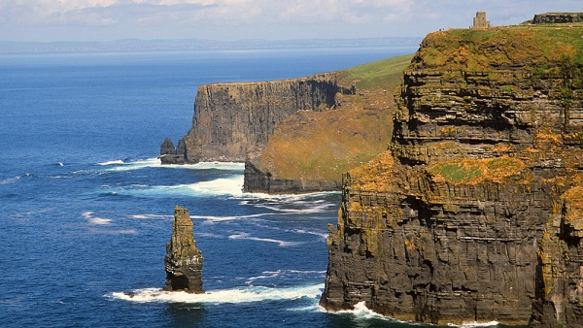
Moxer rock
One of the most unusual coasts in Europe - actually huge vertical wall 200 meters high stretched on 8 km in length..

Slide 5
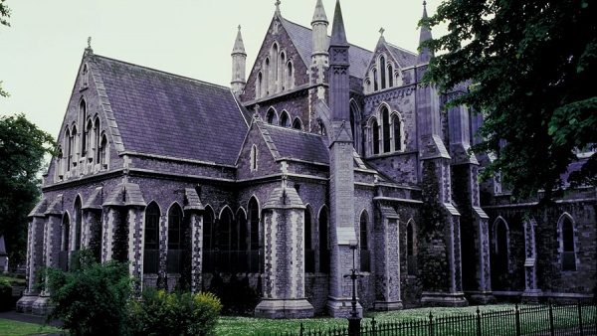
Saint Patrick's cathedral
It is the biggest cathedral of Ireland. Near a cathedral there is a bed on which place there was a well earlier. From there Saint Patrick took water for a baptism.

Slide 6
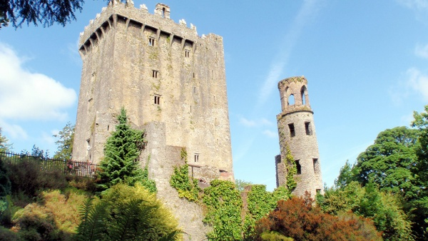
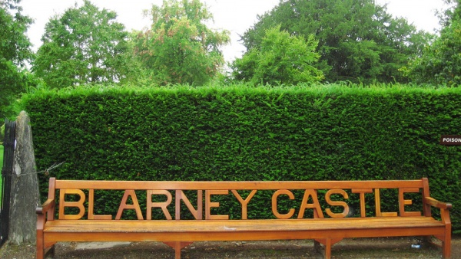
Castle Blarni's
The most popular medieval fortress in Ireland as grants any desires. Blarni's called the magic stone is walled in one of ancient walls by "an eloquence stone": if to kiss him, it is possible to seize oratory in a moment.

Slide 7
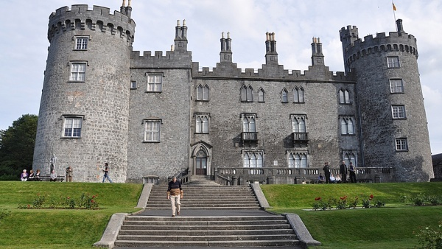
Castle Kilkenny
Kilkenny – very old, many times reconstructed, and from that even more interesting lock of Ireland. It constructed at the end of the XII century on the river of Holes. The last five centuries it belonged to an influential Irish clan Batlerov

Slide 8
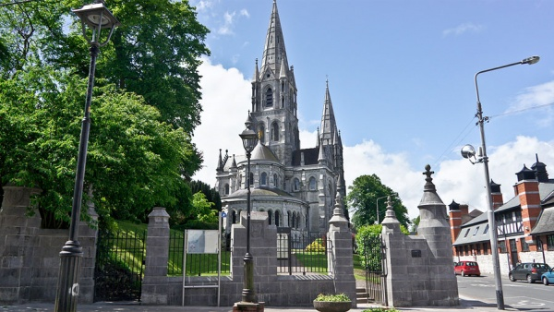
Saint Fin Barre's Cathedral
One of the main architectural sights of Cork, constructed in honor of the founder and the Saint patron of the city - Finbarra.

Slide 9
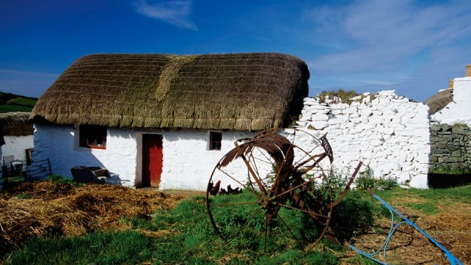
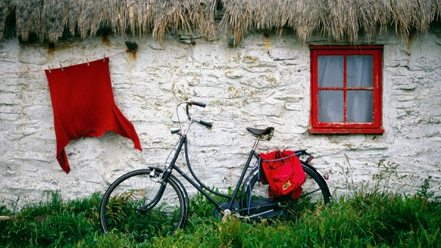
Aran Islands
Inishmor, Inishman and Inisha is the natural "fort" protecting Galway Bay from uninvited guests. On three islands there are ancient stone fortresses, and locals swim by ancient boats and wear traditional Irish clothes

Slide 10
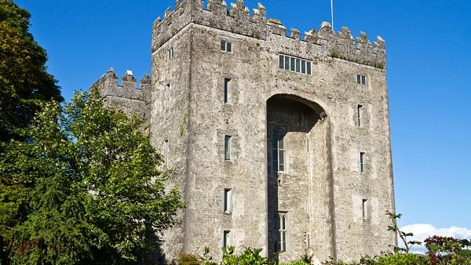
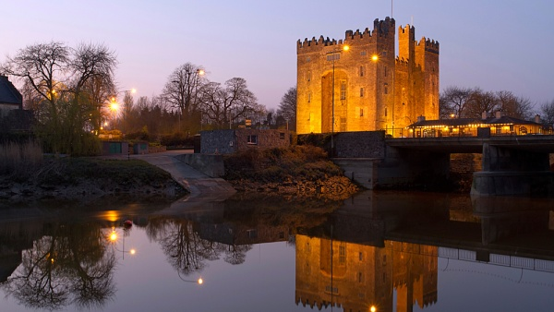
Bunratty Castle
Bunratti from all ancient castles of the island remained best of all.

Slide 11
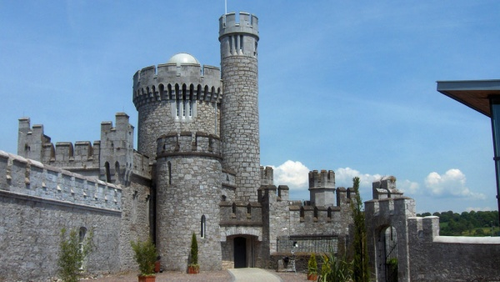
Blackrock Castle Observatory
Modern planetarium in the 400-year lock

Slide 12
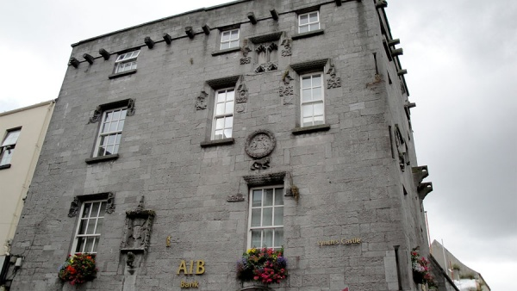
Lynch's Castle
This construction belonged to the most known golueysky clan which head condemned on the death penalty of own son and the hands executed a sentence.

Slide 13
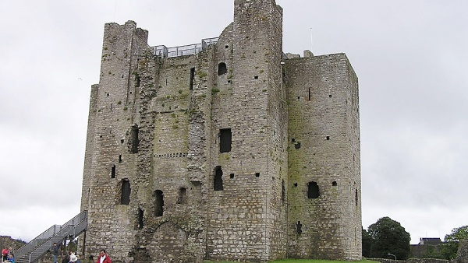
Trim Castle
This lock badly remained. But in the XX century to myself all the same I won glory. Here in 1995 removed "Brave heart" with Mel Gibson. According to the scenario Trim played a role of the cities of York and London.

Slide 14
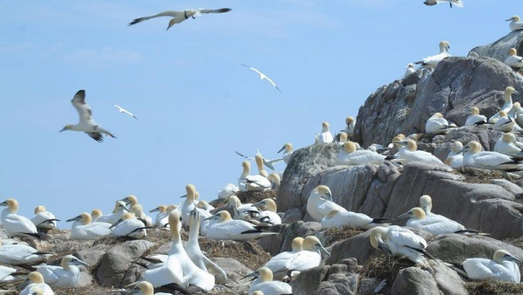
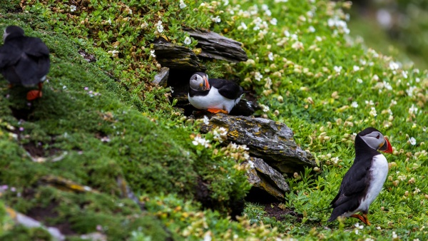
Island Big Saltee
Solti's islands is a couple of small islands in five kilometers from east coast of Ireland. They absolutely wild – people here don't live more eyelid, coming only to look at birds who in a huge number occupy these scraps of land.

