Slide 1
Queen's Official Birthday
Alla Penkova 10-B

Slide 2
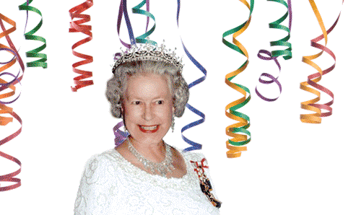
Queen was born on 21th of April in 1926. Her birthday is celebrated not only on 21th of April, but also in the 3d Saturday of June.

Slide 3
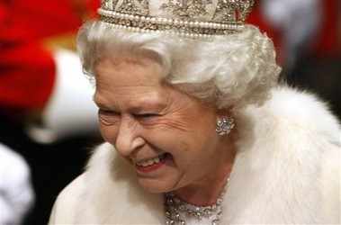

Slide 4
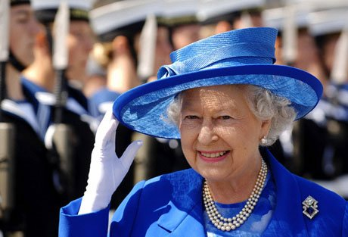

Slide 5
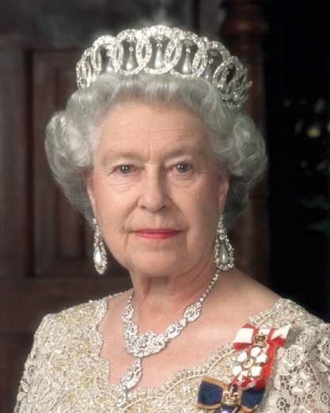

Slide 6
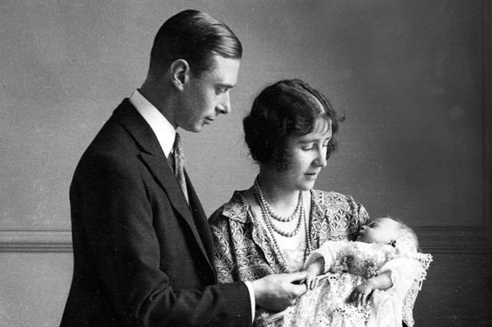
Elizabeth was the first child of Duke and Duchess of York. When she became the crown princess, she began to study History and Law. She has also been studying Arts and Music and was good swimmer and rider.

Slide 7
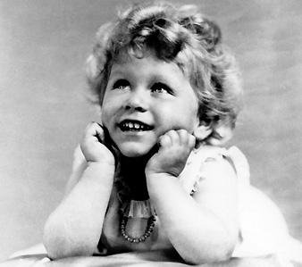

Slide 8
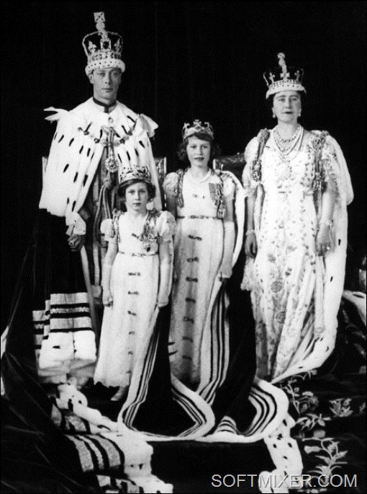
In her youth, she was involved in public life.

Slide 9
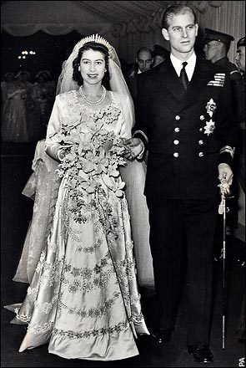
In 1947 was the wedding of the Princess and the Duke of Edinburgh.

Slide 10
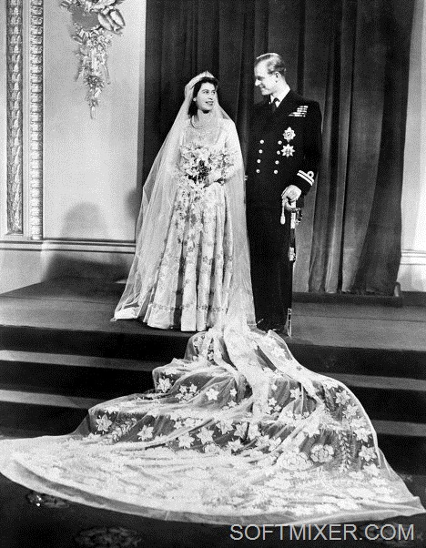

Slide 11
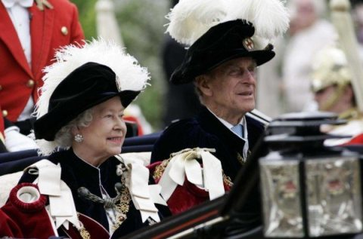

Slide 12
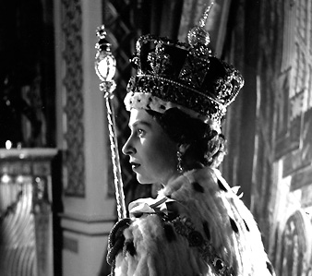
Queen Elizabeth II ascended the throne on February 6 in 1952

Slide 13
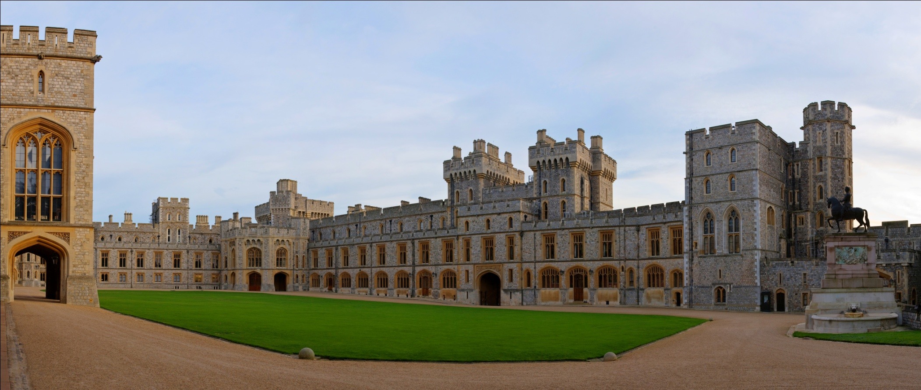
Birthday every year is celebrated lavishly at Windsor Castle.

Slide 14
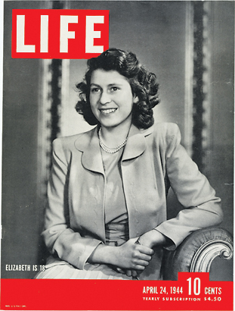
In the Queen's birthday, all the newspapers, radio and television stations congratulate the queen with her ​​birthday.

Slide 15
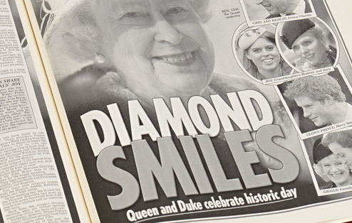

Slide 16
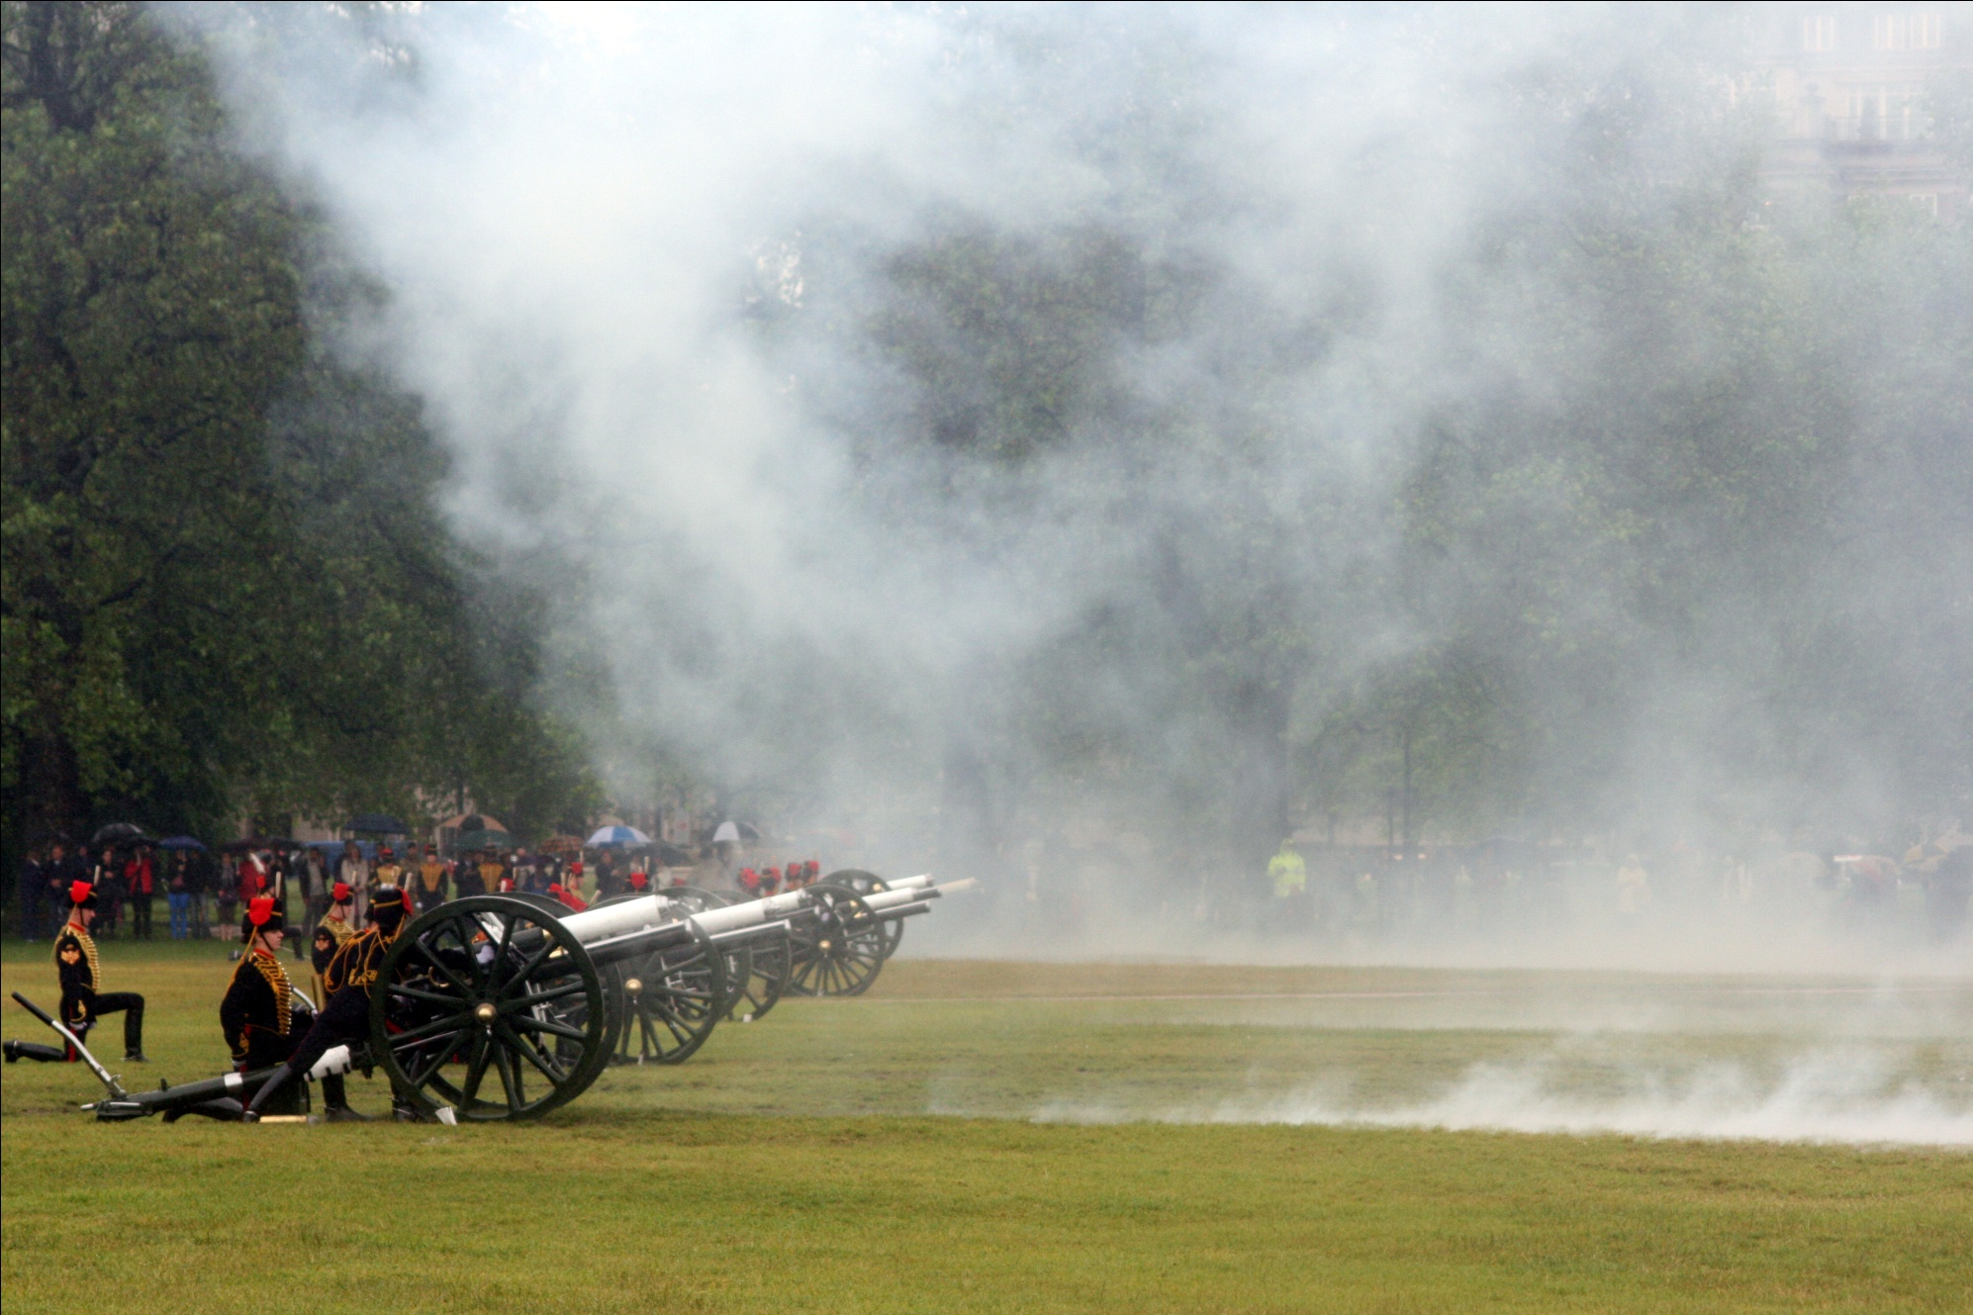
A 41 gun salute in Hyde Park

Slide 17
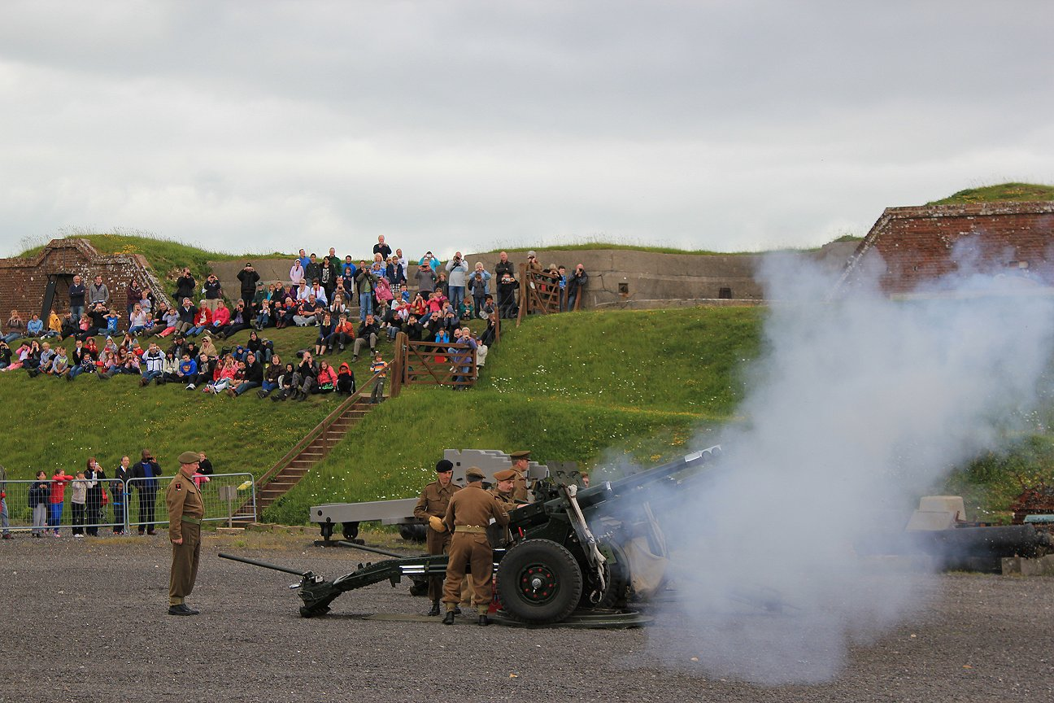
A 21 gun salute in Windsor Great Park

Slide 18
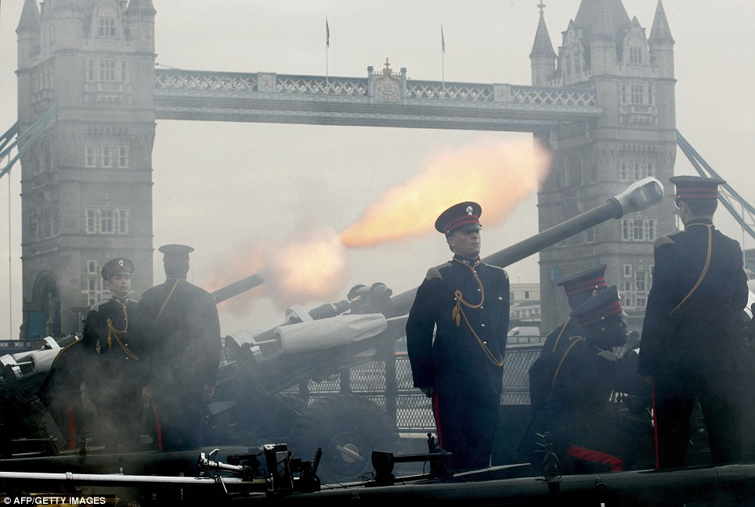
A 62 gun salute at the Tower of London

Slide 19
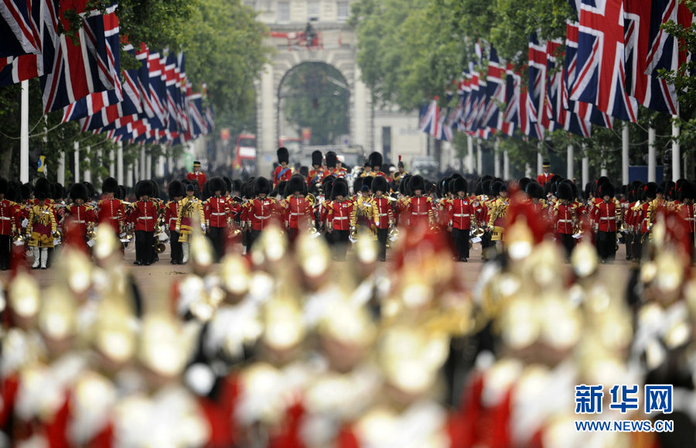
Trooping the Colour parade moves between Buckingham Palace, The Mall and Horseguards’ Parade.

Slide 20
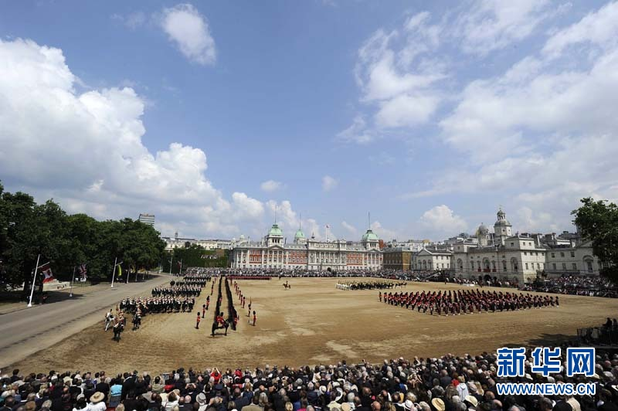

Slide 21
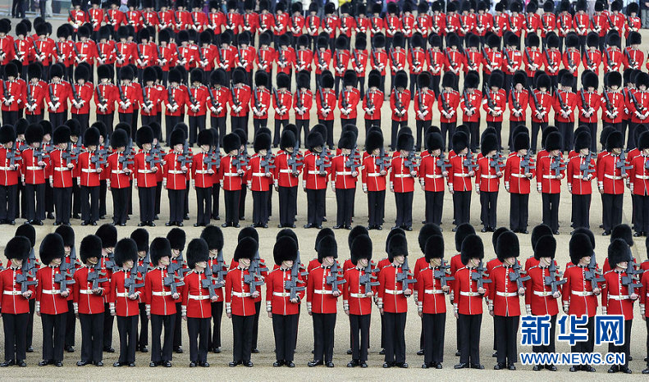

Slide 22
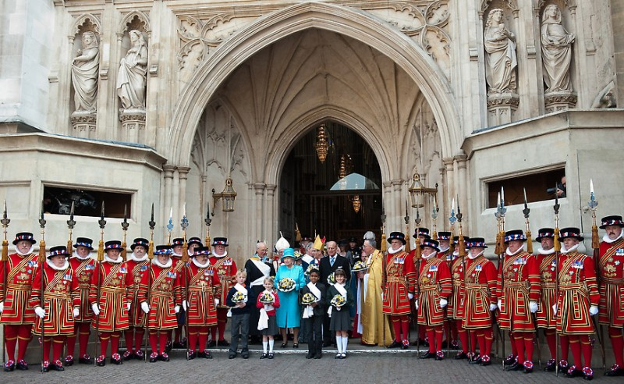
In 2013 Trooping the Colour will be held on 15 June.

Slide 23

The first Trooping the Colour

Slide 24
Thanks for watching♥

Slide 25
