Slide 1
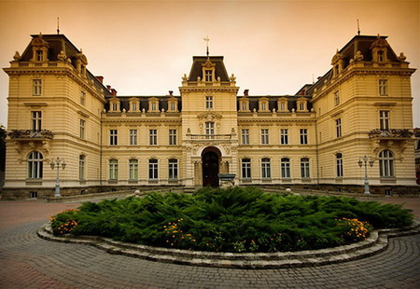
Lviv National Art Gallery
Prepared
Manakova Svetlana
Founded in 1897

Slide 2
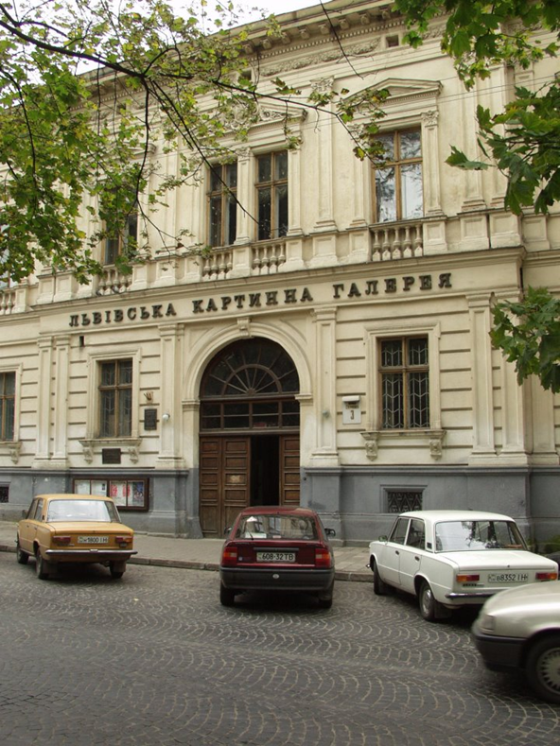
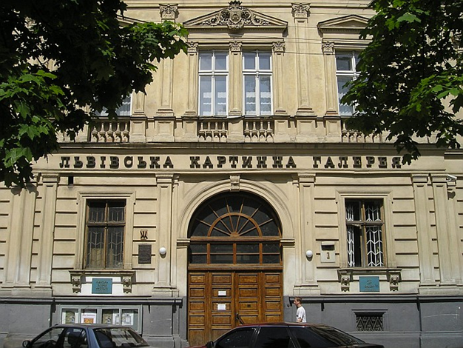
the largest art museum in Ukraine. Located on the street Stefanik 3, opposite the library name Stefanik. The total number of items is more than 50 thousand.

Slide 3
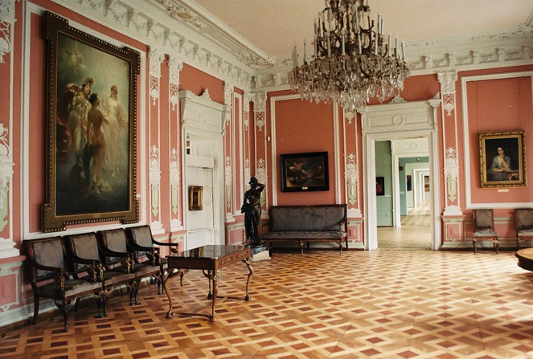

Slide 4
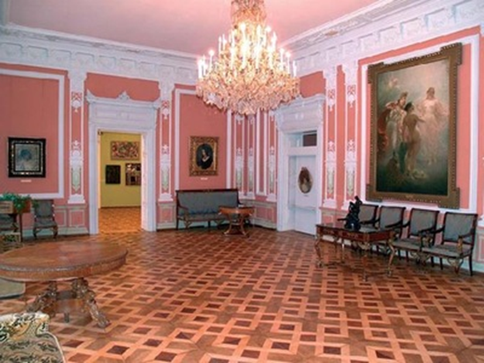

Slide 5
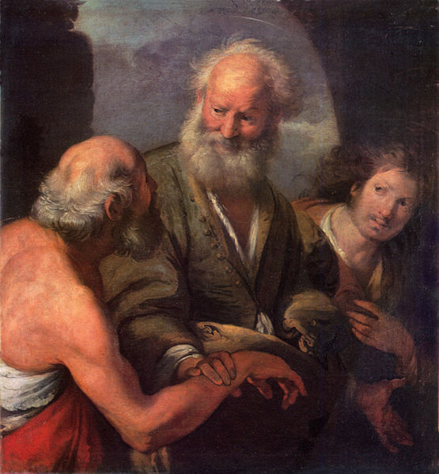
Department of Italian Art.
Italian primitives are generally rare in museums around the world. Only one exception - London.
So in Lviv, you can see only a few examples of early Italian painting.

Slide 6
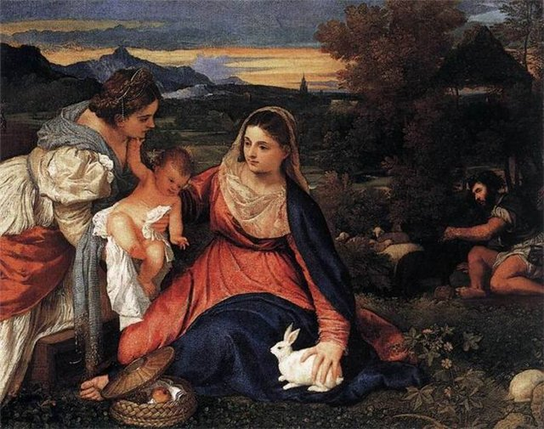
"Madonna with Child and Catherine of Alexandria"

Slide 7
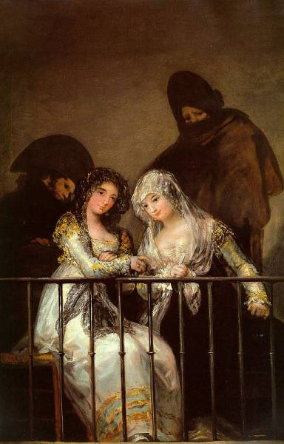
Artwork Spain.
Art of Spain should be studied only in Spain itself. Samples of her art in other museums around the world are rare.

Slide 8
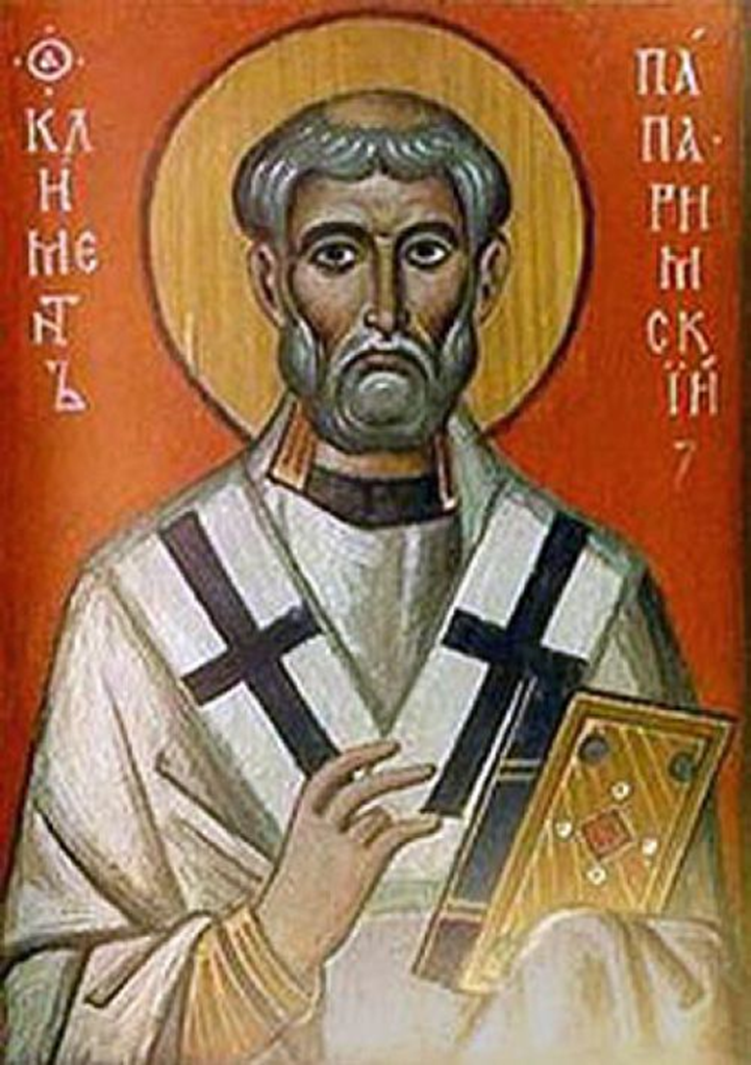
Jose de Ribera painting "Saint Jerome" 17 century.

Slide 9
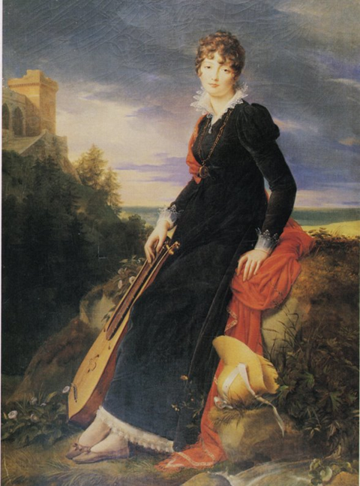
Works of art in France.
Works of artists of France is very difficult to acquire. Even more difficult to collect. It was, perhaps, always. Art of this country had practically no crisis was prestigious.

Slide 10
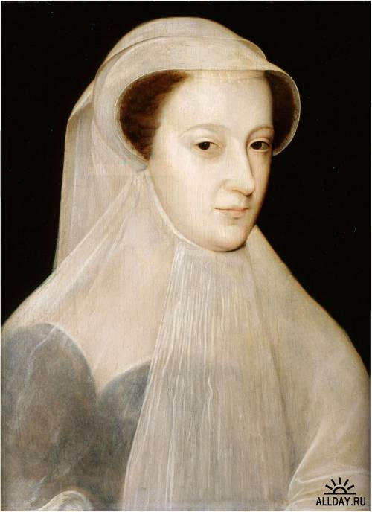
Portrait of Mary Stuart

Slide 11
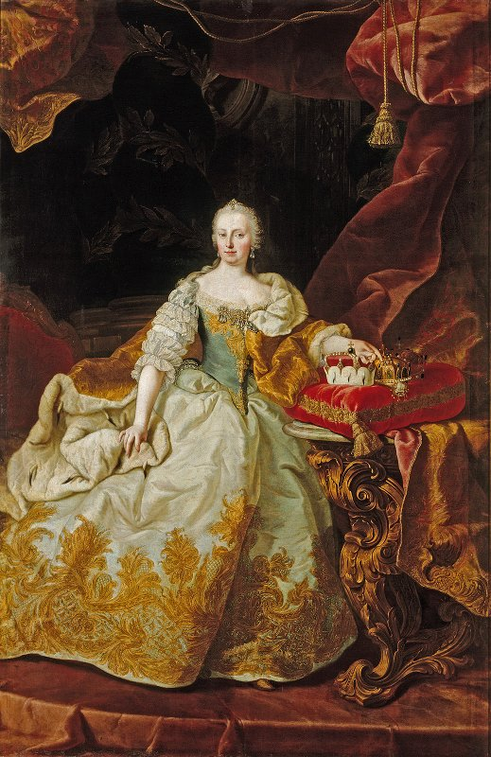
Portrait of Empress Maria Theresa.

Slide 12
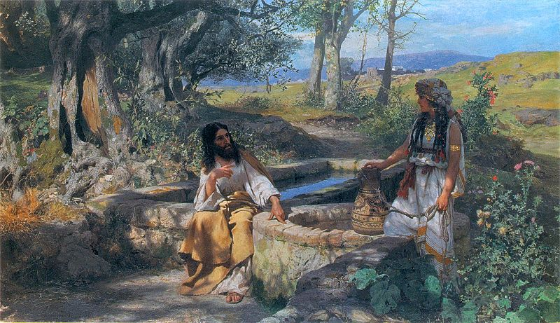
Works of art of the Russian Empire.

Slide 13
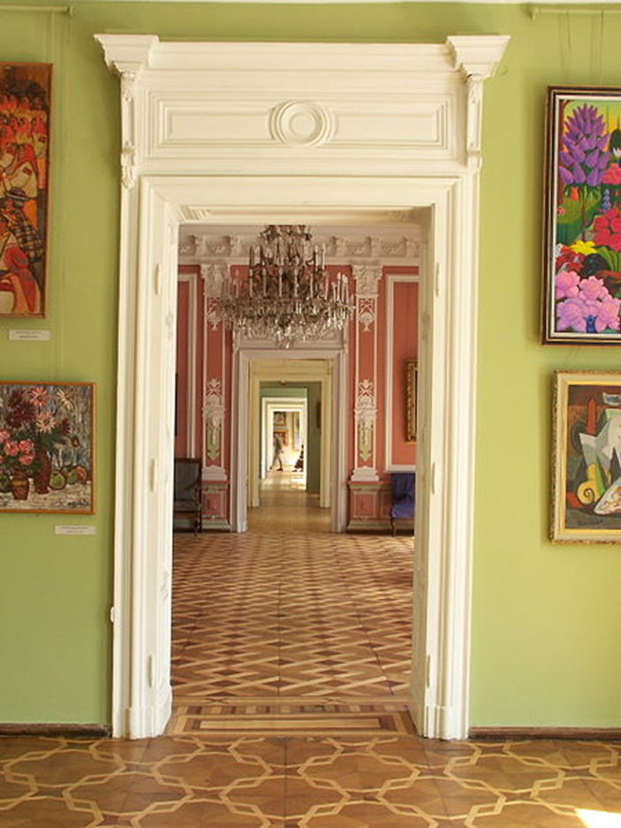
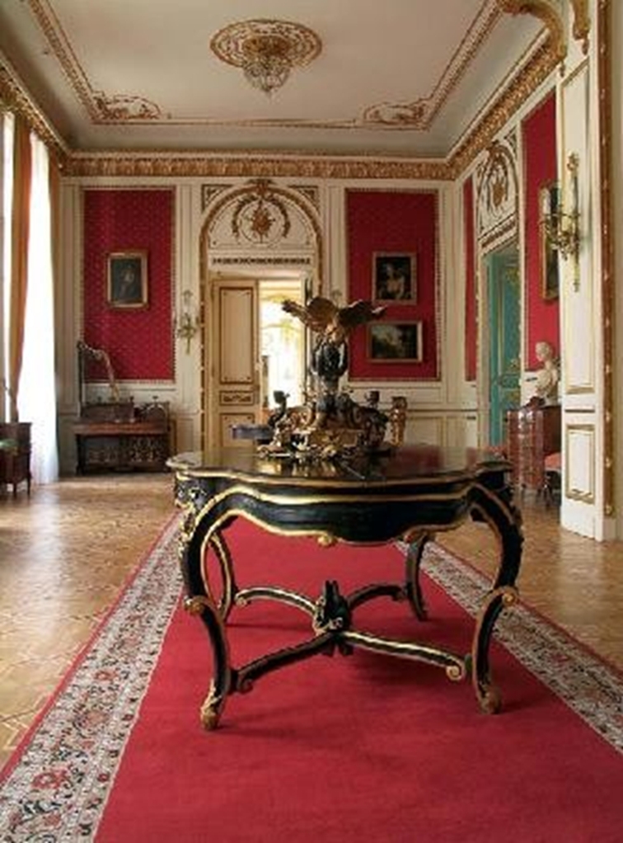

Slide 14
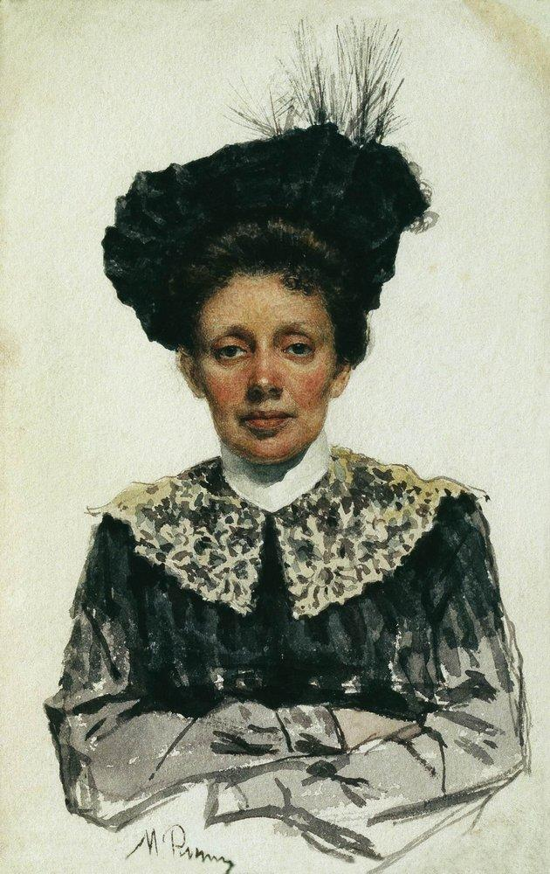
"Portrait of an Unknown Woman" painted by Ilya Repin

Slide 15
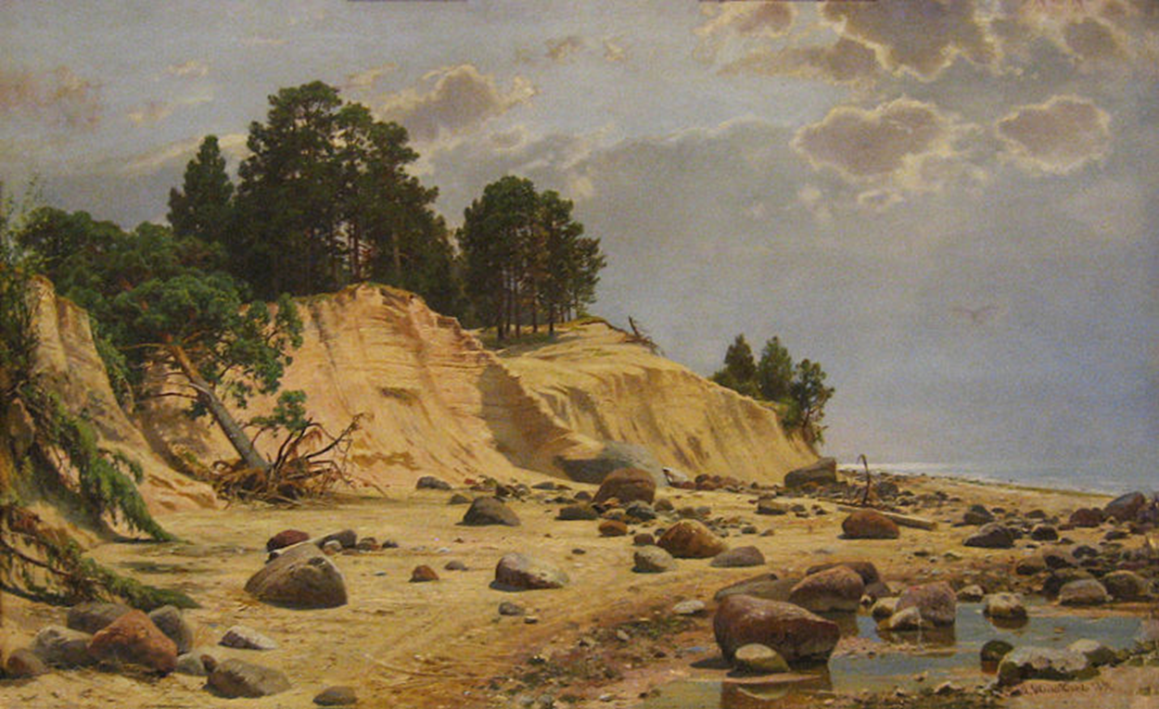
Landscape "After the storm in Mary-Hovi" Shishkin

Slide 16
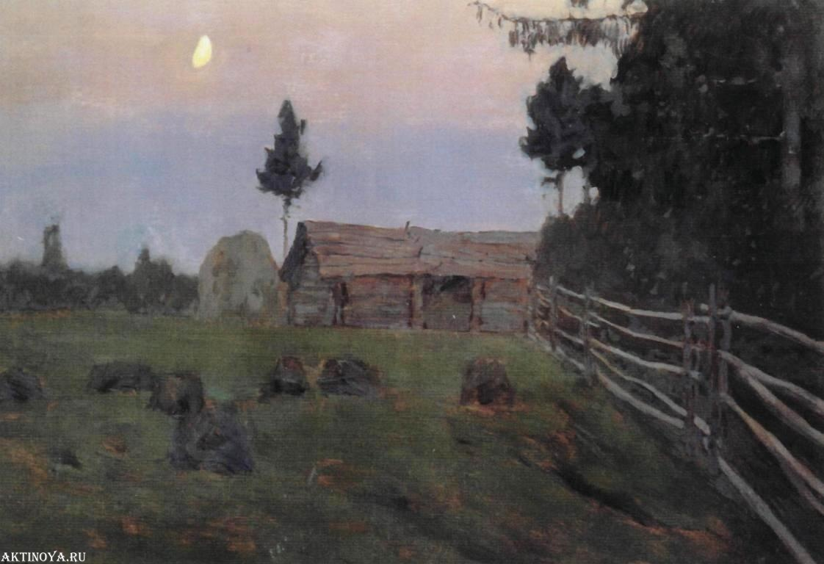
«Twilight»
Isaac Levitan

Slide 17
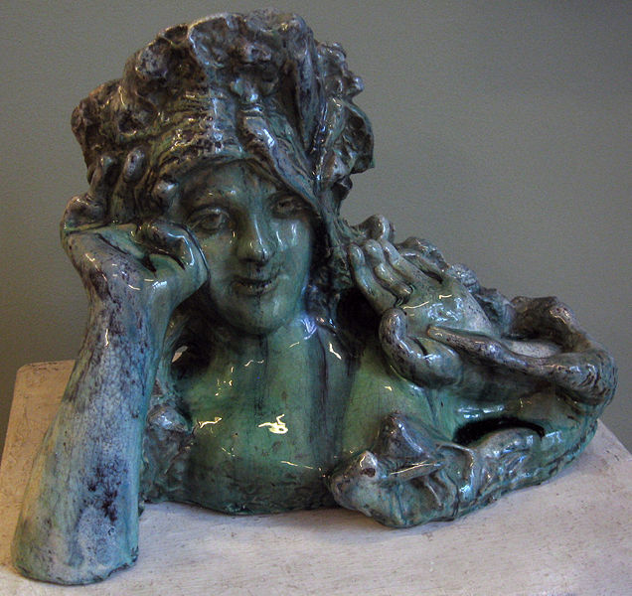
"Sea Queen Volkhov" - Mikhail Vrubel

Slide 18
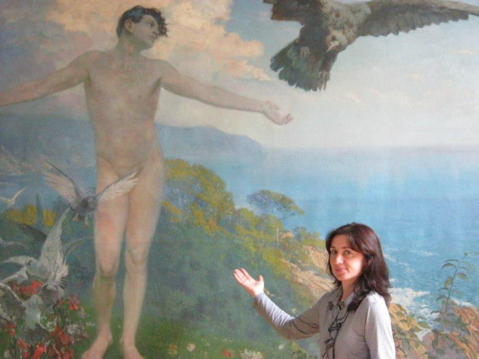
game

Slide 19
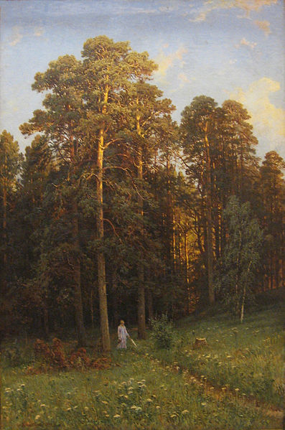
а) Germany
b) France
с) Russian

Slide 20
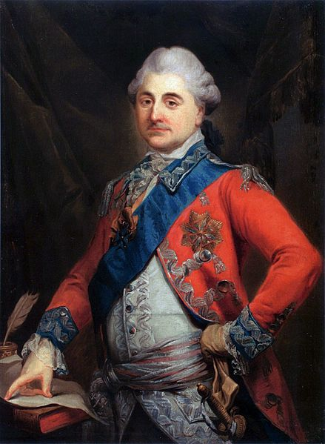
a) Italian
b) Russian
c) Ukraine

Slide 21
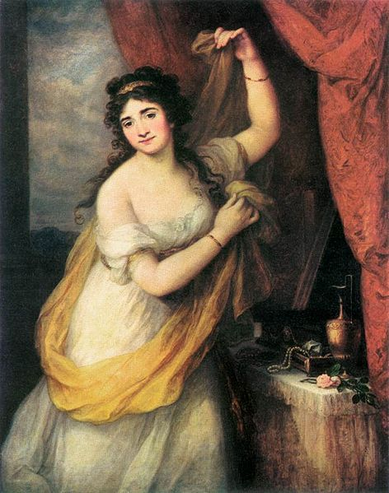
a)Germany
b)Spain
c) Ukraine

Slide 22
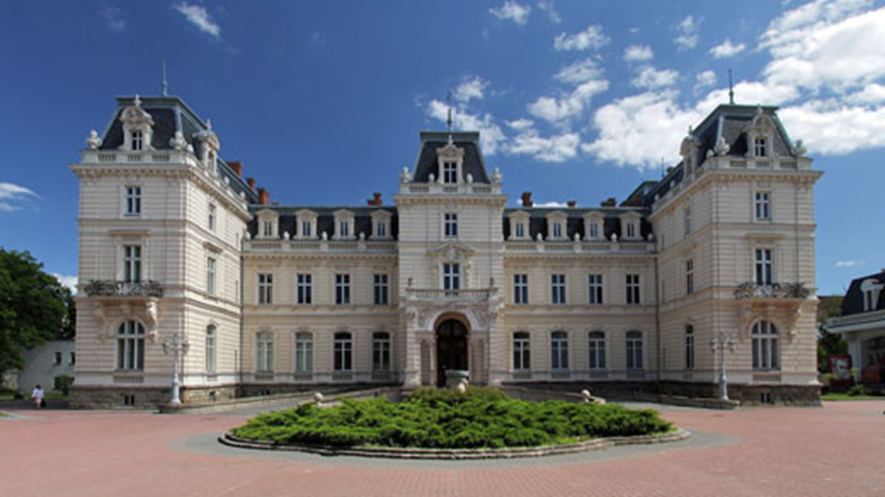
win

Slide 23
Thank you for your attention!

