Slide 1
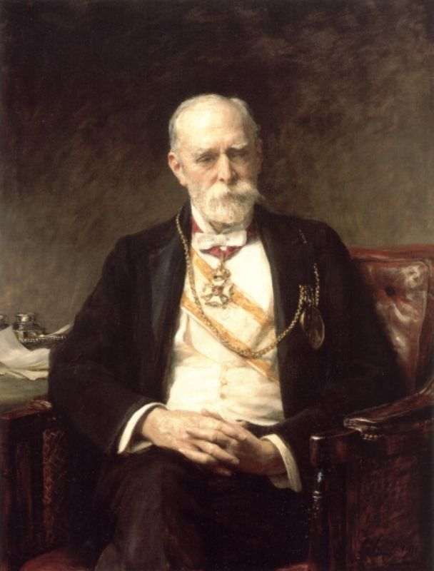
Sir Edward John Poynter

Slide 2
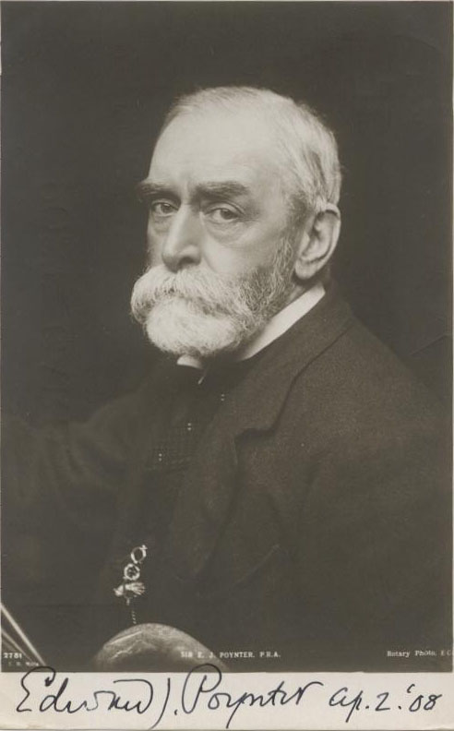
Edward Poynter was the son of the architect Ambrose Poynter.
He was born in Paris, though his parents returned to Britain
soon after. He was educated at Brighton College and Ipswich
School, but left school early for reasons of ill health, spending
winters in Madeira and Rome. In 1853 he met Frederick
Leighton in Rome, who made a great impression on the 17-
year-old Poynter. On his return to London he studied at Leigh's
academy in Newman Street and the Royal Academy Schools,
before going to Paris to study
in the studio of the classicist
painter Charles Gleyre where
James McNeill Whistler and
George du Maurier were
fellow-students

Slide 3
He became best known for his large historical paintings
such as Israel in Egypt (1867; Guildhall Art Gallery, London),
followed by St George for England (1869), a mosaic for the
Central Lobby of the Palace of Westminster, depicting St
George and the Dragon. Visit of the Queen of Sheba (1871–
75) and King Solomon (1890). He was admitted as an
associate of the Royal Academy in 1869

Slide 4
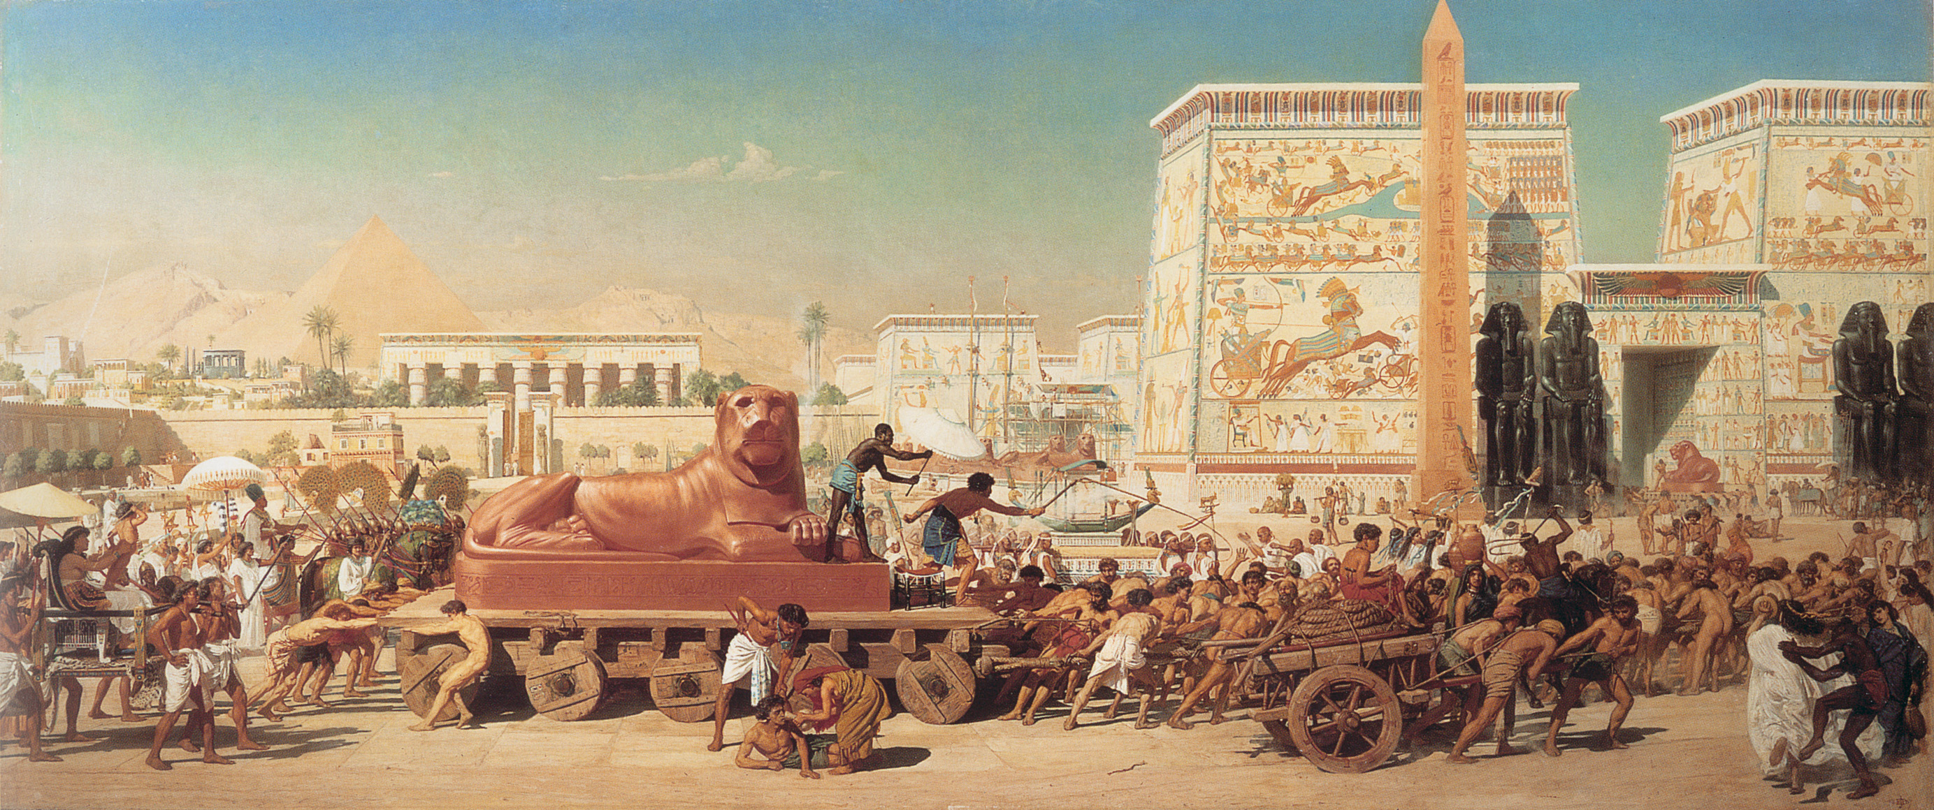
Israel in Egypt (1867)

Slide 5
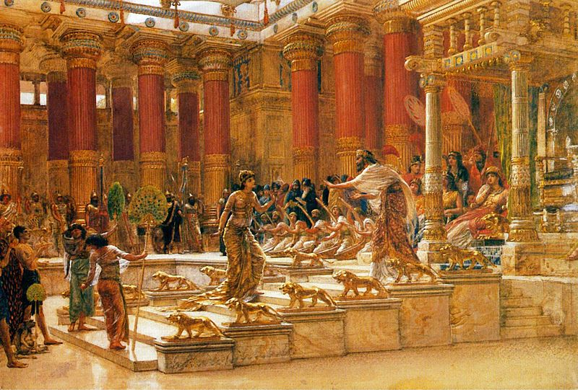
Visit of the Queen of Sheba (1871–75)

Slide 6
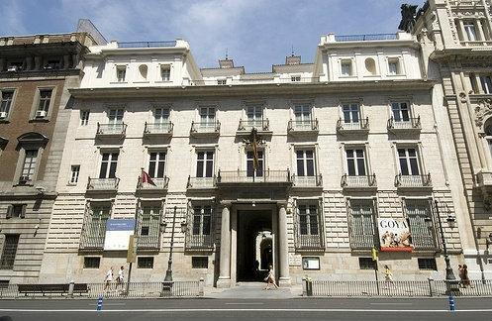
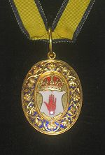
Poynter held a number of official posts: he was the first Slade
Professor at University College London from 1871 to 1875,
principal of the National Art Training School from 1875 to
1881 and director of the National Gallery from 1894 to 1904
(overseeing the opening of the Tate Gallery). He became
a Royal Academician in 1876. In 1896, on the death of Sir John
Millais, Poynter was elected President of the Royal Academy.
He received a knighthood in the same year and an honorary
degree from Cambridge University in 1898. He was made
a baronet in 1902

Slide 7
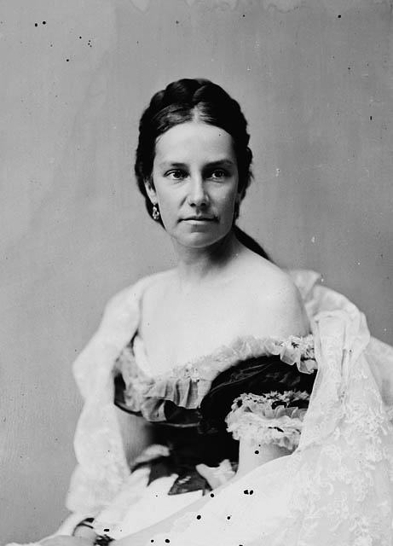
In 1866 Poynter married the famous
beauty Agnes MacDonald, daughter
of the Rev G B MacDonald of
Wolverhampton, and they had three
children. Her sister Georgiana
married the artist Edward Burne-
Jones; her sister Alice was the
mother of writerRudyard Kipling; and
her sister Louisa was the mother of
three-times-Prime Minister of the
UnitedKingdom Stanley Baldwin

Slide 8
Poynter's old school, Brighton College held an
exhibition of Poynter's paintings and drawings
entitled 'Life at Arms Length' in its Burstow
Gallery in November–December 1995
Sir Edward John Poynter died 26 July 1919
in London

Slide 9
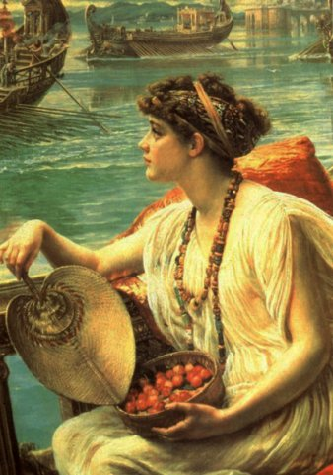
The Roman Boat Race (1889)

Slide 10
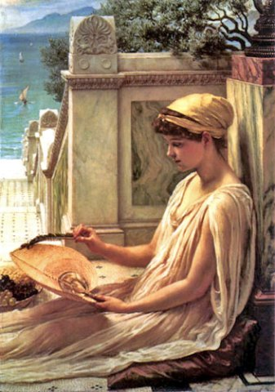
On the Terrace

Slide 11
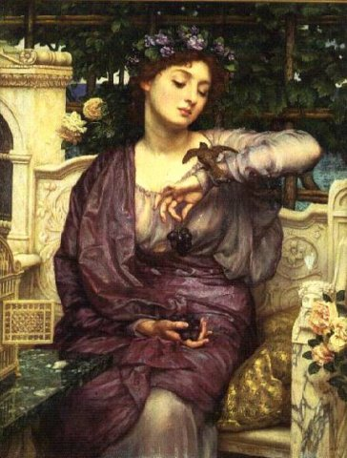
Lesbia and her Sparrow

Slide 12
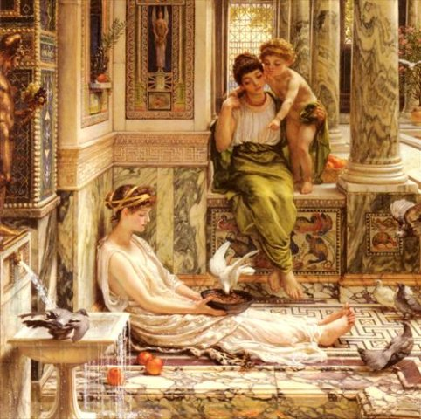
A Corner of the Villa

Slide 13
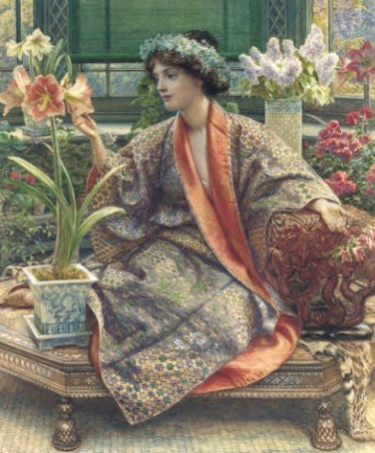
A Hot House Flower

Slide 14
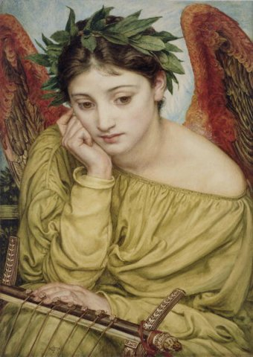
Erato Muse of Poetry

Slide 15
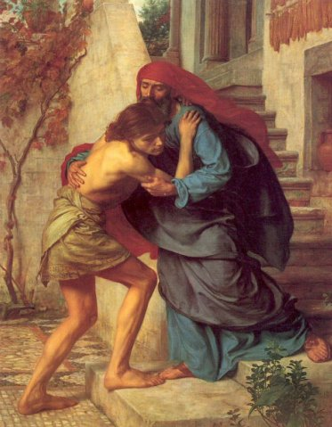
The Return of the Prodigal Son

