Slide 1
Parliament of the United Kingdom of Great Britain and Northern Ireland

Slide 2
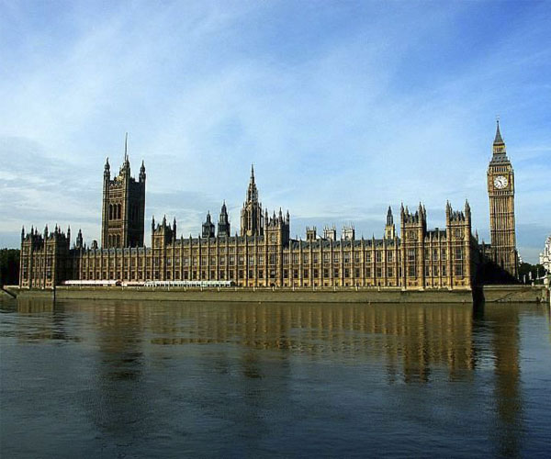
The British Parliament is often popularly referred to as the "mother of all parliaments", as the legislature of many countries, and especially the member countries of the Commonwealth created in his sample.

Slide 3
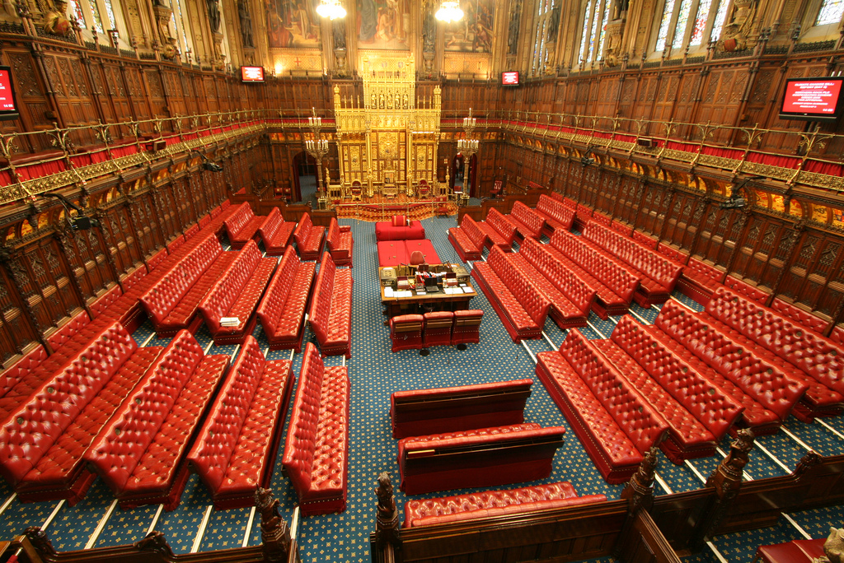
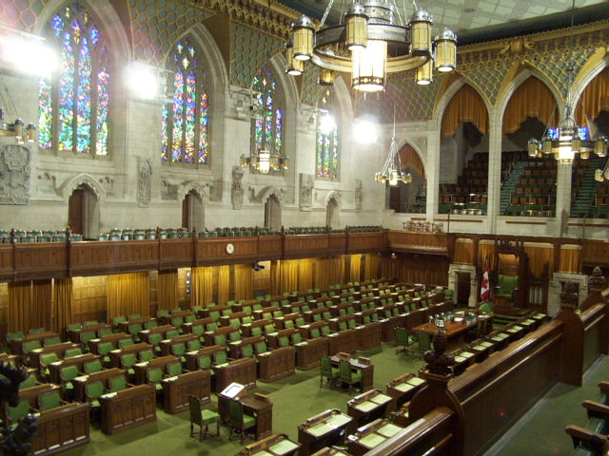
Bicameral parliament
House of Lords
House of Commons

Slide 4
House of Lords
Opposition her Majesty - The Labour Party 100%

Slide 5
House of Commons
Opposition Her Majesty - The Labour Party 100%

Slide 7
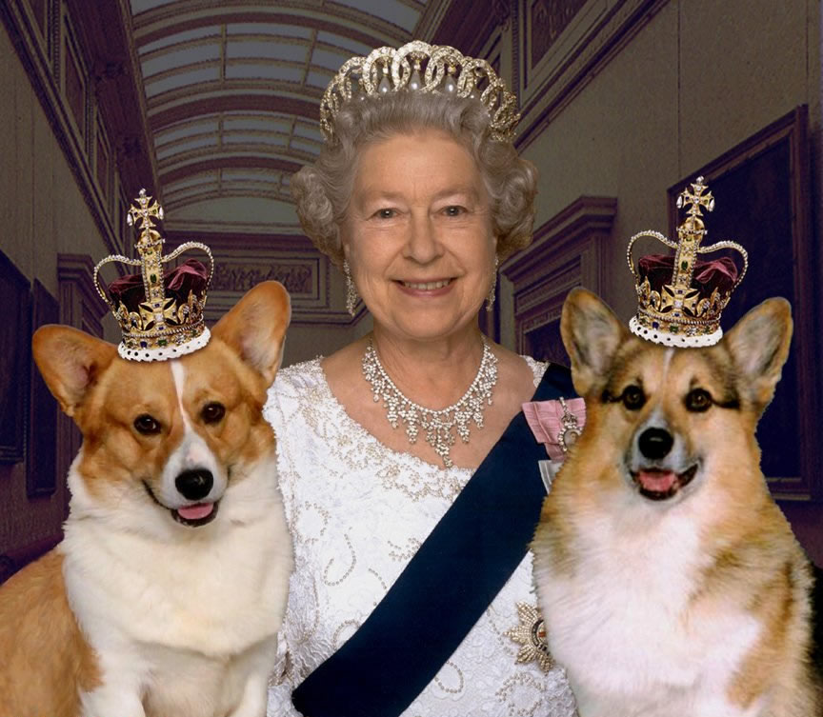
Queen heads the parliament, however, its role is largely ceremonial: in practice it traditionally operates according to the recommendations of the Prime Minister and other members of the government.

Slide 8
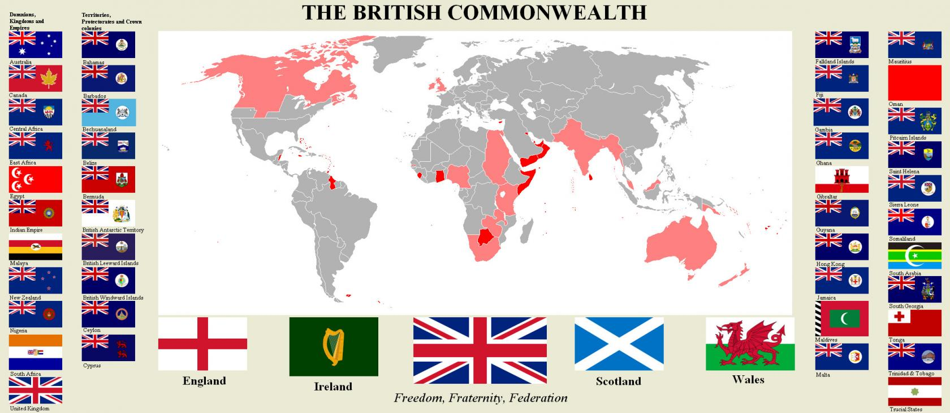
In the Middle Ages in the British Isles, there were three kingdoms of England, Scotland and Ireland, each with its own parliament. According to the Act of Union in 1707, England and Scotland were united under the control of the British Parliament, and the Act of Union in 1800 included representatives of the Irish Parliament in the United Kingdom.

