Slide 1
Endangered Sea Animals Issues

Slide 2
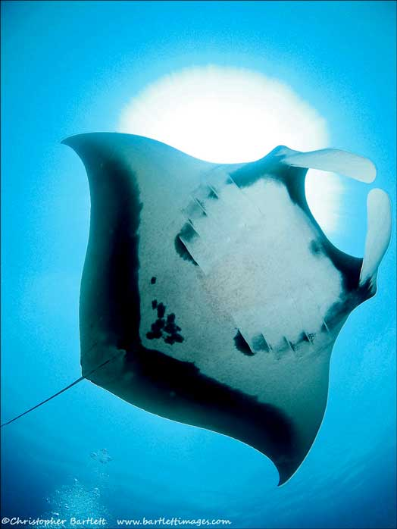
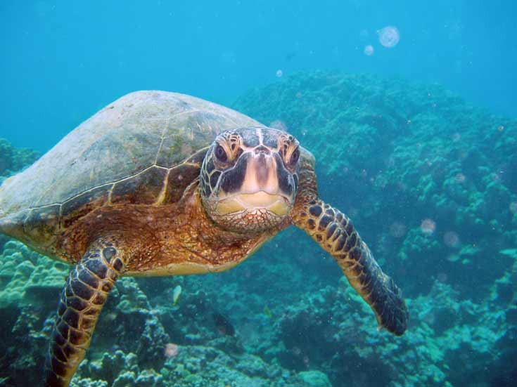
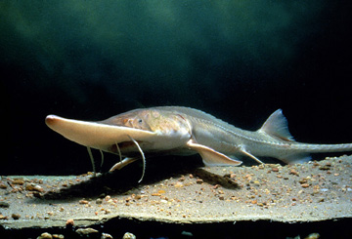
Reasons for being endangered

Slide 3
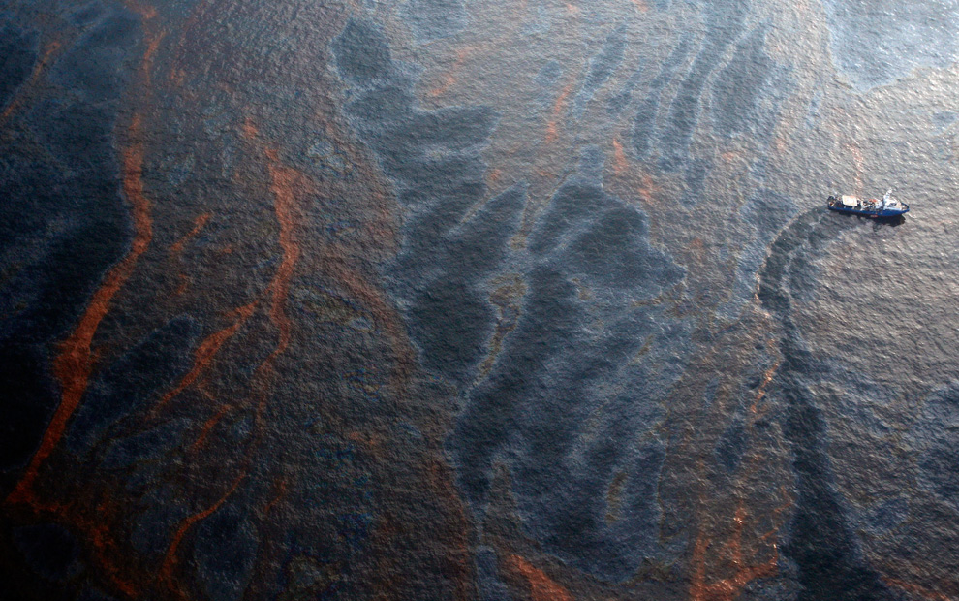
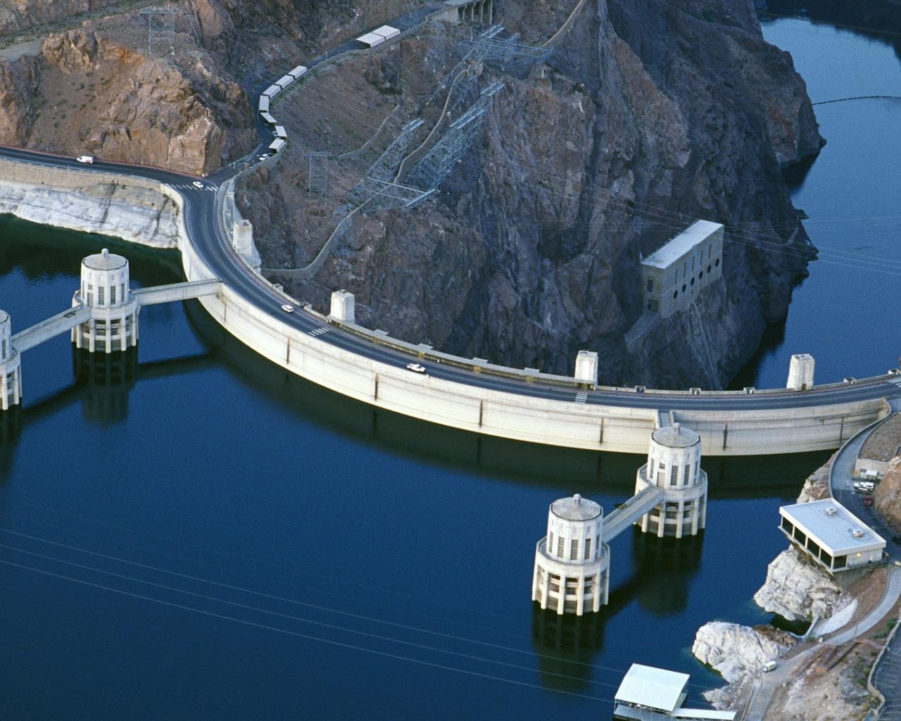
Main reasons of extinction

Slide 4
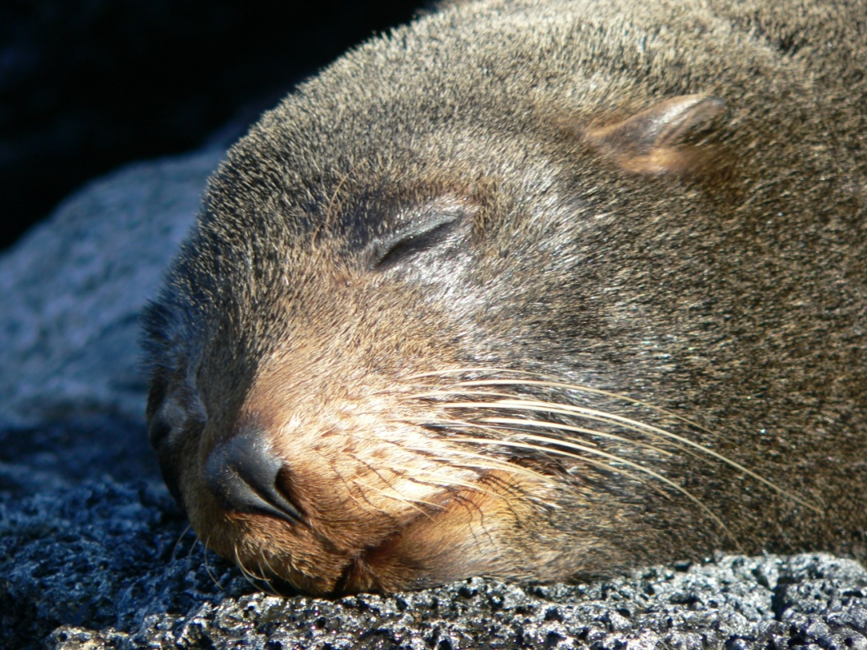
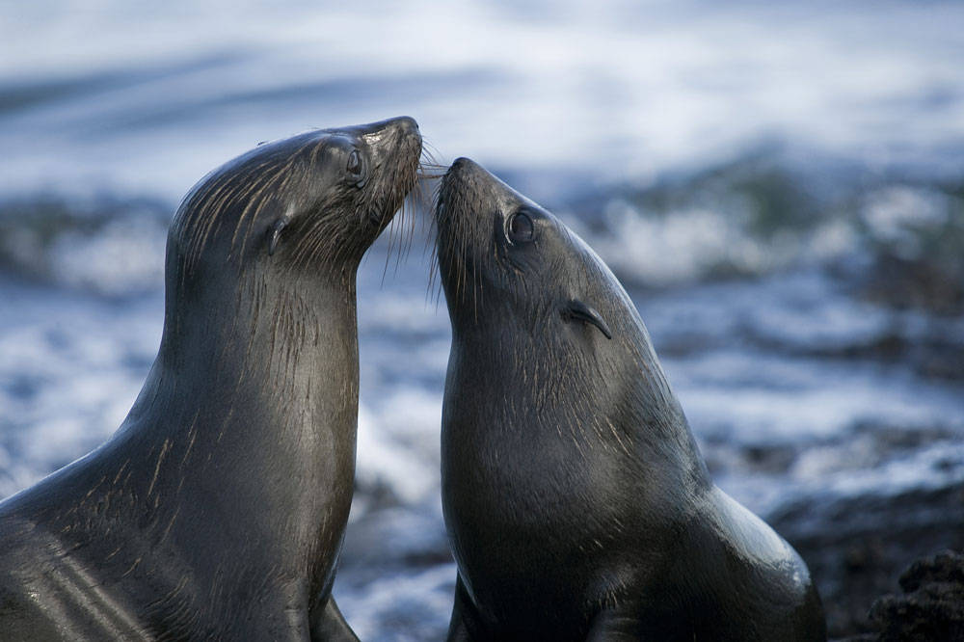
Galapagos Fur Seal

Slide 5
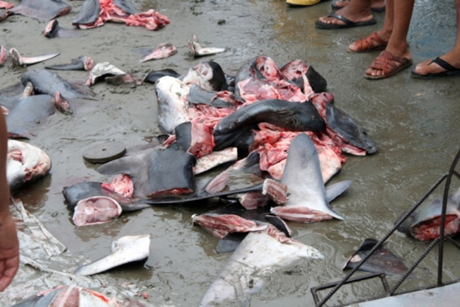
Scalloped Hammerhead

Slide 6
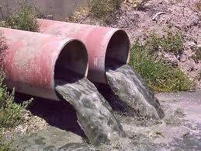
Pallid Sturgeon

Slide 7
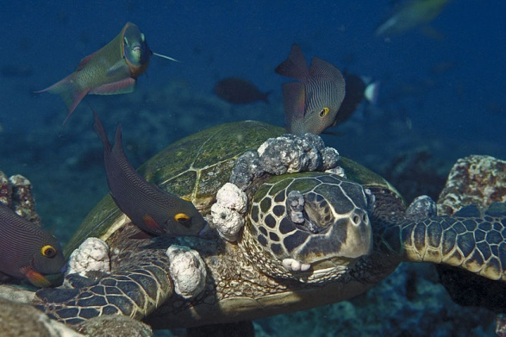
Green Sea Turtle

Slide 8
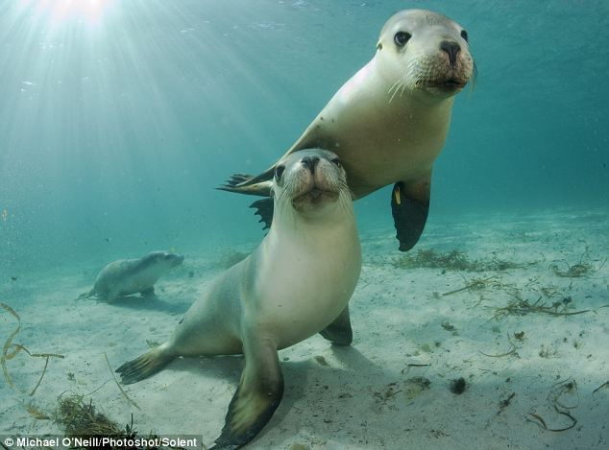
Australian Sea Lion

Slide 9
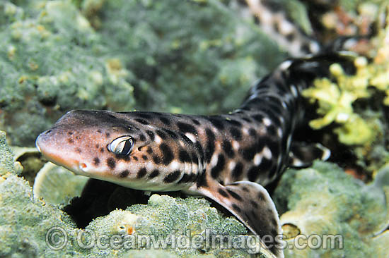
African Spotted Catshark

Slide 10
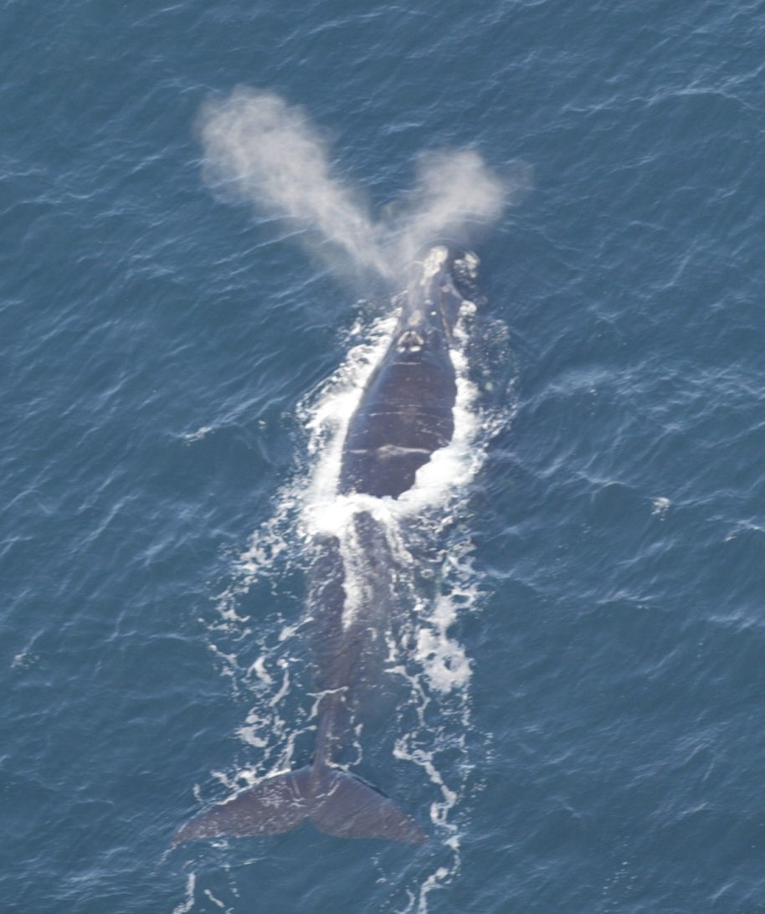
North Atlantic Right Whale

Slide 11
THANK YOU FOR YOUR ATTENTION!

